Slide 1

Principal Component Analysis (PCA)
Summer Internship- 2026
Name : Chetna Saharan
Supervisor: Prof. Millie Pant
Mentor: Ms. Riya & Mr. Harjeet Singh Applied Mathematics & Scientific Computing
Indian Institute of Technology Roorkee

Slide 2

Agenda
Principle Component Analysis (PCA)
Dimensionality Reduction: The Need
How PCA Works
Standardization(Mean centering)
Covariance Matrix
Calculating Eigenvectors and Eigenvalues
Explained Variance
Implementation

Slide 3
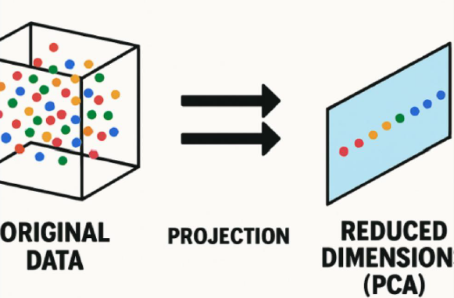
Principle Component Analysis (PCA)
Principal Component Analysis (PCA) is an unsupervised linear transformation and dimensionality reduction technique widely applied across machine learning, data science, and advanced statistical modeling.
Why PCA is Used
Reduces the number of features (dimensions).
Removes redundancy caused by correlated variables.
Speeds up machine learning model training.
Helps visualize high-dimensional data in 2D or 3D.
Reduces noise while preserving important information.

Slide 4
Dimensionality Reduction: The Need
The process of reducing the number of random variables under consideration by obtaining a set of principle variables.
Curse of Dimensionality: More features often lead to sparsity, requiring exponential data to maintain significance.
Overfitting Prevention: Reducing features helps the model focus on signal rather than noise.
Computational Efficiency: Faster training times and lower memory requirements.

Slide 5
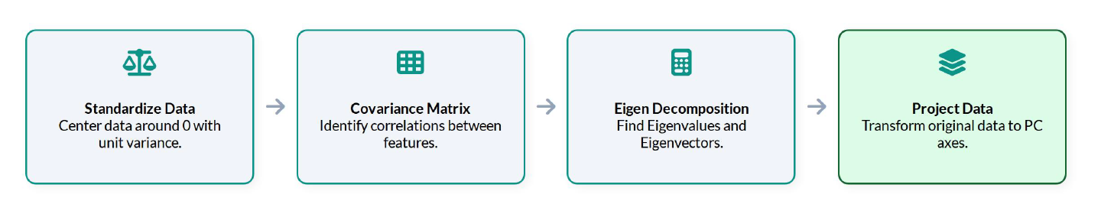
How PCA Works

Slide 6

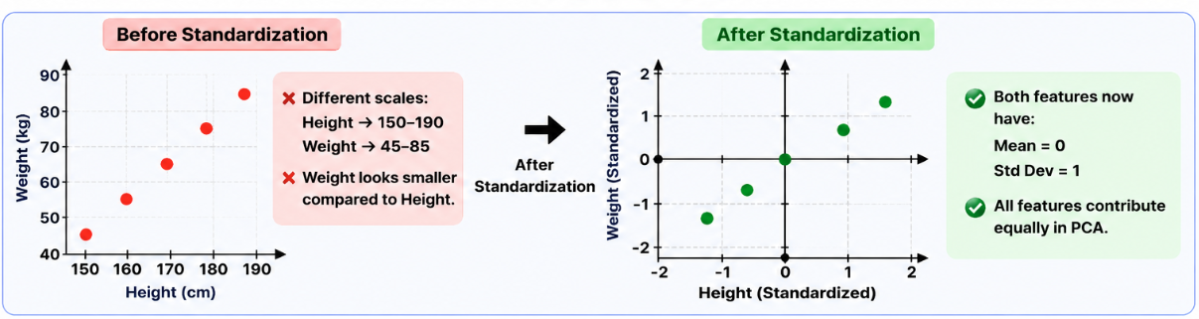
Standardization(Mean centering)
Definition
Standardization is the process of scaling all features so that they have:
Mean = 0
Standard Deviation = 1
This is an important preprocessing step because PCA is sensitive to the scale of the data.
​
Where:
X = Original value
μ (mu) = Mean of the feature
σ (sigma) = Standard deviation

Slide 7
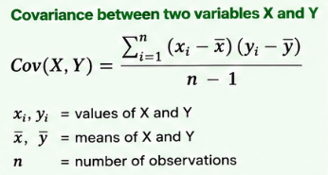
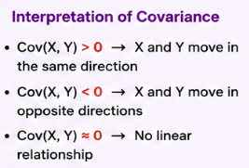
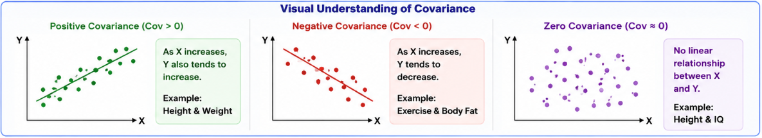
Covariance Matrix
Definition
The covariance matrix measures how two variables change together. It helps PCA identify relationships between features.

Slide 8
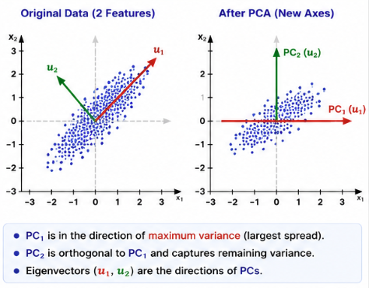
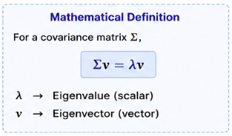
Calculating Eigenvectors and Eigenvalues
We decompose the Covariance Matrix into its Eigenvectors and Eigenvalues.
Eigenvectors
They represent the direction of the new axes (principal components).
Eigenvalues
They indicate how much variance each principal component explains.
Larger eigenvalue = More important component.

Slide 9
Variance Explained & Choosing k
Each principal component explains a share of total variance; a scree plot helps pick how many to keep.
Elbow / knee of the curve suggests k
Keep components until cumulative variance ≈ 90-95%
Remaining PCs mostly capture noise
Example: keeping PC1–PC4 above retains ~84% of total variance with 1/3 fewer features.
6

Slide 10
Implementation
**Dataset:** UCI Wine dataset (`wine_dataset.csv`) — 178 samples, 13 chemical-analysis
features of wines grown in the same region of Italy, derived from three different
cultivars (`target` / `target_name`).
**Goal:** Reduce the 13 correlated chemical features down to a handful of principal components,
inspect the eigenvalues / explained variance, and see how well PCA preserves the class structure in just 2 dimensions.
STEPS
Load & explore the data
Standardize the features
Fit PCA and inspect eigenvalues / eigenvectors
Look at variance explained + choose `k`
Visualize the projected data
Compare a classifier trained on raw vs. PCA- reduced features

Slide 11
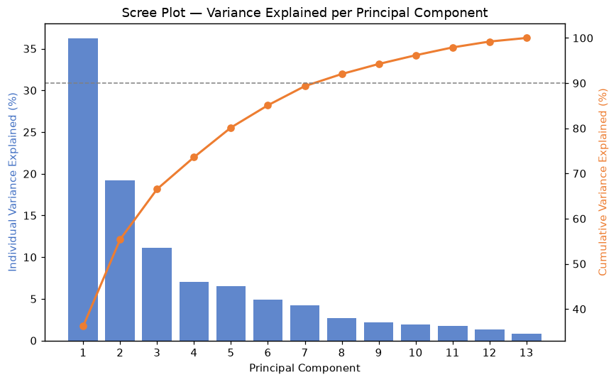
Standardization
Mean per feature (should be ~0): [-0. -0. -0. -0. -0.]
Std per feature (should be ~1): [1. 1. 1. 1. 1.]
2. Covariance Matrix, Eigenvalues & Eigenvectors
Covariance matrix shape: (13, 13)
Top 5 eigenvalues: [4.732 2.511 1.454 0.924 0.858]
3. Variance Explained & Scree Plot
Choosing `k`:** looking at the scree plot, the curve "elbows" around PC3-PC4,
and the cumulative line crosses ~90% variance retained by about 8 components
(down from the original 13). For 2D visualization purposes we'll use `k = 2`
below, even though it retains less variance, since it's easy to plot.

Slide 12
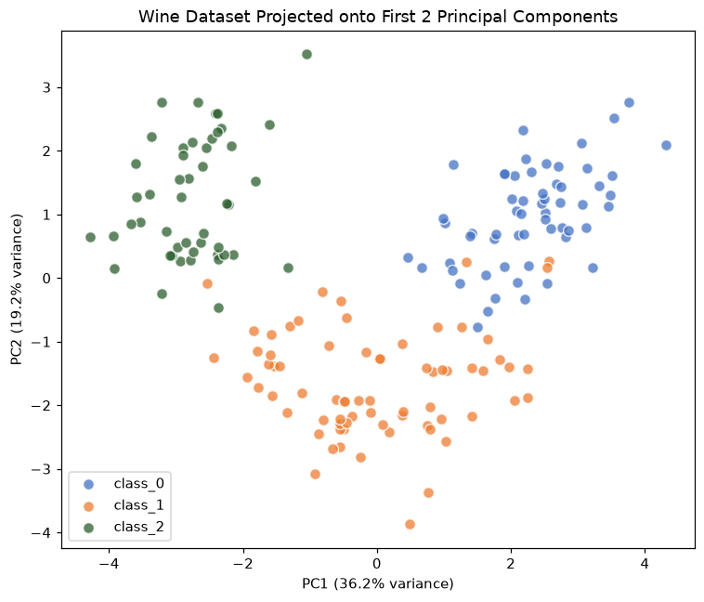
Variance retained by PC1 + PC2: 55.41 %
Even though we collapsed 13 chemical measurements into just 2 components, the three wine cultivars remain clearly separated a good sign that PCA preserved the structure that matters.

Slide 13
References
• Jolliffe, I. T. (2002). Principal Component Analysis (2nd ed.). Springer.
• Bishop, C. M. (2006). Pattern Recognition and Machine Learning. Springer.
• Pedregosa et al. (2011). Scikit -learn: Machine Learning in Python. JMLR 12, 2825–2830.
• Fisher, R. A. (1936). The Iris dataset — UCI Machine Learning Repository.
8

