Slide 1

Predictive Modeling for Diabetes Diagnosis
A Comparative Study of Classification Models
Name: Chetna Saharan
Supervisor: Prof. Millie Pant
Mentor: Ms. Riya & Mr. Harjeet Singh Applied Mathematics & Scientific Computing
Indian Institute of Technology Roorkee

Slide 2

Introduction
Diabetes mellitus is a chronic condition affecting hundreds of millions worldwide; early risk identification supports timely clinical intervention.
This project applies machine learning to predict diabetes onset using the PIMA Indian Diabetes dataset (768 patient records, 8 diagnostic features).
Features include Glucose, BMI, Age, Blood Pressure, Insulin, Skin Thickness, Pregnancies, and Diabetes Pedigree Function.
Objective: Build, tune, and compare five classification algorithms to identify the most reliable model for diabetes risk screening.
Logistic Regression • K-Nearest Neighbors • SVM • Decision Tree • Random Forest

Slide 3
Dataset Overview
768 patient records × 8 numeric features + binary Outcome target.
Class distribution: 500 non-diabetic (65.1%) vs. 268 diabetic (34.9%) — a moderate imbalance.
Several features (Glucose, BloodPressure, SkinThickness, Insulin, BMI) contain biologically implausible zero values requiring cleanup.
Feature | Mean | Std Dev | Min | Max
Pregnancies | 3.85 | 3.37 | 0 | 17
Glucose | 120.89 | 31.97 | 0 | 199
BloodPressure | 69.11 | 19.36 | 0 | 122
SkinThickness | 20.54 | 15.95 | 0 | 99
Insulin | 79.80 | 115.24 | 0 | 846
BMI | 31.99 | 7.88 | 0 | 67.1
DiabetesPedigreeFunction | 0.47 | 0.33 | 0.078 | 2.42
Age | 33.24 | 11.76 | 21 | 81

Slide 4
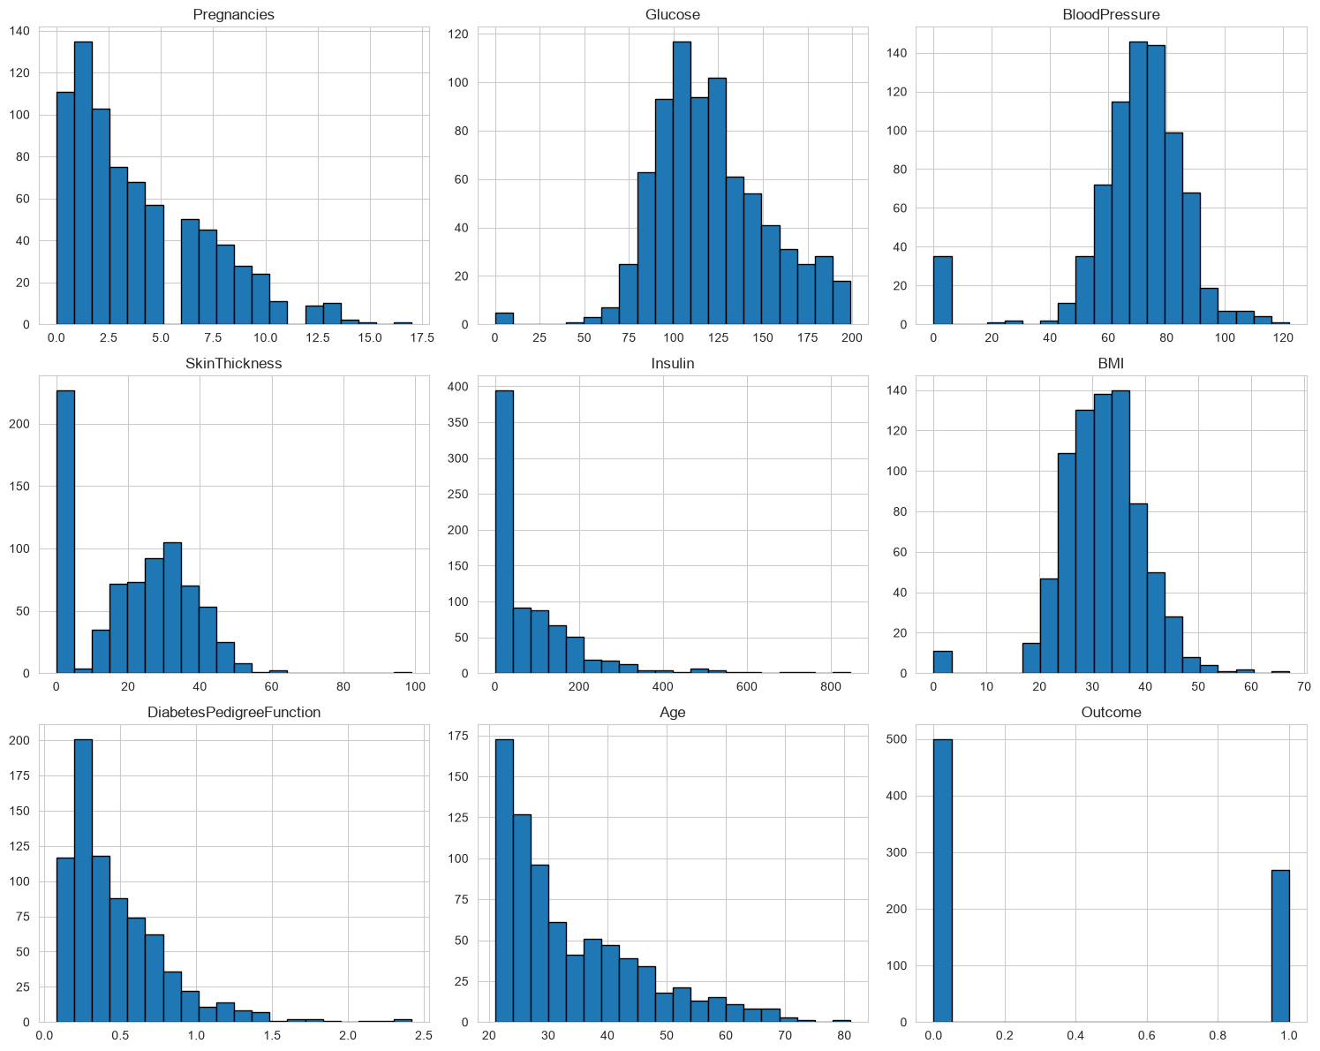
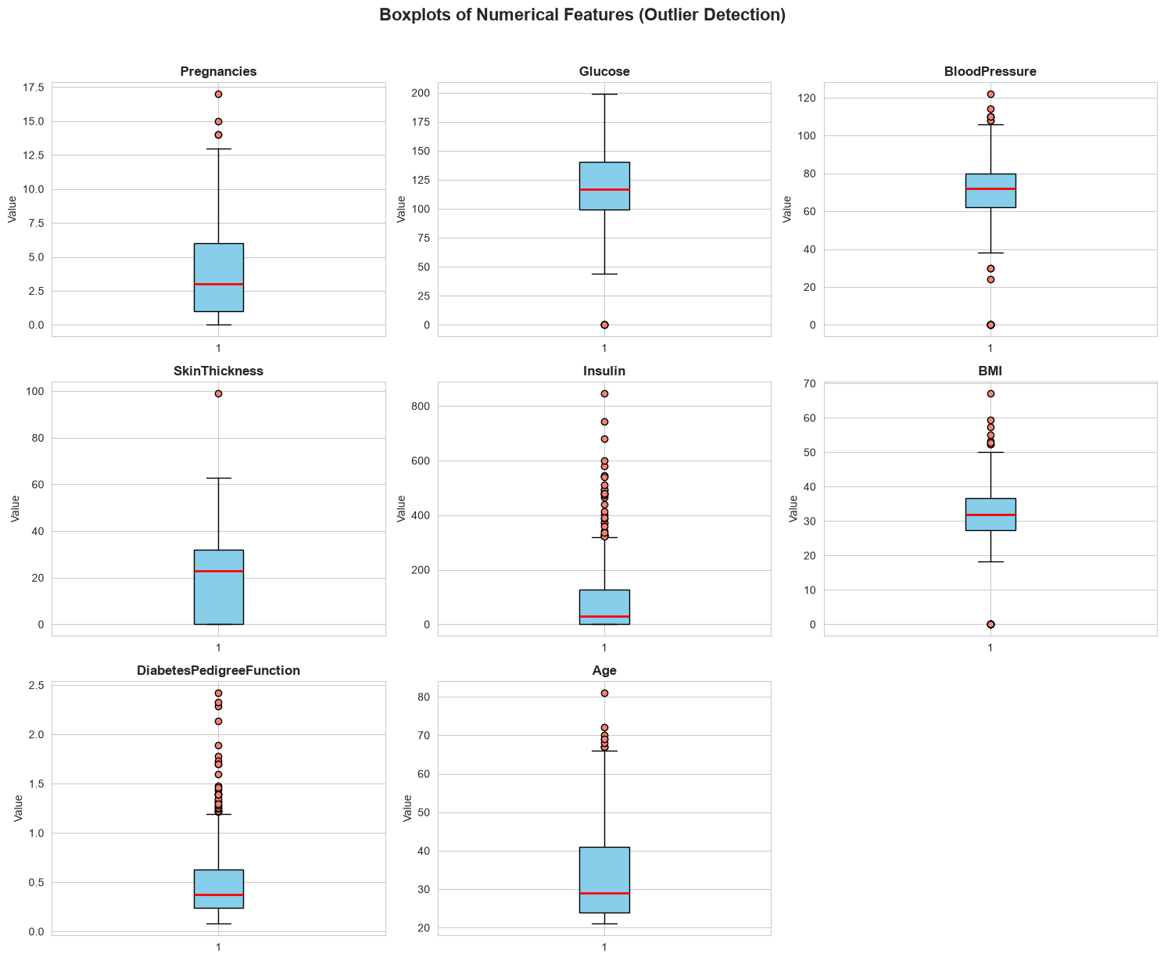
EDA: Distributions & Outliers
Feature histograms: skewed distributions in Insulin, DPF, and Age.
Boxplots reveal outliers concentrated in Insulin and SkinThickness.

Slide 5
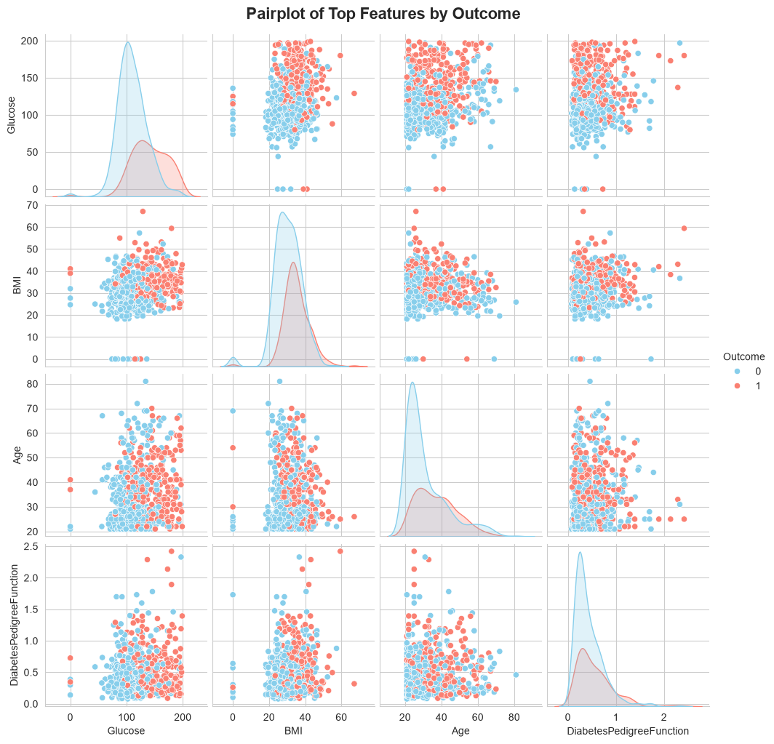
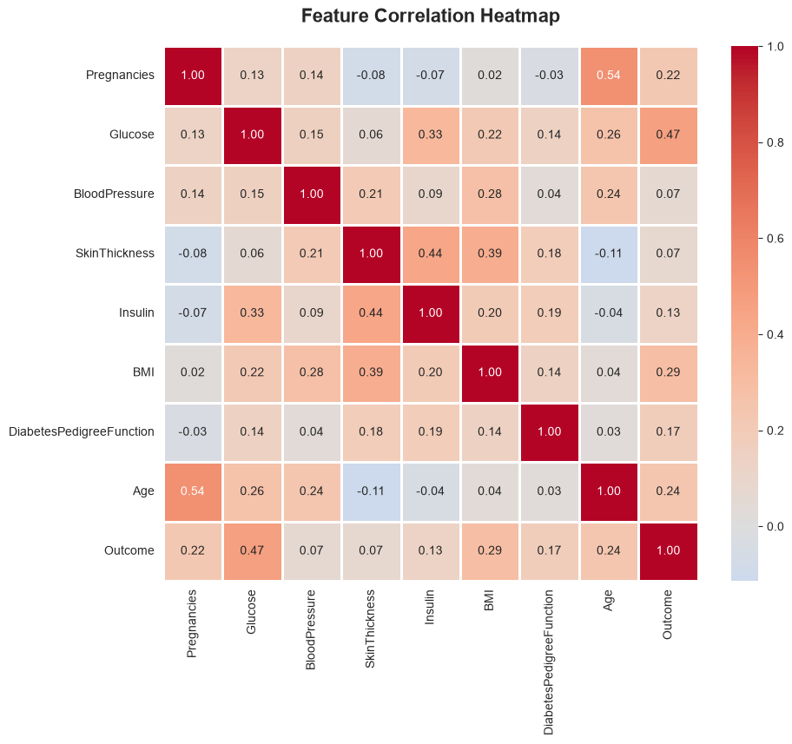
EDA: Correlation & Relationships
Glucose shows the strongest correlation with diabetes Outcome.
Pairplot of top features shows clear separation by Outcome along the Glucose axis.

Slide 6
Data Preprocessing
Missing Value Treatment: Biologically implausible zero values in Glucose, BloodPressure, SkinThickness, Insulin, and BMI treated as missing and imputed using column medians.
Duplicate Check: No duplicate records found across all 768 rows.
Class Imbalance Correction: SMOTE (Synthetic Minority Over-sampling) applied to the 500:268 class split, producing 1,000 balanced samples (500 per class).
Feature Scaling: StandardScaler applied to all features prior to model training; MinMaxScaler evaluated as an alternative but StandardScaler retained.
Feature Selection: ANOVA F-test (SelectKBest) confirmed Glucose, BMI, Age, Insulin, and DiabetesPedigreeFunction as the top 5 predictive features.
Train/Test Split: 80% training (800 samples) / 20% testing (200 samples), stratified to preserve class balance.

Slide 7
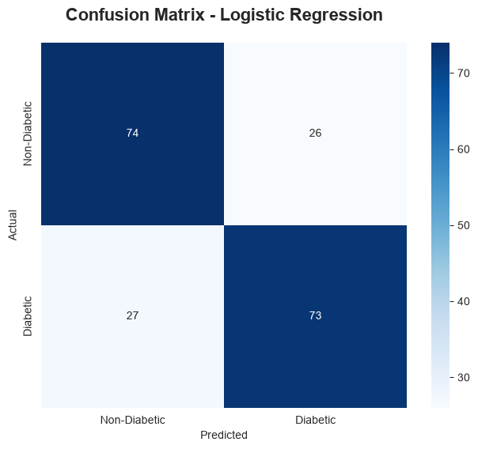
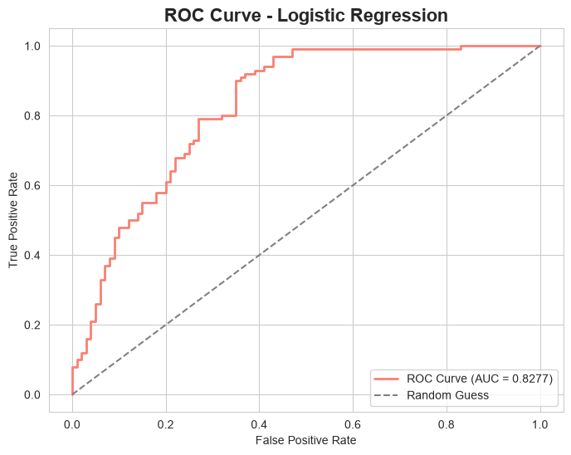
Logistic Regression
Metric | Value
Accuracy | 0.7350
Precision | 0.7374
Recall | 0.7300
F1-Score | 0.7337
ROC-AUC | 0.8277
Odds ratios (exp(coef)) identify Glucose, BMI, and Pregnancies as the strongest positive risk factors. Simplest and most interpretable model, but lowest accuracy of all five — reflecting non-linear relationships in the data.

Slide 8
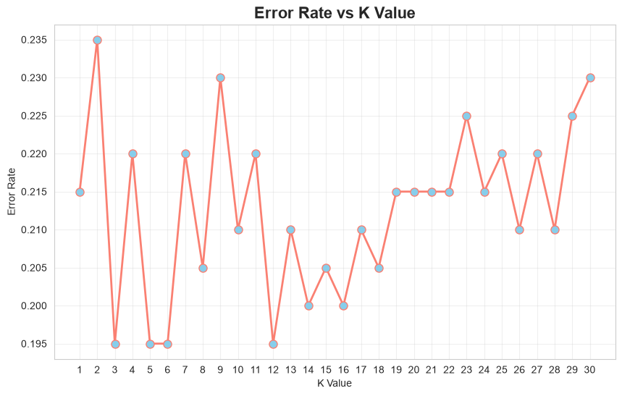
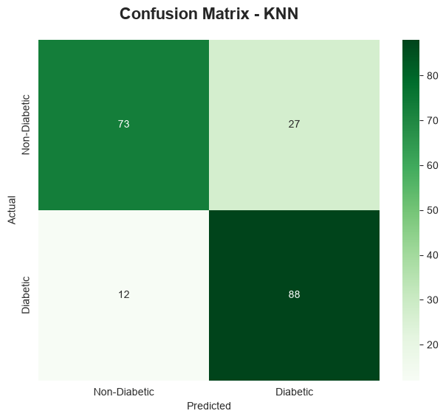
K-Nearest Neighbors (KNN)
Metric | Value
Accuracy | 0.8050
Precision | 0.7652
Recall | 0.8800
F1-Score | 0.8186
ROC-AUC | 0.8625
Elbow method + cross-validation identified optimal K=3. Manhattan distance metric slightly outperformed Euclidean (82.5% vs 80.5% accuracy).

Slide 9
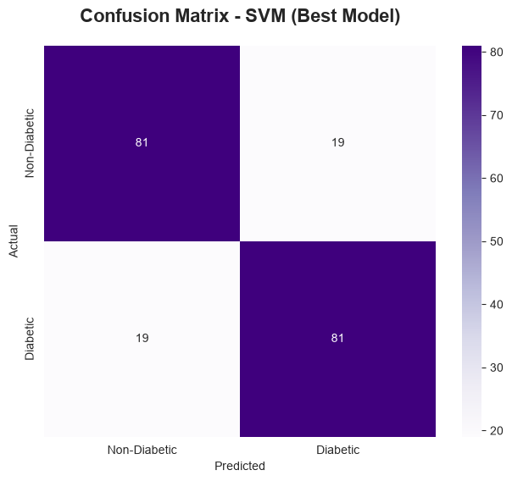
Support Vector Machine (SVM)
Kernel comparison (Linear, RBF, Polynomial, Sigmoid) showed RBF performed best at default settings.
GridSearchCV tuned C ∈ {0.1,1,10,100} and gamma ∈ {0.01,0.1,1,10} → optimal: C=1, gamma=1 (CV accuracy 80.1%).
Metric | Value
Accuracy | 0.8100
Precision | 0.8100
Recall | 0.8100
F1-Score | 0.8100
ROC-AUC | 0.8928

Slide 10
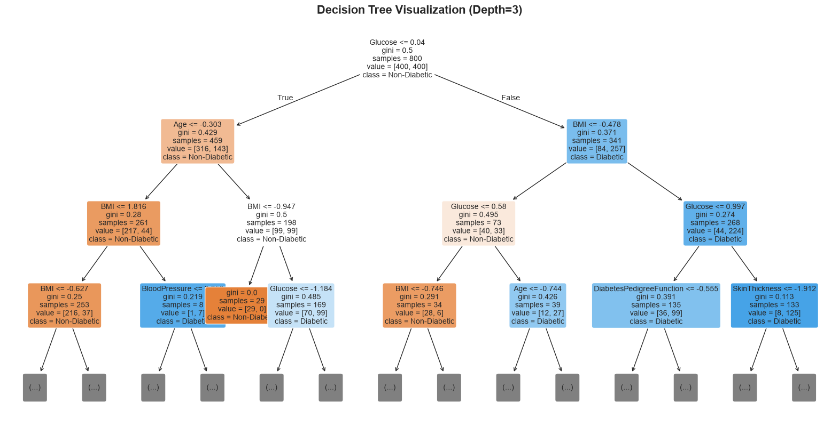
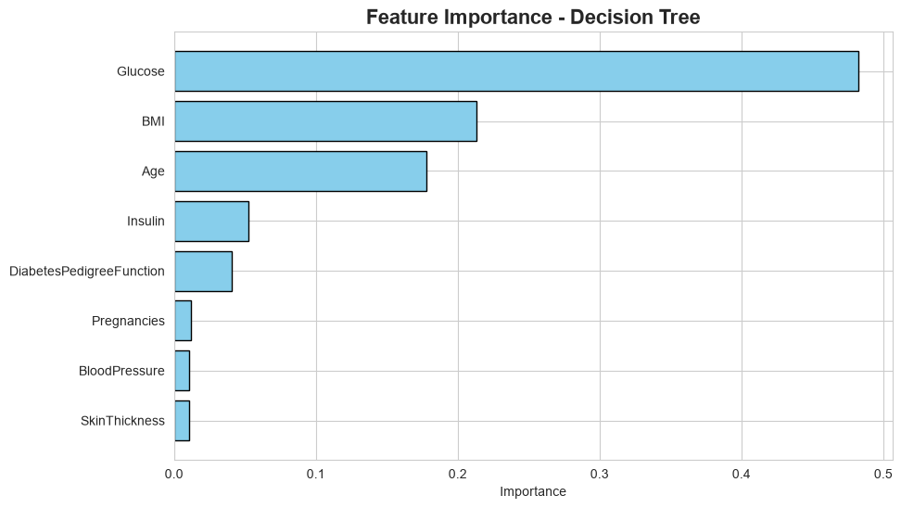
Decision Tree
Metric | Value
Accuracy | 0.8300
Precision | 0.8173
Recall | 0.8500
F1-Score | 0.8333
ROC-AUC | 0.8530
Cost-complexity pruning (ccp_alpha=0.0031) controlled overfitting. Feature importance is concentrated in Glucose (48%), BMI (21%), and Age (18%) — together over 87% of decision weight.

Slide 11
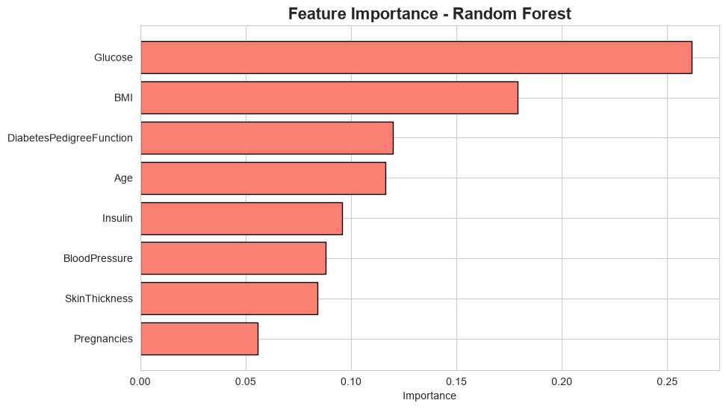
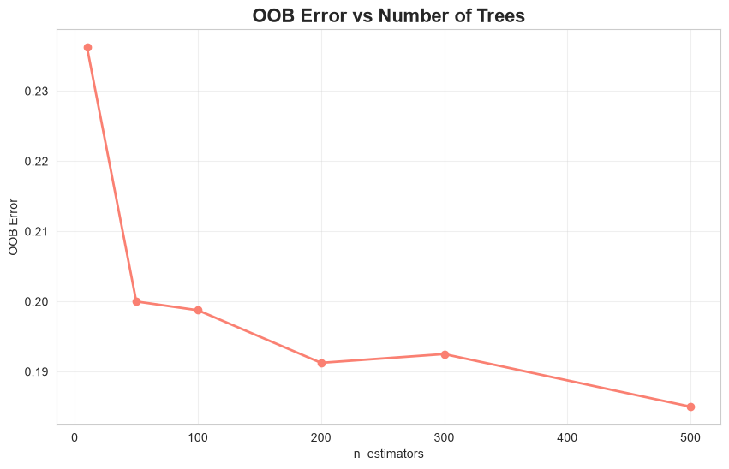
Random Forest
Metric | Value
Accuracy | 0.8350
Precision | 0.8190
Recall | 0.8600
F1-Score | 0.8390
ROC-AUC | 0.9027
Best overall model: 83.5% accuracy, 0.903 ROC-AUC. OOB error stabilizes quickly, confirming minimal overfitting.

Slide 12
Model Comparison: Metrics
Model | Accuracy | Precision | Recall | F1-Score | ROC-AUC
Random Forest | 0.8350 | 0.8190 | 0.8600 | 0.8390 | 0.9027
Decision Tree | 0.8300 | 0.8173 | 0.8500 | 0.8333 | 0.8530
SVM (RBF) | 0.8100 | 0.8100 | 0.8100 | 0.8100 | 0.8928
KNN (K=3) | 0.8050 | 0.7652 | 0.8800 | 0.8186 | 0.8625
Logistic Regression | 0.7350 | 0.7374 | 0.7300 | 0.7337 | 0.8277
Random Forest achieved the top scores on four of five metrics. KNN produced the highest recall (0.88), useful for minimizing missed diabetic cases, while the tuned SVM (RBF) achieved the second-highest ROC-AUC (0.893). Logistic Regression trailed on raw performance but remains the most interpretable model via its odds-ratio coefficients.

Slide 13
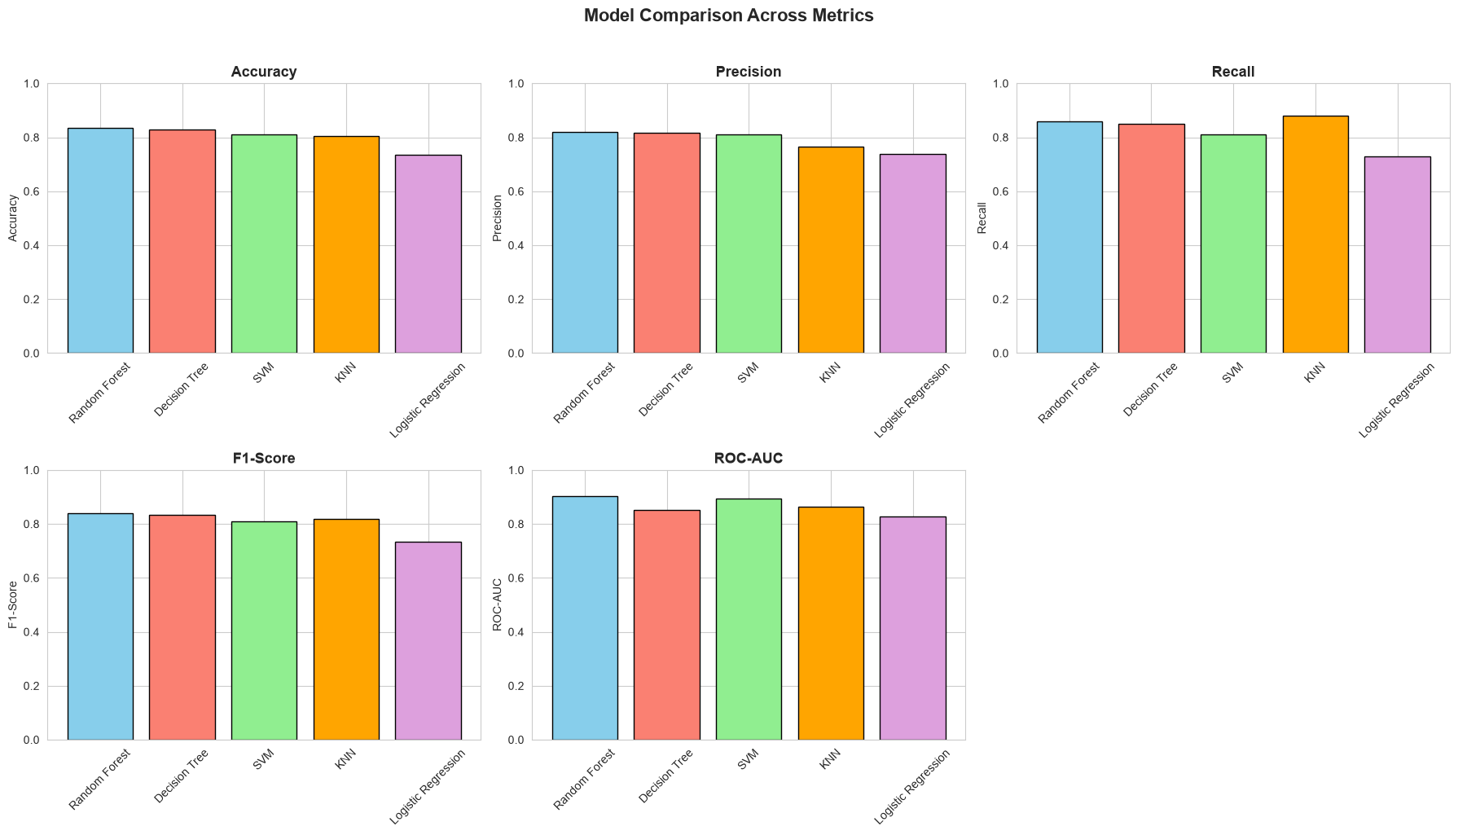
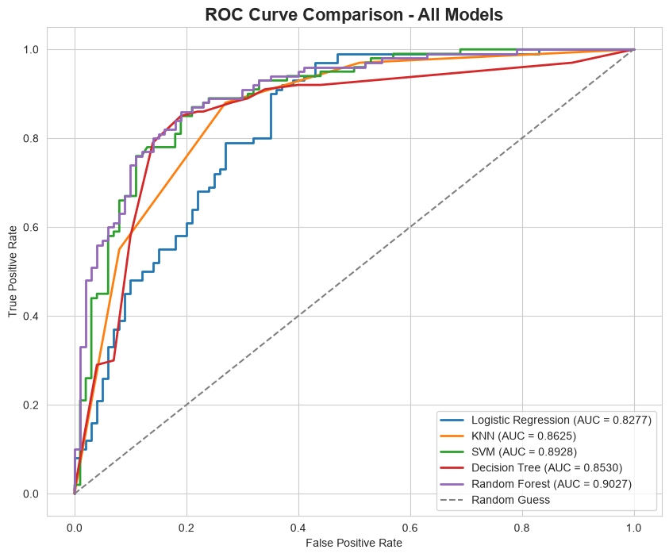
Model Comparison: Visuals
Random Forest offers the best overall trade-off between accuracy and generalization, while SVM (RBF) remains highly competitive on ROC-AUC.

Slide 14
Recommendations
Adopt Random Forest as the primary candidate model for further validation, given its top ranking on four of five evaluation metrics.
Retain the tuned SVM (RBF kernel) as a secondary candidate, particularly where the highest ROC-AUC is prioritized.
Preserve Logistic Regression as an interpretable fallback for contexts requiring transparent, coefficient-level explanations of risk factors.
Future data collection should distinguish true zero measurements from missing data explicitly, rather than encoding both identically.
Explore gradient boosting methods (XGBoost, LightGBM) which often outperform Random Forest on tabular clinical data.
Validate the selected model on an external patient cohort before any clinical deployment, and pair predictions with guidance for confirmatory testing.

Slide 15
References
Conclusion: Random Forest offers the best trade-off between predictive performance and generalization for diabetes screening; Logistic Regression remains valuable where interpretability is required.
Smith, J.W., Everhart, J.E., Dickson, W.C., Knowler, W.C., & Johannes, R.S. (1988). Using the ADAP learning algorithm to forecast the onset of diabetes mellitus. Proceedings of the Symposium on Computer Applications in Medical Care.
Pedregosa, F. et al. (2011). Scikit-learn: Machine Learning in Python. Journal of Machine Learning Research, 12, 2825-2830.
Chawla, N.V., Bowyer, K.W., Hall, L.O., & Kegelmeyer, W.P. (2002). SMOTE: Synthetic Minority Over-sampling Technique. Journal of Artificial Intelligence Research, 16, 321-357.
PIMA Indian Diabetes Dataset, Kaggle / UCI Machine Learning Repository.

