Slide 1
TITLE : REAL TIME ACCENT TRANSLATION
PIP2001 Capstone Project
Review-0
Batch Number: CIT-G29
Roll Number | Student Name
KEERTHI | 20211CIT0108
CHETANA P SUTHAR | 20211CIT0111
LEKHANA E | 20211CIT0124
PAVANI M | 20211CIT0067
Under the Supervision of,
Ms. Sridevi . S
School of Computer Science and Engineering
Presidency University
Name of the Program: B.Tech (CSE – Internet of Things)
Name of the HoD: Dr. Anandaraj S P
Name of the Program Project Coordinator: Dr. Sharmasth Vali Y
Name of the School Project Coordinators: Dr. Sampath A K / Dr. Abdul Khadar A / Mr. Md Ziaur Rahman

Slide 2
Content
Problem Statement
Analysis of Problem Statement
Timeline of the Project
References

Slide 3
Problem Statement Number: PSCS95
Organization: HARMAN
Category (Hardware / Software / Both) : Software
Problem Description : Conference calls have become order of the day. Participants attend the conference calls from various locations and nationalities and speak the language differently. This causes hurdles in ability to understand and also how quickly a thought is communicated. This problem is to develop a real time accent translation system based on the recipients' and deliverer's accents. The idea is to achieve far better understanding during conference calls, which will make the communication far more effective.
Difficulty Level: Complicated

Slide 4
Analysis of Problem Statement
Technology Stack Components :
Speech Recognition (STT - Speech-to-Text)
Purpose: Convert spoken words into text.
Technology :
- Google Speech-to-Text API: Supports multiple languages and accents, and provides high accuracy.
- Mozilla DeepSpeech: Open-source and offers customization options for speech recognition.
Libraries:
- speech_recognition (Python)
- pocketsphinx

Slide 5
Analysis of Problem Statement (contd...)
2. Text Processing (Accent Translation):
Purpose: Modify the recognized text to align with the target accent's phonetic and
linguistic rules.
Technology:
- Phoneme Processing: Use Grapheme-to-Phoneme (G2P) models like Phonetisaurus to convert text into phonetic representations.
- Natural Language Processing (NLP): Tokenize and analyze text using libraries like NLTK or spaCy to ensure syntactical accuracy after accent transformation.

Slide 6
Analysis of Problem Statement (contd...)
3. Text-to-Speech (TTS - Speech Synthesis)
Purpose: Convert the processed text back into speech in the desired accent.
Technology:
Google Text-to-Speech (gTTS): Provides high-quality speech synthesis with various voice options and accents.
Mozilla TTS: Open-source option with neural network-based TTS and accent flexibility.
Libraries:
pyttsx3 (TTS in Python)
gtts (for Google TTS)

Slide 7
Analysis of Problem Statement (contd...)
5. Real-time Streaming & Processing
Purpose: Handle live audio data, process it in real-time, and ensure minimal latency.
Technology:
WebRTC: For real-time audio streaming in conference calls, allowing two-way communication.
Socket Programming: Implement with libraries like WebSocket or Socket.IO for real-time data transmission between client and server.

Slide 8
Analysis of Problem Statement (contd...)
6. Backend & Infrastructure
Purpose: Host the speech processing services and ensure scalability and real-time performance.
Technology:
Message Queues: Apache Kafka or RabbitMQ for managing streaming data in real-time.
APIs:
Use RESTful APIs or gRPC for communication between different services (e.g., connecting STT and TTS).

Slide 9
Analysis of Problem Statement (contd...)
7.Frontend (User Interface)
Purpose: Provide an interface for users to interact with the system, either on desktop or mobile.
Technology:
Web Frameworks:
React.js or Angular for building responsive web interfaces.
Mobile Apps:
Native iOS/Android apps if targeting mobile users.
Integration with WebRTC: For seamless real-time communication in conference calls.

Slide 10
HARDWARE AND SOFTWARE REQUIREMENTS OF REAL TIME ACCENT TRANSLATION:
For Local Development & Testing:
Basic Machine (For Testing on a Personal Computer):
Processor: Minimum Intel i5 or equivalent (Recommended: Intel i7 for faster processing)
RAM: Minimum 8 GB (Recommended: 16 GB or higher for handling speech models and real-time processing)
GPU (Optional, but recommended for model training):
NVIDIA GTX 1060 or higher
CUDA-enabled GPU for faster model training and inference (for deep learning models like Tacotron, WaveNet)
Storage: Minimum 256 GB SSD (Recommended: 500 GB SSD for faster read/write operations)
Microphone & Speakers: For capturing and playing audio during development and testing.

Slide 11
HARDWARE AND SOFTWARE REQUIREMENTS OF REAL TIME ACCENT TRANSLATION:
2. Operating Systems:
Linux (Ubuntu, CentOS, etc.)
Windows 10/11 or macOS
3.Programming Languages & Frameworks: Python 3.7 or higher and Backend Frameworks(Node.js or socketOI)
4.Machine Learning Libraries: Speech Recognition (STT), Natural Language Processing (NLP) and Speech Synthesis (TTS)
5.Audio Processing Libraries: PyAudio or LibROSA
6. API’s and Real-Time Communication Frameworks:
Speech-to-Text APIs and WebRTC Framework

Slide 12
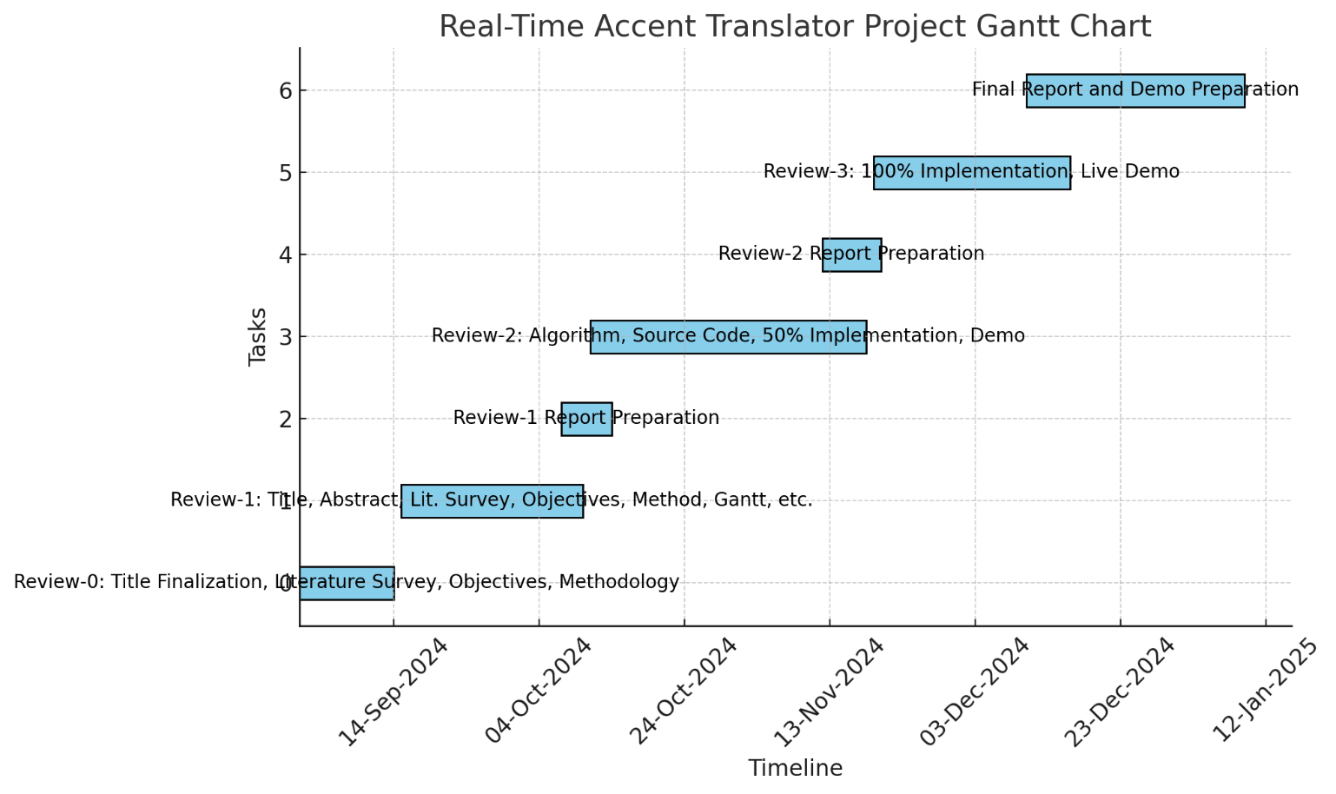
Timeline of the Project (Gantt Chart)

Slide 13
References (IEEE Paper format)
1. Accented Text-to-Speech Synthesis with a Conditional Variational Autoencoder https://ar5iv.org/pdf/2211.03316
2. Transfer the Linguistic Representations from TTS to Accent Conversion with Non-parallel Data https://ar5iv.org/abs/2401.03538
3. Real-Time Language Translation Using AI and ML https://easychair.org/publications/preprint/jjqv
4. Real-Time Speech Translation Using Deep Learning: Challenges and Future Directions https://www.sciencedirect.com/science/article/pii/S0957417421001201 5. Real-Time Voice Translation: A New Approach to Cross-Lingual Communication https://ieeexplore.ieee.org/document/9347620 . References
6. Accent Recognition and Real-Time Accent Adaptation for Speech Recognition https://www.researchgate.net/publication/345781230

Slide 14
References (IEEE Paper format)
7. Deep Learning Techniques for Real-Time Speech Translation https://link.springer.com/article/10.1007/s11042-020-09363-2
8. End-to-End Speech Translation for Conversational Speech https://arxiv.org/abs/1906.01529.
9. Neural Network Approaches for Real-Time Multilingual Speech Recognition https://ieeexplore.ieee.org/document/9294185
10. Challenges in Real-Time Accent Translation: A Survey https://easychair.org/publications/preprint/jjqv

Slide 15


