Slide 1

PROJECT :
HR EMPLOYEE ATTRITION ANALYSIS
Submitted By: Panna Chetry
Batch: Apr 2026

Slide 2

CONTENT
Introduction
Problem Statement
Dataset Description
Data Cleaning
EDA
Conclusion
Suggestion

Slide 3
INTRODUCTION
Employee attrition refers to the gradual reduction of an organization's workforce due to voluntary or involuntary employee departures. High attrition can increase recruitment and training costs, reduce productivity, and affect overall organizational performance. Analysing employee attrition helps organizations identify the key factors influencing turnover and develop effective strategies to improve employee retention and workforce stability.

Slide 4

PROBLEM STATEMENT
Organization need to understand why employees leave.
High employee attrition affects organizational productivity, increases recruitment and training costs, and leads to the loss of skilled talent.
The goal is to identify key drivers of attrition using data analysis.
Insight help HR improve retention and workforce planning.

Slide 5
DATASET DESCRIPTION
Dataset: HR Employee Attrition
Rows: 1470
Columns: 35
Target Variable: Attrition
Key Fields: Age, Department, Job Role, Monthly Income, Overtime, Job satisfaction, Job Level, Years at Company, Salary Hike

Slide 6
DATASET CLEANING
Dataset Verification
Imported the dataset into Jupyter Notebook using pandas.
Verified the dataset dimensions(1470 rows * 35 columns) and dataset shape.
Reviewed column names and data types.
Data Type Validation
Verified that:
Numerical columns – Integer(int64)
Categorical columns – Objects

Slide 7
DATASET CLEANING
Data Cleaning & Preprocessing
No missing values found.
No duplicate records detected.
Removed non-informative columns:
  EmployeeCount
  Over18
  StandardHours
  EmployeeNumber

Slide 8
Outlier Analysis
Outliers were identified using the Interquartile Range (IQR) method and box plots.
Outliers were observed in variables such as Monthly Income, Total Working Years, Years at Company, and Years Since Last Promotion.
After reviewing these variables, the outliers were considered valid because they likely represent employees with higher salaries, more work experience or longer service. As these are not error so they are kept for further analysis.
✔ Dataset prepared for visualization and analysis.

Slide 9
EXPLORATORY DATA ANALYSIS

Slide 10
Descriptive Analysis
Analysis Performed
Examined employee demographics (Age, Gender, Department, Job Role).
Calculated summary statistics such as mean, median, minimum, and maximum for numerical variables.
Analysed the distribution of key variables like Monthly Income, Years at Company, and Age.
Reviewed the frequency of categorical variables such as Attrition, Department, and Overtime.
Key Findings
The dataset contains 1,470 employee records with 35 features.
The average employee age is approximately 37 years.
The average monthly income is approximately ₹6,500 (or 6500 in the dataset's units).
Approximately 16.1% of employees left the organization.
Most employees belong to the Research & Development department.
:

Slide 11
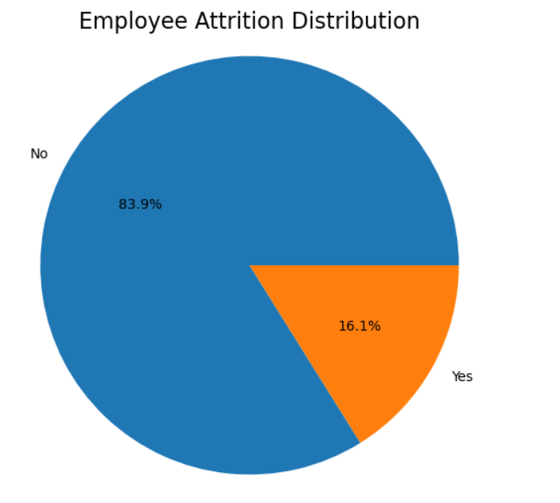
Overall Employee Attrition
Observation
237 employees left the company.
Attrition rate is 16.1%.
Approximately 1 in 6 employees resigned.

Slide 12
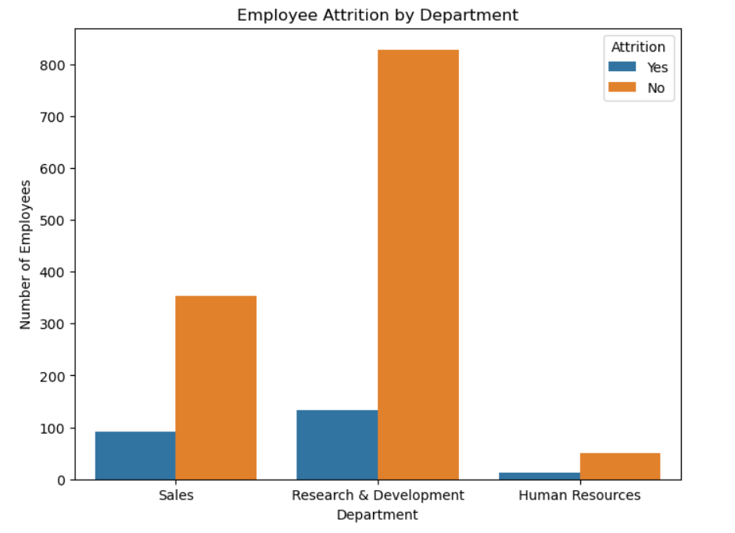
Attrition by Department
Observation
✔ Research & Development department has the highest attrition followed by Sales.
✔ HR has the lowest attrition.

Slide 13
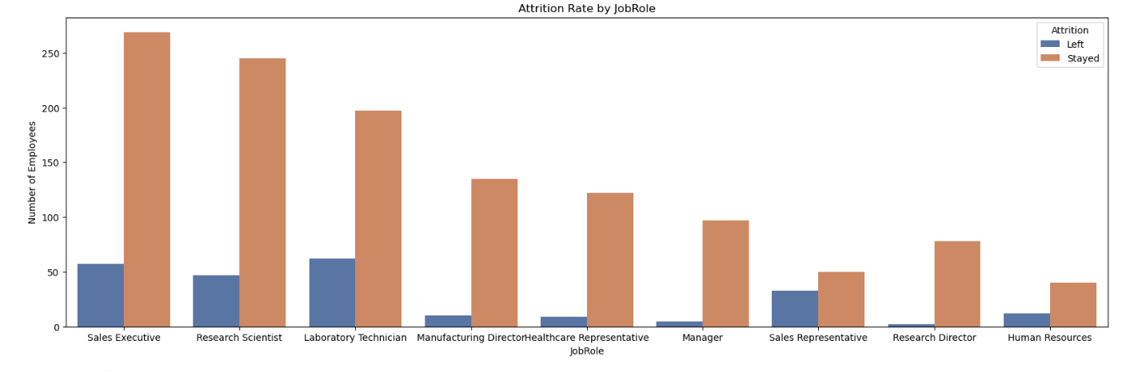
Attrition by Job Role
Observation
Operational and customer-facing roles
show higher employee turnover.
Laboratory Technicians have the highest number of employees leaving.
Sales Executives and Research Scientists also show relatively high attrition.
Managerial and senior-level roles have comparatively lower attrition.

Slide 14
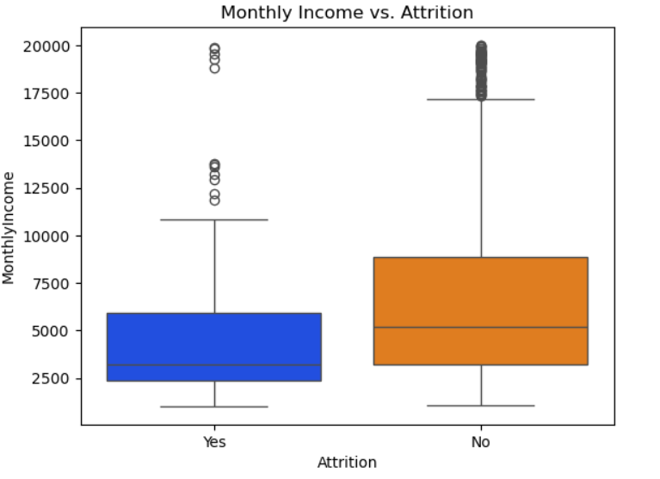
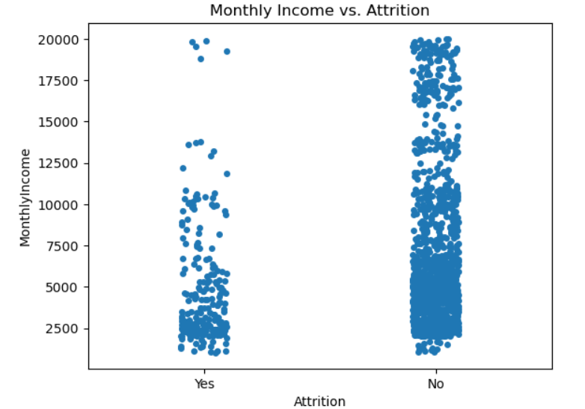
Attrition by Monthly Income
Observation
Employees with lower salaries are more
likely to leave the organization.

Slide 15
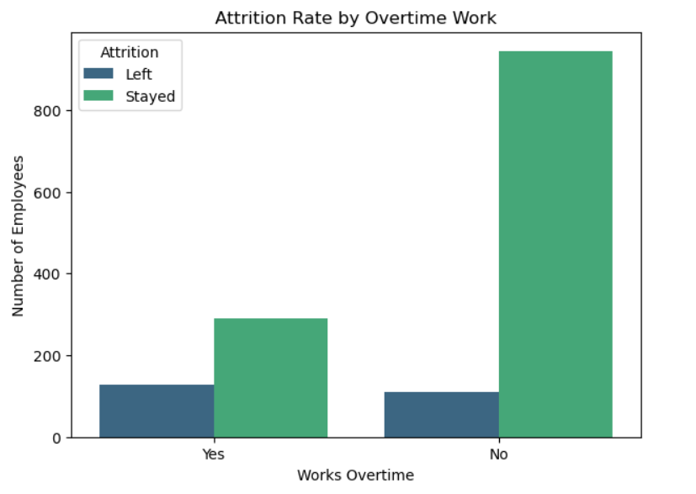
Attrition by Overtime
Observation
Employees working overtime
show significantly higher attrition.
While only a minority of the workforce works overtime (usually around 28-30% of total staff), they represent a massive, disproportionate percentage of the total pool of people who resign.

Slide 16
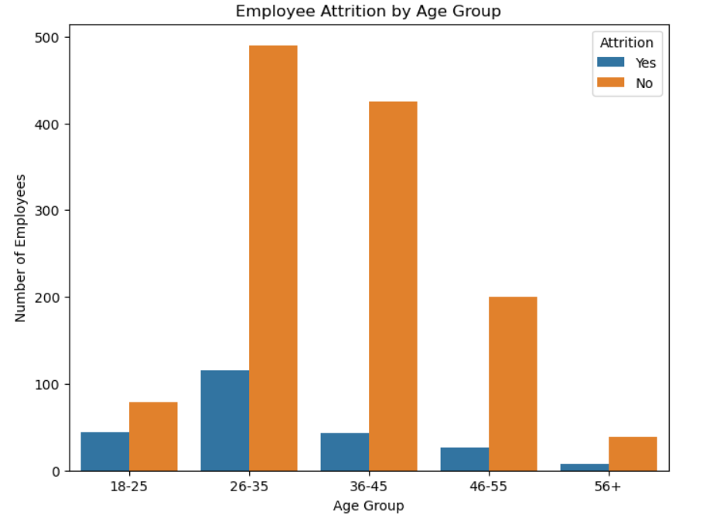
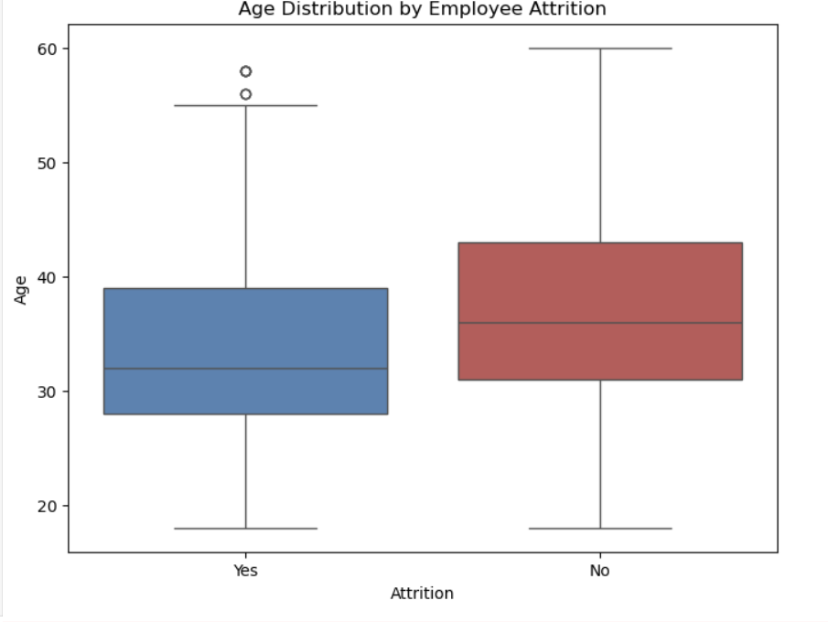
Attrition by Age
Observation
Highest attrition is observed among employees aged 26–35 years.
Attrition decreases as employee age increases.
Younger employees may be more likely to switch jobs for career advancement and better compensation.

Slide 17
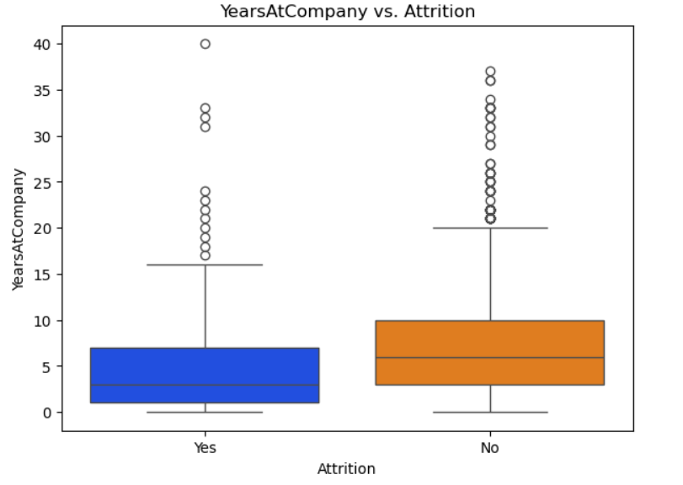
Attrition by Years at Company
Observation
Employees with fewer years in the
company leave more frequently.
There is a massive, disproportionate spike in attrition among employees who have been with the company for less than 2 years.

Slide 18
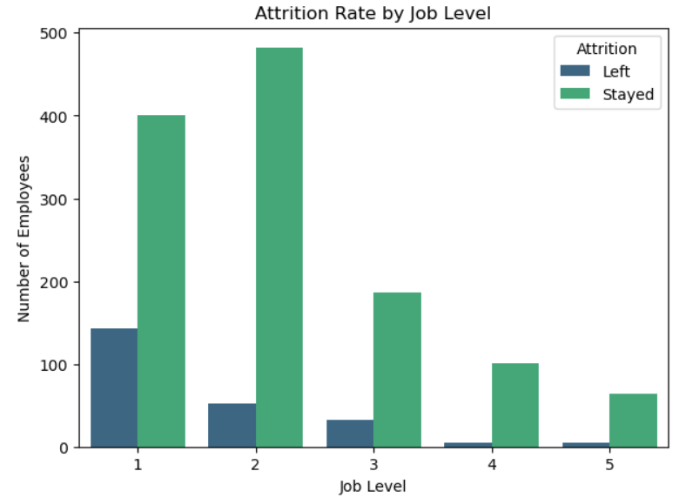
Attrition by Job Level
Observation
Level 1: Highest attrition (25–30%); entry-level employees are most likely to leave.
Levels 2 & 3: Attrition drops (<15%) due to career growth and better compensation.
Levels 4 & 5: Lowest attrition (<5%), reflecting strong employee retention and organizational commitment.

Slide 19
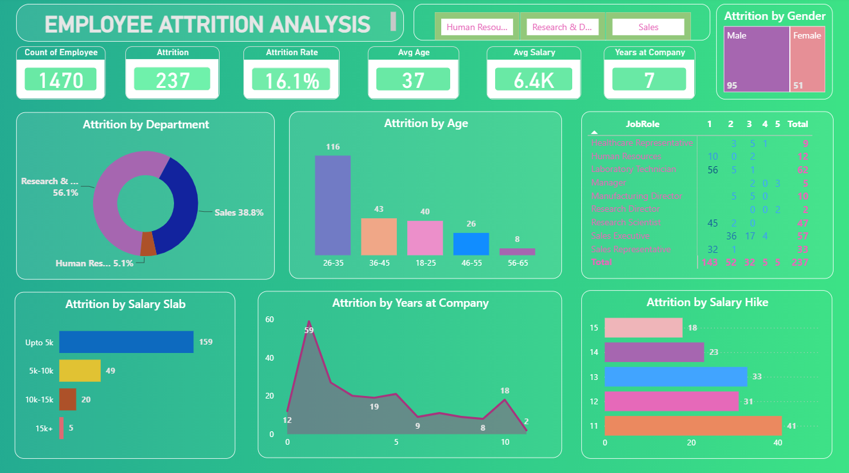
Key Insights
Attrition Rate = 16.1%
Research & Development department has highest attrition
Overtime strongly impacts attrition
Lower salary increases turnover
Employees with fewer years in the
company leave more frequently
Low job satisfaction contributes
to attrition
Highest attrition is observed among employees aged 26–35 years
Entry-level employees are the most likely to leave.

Slide 20
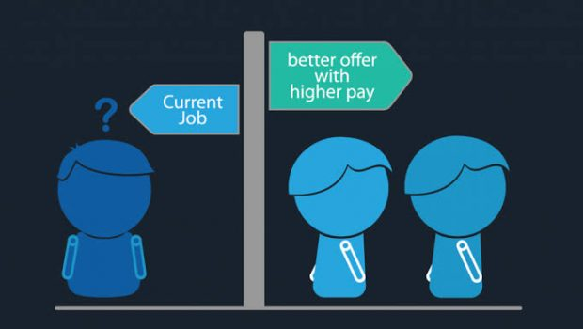
CONCLUSION
Employee attrition is influenced by
multiple factors such as
• Salary
• Overtime
• Age group
• Job Satisfaction
Using HR analytics enables organizations
to make informed decisions that improve
employee retention.

Slide 21
Suggestions
To have a low attrition rate, it is important for companies to:
Fairly pay employees in same job level, same job involvement, same job role with almost equal monthly income and stocks.
Offer competitive compensation and performance-based rewards.
Increase allowance for employees to work overtime, and make sure that those working overtime is being paid more than those who are not.
Improve retention strategies for entry-level employees.
Also, companies should remember to appreciate their employees and work on the harmonic balance of their company.

Slide 22
Thank You

