Slide 1
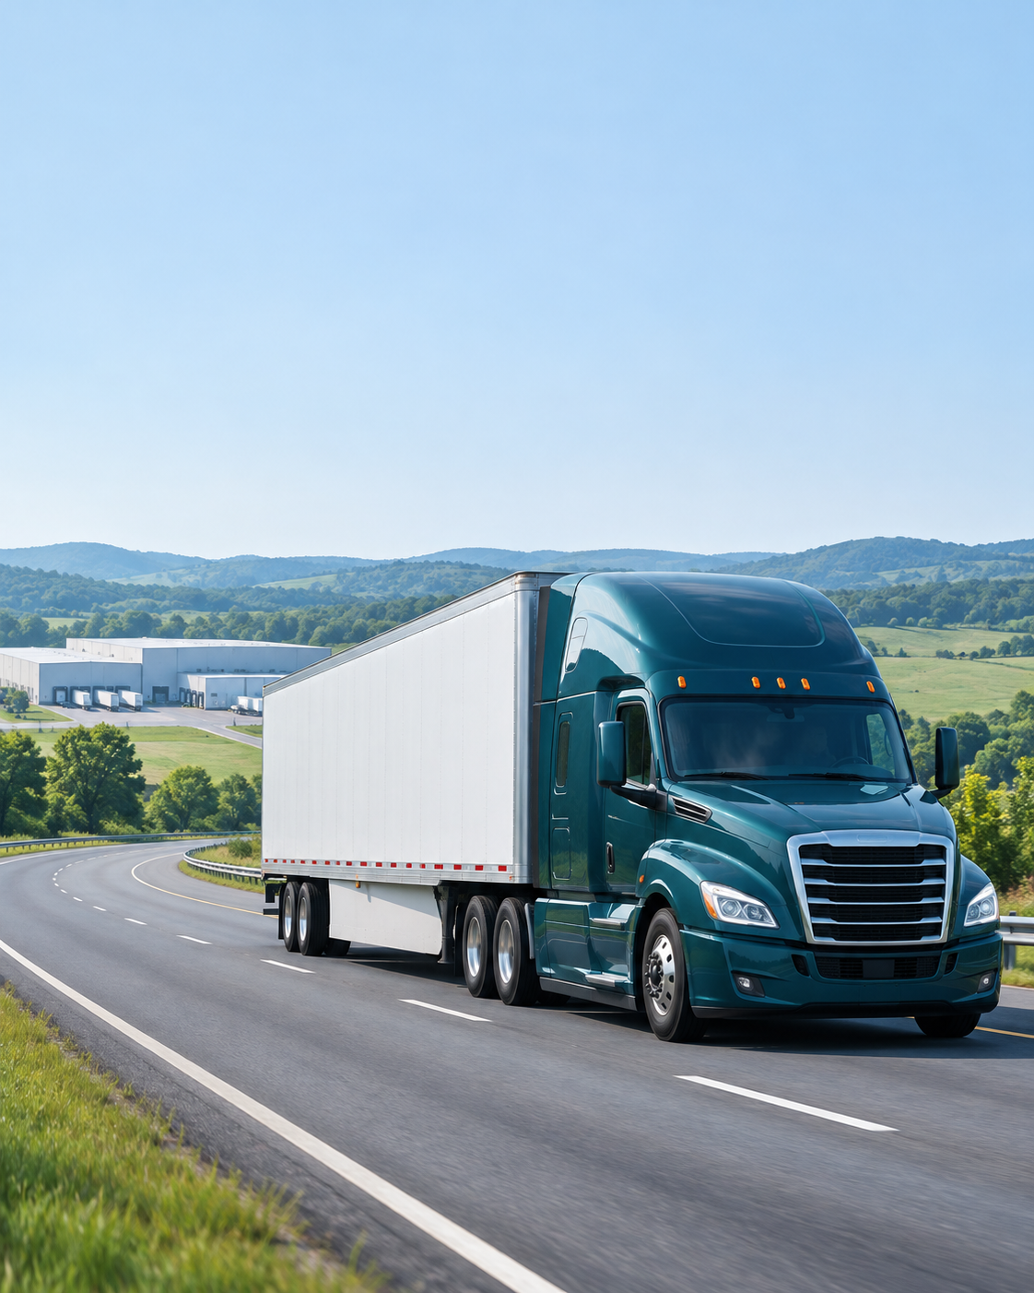
ROUTEMIND AI / PROJECT REVIEW
ILLUSTRATIVE FREIGHT NETWORK
RouteMind AI
FRE
PHX
AUS
Tell us the shipment.
We’ll find the lane.
Conversational ground-freight planning
with evidence and verified route decisions.
PROJECT TEAM
Chetana Patel
Minh N Phan
Dilara Siraeva
Illustrative AI-generated image
RouteMind AI | Class presentation | All operational data is simulated
01
Notes:
Good morning. Our project is RouteMind AI, a conversational freight-planning assistant. We are Chetana Patel, Minh N Phan and Dilara Siraeva. It supports a planner in comparing shipment routes and reviewing the evidence behind the choices. All operating data is simulated. The cover photograph is an AI-generated illustration, not a photo of a real project shipment.

Slide 2
ROUTEMIND AI / PROJECT OVERVIEW
What we will show
The problem, the data, the approach and how we check the results.
The project
The data
The approach
Evaluation
Turn a shipment request into feasible, ranked routes.
A reproducible network and versioned document corpus.
NLP + hybrid RAG + deterministic optimization.
Check routing, language extraction, retrieval and answer grounding.
Understand the request. Verify the route. Make the supporting evidence visible.
RouteMind AI | Class presentation | All operational data is simulated
02
Notes:
We will explain the planning problem, the data we use, the approach and how we evaluate it. The goal is to turn a shipment request into feasible ranked routes. Language understanding, evidence retrieval and route correctness are evaluated separately. The icons illustrate the topics and are not additional system capabilities.

Slide 3
ROUTEMIND AI / OPENING QUESTION
Which route would you choose?
15 pallets of fragile electronics. Fremont to Austin. Budget: $4,000.
OPTION A / LOWER COST
OPTION B / EARLIER ARRIVAL
Fremont
Phoenix
Austin
Fremont
Austin
$2,100
$3,400
One transfer
Direct · Arrives 8 hours earlier
Before choosing, what else would you need to know?
RouteMind AI | Class presentation | All operational data is simulated
03
Notes:
Imagine you are moving 15 pallets of fragile electronics with a $4,000 budget. Option A costs $2,100 and includes a Phoenix transfer. Option B costs $3,400, is direct and arrives eight hours earlier. Which would you choose? Pause briefly. Ask what else people would need to know: deadline, handling, capacity or connections. These are schematic diagrams and simulated prices, not road maps or real quotes.

Slide 4
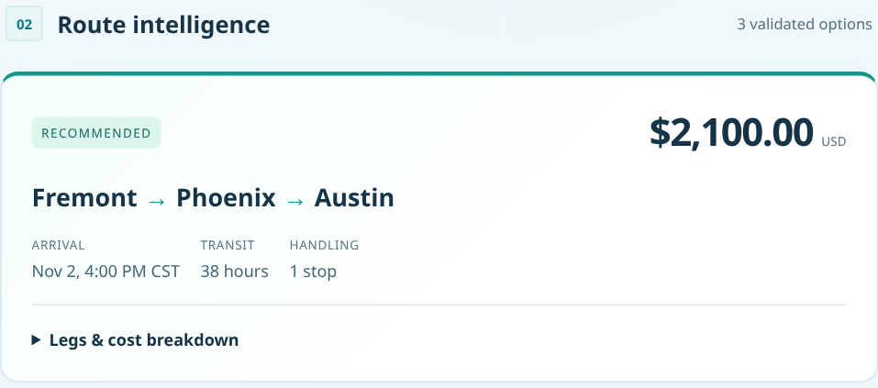
ROUTEMIND AI / INTRODUCTION
Meet RouteMind AI
A conversational assistant for comparing suitable ground-freight routes.
Describe
ACTUAL APPLICATION / SYNTHETIC SHIPMENT
Locations, quantity, budget, deadline and cargo care.
Compare
Review cost, arrival, transfers and supporting information.
Explore
“Make it faster, but keep the budget.”
The user reviews the options and makes the final choice.
RouteMind AI | Class presentation | All operational data is simulated
04
Notes:
The planner describes the shipment, compares feasible options, then asks a follow-up such as “Make it faster, but keep the budget.” The screenshot is from the actual application using its synthetic 15-pallet example. It is a cropped view of the recommendation panel, not a live freight quote. Decision support only: the user makes the final choice.

Slide 5
ROUTEMIND AI / THE PLANNING CHALLENGE
What makes a route suitable?
A route must satisfy the shipment’s requirements—not just offer a low price.
Budget
Cargo care
$
What can we spend?
Can the carrier handle these goods?
Delivery deadline
Shipment decision
Connections
When must it arrive?
Which route fits?
Are the transfers practical?
Shipment size
Carrier reliability
Is there enough capacity?
Does it meet the requirement?
A change to one requirement can change the best route.
RouteMind AI | Class presentation | All operational data is simulated
05
Notes:
A shipment decision depends on budget, deadline, shipment size, cargo care, practical connections and carrier reliability. Changing one requirement may change the best route. The graph is a presentation visual, not a graph database. Carrier reliability is an individual service-provider threshold, not a promised route-level probability. Our problem is to turn the request into feasible, explainable choices and keep the evidence visible.

