Slide 1


PRECISION SHEET METAL MANUFACTURING
A clean, controlled manufacturing partner for prototypes, job work and production batches.
Capability Deck
| Mysore

Slide 2
Built for precision sheet-metal work
From DXF to finished bent components — with process control at every stage.
01
02
03
04
Cut
Bend
Control
Deliver
Laser cutting for MS, SS, aluminium and sheet-metal profiles with controlled nesting and first-piece approval.
CNC press brake bending with tooling selection, bend sequence review and angle verification.
Inspection, traceability, material records and customer-ready quality reports.
Clean packing, dispatch clearance and committed delivery tracking.

Slide 3
ONE SHOP.
MULTIPLE METAL SOLUTIONS.
6 kW
fiber laser capability
150 Ton Press Brake
Bending machine capability
✓
Laser cutting
✓
CNC bending
DXF → Part
✓
Deburring and finishing coordination
engineering-to-production workflow
✓
Inspection and dispatch documentation
Batch + Prototype
suitable for small and repeat jobs

Slide 4
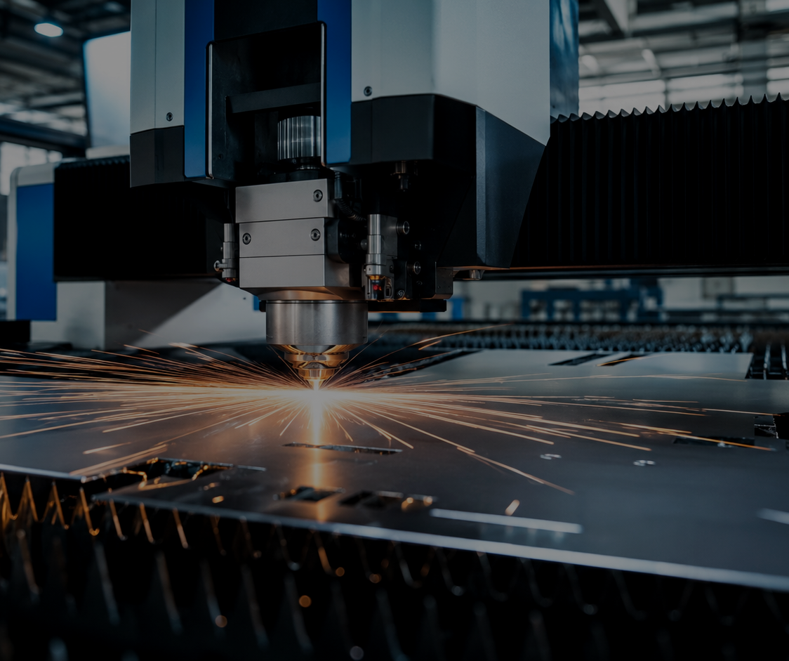
Laser cutting capability
Fast, clean and repeatable cutting with controlled process parameters.
What customers get
✓
DXF review before cutting
✓
Nesting review for material utilization
✓
First-piece cut approval
✓
Burr / dross / edge quality checks
✓
Thickness-wise cutting parameter master
Typical materials
MS • SS • Aluminium • GI • Brass* • Copper*
*Final feasibility depends on thickness, grade, gas and edge-quality requirement.

Slide 5
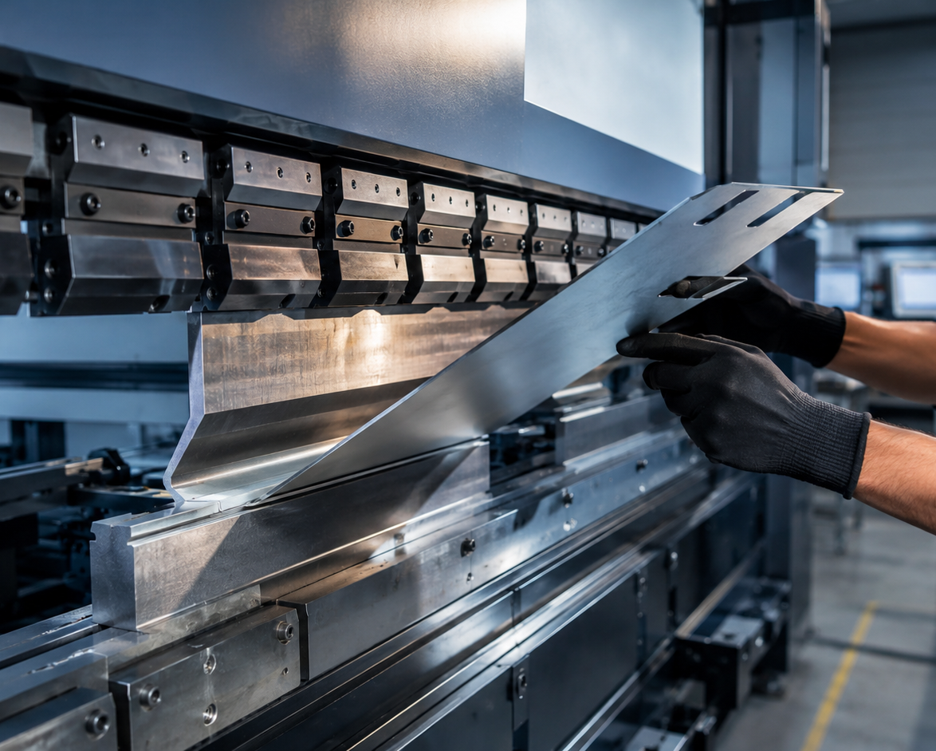
CNC bending capability
Bending quality is controlled before production, not corrected after rejection.
Bending control points
✓
Minimum flange and bend feasibility review
✓
Punch / die selection record
✓
Bend sequence approval
✓
First bend angle approval
✓
Tool marks, cracks and reverse bend checks
Result: predictable dimensions, fewer reworks and cleaner formed parts.

Slide 6
Engineering support that reduces customer effort
We help convert drawings into manufacturable sheet-metal parts.
01
Drawing review
Material, thickness, bend notes, tolerance and revision check.
02
DXF cleanup
Scale, duplicate entities, open profiles and layer review.
03
Flat pattern check
Bend allowance, K-factor and development approval.
04
Bend feasibility
Minimum flange, hole-to-bend distance and tooling clearance.
05
Revision control
Latest file confirmation before production release.

Slide 7
Customer workflow
A simple production flow designed for speed, clarity and traceability.
Enquiry
Review
Cut
Bend
Inspect
Dispatch
Drawing / DXF / quantity
Feasibility + quote
Nesting + first piece
Tooling + sequence
Dimensional + visual
Packing + reports
Traceability is captured at each stage: customer PO, drawing revision, material heat number, program file, operator, inspection and dispatch.

Slide 8
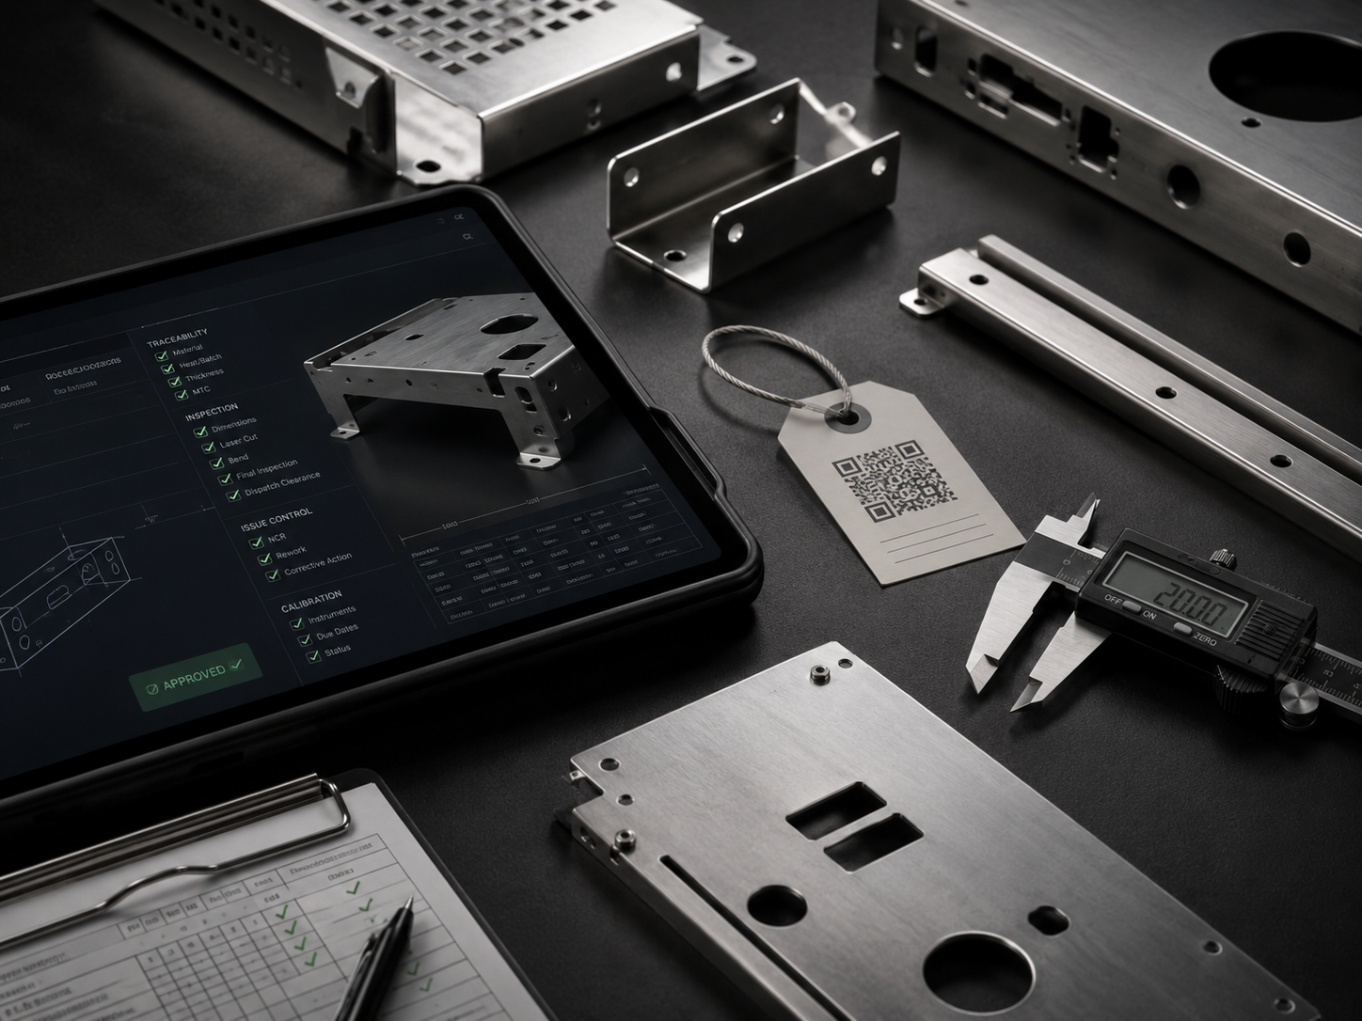
Quality documentation customers can trust
Simple forms for operators. Professional records for customers.
✓
Material traceability
Grade, thickness, heat/batch number and MTC tracking.
✓
Inspection records
Laser cut, bend dimension, final inspection and dispatch clearance.
✓
Issue control
NCR, rework, customer deviation and corrective action format.
✓
Calibration control
Instrument list, due dates and status visibility.

Slide 9

WHY CUSTOMERS CHOOSE
01
02
03
04
Speed
Clarity
Control
Support
Quick quotation, planned cutting and tracked dispatch.
Simple communication from drawing review to delivery.
First-piece approvals, inspection and document records.
Design and manufacturing feedback from an engineering team.

Slide 10
Engagement models
Flexible options based on your requirement and volume.
Prototype support
Production job work
Development partner
Small quantities, quick DXF review, sample development and feedback.
Repeat batches with fixed parameters, inspection records and delivery plan.
Design review, flat pattern, bend feasibility and product-to-production support.
NEW PARTS
REPEAT WORK
ENGINEERING

Slide 11
For fastest quotation
Send complete inputs once. We will take it forward systematically.
☐
Drawing / DXF
PDF drawing + DXF flat pattern / 3D file if available
☐
Material
Grade, thickness, finish and certificate requirement
☐
Quantity
Prototype, trial batch or production volume
☐
Operations
Cutting only / cutting + bending / fabrication / finishing / secondary processes
☐
Delivery
Required date, packing instruction and dispatch address
Tip: Latest drawing revision and clear tolerance notes avoid delay and rework.

Slide 12
Industries we serve
Precision sheet-metal solutions for product companies, machine builders and production teams.
01
Machine Builders & SPM
02
Automation & Robotics
03
Electrical Panels
04
Medical Equipment
Frames, guards, covers, brackets, machine panels and custom sheet-metal parts.
Robot cells, sensor brackets, automation enclosures, conveyors and fixtures.
Control cabinets, panel doors, gland plates, cable trays and busbar supports.
Clean sheet-metal parts, covers, carts, brackets and equipment enclosures.
05
Automotive & EV
06
Aerospace & Defense
07
Architecture & Interiors
08
Product Development
Prototype parts, production brackets, battery support plates and assembly fixtures.
High-accuracy plates, brackets, covers and low-volume precision fabrication.
Decorative panels, signage, partitions, railings and custom metal features.
Fast prototypes, DFM support, pilot builds and repeatable small-batch production.
Ideal for customers who need quality, speed and engineering support — not just cutting.

Slide 13

LET’S BUILD
BETTER SHEET-METAL PARTS.
Laser Cutting • CNC Bending • Fabrication Support • Quality Documentation
| Mysore
Phone: 7975525982 / Email: spindelx @gmail.com/ Website: www.spindelx.com

