Slide 1
Monitoring Basics Prometheus and Grafana
Chethan Gatty
July 16, 2020

Slide 2
Requirement for monitoring
Bottlenecks in Troubleshooting
Ensure business-critical applications run smoothly
Monitor unusual network activity
Control the use of resources

Slide 3

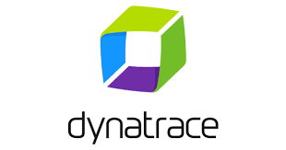

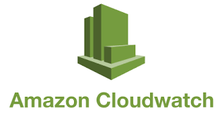



Monitoring Basics
Logs vs Metrics
A log is a system generated set of data when an event has happened to describe the event.
Metrics are a measurement at a point in time for the system
A log is an event that happened and a metric is a measurement of the health of a system.
Monitoring Tools

Slide 4
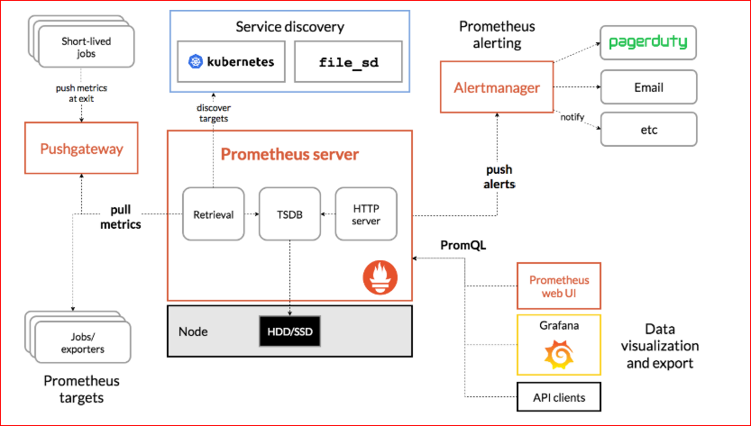
Monitoring Basics
Prometheus is an open-source systems monitoring and alerting tool.
Grafana is an Open source visualization and analytics software which turn your time-series database (TSDB) data into beautiful graphs and visualizations

Slide 5

Demo

Slide 6
Thank you.
Chethan Gatty

