Slide 1
Efficient Online and Batch Learning using
Forward Backward Splitting
J. Duchi, Y. Singer
Journal of Machine Learning Research, 2009
中田研究室
12M42340 張 志鋒

Slide 2
What is Machine Learning
Regression
回帰問題
Classification
分類問題

Slide 3
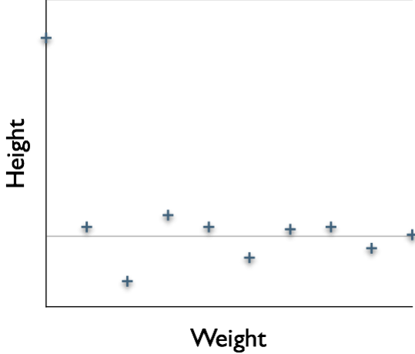
What is Machine Learning
Weight | Height
1 | 5
4 | 0
2 | 5
7 | 2
8 | 4
... | ...
4 | ?
Prediction
Regression

Slide 4
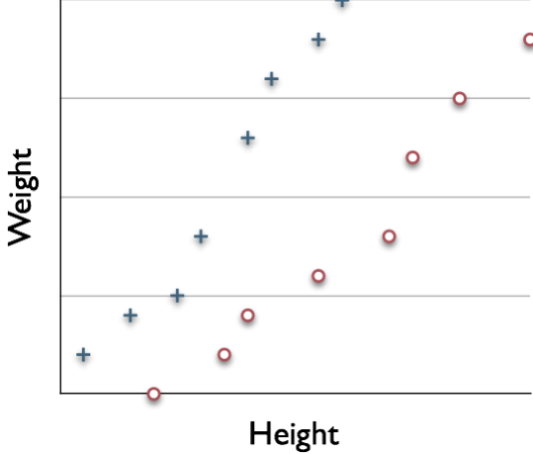
What is Machine Learning
Class A
Class B
Weight | Height | Class
1 | 5 | A
4 | 0 | B
2 | 5 | A
7 | 2 | B
8 | 4 | B
... | ... | ...
4 | 6 | ?
Prediction
Classification

Slide 5

Formulation of Machine Learning
Loss function
Classification
Regression
Regularizer
The Goal is to minimize this loss function with regularizer,
yielding a regularized sparse solution

Slide 6
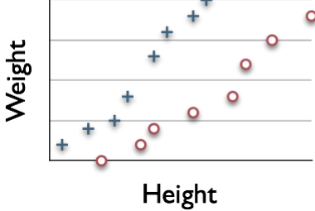

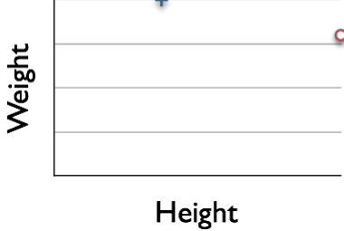
Learning
Weight | Height | Class
1 | 5 | A
4 | 0 | B
2 | 5 | A
7 | 2 | B
8 | 4 | B
...
5 | 3 | A ? B
8 | 4 | A ? B
...

Slide 7
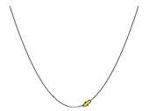
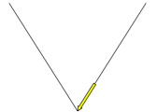
What is the problem?
For Sparsity
Convex &
Differentiable
Convex but
Non-differentiable
凸かつ微分可能
凸かつ微分不可能

Slide 8
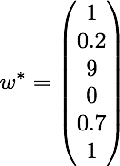
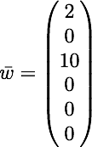
What is the problem?
A sparse matrix is a matrix populated
primarily with zeros
Accurate
Sparse
正確さ
Trade-off
疎性
In machine learning, we prefer sparse solutions

Slide 9
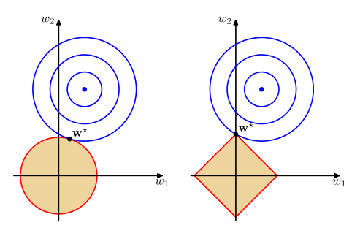


What is the problem?

Slide 10
Approaches of Machine Learning
Batch learning
Online learning

Slide 11

Batch Learning
Weight | Height | Class
1 | 5 | A
4 | 0 | B
2 | 5 | A
7 | 2 | B
8 | 4 | B
...
5 | 3 | A ? B
8 | 4 | A ? B

Slide 12







What is Batch Learning
Class A
Class B

Slide 13

What is Online Learning
Weight | Height
1
1 | 5
2
4 | 0
3
2 | 5
4
7 | 2
5
8 | 4
...
...
t
5 | 3

Slide 14
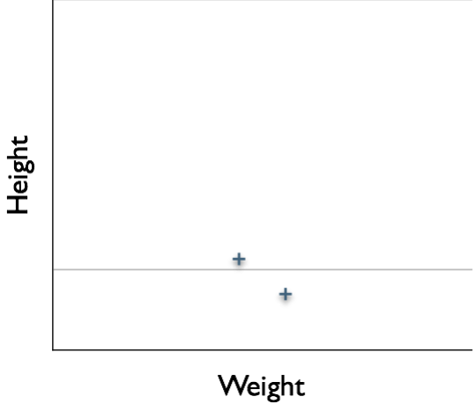



What is Online Learning
Add Data 2
Regression

Slide 15
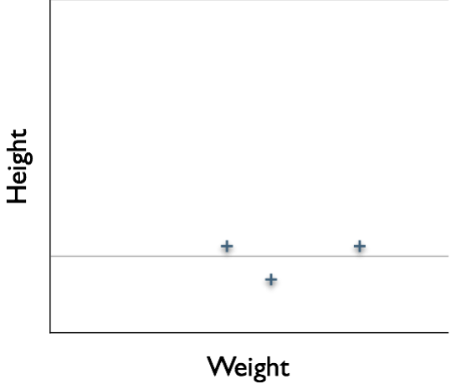




What is Online Learning
Add Data 2
Add Data 3
new data
Regression

Slide 16




What is Online Learning
Add Data 2
Add Data 3

Slide 17

What is Online Learning
Add Data 2
Online Learning
Add Data 3
Add Data 4
Batch Learning
Add Data 5
...
Save Memory
Easy to re-learn
Add Data t

Slide 18
How to update?
That is the question

Slide 19
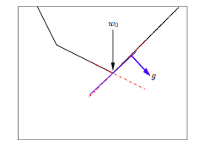
The Fobos Algorithm
Classical method: Subgradient method

Slide 20
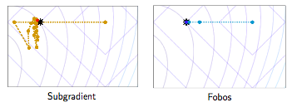
The Fobos Algorithm

Slide 21

The Fobos Algorithm
step 1
step 2

Slide 22
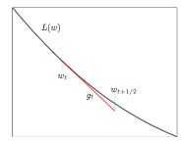
The Fobos Algorithm
Step 1: minimize Loss

Slide 23

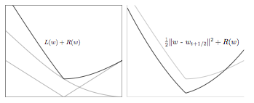
The Fobos Algorithm
Step 2: Regularization

Slide 24
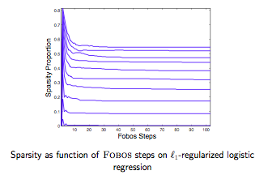
Sparsity

Slide 25
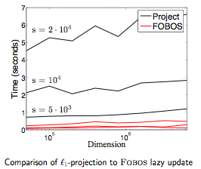
Sparse timing experiments

Slide 26
Conclusions
General framework for stochastic gradient with regularization.
Lazy updates for efficency in high dimensions
Fobos is efficient for online learning with sparse data

Slide 27
In my opinion
The approach of Fobos to Forward-Backward Splitting is interesting.
It should be faster if put structural assumptions of problem in it.

