Slide 1
Main Purpose: Monitoring Data from a Trading Bot
CK - Create, Update, Retrieve and Delete Watchlist of Instruments
Homepage – General Info, Signup and Login
Streaming Live Chart
Retrieve/View Tick Data
Email/Telegram Sent when Trading Alert Levels hit
Retrieve/View 30-min Interval Bollinger Bands Data
Create, Update, Retrieve and Delete Trading Alerts
Retrieve/View Current Positions
Bot Killswitch
Retrieve/View Trading History + PnL

Slide 2

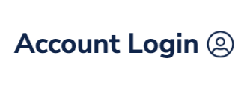
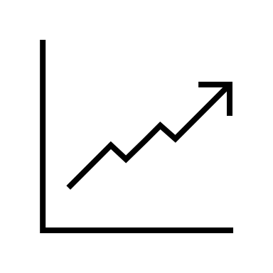


Home Dashboard Alerts
Algo Viewer
Easily Monitor a Live Quantitative Trading Bot
Track a
Live Streaming Chart
Access Tables of Financial Data
Set Alert Levels and Get Notified via SMS/Telegram
This is a paragraph describing briefly how the algorithm works, what instruments its trading, and maybe a disclaimer on how the information here shouldn’t be perceived as financial advice etc.

Slide 3
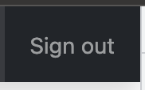

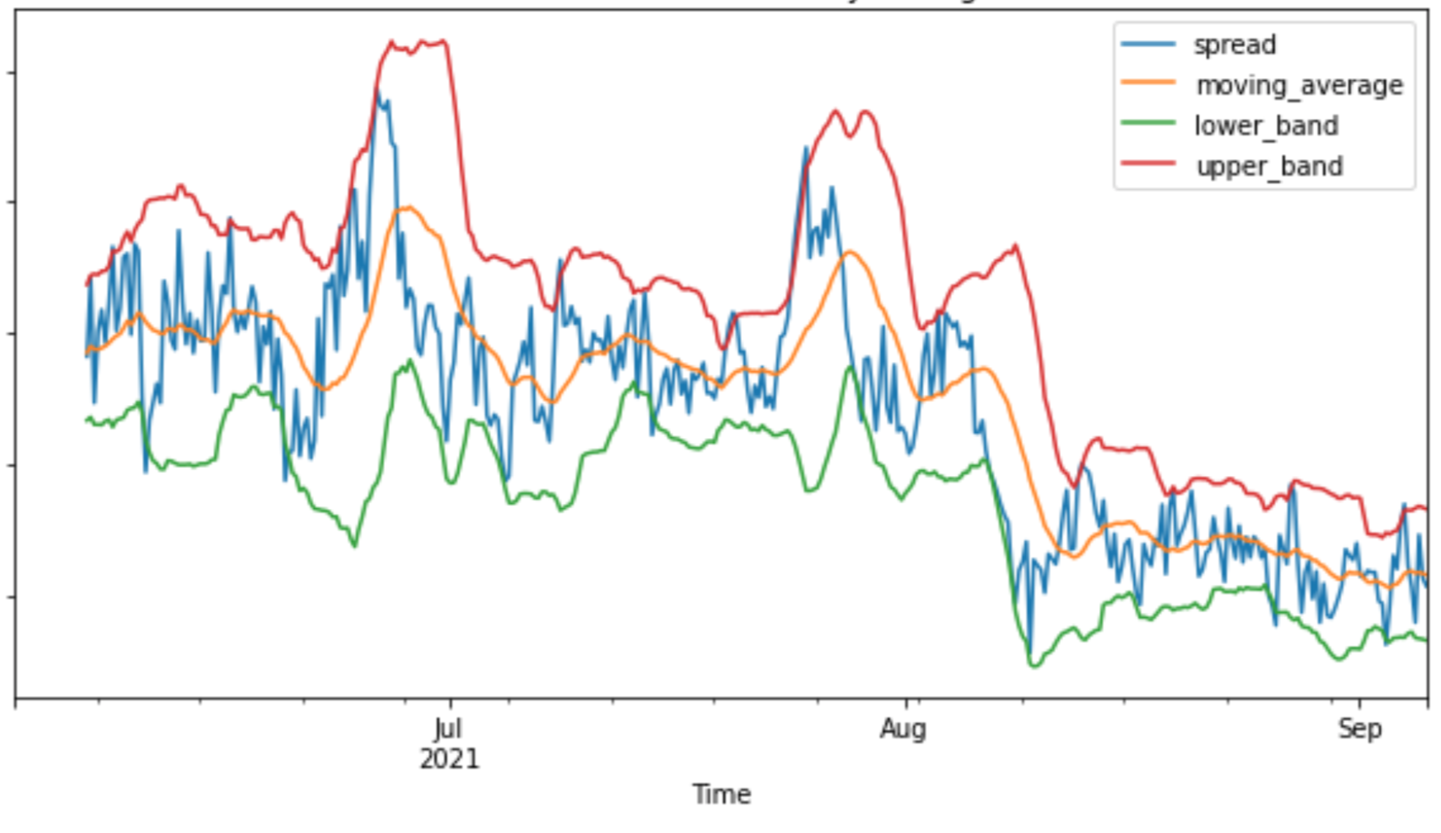
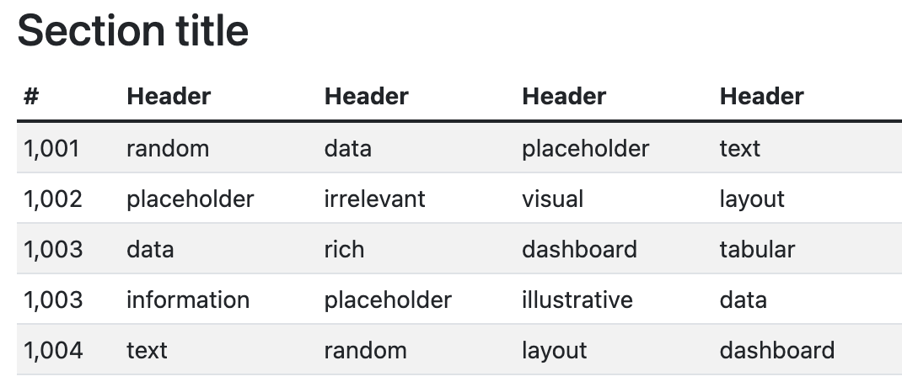
Home Dashboard Alerts

Slide 4

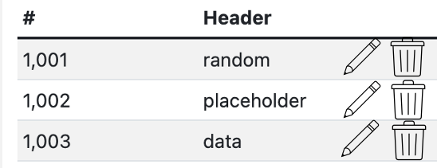
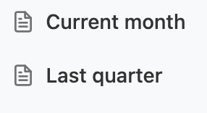
Home Dashboard Alerts
Saved Alerts

Slide 5
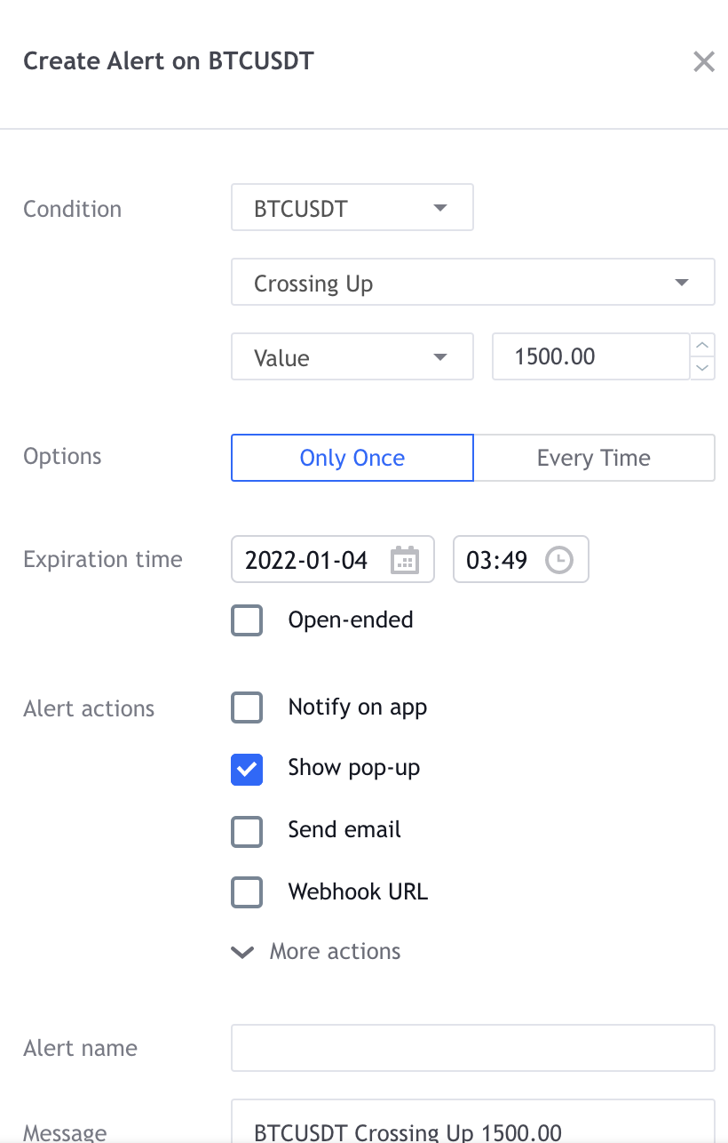
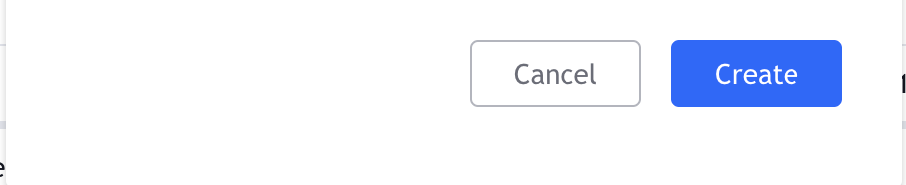
Home Dashboard Alerts
Saved Alerts

Slide 6

Home Dashboard Alerts
Saved Alerts

