Slide 1
Main Purpose: Monitoring Backtests for a Trading Bot
Homepage – General Info, Signup and Login
Choose Backtests: all instruments OR custom triplets
ROI Charts for each instrument triplets backtested
Retrieve/View backtest data: ROI, net ROI, commissions, half-life, start date, end date and backtest created date
Create, Update, Retrieve and Delete starting balance and PNL

Slide 2

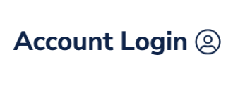
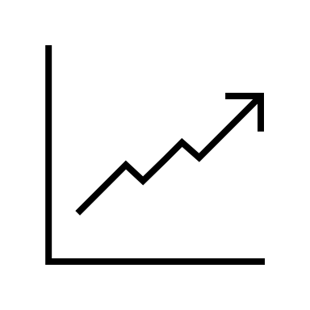


Home Dashboard Alerts
Algo Viewer
Easily Monitor a Live Quantitative Trading Bot
Track a
Live Streaming Chart
Access Tables of Financial Data
Set Alert Levels and Get Notified via SMS/Telegram
This is a paragraph describing briefly how the algorithm works, what instruments its trading, and maybe a disclaimer on how the information here shouldn’t be perceived as financial advice etc.

Slide 3
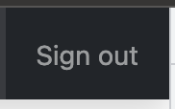

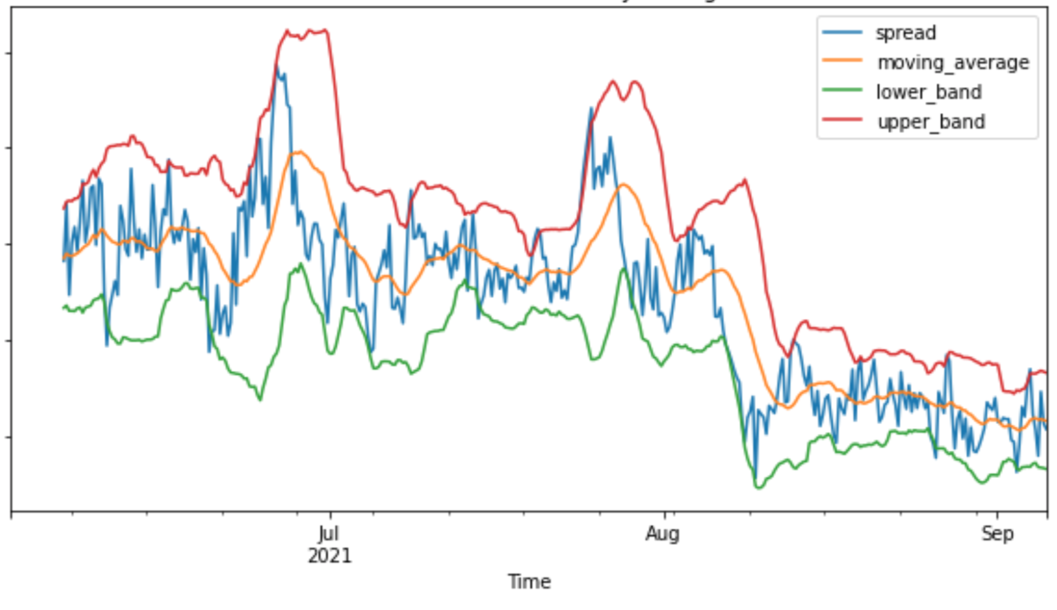
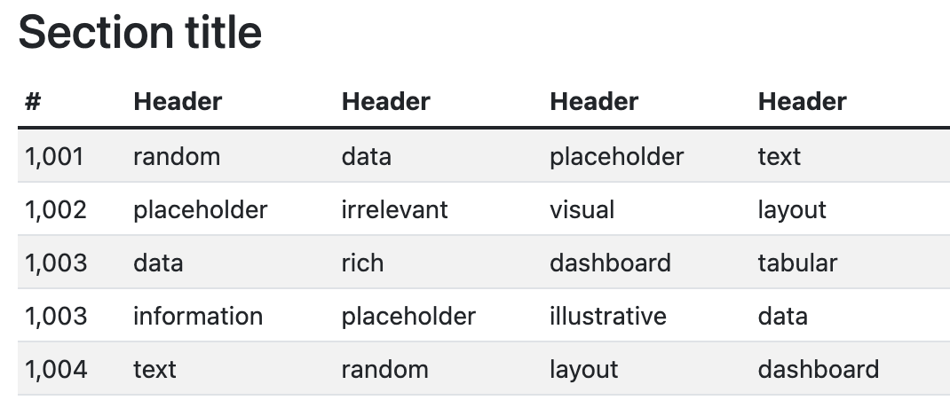
Home Dashboard Alerts

Slide 4

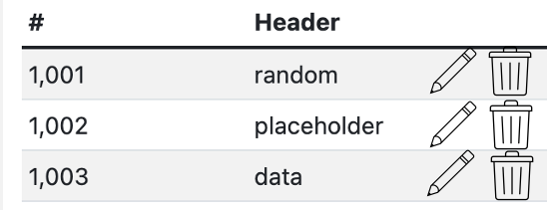
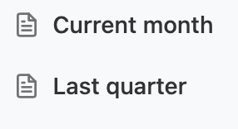
Home Dashboard Alerts
Saved Alerts

Slide 5
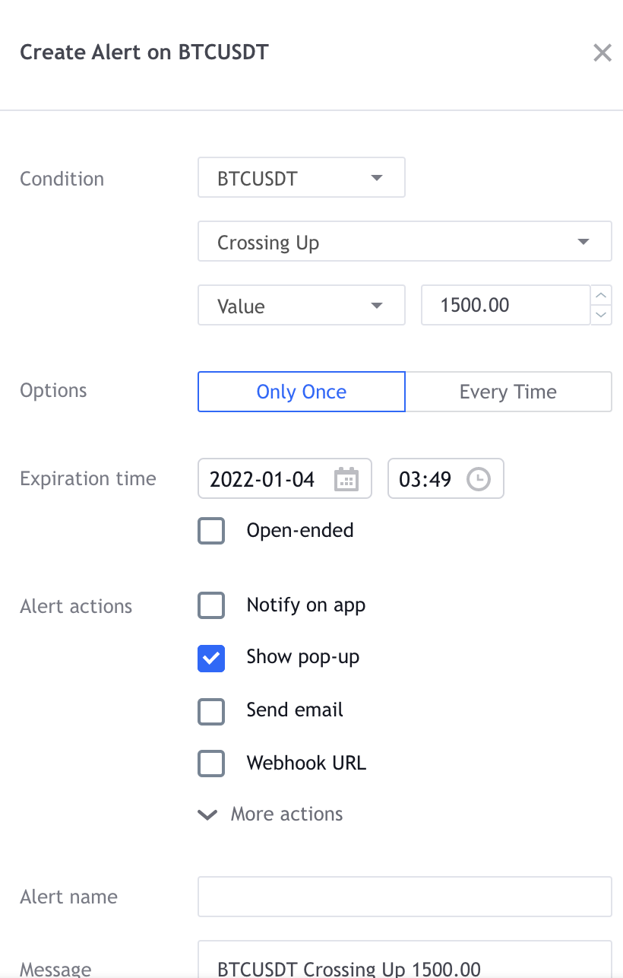
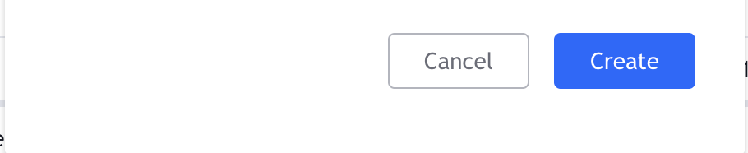
Home Dashboard Alerts
Saved Alerts

Slide 6

Home Dashboard Alerts
Saved Alerts

