Slide 1
Otters vs Koels: Tower Defense Game
Start Game:
Place towers which cost points on column – across 4 rows
Start Round
“Plants vs Zombies” clone: fixed number of enemies spawn from right hand side on grid, slowly advancing to left hand side
towers shoot and kill them with enemies HP reduction shown
Enemies killed generate more points
Points used to buy more towers
Round is over when all enemies are all killed or 1 makes it to the end
New round begins
Survive 5 rounds, and you win the game
Homepage – Instructions, Signup and Login
Must Login to Play
“High Score” Scoreboard per User per Game stored in table, can be viewed after victory/game loss

Slide 2


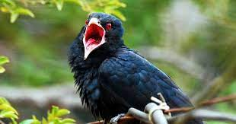
Homepage
Otters vs Koels
Defend the Otters from the Avian Invaders
How to Play:
Signup or Login
Place towers which cost points on column ….
….

Slide 3

Homepage
Account Login

Slide 4
Start Round 1
Homepage
Welcome Back, Bishan10Godfather
How to Play:
Place towers which cost points on column ….
….

Slide 5
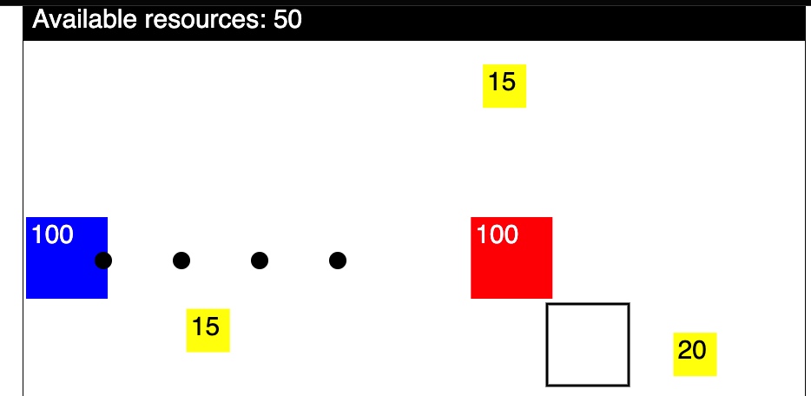
Start Round
Homepage
Welcome Back, Bishan10Godfather
Round 1

Slide 6
Start Round 2
Homepage
Welcome Back, Bishan10Godfather
Congrats! You won Round 1. Ready for Round 2?

Slide 7
Start New Game
Homepage
Welcome Back, Bishan10Godfather
GAME OVER

Slide 8
Start New Game
Homepage
Welcome Back, Bishan10Godfather
CONGRATS, YOU PREVAILED AGAINST THE KOELS!!!

Slide 9
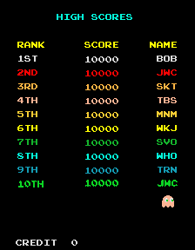
Start New Game
Homepage
Welcome Back, Bishan10Godfather

