Slide 1
“Cards Against Humanity” SG clone – multiplayer voting-loop card game
Start Game:
Multiplayer by default – players can join simply by opening URL
Start Game, URL generated, send to friends,
no new players can join the game after the Round Begins – need 3 players minimum, max 5
Cards Against Humanity game loop with SG answers, but Computer is Dealer.
Players draw 10 cards
Computer-dealer shows question card
Each player picks what they think are the funniest answers
Everyone else votes for the funniest card submissions
You can’t vote for your own card
The winner of that round is the one with the highest number of votes on their card
First to 10 rounds won, wins game
Homepage – Instructions, not strict “signup” but anyone can join on the websocket and throw their name in
“High Score” Scoreboard per User per Game stored in table, can be viewed after victory/game loss

Slide 2

Politically Incorrectness, Singapore
Pick & Vote for The Funniest Answers
How to Play:
…
….
Graham
Enter Your Name to Start A Game!

Slide 3
Politically Incorrectness, Singapore
Pick & Vote for The Funniest Answers
How to Play:
…
….
Graham
Enter Your Name to Start A Game!
Copy and paste this URL to allow friends to join: http://gameurl.com/abc

Slide 4
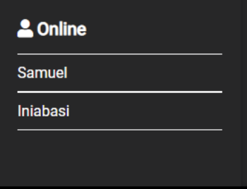
Politically Incorrectness, Singapore
Start Game!
Pick & Vote for The Funniest Answers
How to Play:
…
….

Slide 5

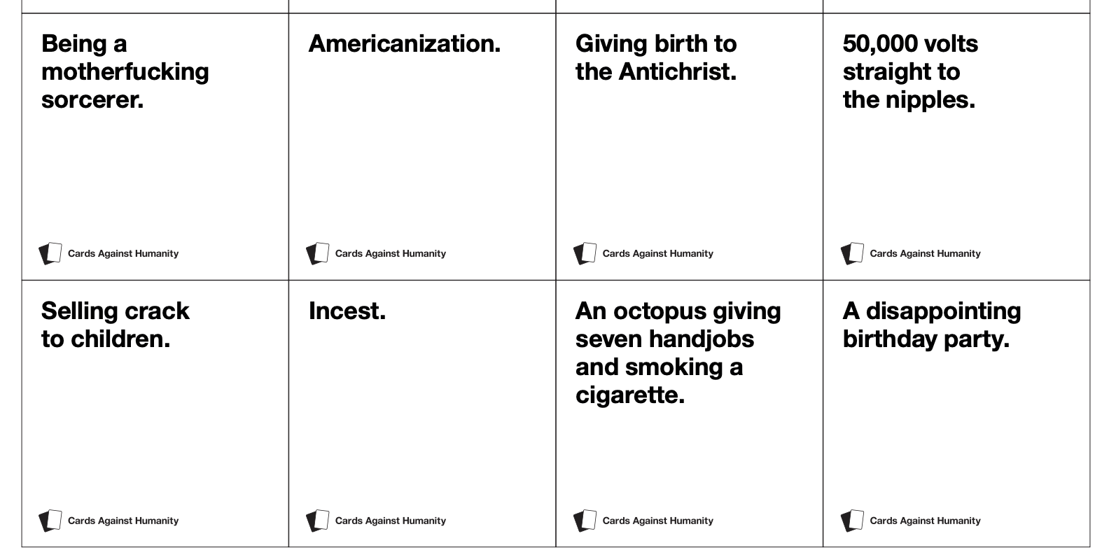
Politically Incorrectness, Singapore
Choose 1 Card

Slide 6
Politically Incorrectness, Singapore
Choose 1 Card

Slide 7


Politically Incorrectness, Singapore
Vote For The Funniest Card (yours is excluded)

Slide 8
Politically Incorrectness, Singapore
Vote For The Funniest Card (yours is excluded)
3 Votes, Player 2 WINS!
0 Votes

Slide 9
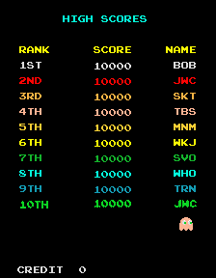
Start New Game

