Slide 1

Scaffold-Based Analytics to Enable Hit-To-Lead Decisions
Applying data science / analytics / visualization to large chemical datasets in drug discovery
Deepak Bandyopadhyay
Sr. Scientific Investigator, Advanced Manufacturing Technology Informatics, GlaxoSmithKline 709 Swedeland Rd, King of Prussia, PA 19406
Thanks to:
Lena Dang and Josh Swamidass,
Rajarshi Guha, Zangdong He, Stephen Pickett, Martin Saunders, Nicola Richmond, Darren Green, Eric Manas, Todd Graybill, Rob Young, Mike Ouellette, Stan Martens, Javier Gamo, Lourdes Rueda
Constantine Kreatsoulas, Pat G. Brady, Joe Boyer, Genaro Scavello, Dac-Trung Nguyen, Tyler Peryea, Ajit Jadhav
GSK NCATS/NIH WUSTL

Slide 2
Outline
Background and Introduction
Drug Discovery, Screening, Hit Triage, Clustering
Methodology and Applications
Overlapping Scaffolds concept; Spotfire Visualization / Navigation
Use cases: prioritizing chemical series; improving molecule properties; merging datasets
Statistical Framework
Comparing structure & activity ontologies
Conclusions & Future Work

Slide 3
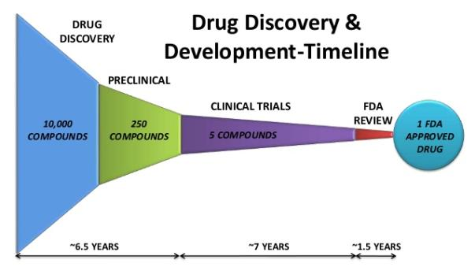
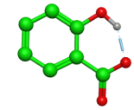


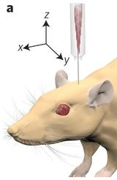

Drug Discovery Parts/Timeline
Focus of Drug Discovery
Narrow down on one or a few substances to test in humans and develop into a drug that treats a disease
Components:
MILLIONS /
BILLIONS OF COMPOUNDS
SCREENED
Slideshare.net
iterate
Target Selection and Validation
Screening (Lead Discovery)
Medicinal Chemistry (Lead Optimization)
In Vitro Biology
In Vivo Biology
target
genome
disease

Slide 4
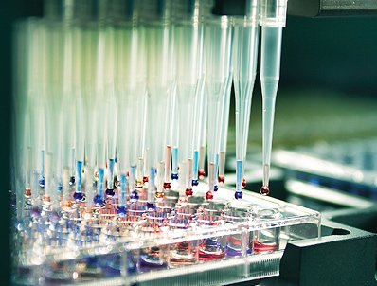
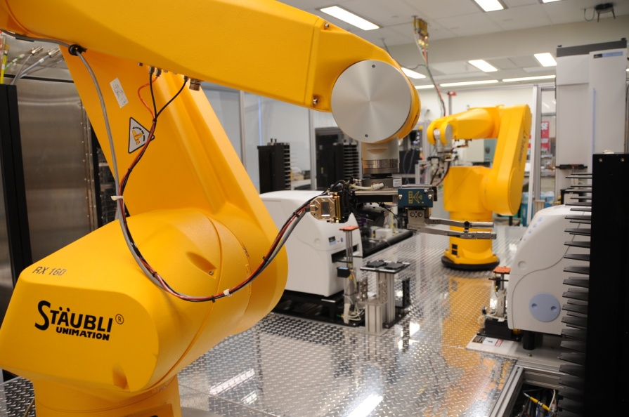
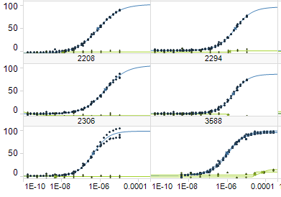
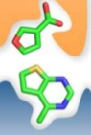
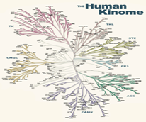
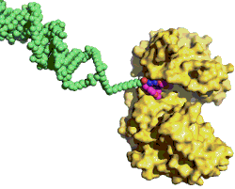
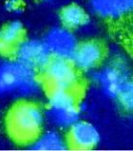
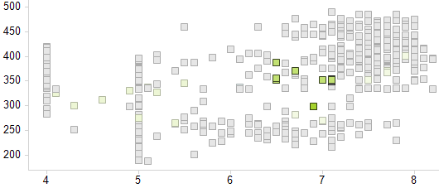
Hit-To-Lead Discovery at GSK
High-throughput screening
(HTS)
millions of chemically diverse compounds
Robotics and automation
Other types of screening we use
Fragments Focused DNA-encoded library Phenotypic
Output: (lots of) bioactivity & property data!
Response
Concentration
Property
Activity
Slideshare.net

Slide 5
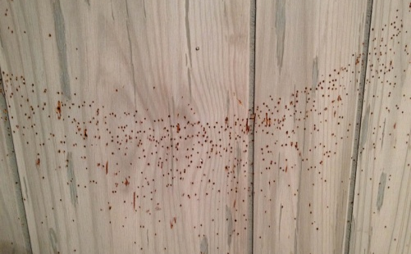

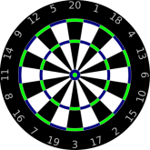
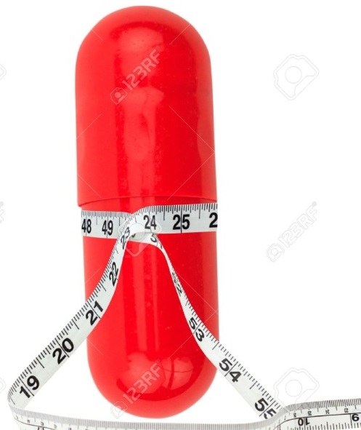
Criteria for Hit Triage
Isolate good chemical starting points and weed out bad ones
Bioactivity is often denoted “pIC50” *
↑ higher is better
Potency Criteria
Bioactivity
Selectivity
Promiscuity
Developability Criteria (related to ease of drug development)
Physical/Chemical Properties often predictive, e.g.
Molecular Weight (↓, lower is usually better)
Lipophilicity (↓)
Solubility/permeability (↑)
Good properties predict better drug development outcomes
Hits Target
Avoids Off-Target
Promiscuity is often denoted “IFI” (Inhibition Frequency Index)
IFI = # targets Hit *100
# targets Tested
↓ lower is better
Does not hit many proteins that are unrelated to primary activity!
* IC50 = 50%-inhibitory concentration pIC50 = -log₁₀(IC50)

Slide 6
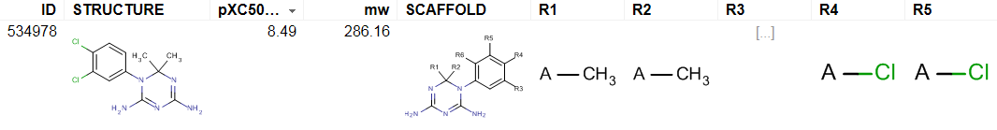
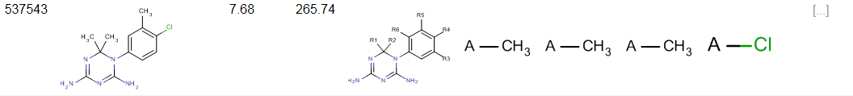
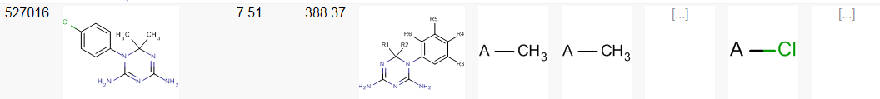
Structure-Activity Relationships (SAR): Medicinal Chemists’ “Core” Data Science
SAR hypothesis: measurable properties and bioactivity of a molecule are related to its chemical structure
Often visualized in a SAR Table:
Split molecule: fixed core/scaffold, variable R-groups
View spreadsheet with molecular structures, Cores/R-groups and Activity/Property Data
y = f(x)
R₁
R₂
core
x
y
factors of x
Cycloguanil
active metabolite of malarial drug Proguanil
GSK anti-malarial dataset (Nature 2010), 13.5k compounds

Slide 7
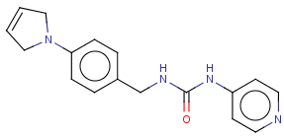
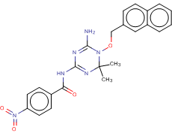
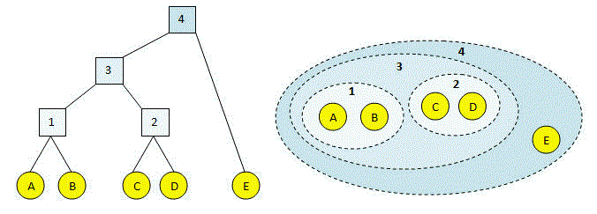
Automation is Necessary for Large Datasets
Manually created SAR tables do not scale to screening datasets
HTS hits comprise 5-50k molecules, with 1000’s of cores/scaffolds!
Traditional cheminformatics solutions for automation:
Chemical Fingerprint (Molecule to Bit String based on features) :
Manual Substructure Searches
C=CCNc
E.g. Map atomic paths to bits in fingerprint
C=CCN
cccCN
C=CC
Nccc
C=C
cccCN
Nccc
0000100…1010001…0010000…0000001…
Fingerprint Similarity
Tanimoto Coefficient:
# both bits 1 / # either bit 1
Clustering by Similarity
Hierarchical Agglomerative
Substructure1
SAR Table 1
Substructure3
SAR Table 3
Substructure2
SAR Table 2
A
A & B
B only
A:
1s
1s
0s
Manually Merge Results
B:
0s
1s
1s
Image: http://www.drive5.com/usearch/manual/agg.html

Slide 8

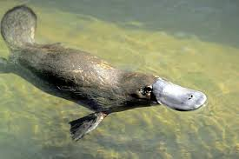
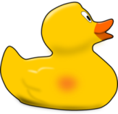


Limitations of Clustering
seals (fur)
ducks
(bill)
?
?
?
?
penguins (flipper)
singleton
Placing a Molecule in a single cluster can be limiting
Notes:
Adding the hier does not fix the agg isues, only adds complexity in navigation . Things at different levels may not be matched

Slide 9
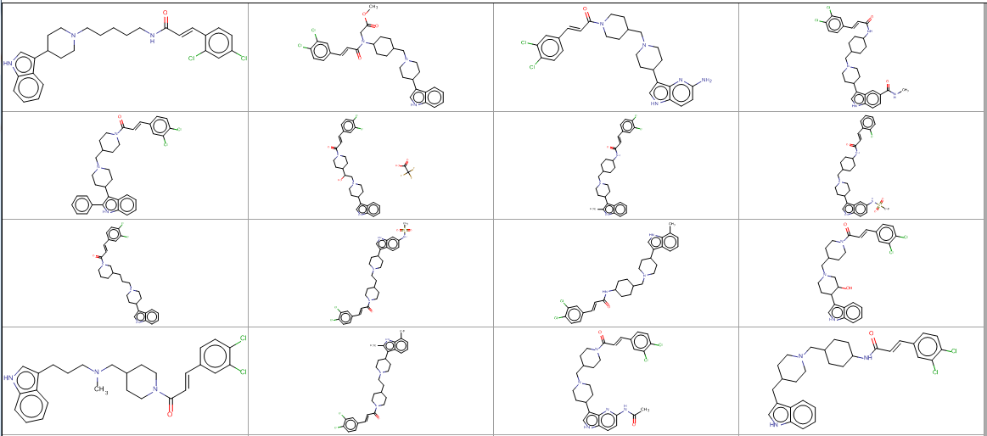
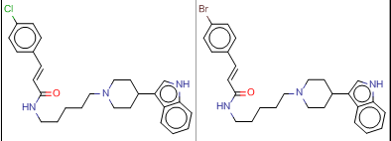
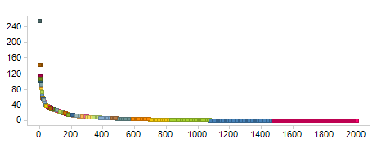
Limitations of Clustering
Clustering can create non-ideal partitions and miss connections
Some example molecules from Complete Linkage cluster 3 in GSK anti-malarial dataset
similar molecules ≠ same cluster
Many singletons
Cluster 3
Cluster 10
Cluster Size
?
Complete Link Cluster ID
GSK anti-malarial dataset (Nature 2010), 13.5k compounds
Notes:
Adding the hier does not fix the agg isues, only adds complexity in navigation . Things at different levels may not be matched

Slide 10
Outline
Background and Introduction
Drug Discovery, Screening, Hit Triage, Clustering
Methodology and Applications
Overlapping Scaffolds concept; Spotfire Visualization / Navigation
Use cases: prioritizing chemical series; improving molecule properties; merging datasets
Statistical Framework
Comparing structure & activity ontologies
Conclusions & Future Work

Slide 11
Automatic Decomposition into (All) Overlapping Scaffolds
Molecule
Malarial parasite assay pIC₅₀ 8.1
Scaffold(s)
Related Molecules
2 total
…
49 total
…
226 total
GSK anti-malarial dataset (Nature 2010), 13.5k compounds
Notes:
What I will be describing is a method that exhaustively finds all possible shared (or common or frequent) substructures – which we call scaffolds within your data set using a tool from the NIH.
Here is a screening hit that I will use to demonstrate this.
… (don’t need to go into gory details)
Biaryl substructure is contained in these molecules that have low similarity to the original hit molecule.

Slide 12
Next Step: Combine with Activities and Properties
Molecule
Avg pIC₅₀
8.15
Avg pIC₅₀
7.8
Avg pIC₅₀
7.8
Scaffold(s)
Annotation
Related Molecules
8.2
8.2
7.5
8.5
7.9
7.7
7.4
8.5
8.0
2 total
7.7
8.2
…
49 total
…
226 total
GSK anti-malarial dataset (Nature 2010), 13.5k compounds
Notes:
We can aggregate activities & properties at the scaffold-level and then drill-down to the underlying data for individual compounds to progress scaffolds of interest.

Slide 13
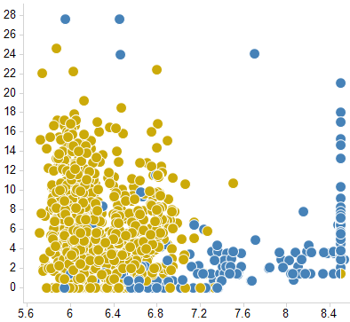

Use Case: Linking Molecules By Scaffolds
Find related molecules with improved properties
Implemented in the Spotfire visualization platform
Molecule
Data tables related to each other
Scaffold(s)
Annotation
Related Molecules
Colored by
Scaffold
← Lower promiscuity (IFI)
● > 
Keep top half of molecule, substitute bottom half
Improving pIC50 →
GSK anti-malarial dataset (Nature 2010), 13.5k compounds

Slide 14
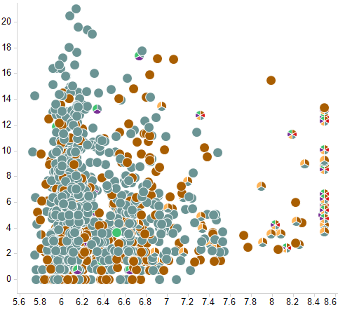




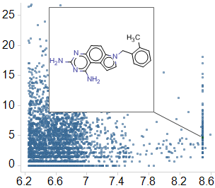







Navigating Compounds by Scaffold
Deconstructing SAR of molecules by scaffolds
Molecule
Scaffold(s)
Each pie is one compound
Each sector/color is one scaffold
Annotation
Related Molecules
IFI (promiscuity)
IFI (promiscuity)
pIC50
pIC50
GSK anti-malarial dataset (Nature 2010), 13.5k compounds

Slide 15
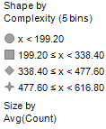
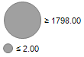
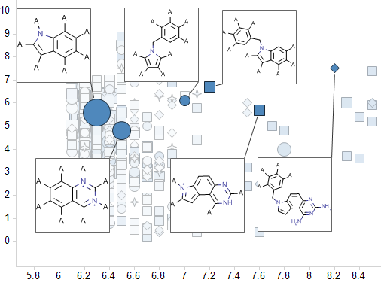
Make Decisions on Scaffolds
Scaffold aggregate activity – to prune down & progress scaffolds
Molecule
Shape by Complexity
Size by Count
(# molecules that share a scaffold)
Scaffold(s)
Annotation
Related Molecules
17 molecules
1016 mole-cules
Avg(IFI)
IFI (promiscuity)
Avg(pIC50)
pIC50
GSK anti-malarial dataset (Nature 2010), 13.5k compounds

Slide 16
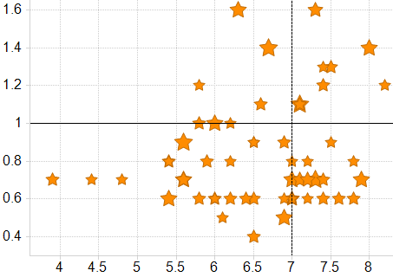
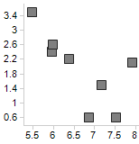

Use Case: Multiple Dataset Merging on Target “X”
Task: Combine datasets from multiple screening campaigns to identify new series
Approach: Merge datasets using scaffolds as the key
Benefits: √ find series across datasets
historical data new data
FBDD (small fragment screen) 288 pIC50s
HTS 2012 2M screened 4564 pIC50s
HTS 2014 350K top-up 3613 pIC50s
DNA ELT
130 libraries 824 features
9259
compounds
Activity data available
No activity data
Each  is one scaffold
New lead series discovered!
Selected scaffold
HTS 2014
Molecule
Improving selectivity 2 (avg) →
Scaffold(s)
Improving selectivity 2 →
Annotation
HTS 2012
Related Molecules
← Improving property 1 (avg)
← Improving property 1

Slide 17
Outline
Background and Introduction
Drug Discovery, Screening, Hit Triage, Clustering
Methodology and Applications
Overlapping Scaffolds concept; Spotfire Visualization / Navigation
Use cases: prioritizing chemical series; improving molecule properties; merging datasets
Statistical Framework
Comparing structure & activity ontologies
Conclusions & Future Work

Slide 18
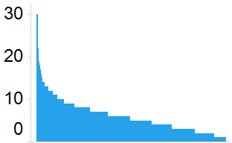
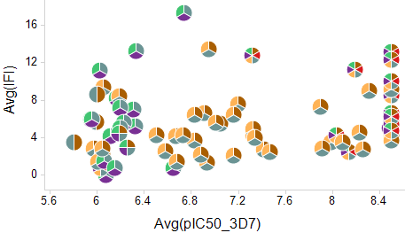
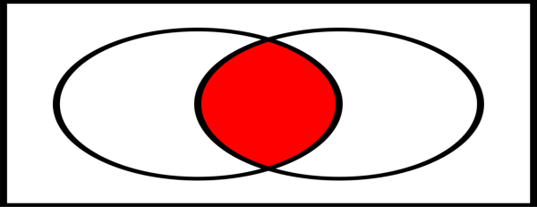
Statistical Framework to Compare Overlapping Scaffolds
1 compound (C)
6 scaffolds in compound C
“Structure group” of C (S_{c}): 80 related molecules that share >=2 scaffolds with C
How many scaffolds in each compound?
of 6k total scaffolds (S)
compound IDs (13.5k)
of 13.5k total
Scaffolds form an ontology (grouping) over molecules
Common Proportion: measure of similarity between two ontologies
Consider two structural decomposition methods S1 and S2
CP_{c} = “common proportion” for a compound C
CP_{c}(S1,S2) = (S1_{c} ∩ S2_{c}) / (S1_{c} U S2_{c})
In picture: CP_{c} = red/(red + white)
S1_{c}
S2_{c}
GSK anti-malarial dataset (Nature 2010), 13.5k compounds

Slide 19
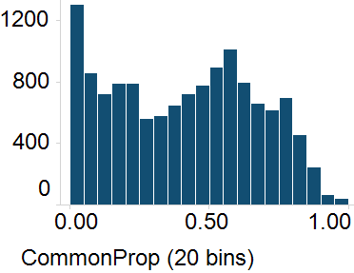
Comparing Methods for Finding Overlapping Scaffolds
We compared three methods
S1 (“Frameworks”)
S2 (“R-Group Tool”)
S3 (“Scaffold Networks”)
Some observations:
Method differences: Methods are complementary with dissimilar output for many compounds.
Method equivalence: Overall, the methods deconstruct molecules in similar ways and can be used to derive similar insights about Structure-Activity Relationships.
Modular visualization: any method that produces a map of molecules to scaffolds can be plugged in to our Spotfire framework.
Molecule
Scaffold(s)
Related Molecules
# molecules
No overlap
Almost complete overlap
S1_{c}
S2_{c}
S1_{c}
S2_{c}
GSK anti-malarial dataset (Nature 2010), 13.5k compounds
1. GSK implementation of Bemis-Murcko and RECAP frameworks
2. Scaffolds generated by the NCATS R-group tool / Scaffold Hopper
3. Output of Scaffold Network Generator (SNG) from J. Swamidass lab at WUSTL

Slide 20
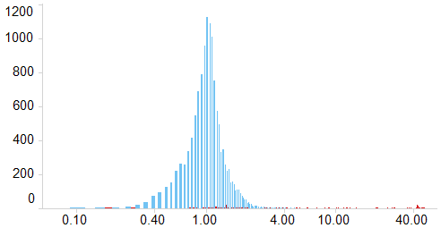

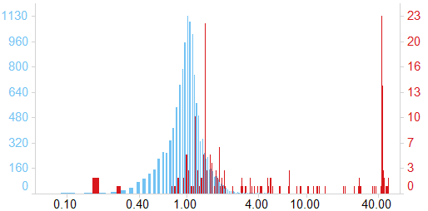
Does Structure Predict Activity? Statistical Basis of SAR
Activity similarity ontology (A):
Group compounds with similar biochemical activity
Each compound’s Activity group (A_{c}) defined to be the same size as its corresponding structure group S_{c}
Use Common Proportion to compare S with A:
CP_{c}(S,A) = S_{c} ∩ A_{c} / S_{c} U A_{c} = red/(red + white)
High values of CP_{c}(S,A) confirm presence of SAR
Normalize using random structural groups:
Norm_CP = __________CP_________ Expected CP for random S
Compound C
80 compounds in A_{c} (same size as S_{c})
pIC50
S_{c}
A_{c}
200 most potent compounds (pIC50 > 7.6) remaining compounds
All 13.5k compounds in dataset
Hit series with good SAR: Over 40x the overlap expected by chance!
Potential false +ves
Histogram of Norm_CP (1000 bins, Log scale)
GSK anti-malarial dataset (Nature 2010), 13.5k compounds

Slide 21
Conclusions and Future Directions
Data science techniques familiar to you can be optimized for chemical datasets and applied in drug discovery
Overlapping scaffold generation is a powerful way to prioritize compounds and relate data across large & diverse datasets
Many applications: discovery and cohesive visualization of chemical series; finding molecules with better properties; merging datasets
Versatile and informative visualization method - many different scaffold generation methods can be plugged in
Statistical methods can be used to correlate structural groupings with activity and identify compound families worth pursuing
Future improvements planned:
Scalability to larger and ever-changing datasets
Automated selection of informative scaffolds
Combining multiple scaffold-generation methods
Open to your ideas!

Slide 22

Q&A / Backup

Slide 23
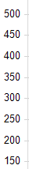
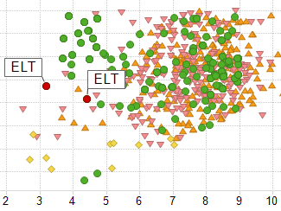

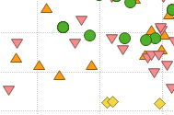
Use Case: Multiple Dataset Merging on Target “X”
Task: Combine datasets from multiple screening campaigns to identify new series
Approach: Merge datasets using scaffolds as the key
Benefits: √ find series across datasets
historical data new data
FBDD (small fragment screen) 288 pIC50s
HTS 2012 2M screened 4564 pIC50s
HTS 2014 350K top-up 3613 pIC50s
DNA ELT
130 libraries 824 features
9259
compounds
Activity data available
No activity data
√ identify promising compounds to make/test
Compounds identified and rescued!
Dataset:
Weak hit
make
Molecule
Navigate by scaffold
← lower molecular weight
Scaffold(s)
test
Annotation
Scaffold
Related Molecules
← Improving property 1

