Slide 1

Scaffold-Based Analytics to Enable Hit-To-Lead Decisions
Applying data science / analytics / visualization to large chemical datasets in drug discovery
Deepak Bandyopadhyay
Sr. Scientific Investigator, Advanced Manufacturing Technology Informatics, GlaxoSmithKline 709 Swedeland Rd, King of Prussia, PA 19406
EDITED IMAGES – for ELNB
Thanks to:
Lena Dang and Josh Swamidass,
Rajarshi Guha, Zangdong He, Stephen Pickett, Martin Saunders, Nicola Richmond, Darren Green, Eric Manas, Todd Graybill, Rob Young, Mike Ouellette, Stan Martens, Javier Gamo, Lourdes Rueda
Constantine Kreatsoulas, Pat G. Brady, Joe Boyer, Genaro Scavello, Dac-Trung Nguyen, Tyler Peryea, Ajit Jadhav
GSK NCATS/NIH WUSTL

Slide 2

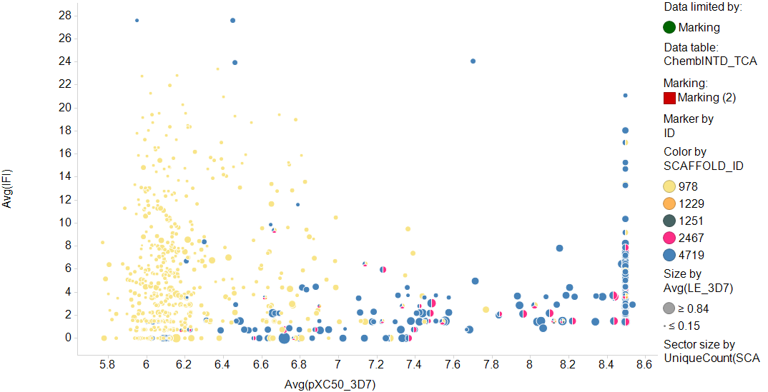
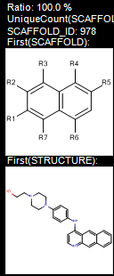
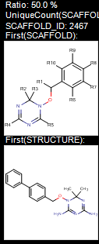
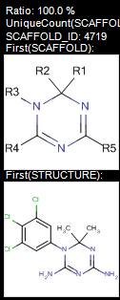
Related Molecules from NCATS R-Group Tool: Visualizing Scaffold Overlap and Activity
Hit
Prioritization
Each pie is one compound
Each sector/color is one scaffold
Scaffold 978 alone
not highly active
Co-occurring
active scaffolds
Scaffold 4719
active by itself
IFI
pXC50 in 3D7 (PF susceptible strain)
Notes:
Backup?

Slide 3
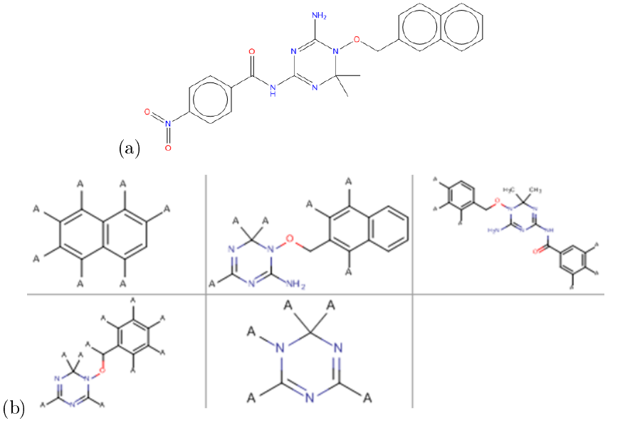
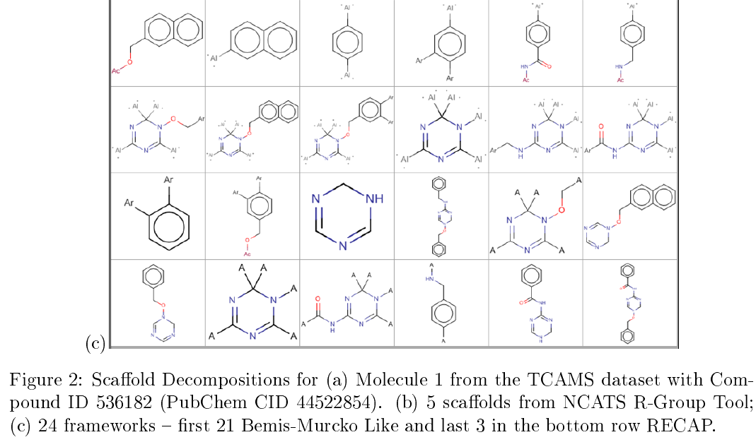
Figure 2 – SNG removed from approved version

Slide 4
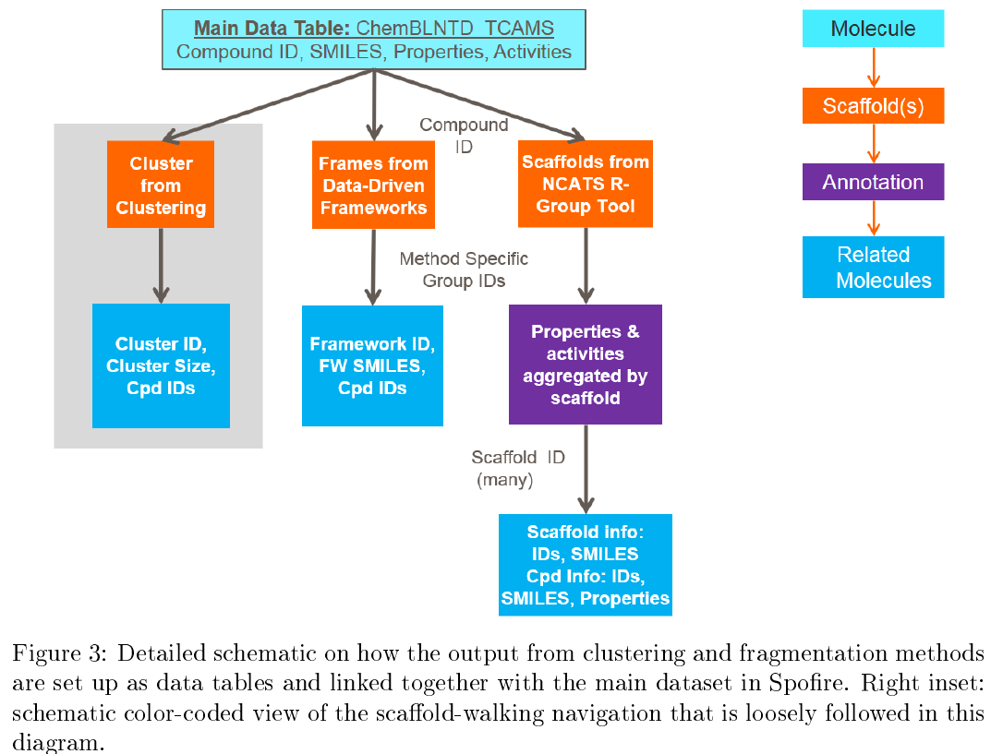
Figure 3 : Removed SNG

Slide 5
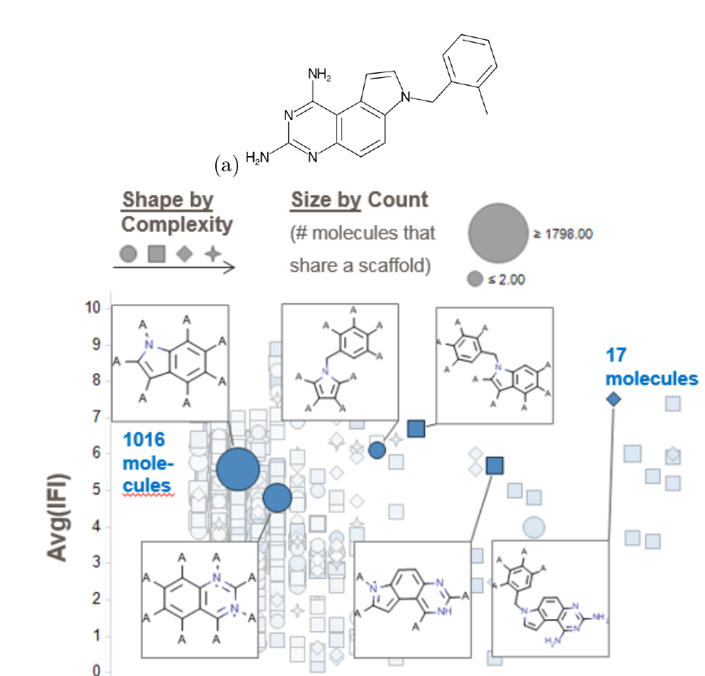
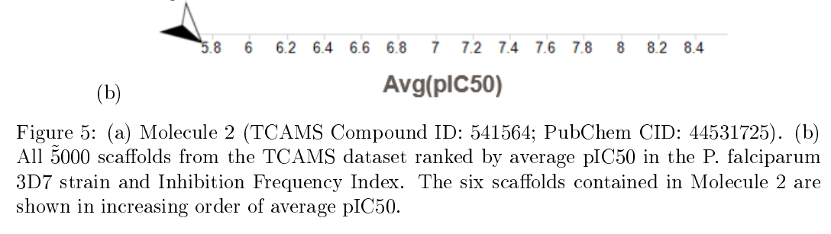
Figure 5: Added (a) molecule depiction

Slide 6
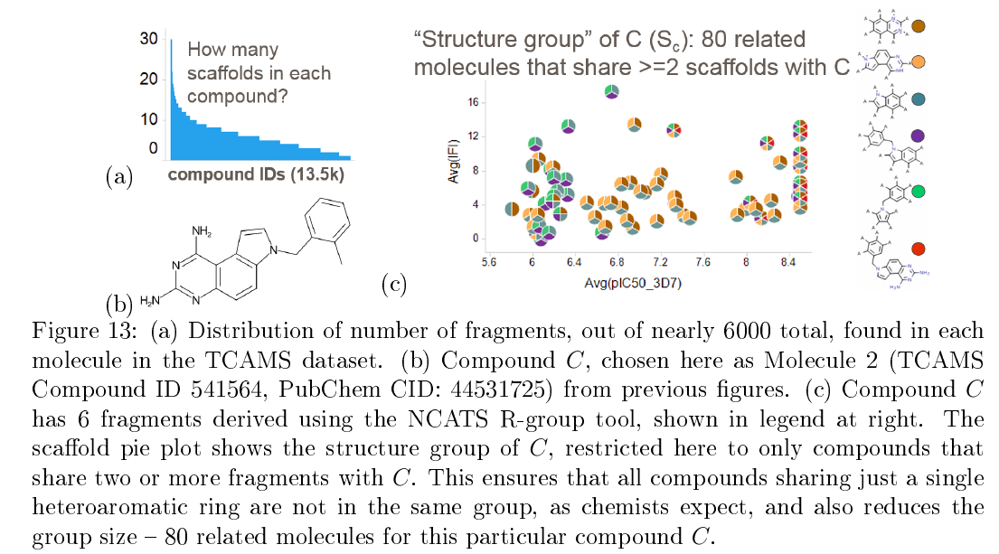
Fig 13 new version without color circles, with legend

Slide 7
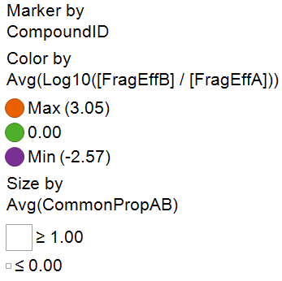
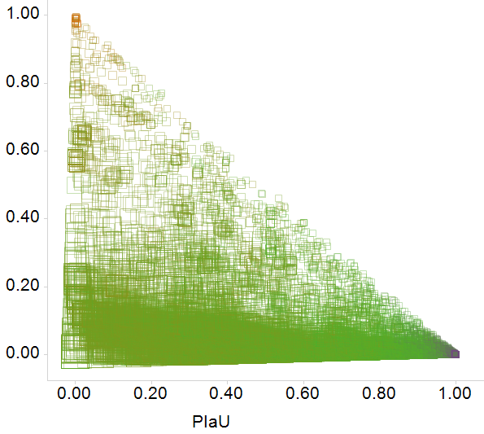
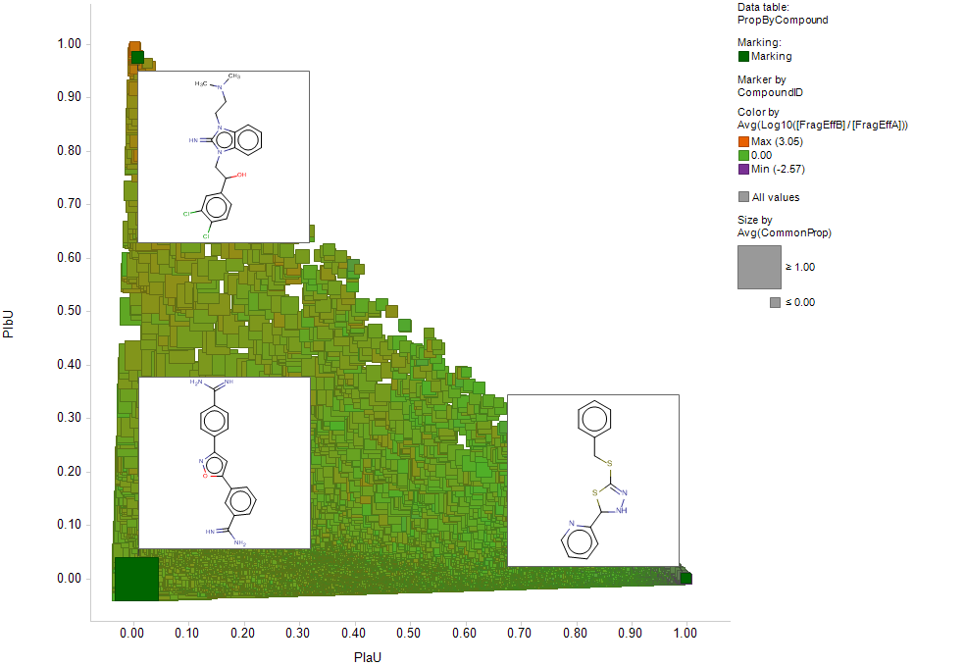
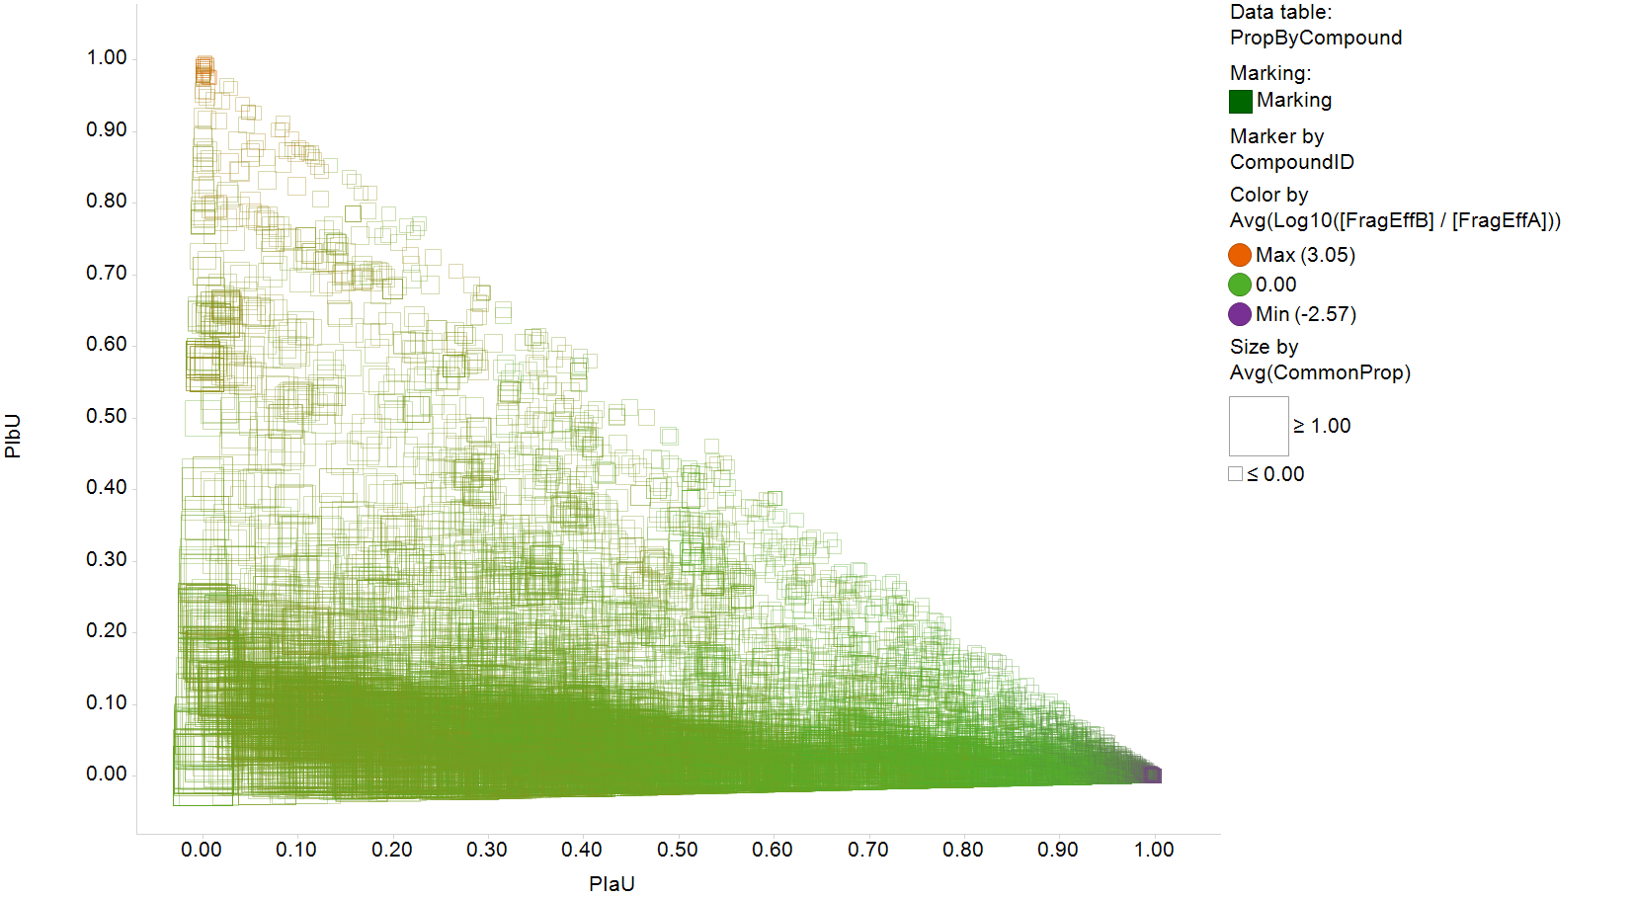
Stats FW A vs RGT B
Notes:
Stats:
The two methods allow you to access different sets of molecules starting from any molecule in TCAMS (average overlap in coverage is 40%).
On the aggregate (average/median), you can link to about twice as many molecules with the frameworks, however, this is because on the aggregate there are 6 times more frameworks than NCATS scaffolds, so the “fragment efficiency” is actually 3 times greater for NCATS scaffolds. One could also argue that many of the framework-only links (eg. variously decorated benzene rings) are not useful.
The outliers are interesting: compounds in a rare tautomer are unified with the dominant one by the NCATS tool, but left as singletons by the frameworks. And compounds whose only link with other molecules would be eg. a benzene ring remain singletons with the R-group tool.

Slide 8
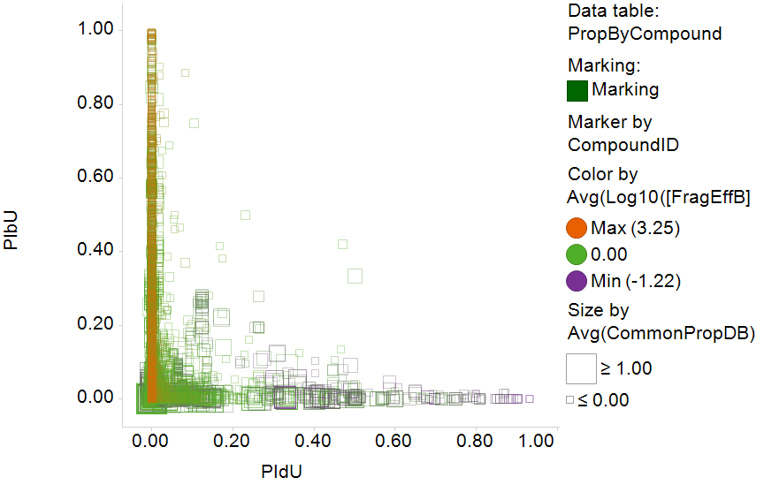
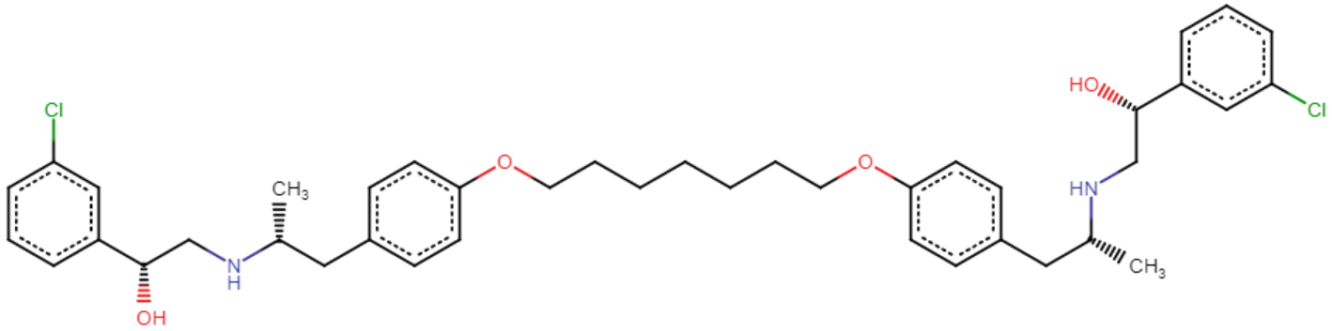
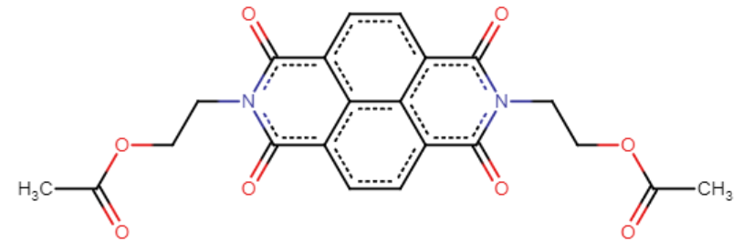
Stats Cluster D vs. RGT B
Notes:
Stats:
The two methods allow you to access different sets of molecules starting from any molecule in TCAMS (average overlap in coverage is 40%).
On the aggregate (average/median), you can link to about twice as many molecules with the frameworks, however, this is because on the aggregate there are 6 times more frameworks than NCATS scaffolds, so the “fragment efficiency” is actually 3 times greater for NCATS scaffolds. One could also argue that many of the framework-only links (eg. variously decorated benzene rings) are not useful.
The outliers are interesting: compounds in a rare tautomer are unified with the dominant one by the NCATS tool, but left as singletons by the frameworks. And compounds whose only link with other molecules would be eg. a benzene ring remain singletons with the R-group tool.

Slide 9
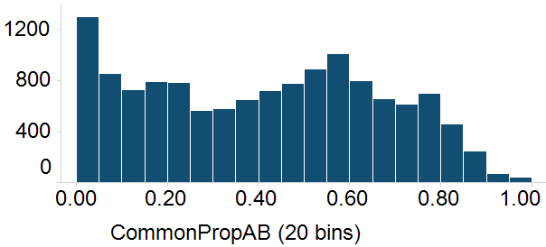
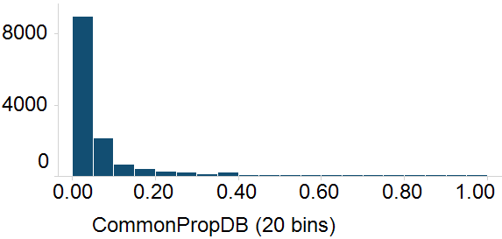
Stats bar charts
# molecules
# molecules

