Slide 1

Scaffold-Based Analytics to Enable Hit-To-Lead Decisions
Applying data science / analytics / visualization to large chemical datasets in drug discovery
Deepak Bandyopadhyay
Sr. Scientific Investigator, Advanced Manufacturing Technology Informatics, GlaxoSmithKline 709 Swedeland Rd, King of Prussia, PA 19406
EDITED IMAGES – for ELNB
Thanks to:
Lena Dang and Josh Swamidass,
Rajarshi Guha, Zangdong He, Stephen Pickett, Martin Saunders, Nicola Richmond, Darren Green, Eric Manas, Todd Graybill, Rob Young, Mike Ouellette, Stan Martens, Javier Gamo, Lourdes Rueda
Constantine Kreatsoulas, Pat G. Brady, Joe Boyer, Genaro Scavello, Dac-Trung Nguyen, Tyler Peryea, Ajit Jadhav
GSK NCATS/NIH WUSTL

Slide 2
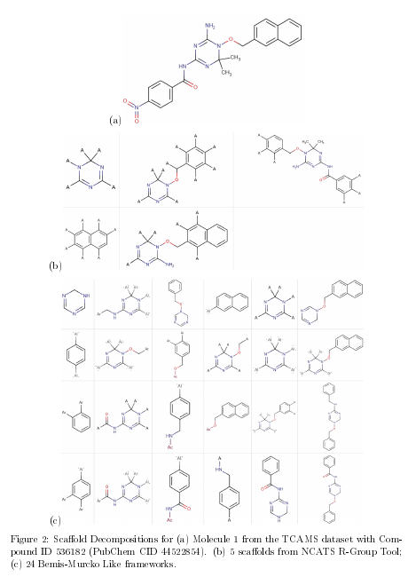
Fig 2 – showing RG vs. FW fragments
Rendering quality improvement, + in caption not mentioning RECAP as on careful examination of the dataset structures, all of them were Bemis-Murcko
Try any of the Spotfire files to see the data, but especially the bookmarks saved in “chemblntd_gsk_cpd_search_hier_SNG_v4.dxp”
Raw data is in the Datasets folder

Slide 3
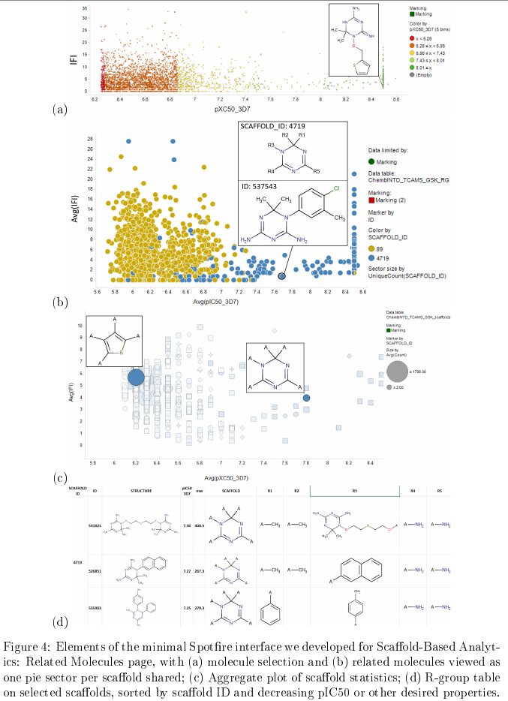
Fig 4 – overhauled structure rendering
No changes to content
“two color SAR” bookmarks in Spotfire file “chemblntd_gsk_TCAMS_RG_frames_eLNB_v2.dxp”

Slide 4
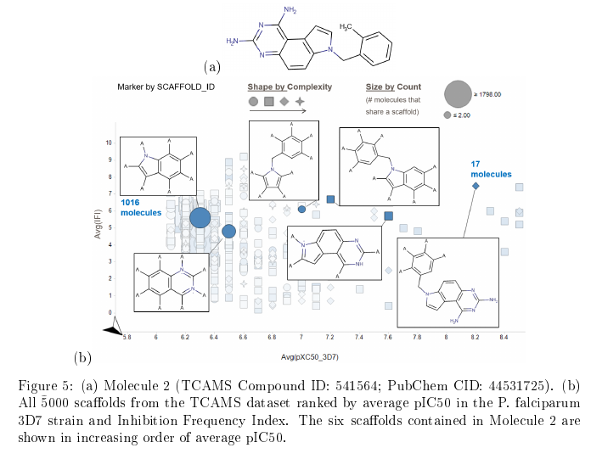
Fig 5 – only structure rendering improvement
No changes to content
“3ring_scaf_aggr_pose_hires” bookmark in Spotfire file “chemblntd_gsk_TCAMS_RG_frames_eLNB_v2.dxp”

Slide 5
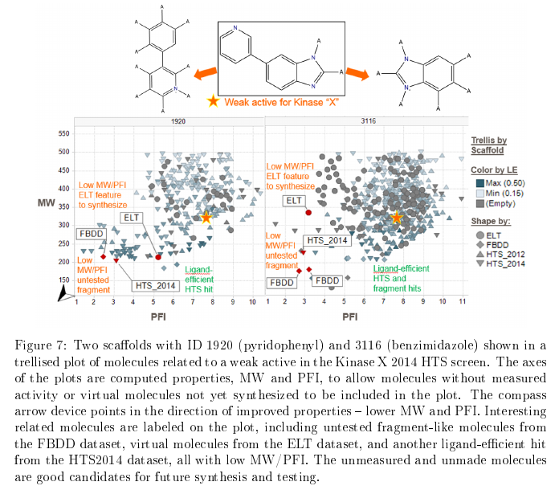
Fig 7 – only structure rendering improvement
GSK Kinase X data – plot below structures not changed.

Slide 6
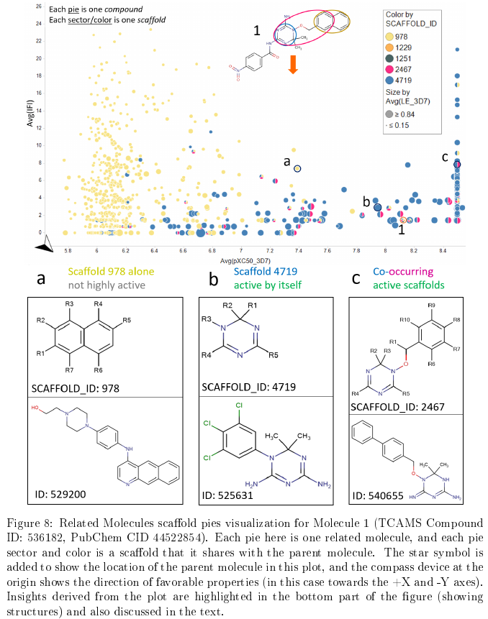
Fig 8 – structure rendering and stylistic improvement
Yellow instead of blue for scaffold 978 for contrast
Structure images pulled out of tooltips and re-rendered
Bookmark “mol1 scafwalk*” in file “chemblntd_gsk_cpd_search_hier_SNG_v4.dxp”

Slide 7
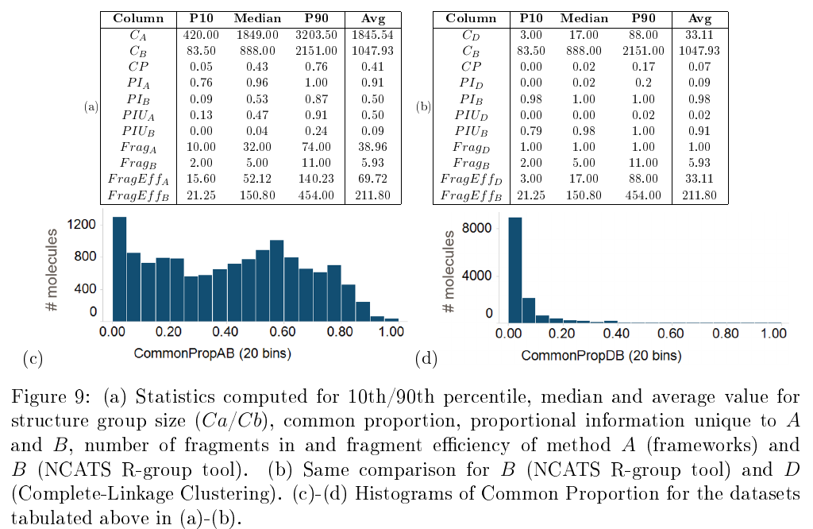
Stat table/histo (a) FW A vs RGT B (b) Clink D vs RGT B
RHS tables and figures are new, LHS already verified
Table (b) calculations are based on R Code in SI and code/data needed to reproduce are in stats folder of repo
Histogram (d) in file “chemblntd_gsk_TCAMS_Stats_PropByCompd_DD_RG_CLink_eLNB.dxp” Tab HistCP (D)
Notes:
Stats:
The two methods allow you to access different sets of molecules starting from any molecule in TCAMS (average overlap in coverage is 40%).
On the aggregate (average/median), you can link to about twice as many molecules with the frameworks, however, this is because on the aggregate there are 6 times more frameworks than NCATS scaffolds, so the “fragment efficiency” is actually 3 times greater for NCATS scaffolds. One could also argue that many of the framework-only links (eg. variously decorated benzene rings) are not useful.
The outliers are interesting: compounds in a rare tautomer are unified with the dominant one by the NCATS tool, but left as singletons by the frameworks. And compounds whose only link with other molecules would be eg. a benzene ring remain singletons with the R-group tool.

Slide 8
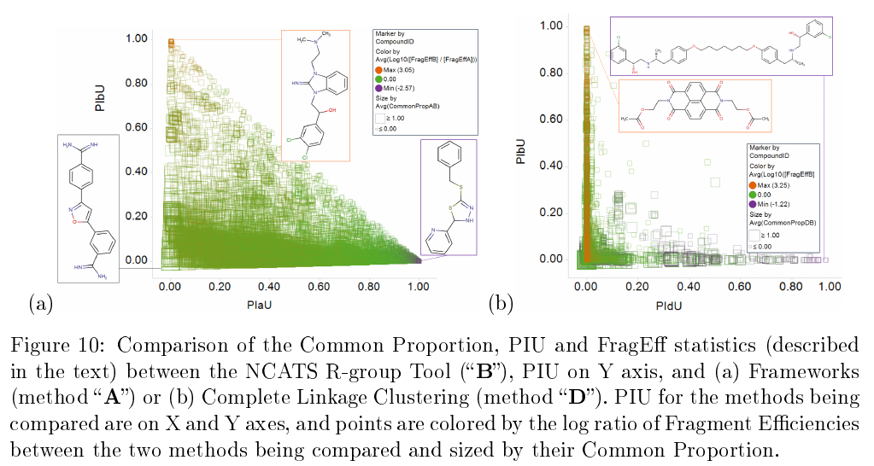
Stat plot (a) FW A vs. RGT B, (b) Cluster D vs. RGT B
Plot (b) in file “chemblntd_gsk_TCAMS_Stats_PropByCompd_DD_RG_CLink_eLNB.dxp” Tab “Compare CLinkClus(D) and RGdecomp(B)”. Dataset built with code & data in stats folder in repo – same as previous figure

Slide 9
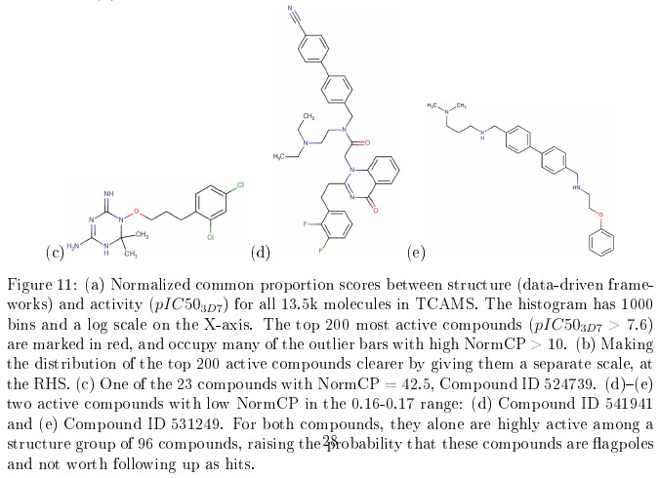
Fig 11 (c)-(e) – only structure rendering changed
Structures rendered directly from SMILES – Spotfire file “DDDtable” not updated

Slide 10
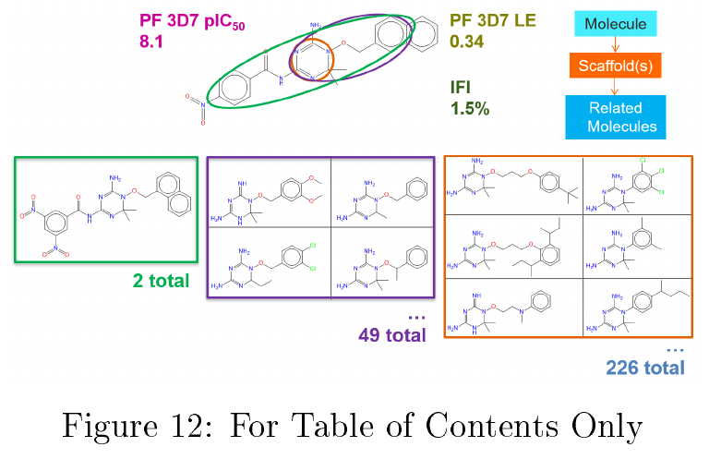
Fig 12 – for TOC only
Adapted from previously approved presentation

Slide 11
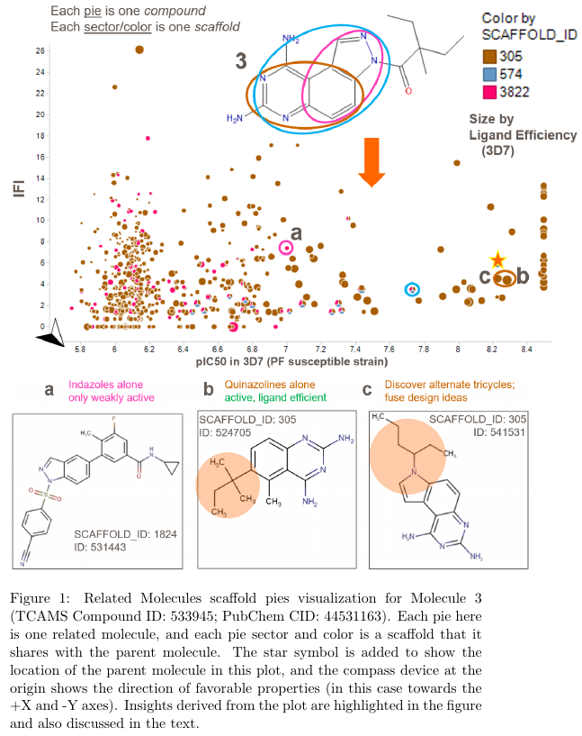
SI fig 1 – moved from paper
Structures redrawn, design changed
Bookmark “3ring SI scafwalk2” in Spotfire file “chemblntd_gsk_TCAMS_RG_frames_eLNB_v2.dxp”

Slide 12
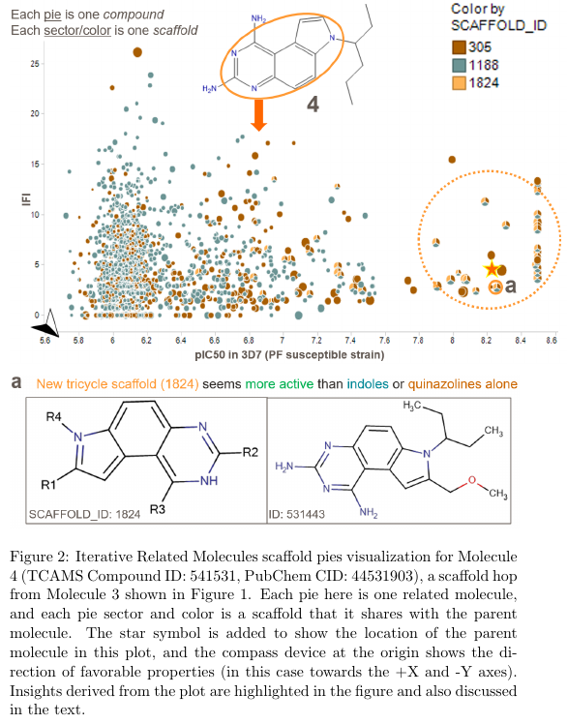
SI Fig 2 – moved from paper
Structures redrawn, design changed
Bookmark “3ring SI scafwalk3” in Spotfire file “chemblntd_gsk_TCAMS_RG_frames_eLNB_v2.dxp”

Slide 13
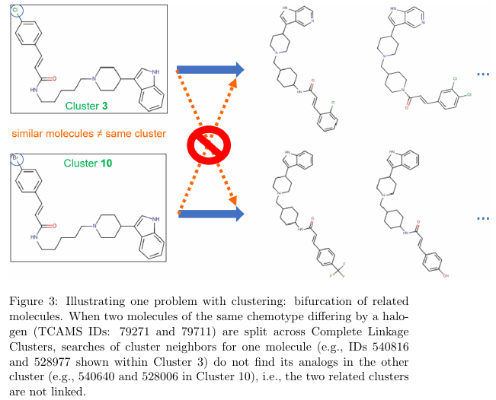
SI figure 3 – moved from main paper
Structure rendering improved, figure simplified, cluster member exemplars and alignment may have changed slightly without affecting the message

Slide 14
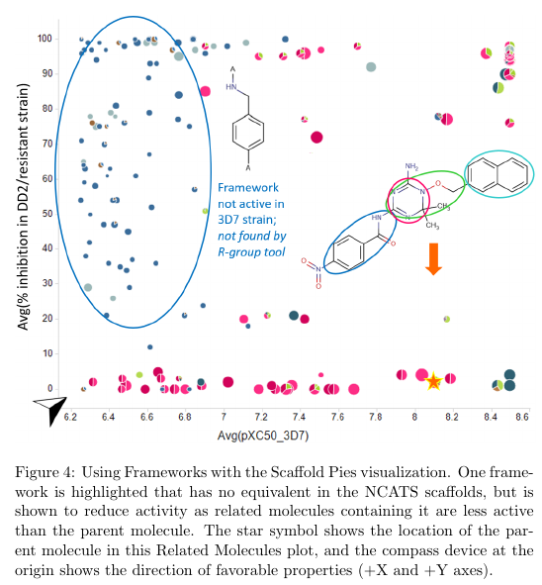
SI Figure 4
Structure and framework rendering improved
Data otherwise the same
As previously approved
See bookmark “mol1_536182_frame_pies” in file “chemblntd_gsk_TCAMS_RG_frames_eLNB_v2.dxp”

Slide 15
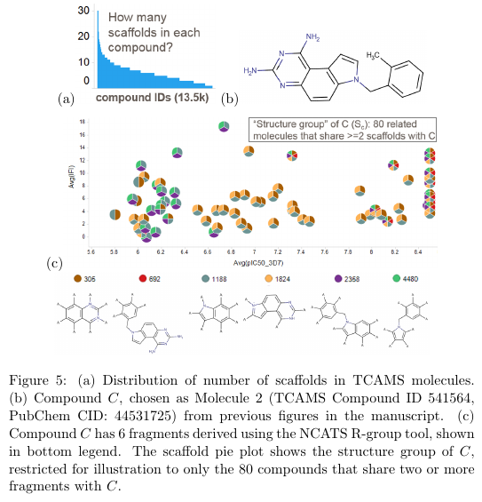
SI Figure 5
Structure and substructure rendering only
Bookmark “3ring benzyl scafpie 2overlap” in file “chemblntd_gsk_TCAMS_RG_frames_eLNB_v2.dxp”

