Slide 1
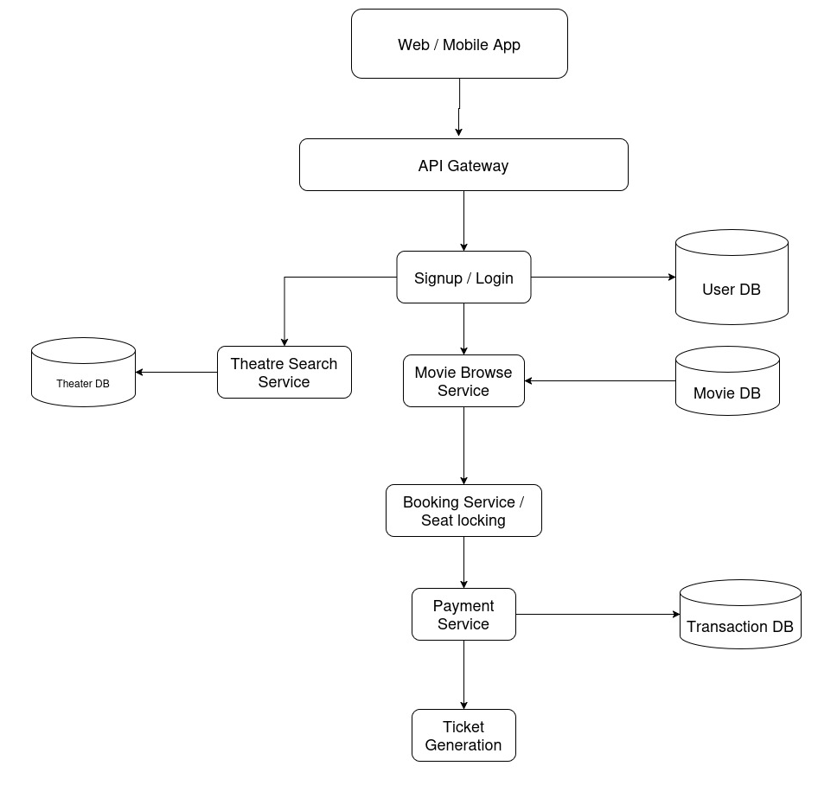
BookMyShow HLD

Slide 2
Database Design
Movie
  Movie Id
  Movie name
  Language
  Ratings
  Duration
  Genre
  Actors
Theater
  Theatre Id
  Theater name
  Address
  No of screens
Screen
  Screen Id
  Movie Id
  Capacity
  Start time
  End time
Show
  Show Id
  Screen Id
  Start time

Slide 3
Database Design
Booking
  Booking Id
  User Id
  Amount
  Transaction Id
  Screen Id
User
  User Id
  Name
  Age
  Address

Slide 4
Requirements
Functional Requirements
  Sign up/Login
  Search movies
  Search theatres by city
  View show timings
  View seat availability
  Select seats
  Pay for tickets
  Receive ticket
Non-Functional Requirements
  High availability
  Horizontal scalability
  Low latency
  No double booking
  Fault tolerance

