Slide 1
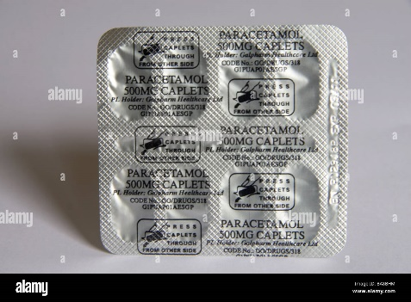
Image Preprocessing Stage
Convert Image to Tensor & Resizing Image
Normalizing the Image

Slide 2

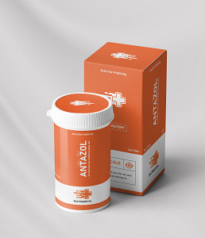
Paracetamol
Text Encoder
T1
…
TN
I1
I1.T1
…
I1.TN
Image Encoder
…
…
…
…
IN
IN.T1
…
IN.TN

Slide 3
Paracetamol
Antazol
a photo of a {medicine}.
Text Encoder
…
…
…
Zimacal
T1
T2
…
TN
Image Encoder
I1
I1.T1
I1.T2
…
I1.TN
A photo of “Antazol”

Slide 4

A text of “Antazol”
Character Embedding
Pre-Net
CBHG
Encoder
Attention
Generated Waveforms
Pre-Net
Attention RNN
Decoder RNN
WaveNet
Vocoder
Decoder

