Slide 1
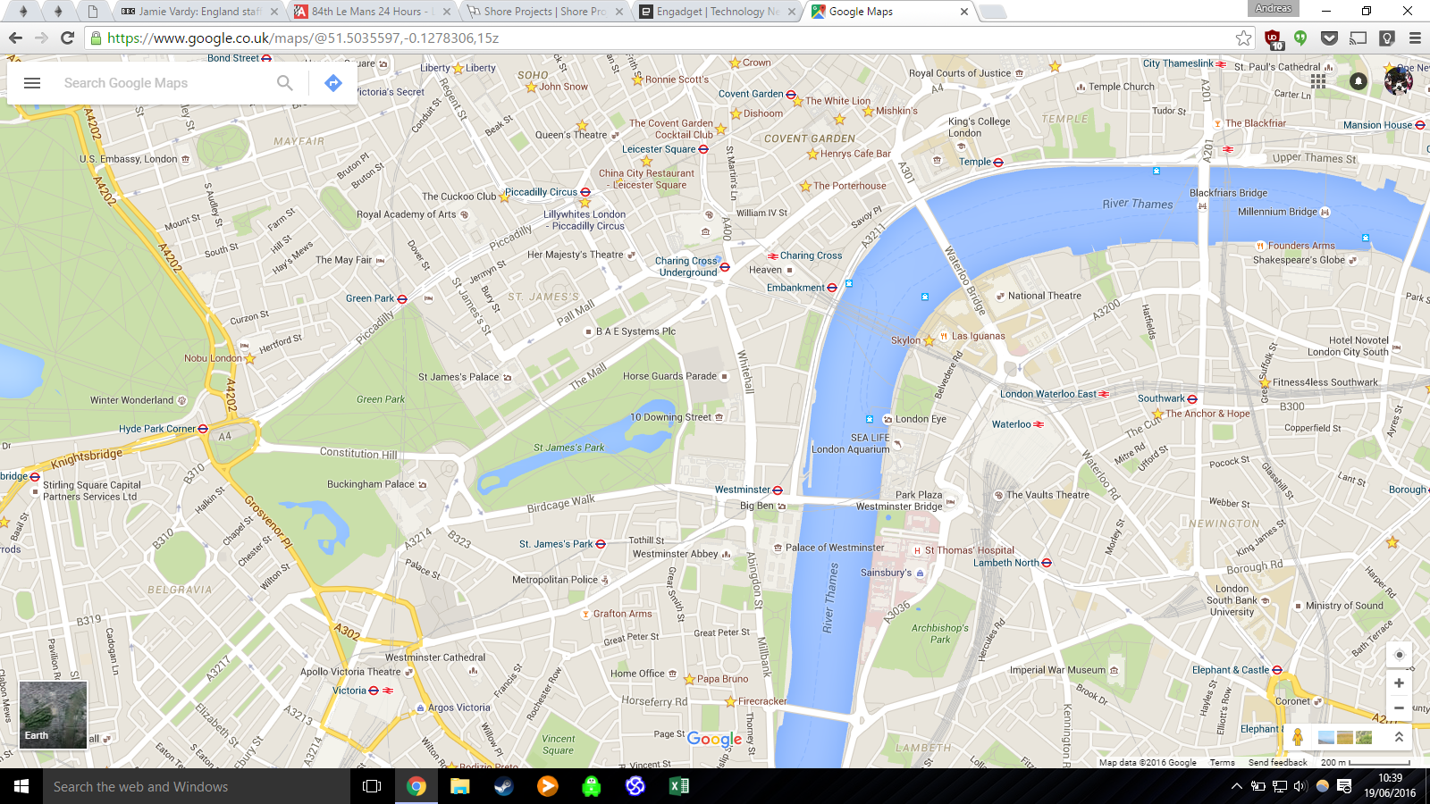

Slide 2
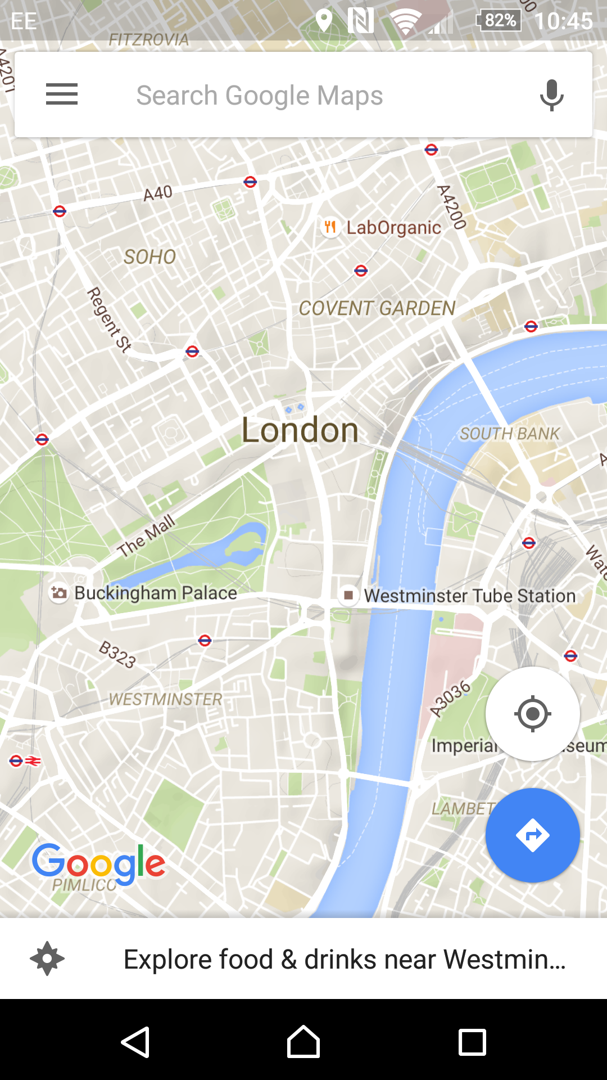
Abandon LU station?
I’m heading into London via waterloo today? I hear there are problems
Just walked passed Waterloo and looks
like their not letting people in. Agree there may be issues
I’m waiting to get a train to Guildford. Yes their not letting people onto the Platforms
Just got an announcement from the train guard, there are signal problems between Vauxhall and Waterloo….SAD TIMES!
Waterloo closed?
Queeny
I’m heading into London via waterloo today? I hear there are problems
At horse guides parade. When is the queen coming out?
Just walked passed Waterloo and looks
like their not letting people in. Agree there may be issues
Queen won’t be coming out until 16.000. She is to busy feeding the corgis
I’m waiting to get a train to Guildford. Yes their not letting people onto the Platforms
Queen won’t be coming out until 16.000. She is to busy feeding the corgis
Just got an announcement from the train guard, there are signal problems between Vauxhall and Waterloo….SAD TIMES!
Queen won’t be coming out until 16.000. She is to busy feeding the corgis

Slide 3
Abandon LU station?
Speedy’s cafe
Yes, its Stand station. Used to be a branch of the Piccadilly line
Love this place, I prefer this to the actual Baker’s street. #sherlock
Queeny
Queen won’t be coming out until 16.000. She is to busy feeding the corgis
Waterloo closed?
Just got an announcement from the train guard, there are signal problems between Vauxhall and Waterloo….SAD TIMES!
Green Park dance off
Yo yo yo London, we are having a street dance outside Green Park station!!! We will be hitting the beats for most of today. Get involved boyos (and girlos :D)
Loud bang?
Anyone hear that load bank near Pimlico station? Anyone who what it was?

Slide 4
Abandon LU station?
Speedy’s cafe
Yes, its Stand station.
Love this place
Lalilulelo @ 20:14
Queeny
Won’t be showing herself till 16.00
Waterloo closed?
3 other
signal problems between Vauxhall and Waterloo
Green Park dance off
Yo yo yo London, we are having a street dance
Loud bang?
Anyone hear that load bank near Pimlico station? Anyone who what it was?

