Slide 1
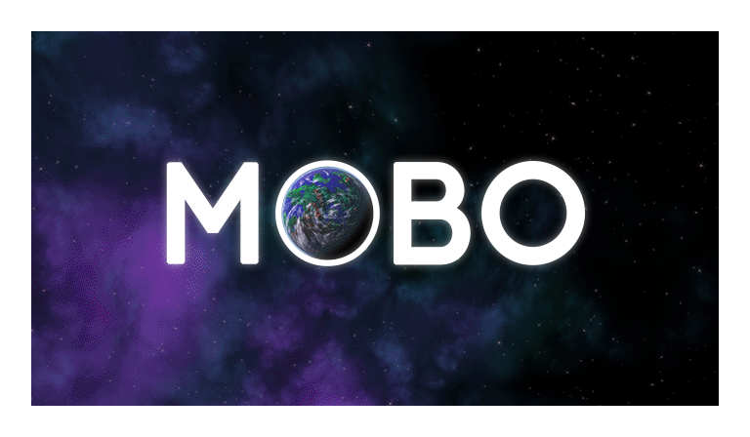
Project Mobo
Christopher John Cola
Viva
CO3015 Computer Science Project

Slide 2
Overview
Background
Project Proposal and Scope
Software and Network Architecture
Client “Mobo” implementation
Server “MoboServerWPF” implementation and synchronisation
Messaging protocol example
Final deliverable and conclusion

Slide 3
Background
Video games have become increasingly ambitious in scope
More complex in design but also their network features
Greater importance:
Network and software architecture
Way synchronisation is achieved (messaging, protocols)
Examples:
Eve Online, The Divison, Battleborn, Overwatch
Eve Online ©2016 CCP hf, Tom Clancy’s The Division ©2016 Ubisoft Entertainment SA,
BattleBorn ©2016 2K Games, Overwatch ©2016 Blizzard Entertainment
Notes:
Video games have become increasingly ambitious in scope
To match the standards of the users
Higher expectation as video games become more complex

Slide 4
Project Proposal and Scope
“Multiplayer XKobo clone”
Client-server architecture
Multiplayer enabled
Synchronisation across clients
Game logic programming
GUI design and 2D sprite handling
Procedural Station generation
Emphasis on polished user experience
Notes:
Xkobo was a simple space shooter game developed for the linux operating system
Players, as spaceships battle tree-like space stations made of nodes
Project was designed to be characteristically similar, with freedom to implement art style and gameplay as I saw fit
At many points intuitively changed and improved various gameplay aspects
Client-server as opposed to peer-to peer

Slide 5
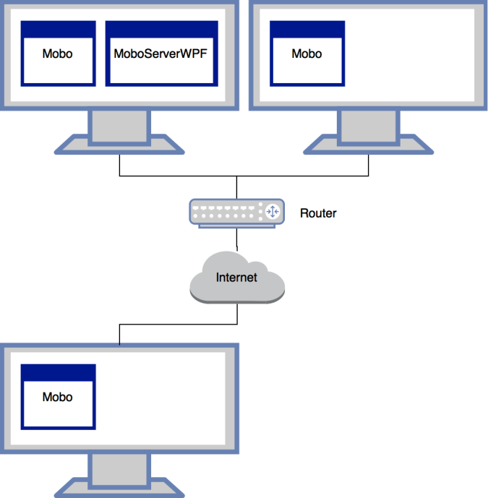
Software and Network Architecture
Client-server
Dedicated server – supports “Drop-in, Drop-out”.
Non-authoritative – supports offline play
Distributed server
Notes:
Network and software architecture
Authentication servers (log in etc)
Statistic tracking servers
Servers than manage local and global game state

Slide 6
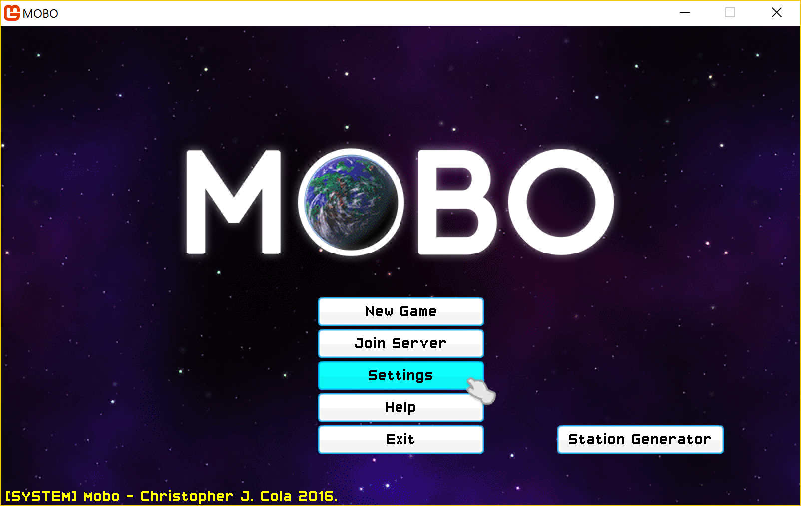
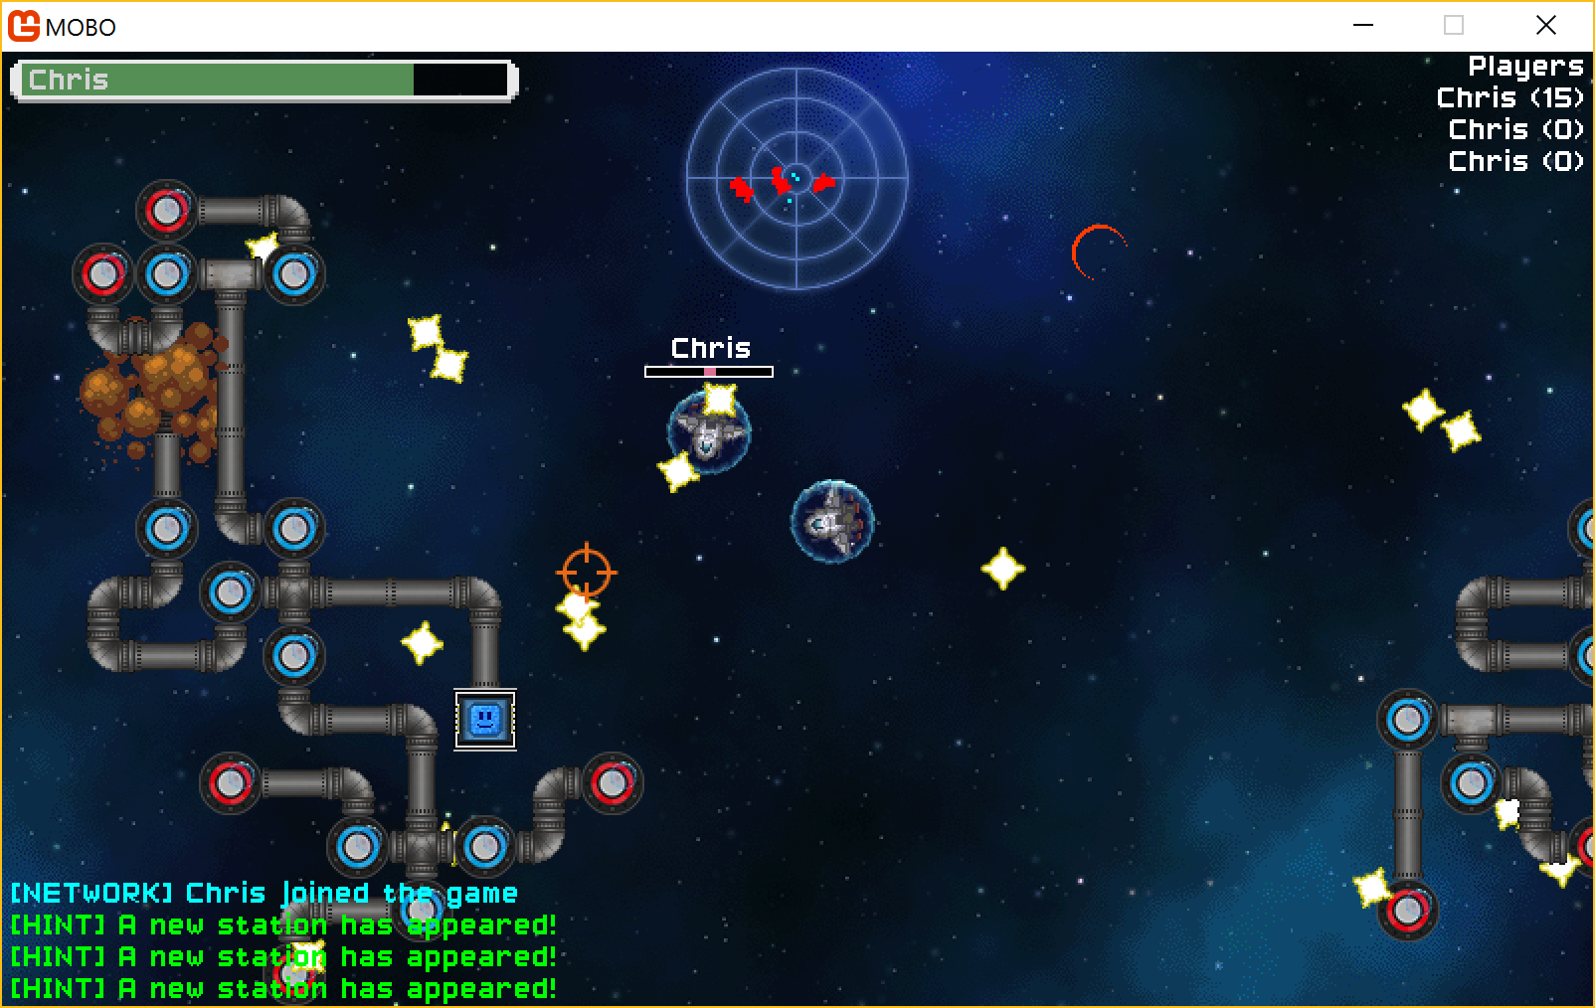
The Client - “Mobo”
Developed using the Monogame/XNA framework
GUI using sprites and 2D effects with emphasis on look and feel
Contains the vast majority of the game logic (“thick client”)
Notes:
GUI
Button/field elements
Contextual cursors
Sounds and visual effects when hovering over buttons
Encapsulated game states
InGame
User input
GUI HUD
Player movement and collision detection
Shooting at correct angles etc.
Animation class for sprite animations
Stations, destruction, generation

Slide 7
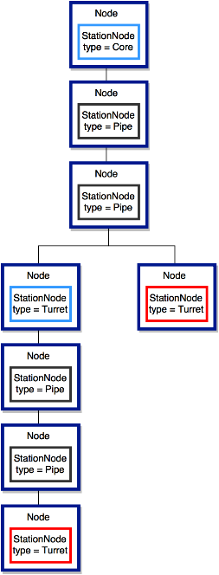
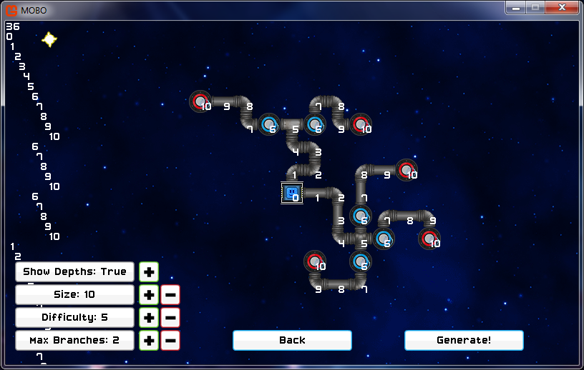
Station Structure and Generation
Modelled as trees built in 2D space
Always unique, procedurally generated using an algorithm,
Collision enabled, destroyable, fire back at players
split_depth = 6;
max_depth = 15;
difficulty = 5;
max_branches = 2;
Notes:
Developed using the Monogame/XNA framework
Important to note differences between XNA framework and a game engine like Unreal or Unity
Contains the majority of the game logic (“thick client”)
Intentional, enables people to play the game offline should they want to

Slide 8
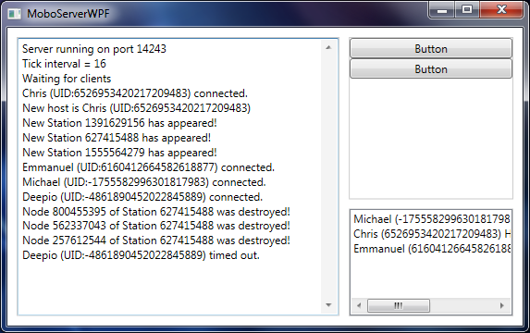
Server and Synchronisation
Developed using Windows Presentation Foundation framework
Messages and protocols using low-level Lidgren.Network
Non-authoritative distributor
Synchronisation fundamental to multiplayer gameplay
Connections / disconnections / hosting
Player position
Projectiles
Stations
Health and score
Notes:
Network and software architecture
Authentication servers (log in etc)
Statistic tracking servers
Servers than manage local and global game state

Slide 9
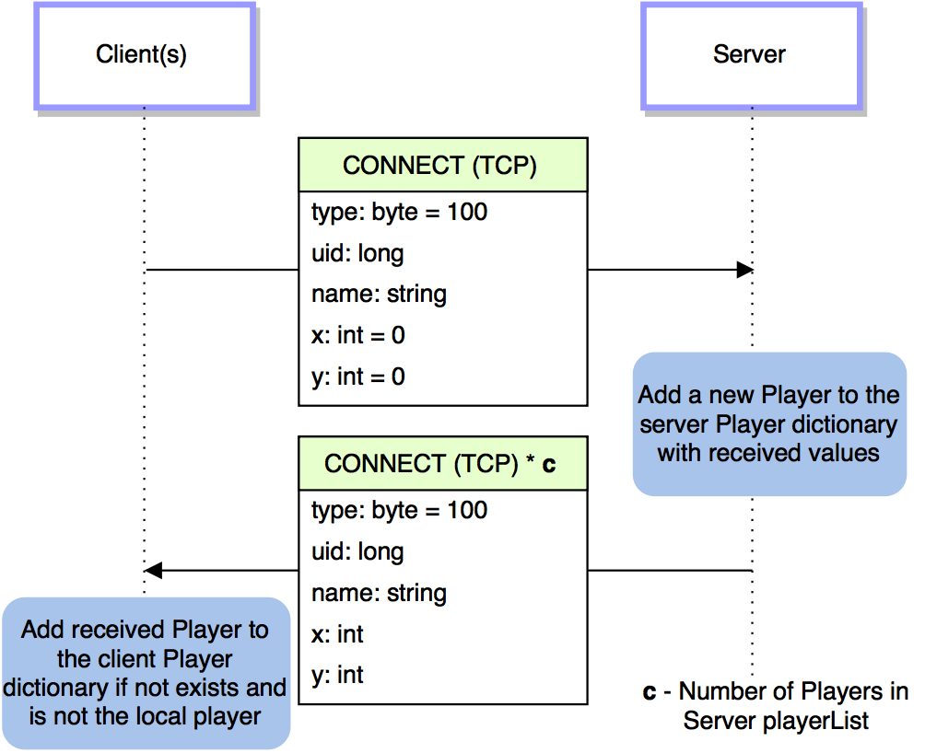
Messaging example: New connection
Notes:
Network and software architecture
Authentication servers (log in etc)
Statistic tracking servers
Servers than manage local and global game state

Slide 10
Final Deliverable and Conclusion
Polished product that resembles quality of a contemporary title
Room for improvement in the future
Valuable insight into challenges of producing networked software
Highly rewarding and enjoyable logic programming and GUI design
Retrospection on planning and design
Large and complex overall software product

