Slide 1

Diabetes
A data science approach on the disease
By Chew Lin Kiat

Slide 2
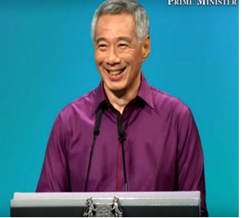
Why it matters to know about diabetes
2 Types of diabetes.
Type 1: Inheritance. Type 2: Lifestyle and age
 | War on diabetes 2017 NDP speech | 3 in 10 will get diabetes. Especially with aging population | Can die faster. 50% amputated with diabetes die within 2 years.

Slide 3
Why it matters to know about diabetes
2 Types of diabetes.
Type 1: Inheritance. Type 2. Lifestyle and age
 | War on diabetes 2017 NDP speech | 3 in 10 will get diabetes. Especially with aging population | Can die faster. 50% amputated with diabetes die within 2 years.

Slide 4
Why it matters to know about diabetes
2 Types of diabetes.
Type 1: Inheritance. Type 2. Lifestyle and age
 | War on diabetes 2017 NDP speech | 3 in 10 will get diabetes. Especially with aging population | Can die faster. 50% amputated with diabetes die within 2 years.

Slide 5
Why it matters to know about diabetes
2 Types of diabetes.
Type 1: Inheritance. Type 2. Lifestyle and age
 | War on diabetes 2017 NDP speech | 3 in 10 will get diabetes. Especially with aging population | Higher risk 50% amputated with diabetes die within 2 years

Slide 6
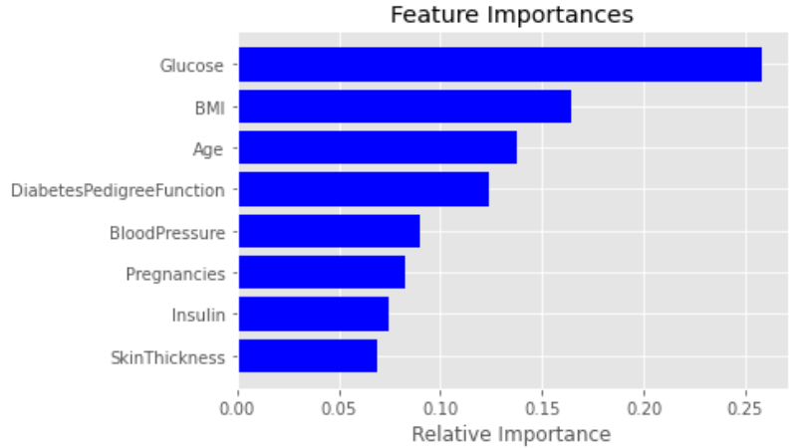
Data source and features importance
Source: Frankfurt hospital in Germany (2000 rows, 9 columns)
Features includes
Glucose
BMI (Body Mass Index)
Age
Diabetes pedigree function
Blood pressure
Pregnancies
Insulin
Skin Thickness

Slide 7
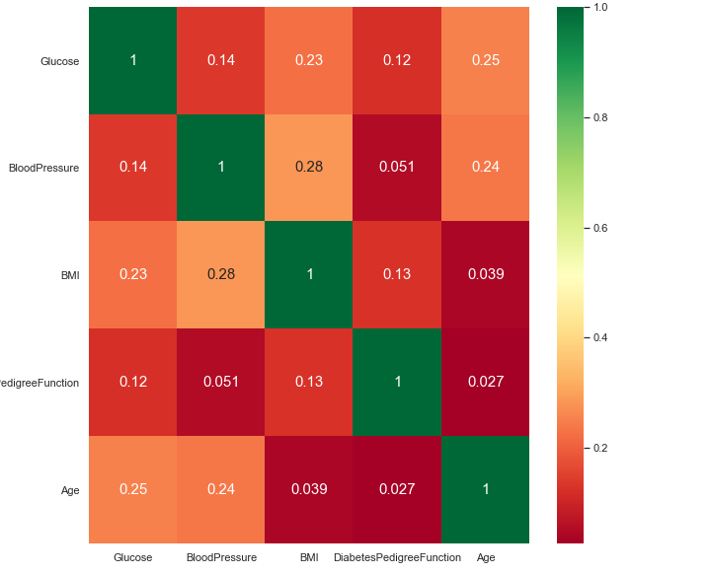
Top 5 features heatmap
No strong correlation among features
Data will be used to do modelling

Slide 8
Assessing the risk in diabetes by age(total data)
Factors | Age 10-30 years | Age 31-50 years | Age 51 to 70 years
Age (counts) | 1106 | 699 | 189
Have diabetes | 21.2% | 52.2% | 45%
Age & BMI > 30 (counts) | 633 | 484 | 99
Have diabetes | 31.6% | 58.5% | 65.7%
Age & BMI > 30 & Glucose > 140 (counts) | 151 | 176 | 62
Have diabetes | 65.6% | 79.0% | 80.6%

Slide 9
Assessing the risk in diabetes by age(total data)
Factors | Age 10-30 years | Age 31-50 years | Age 51 to 70 years
Age (counts) | 1106 | 699 | 189
Have diabetes | 21.2% | 52.2% | 45%
Age & BMI > 30 (counts) | 633 | 484 | 99
Have diabetes | 31.6% | 58.5% | 65.7%
Age & BMI > 30 & Glucose > 140 (counts) | 151 | 176 | 62
Have diabetes | 65.6% | 79.0% | 80.6%

Slide 10
Assessing the risk in diabetes by age(total data)
Factors | Age 10-30 years | Age 31-50 years | Age 51 to 70 years
Age (counts) | 1106 | 699 | 189
Have diabetes | 21.2% | 52.2% | 45%
Age & BMI > 30 (counts) | 633 | 484 | 99
Have diabetes | 31.6% | 58.5% | 65.7%
Age & BMI > 30 & Glucose > 140 (counts) | 151 | 176 | 62
Have diabetes | 65.6% | 79.0% | 80.6%

Slide 11
Assessing the risk in diabetes by age(rf data)
Factors | Age 10-30 years | Age 31-50 years | Age 51 to 70 years
Age (counts) | 175 | 110 | 35
Have diabetes | 17.5% | 57.3% | 45.7%
Age & BMI > 30 (counts) | 97 | 82 | 18
Have diabetes | 27.8% | 63.4% | 66.7%
Age & BMI > 30 & Glucose > 140 (counts) | 20 | 33 | 10
Have diabetes | 50.0% | 84.8% | 90.0%

Slide 12
Cross validation of data on models
To valid the data by dividing the data into K fold for validation of results
Model | CV (X val,y val) | Standard deviation
K nearest neighbour | 76.90% | 2.9%
Gaussian Naive Bayes | 76.50% | 1.5%
Logistic regression | 77.70% | 2.0%
Random Forest | 95.80% | 1.3%
RF: highest score and lowest std derivation

Slide 13
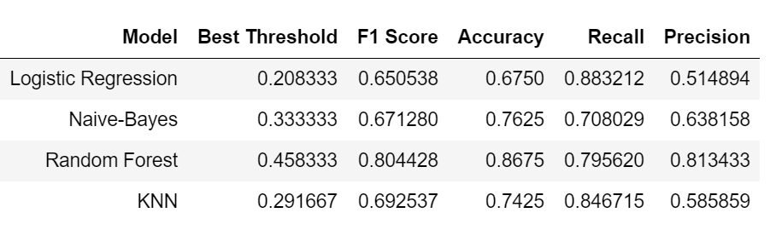
Using gridsearchcv to search best threshold across models

Slide 14
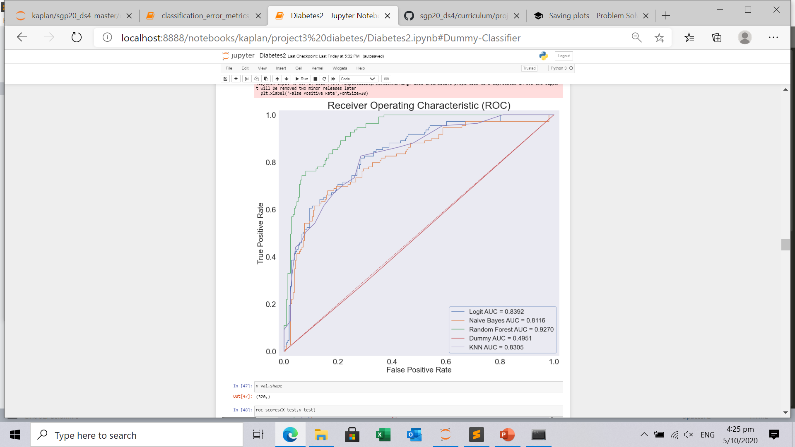
Receiver Operating Characteristics i.e ROC
Area under curve i.e AUC
The line chart which is skewed furthest to the left is the most accurate.
Random Forest i.e 92.70%

Slide 15
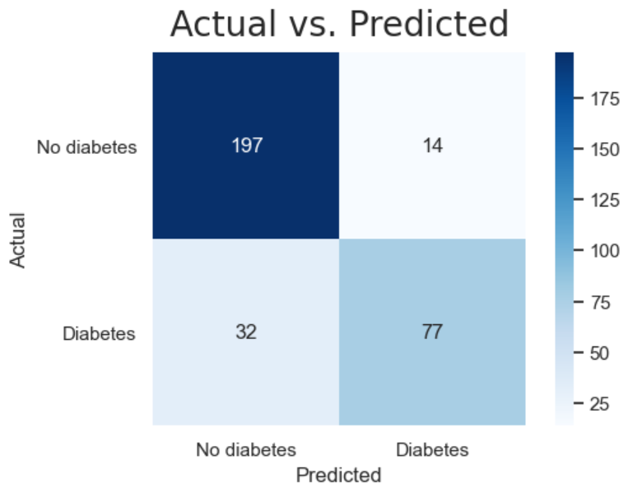
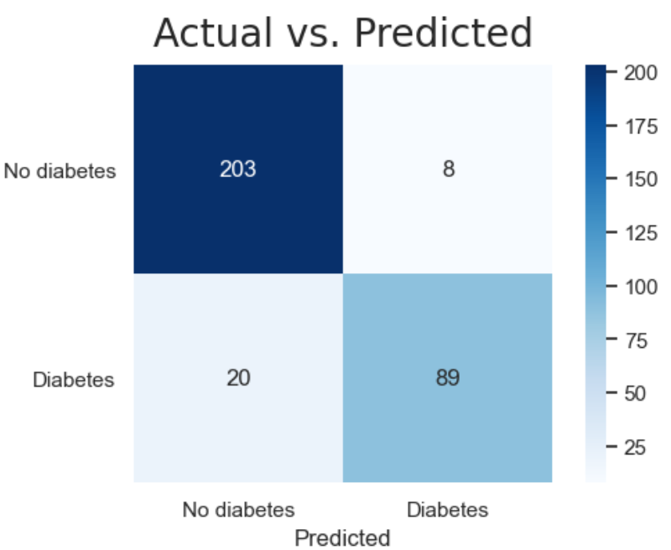
Random Forest confusion matrix
Model 1
Model 2
Threshold 0.44
Threshold 0.50

Slide 16
Random Forest confusion matrix
Model 1
Model 2
Precision(false positive)
14 vs 8
Recall (false negative)
32 vs 20

Slide 17
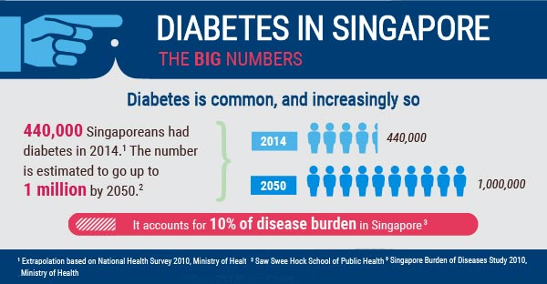
Conclusion
The war against diabetes is a lifelong battle. A timely reminder, we should take care of our health and observe our lifestyle.
Key factors affecting diabetes are glucose, body mass index i.e BMI, food/drinks intake and age.
Diabetes is not a life threatening disease. If you are not sure you have it, do go for a checkup.
Source: Ministry of health

Slide 18

Thank you
Contact info
Email: chewlinkiat@gmail.com
Linkedin: linkedin.com/in/chew-lin-kiat-607bb334
Blog: https://medium.com/@chewlinkiat

