Slide 1
ZeroMQ
make your web app do heavy shit
#sypy
@chewxy

Slide 2
Message Queues – A Primer
Facilitates inter-process communications
Often used in decoupling heavy processing from live requests
Poor man’s distributed processing

Slide 3
Message Queues – A Primer
Take this: [[1,2,3],[4,5,6],[7,8,9]]
Transform into: [1, 4, 9, 16, 25, 36, 49, 64, 81]

Slide 4
Message Queues – A Primer
def processA(data):
return map(lambda x: [y ** 2 for y in x], data)
def processB(data):
return reduce(list.__add__, data, [])
def main(data):
data = processA(data)
print processB(data)
>>> data = [[1,2,3],[4,5,6],[7,8,9]]
>>> main(data)
[1, 4, 9, 16, 25, 36, 49, 64, 81]
Sure it’s easy with functional programming tools.
Also it looks fancy and complicated, which is why it’s in this slide

Slide 5
Message Queues – A Primer
Process A
Process B
data
data
From the example above, the function processA has to perform its map on every element in the data list first before passing on data to processB

Slide 6
Message Queues – A Primer
Process A
Process B
data
data
Queue (external)
Process A₁
Process B₂
Process A₂
Process B₂
Process A₃
Process B₃

Slide 7
Message Queues – A Primer
RabbitMQ
IBM Websphere *
Beanstalk’d
Celery (Python based) *
Some are technically not message queues but for the purposes of SOA and the like, but for the purposes of this talk, let’s consider them MQs

Slide 8
ZeroMQ
Literally, 0 MQ (or rather, no broker)
ZeroMQ uses sockets
I think of ZeroMQ as a network stack with built in MQ

Slide 9
ZeroMQ
Literally, 0 MQ (or rather, no broker)
ZeroMQ uses sockets
I think of ZeroMQ as a network stack with built in MQ
Queue (external)
Process A₁
Process B₂
Process A₂
Process B₂
Process A₃
Process B₃
MQ Management

Slide 10
ZeroMQ
Queue (external)
Process A₁
Process B₂
Process A₂
Process B₂
Process A₃
MQ Management
Process B₃

Slide 11
ZeroMQ
Queue (external)
Process A₁
Process B₂
Process A₂
Process B₂
Process A₃
MQ Management
Process B₃
Producer
Broker + MQ
Consumer

Slide 12
ZeroMQ
Queue (external)
Process A₁
Process B₂
Process A₂
Process B₂
Process A₃
MQ Management
Process B₃
Producer
Broker + MQ
Consumer
The Genius of ZeroMQ
Producer
zmq
zmq
Consumer

Slide 13
ZeroMQ
import zmq
context = zmq.Context()
socket = context.socket(zmq.PUSH)
socket.bind(‘tcp://*:1234’)
>>> socket.send(‘test’)
import zmq
context = zmq.Context()
socket = context.socket(zmq.PULL)
socket.connect(‘tcp://*:1234’)
while True:
msg = socket.recv()
print msg
test
If you are reading this during the presentation that means the live coding didn’t go well

Slide 14
ZeroMQ
Many patterns supported:
Push/Pull (one way)
Request/Reply (two way)
Pub/Sub (one to many)
Many More!
Many protocols supported:
TCP (as example)
IPC (inter-process communication: UNIX only)
InProc (inter-thread communication)
PGM (multicast)
Did I mention… automatic load balancing?
ZeroMQ is easy:
Wrote a push to talk chat app in < 10 minutes
~ 60 lines of code with just one of the above pattern
See Examples

Slide 15
ZeroMQ in Action
Typical usage: As a superfast version of a traditional message queue
Also: Service Oriented Architecture
Personally, I like the UNIX Philosophy better.
Write programs that do one thing and do it well. Write programs to work together. Write programs to handle text streams, because that is a universal interface.

Slide 16
ZeroMQ in Action
Projects I’ve worked on that uses ZeroMQ:
edgeyo (http://edgeyo.com) – project shelved
Strangers for Dinner (http://strangersfordinner.com) – pivoting
A Brand Safety Product
A Data Management Platform
A Media Analysis Toolkit

Slide 17
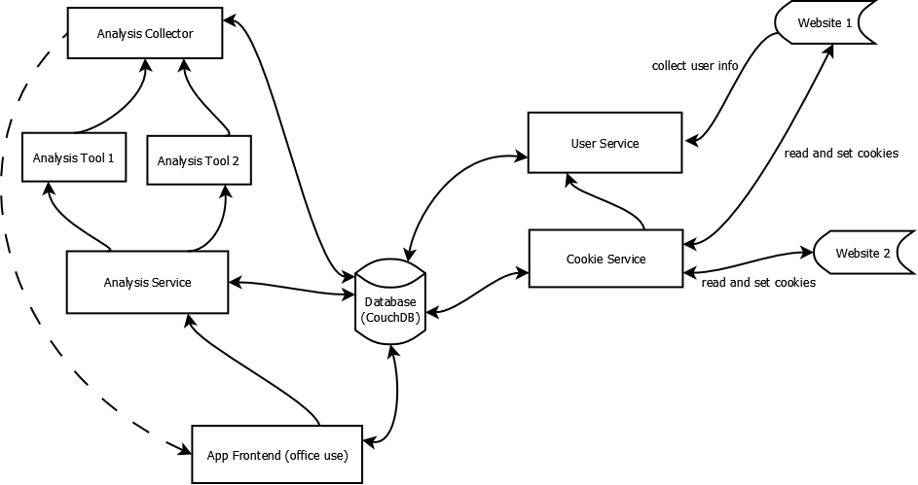
ZeroMQ in Action

Slide 18
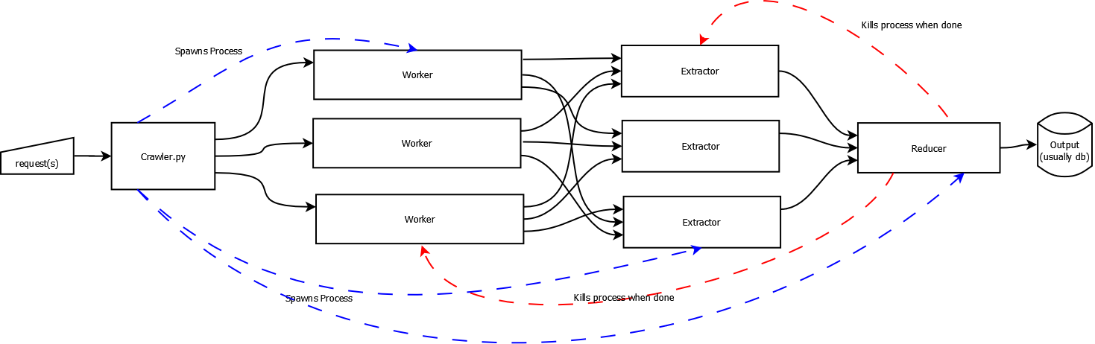
ZeroMQ in Action

Slide 19
Do Heavy Shit
Plan, plan, plan
You cannot tack on ZeroMQ like you tack on RabbitMQ
Spread your load across many processes
Not a poor man’s distributed processing

Slide 20
Make Your Site Fast
POST Handlers
When POSTs are made, reply the user instantly with cached data.
Handle the POST information separately in the back end (by PUSHing your data to your POST handler app)
If you need to communicate results with the user, socket.io is a good idea.

Slide 21
Thank you
Examples: http://github.com/chewxy/SyPyOct2012
Email: chewxy@pressyo.com
Twitter: @chewxy
p/s: follow me now and a unicorn will present bacon and whiskey to you tonight

