Slide 1
Quantum Reservoir Computing
By Rojar raju

Slide 2
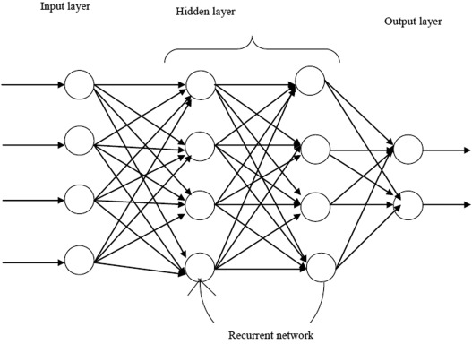
Recurrent Neural networks (rnn)
Type of artificial neural network, system consists of connection between nodes => cycle
Output of nodes affect subsequent input to same nodes => training data to learn
Exhibits temporal dynamic behavior
Language translation, speech recognition, image captioning
Distinguished by “memory”

Slide 3
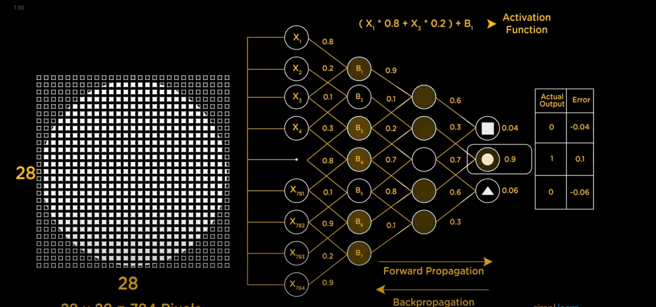
Phrases like “Im feeling blue”
RNN accounts for position in each word

Slide 4
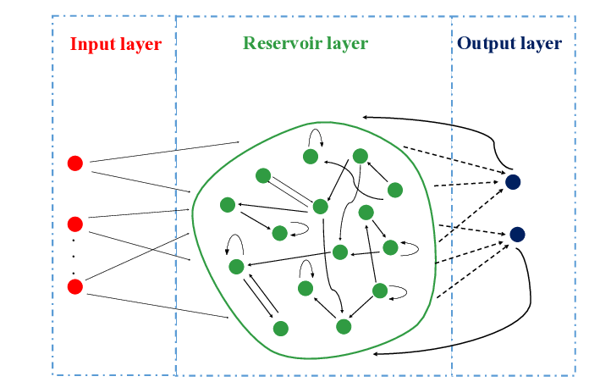
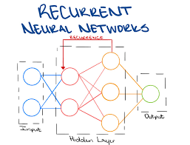
What is reservoir computing?
Framework for computation based on RNN to create complex dynamical systems
Maps input signals to higher dimensional computational basis through reservoir
Reservoir = “black box”
Readout mechanism, obtains state of reservoir and maps it to output node
Extends to physical systems that are not networks in classical sense, but continuous in space/time
“Bucket of water” => Reservoir, perturbation on surface

Slide 5
Advantages RC
Disadvantages NN
Training only required at readout stage
Able to “store” information by connecting units in recurrent loops
=> previous input affects next input/output
Fixing dynamics of reservoir
Training of NN challenging and computationally expensive
More nodes you have more time/computation

Slide 6
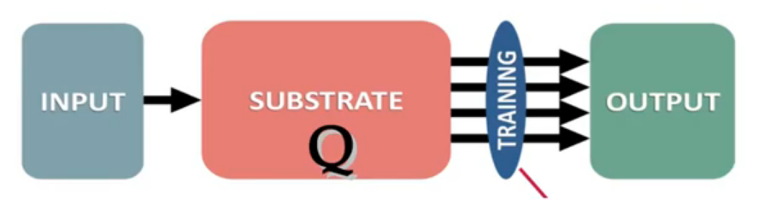
Quantum reservoir computing
Quantum dynamical system as the reservoir
Number of degrees of freedom increases exponentially

Slide 7
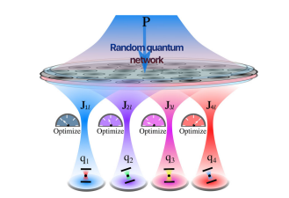
advantages
Ghosh, S., Krisnanda, T., Paterek, T. et al. Realising and compressing quantum circuits with quantum reservoir computing. Commun Phys 4, 105 (2021).
Connection inside network is fixed and random
Quantum domain, quantum nodes coupled via random and uncontrolled quantum tunnelling
Can use classical/quantum data as input/output

Slide 8
QN connected to layer of computational qubits
Strengths of weights between QN and qubits as the only layer that needs optimization
Single QN can implement a wide variety of quantum operations
Quantum tunnelling the only mode of interaction
Coupling weights

Slide 9


El and KII – site dependent energies and hopping amplitudes
The qubits do not interact with eachother but rather by the QN via quantum tunnelling
To train such system, set a sample of pure input states for qubits and compute fidelity resulting from QN compared to ideal states corresponding to desired quantum operation
Coupling weights

Slide 10


Quantum Operations
T = 0 qubits initialized, sample initial states where QN starts in vacuum state
Whole system evolves in time up to t =$τ$, corresponding to unitary operator
Final state of combined system thus is given by
Final state of qubits given by partial trace that traces out QN
Compute fidelity of each input state which is the overlap of the ideal final quantum state and the obtained state $ρ_{q}$
=>
Desired quantum operation of qubits

Slide 11
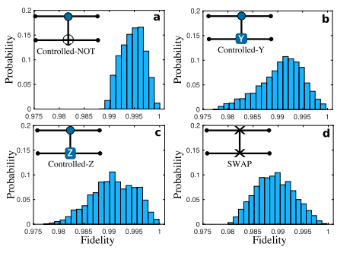
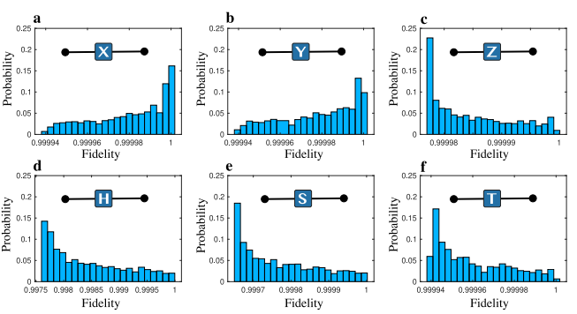

With well chosen tunnelling amplitudes Jkl and appropriate values of P and$τ$
Any quantum operation can be constructed in principle with these quantum gates
Thus, forming a universal gate.
Since a single QN can induce many quantum operations, this will reduce the depth of the circuits “Compressing them”

Slide 12
Conclusion
Talked about RNN and RC
Showed how a set of quantum nodes connecting to computing qubits trained via a learning algorithm is used to adapt the system to a particular quantum operation
With high fidelity, a single QN is enough to induce many quantum operations

Slide 13
Bibliography
https://www.ibm.com/topics/recurrent-neural-networks
https://en.wikipedia.org/wiki/Reservoir_computing
https://en.wikipedia.org/wiki/Recurrent_neural_network
Some papers that helped me understand just a little more:
Gauthier, D.J., Bollt, E., Griffith, A. et al. Next generation reservoir computing. Nat Commun 12, 5564 (2021). https://doi.org/10.1038/s41467-021-25801-2
Suzuki, Y., Gao, Q., Pradel, K.C. et al. Natural quantum reservoir computing for temporal information processing. Sci Rep 12, 1353 (2022). https://doi.org/10.1038/s41598-022-05061-w

