Slide 1
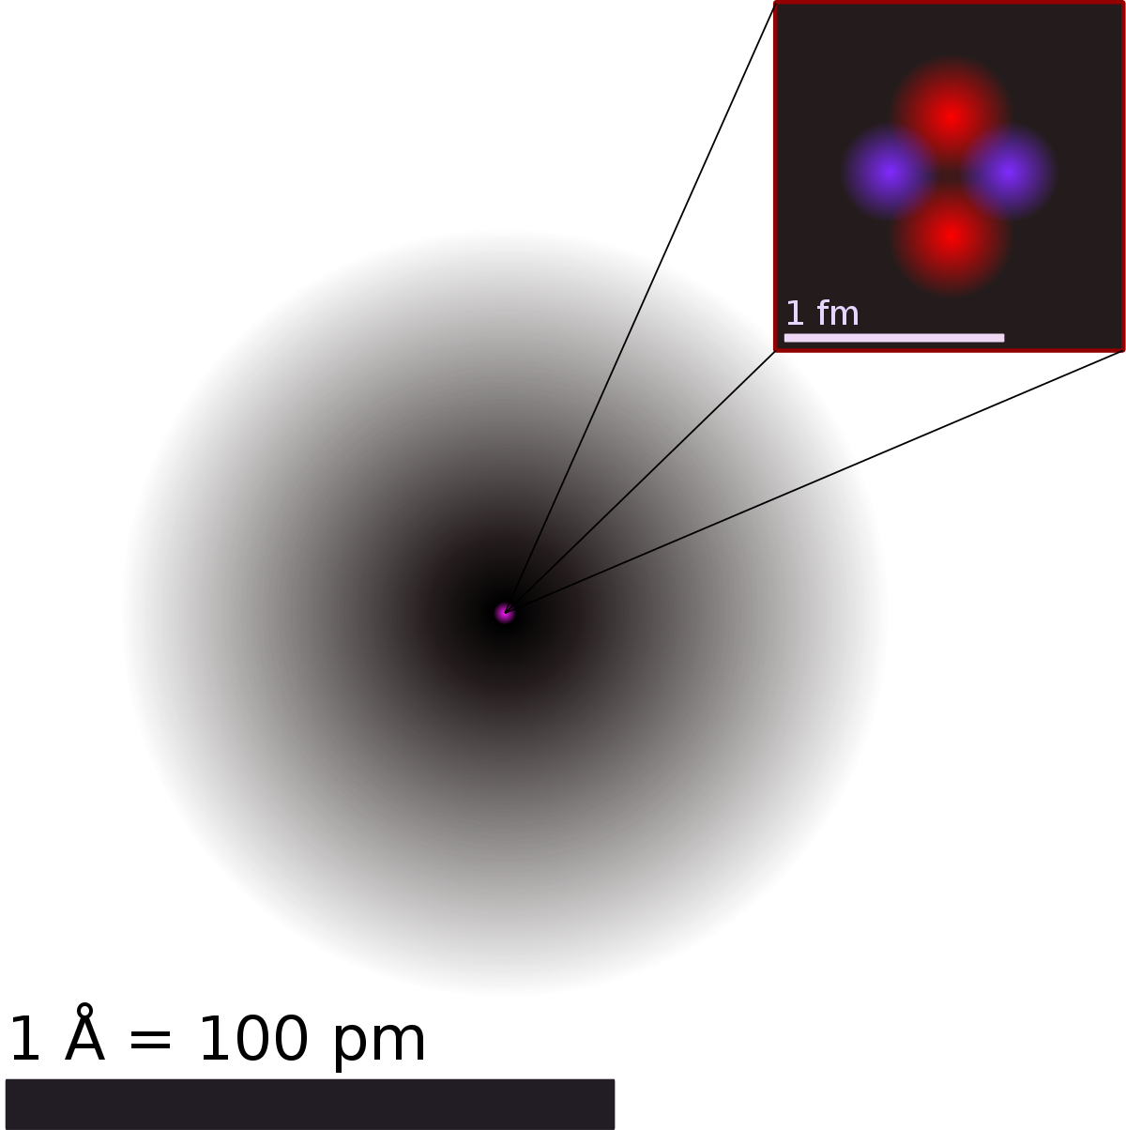
Superposition
Atom – electron cloud => probability of finding electron
Electron is in superposition in terms of location around nucleus
Before measuring electron is at every point in particular time
Wavefunction
Systems not described soley by particles or waves
Ψ, modulus squared gives probability, complex
What does it do?
Combine with schro equation to which solutions are “possible thing system can do”
Unique property: if you have 2 solutions to equation then sum of such is another solution
E.g vectors Ψ1 and Ψ2, then Ψ3 = mΨ1 + nΨ2 => superposition

Slide 2
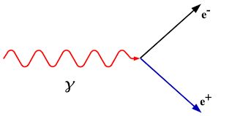
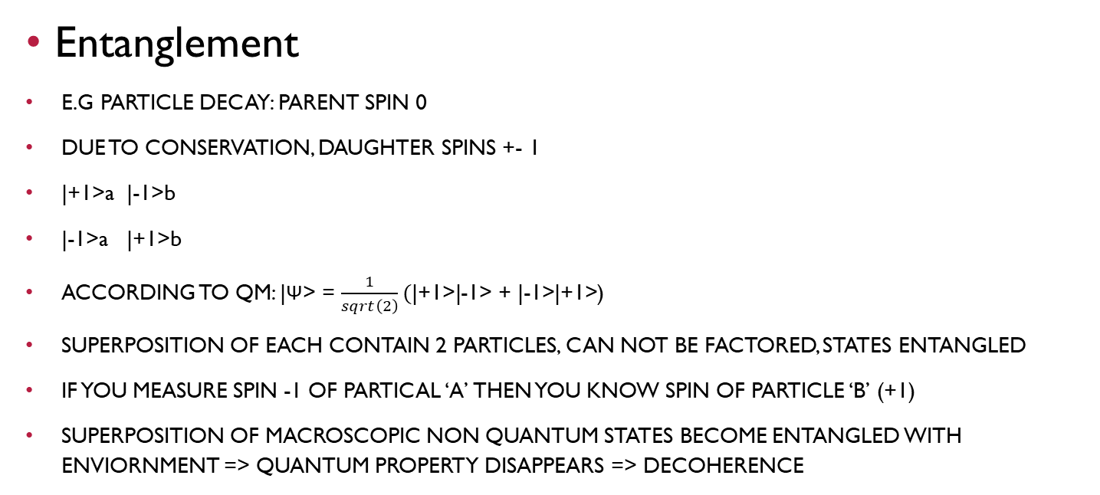
Entanglement
E.G PARTICLE DECAY: PARENT SPIN 0
DUE TO CONSERVATION, DAUGHTER SPINS +- 1
|+1>a |-1>b
|-1>a |+1>b
ACCORDING TO QM: |Ψ> = $\frac{1}{sqrt\left(2\right)}(\text{|+1>|-1>}\text{ + }\text{|}\text{-}\text{1>|}\text{+}\text{1>}\text{)}$
SUPERPOSITION OF EACH CONTAIN 2 PARTICLES, CAN NOT BE FACTORED, STATES ENTANGLED
IF YOU MEASURE SPIN -1 OF PARTICAL ‘A’ THEN YOU KNOW SPIN OF PARTICLE ‘B’ (+1)
SUPERPOSITION OF MACROSCOPIC NON QUANTUM STATES BECOME ENTANGLED WITH ENVIORNMENT => QUANTUM PROPERTY DISAPPEARS => DECOHERENCE

Slide 3
Locality
IF YOU ASSUME SPIN OF ‘A’ WHEN ORIGINAL PARTICLE DECAY, RESULT DOES NOT FIT OBSERVATION
SAY MEASURE SPIN IN 2 DIFFERENT AXIS, ONE ORTHOGONAL TO THE OTHER FOR E.G
IN QM SPIN IN 2 ORTHOGONAL DIRECTIONS HAS SAME TYPE OF MUTUAL UNCERTAINITY
AS POSITION AND MOMENTUM
IF YOU MEASURE SPIN IN ONE DIRECTION YOU DON’T KNOW SPIN IN ORTHOGONAL
NO CORRELATION BETWEEN EXPERIMENT (MEASURE IN SAME DIRECTION: MAXIMALLY CORRELATED)
SAY PARALLEL, CAN CALCULATE HOW STRONGL CORRELATED THE MEASUREMENT OUTCOMES ARE IF SPINS DETERMINED ALREADY @ TIME OF DECAY
UPPER BOUND OF CORRELATION => BELLS INEQUALITY
EXPERIMENTS SHOW SUCH IS VIOLTED
IF OUTCOME OF MEASUREMENT DETERMINED @ TIME OF ENTANLGED STATE CREATED, CAN NOT EXPLAIN OBSERVED CORRELATION
IF SPINS NOT PRE DETERMINED THEN THEY BECOME DETERMIEND ONCE MEASUREMENT TAKES PLACE => NON LOCAL
CORRELATIONS OF SEPERATED PARTICLES STRONGER THAN THEY COULD POSSIBLY BE COMPARED TO STATES THAT HAD BEEN DETERMINED BEFORE MEASUREMENT
QM FORCES YOU TO GIVE UP ON DETERMINISM AND LOCALITY THUS MAKING IT UNPREDICTABLE AND NON LOCAL

Slide 4
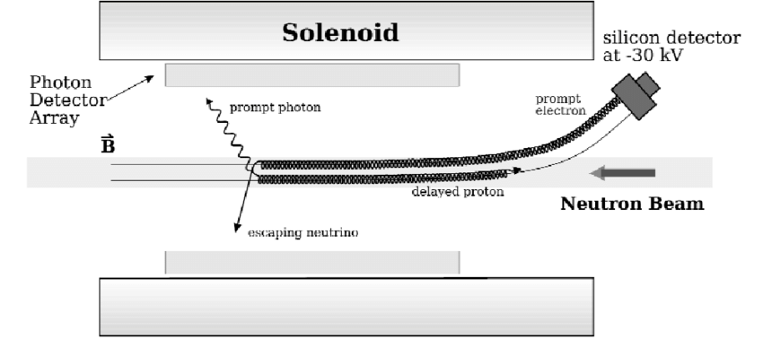
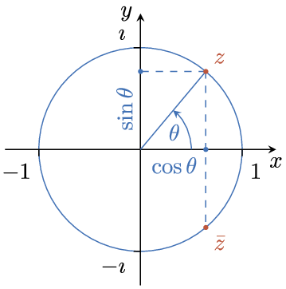
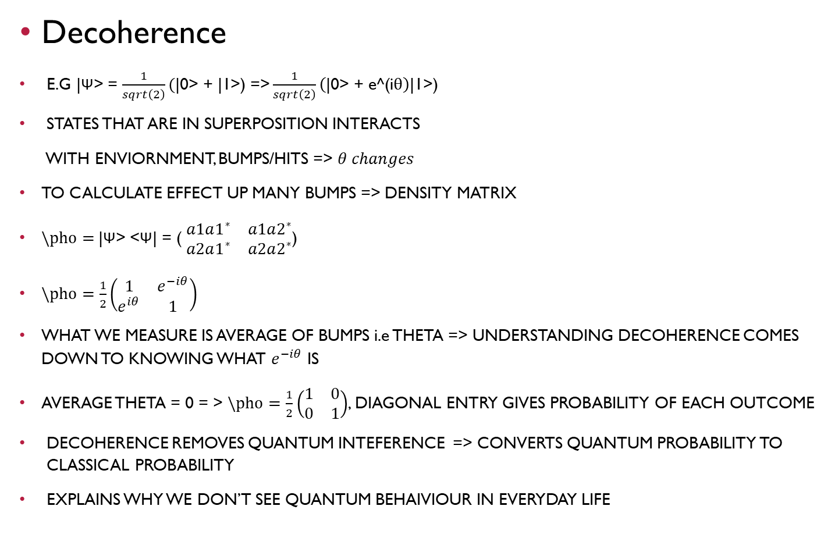
Decoherence
E.G |Ψ> = $\frac{1}{sqrt\left(2\right)}(\text{|}\text{0}\text{>}\text{ + }\text{|1>}\text{)}\text{ =>}\frac{1}{sqrt\left(2\right)}\left(\text{|}\text{0}\text{>}\text{ + }\text{e}\text{^(}\text{i}θ\right)\text{|1>}\text{)}$
STATES THAT ARE IN SUPERPOSITION INTERACTS
WITH ENVIORNMENT, BUMPS/HITS => $θ changes$
TO CALCULATE EFFECT UP MANY BUMPS => DENSITY MATRIX
$\backslash pho=$|Ψ> <Ψ| = ( $\begin{matrix}a1a1^{∗} & a1a2^{∗} \\ a2a1^{∗} & a2a2^{∗}\end{matrix}$)
$\backslash pho=\frac{1}{2}\left(\begin{matrix}1 & e^{−iθ} \\ e^{iθ} & 1\end{matrix}\right)$
WHAT WE MEASURE IS AVERAGE OF BUMPS i.e THETA => UNDERSTANDING DECOHERENCE COMES DOWN TO KNOWING WHAT $e^{−iθ}$ IS
AVERAGE THETA = 0 = > $\backslash pho=\frac{1}{2}\left(\begin{matrix}1 & 0 \\ 0 & 1\end{matrix}\right)$, DIAGONAL ENTRY GIVES PROBABILITY OF EACH OUTCOME
DECOHERENCE REMOVES QUANTUM INTEFERENCE => CONVERTS QUANTUM PROBABILITY TO CLASSICAL PROBABILITY
EXPLAINS WHY WE DON’T SEE QUANTUM BEHAIVIOUR IN EVERYDAY LIFE

Slide 5

Measurement of either particles collapses state of entanglement
Given 2 basis vecotrs {0a, 1a} ϵ Ha and {0b, 1b} ϵ Hb
|Ψ> = $\frac{1}{sqrt\left(2\right)}(\text{|}\text{0}\text{>}\text{a}\text{ (}\text{x}\text{) |1>}\text{b}\text{ -}\text{|}\text{1}\text{>}\text{a}\text{ (}\text{x}\text{) |0>}\text{b}\text{)}\text{ =}\frac{1}{sqrt\left(2\right)}\text{(}\text{|0}\text{1}\text{> }\text{-}\text{ |1}\text{0}\text{>}$)
E.g bells states => maximally entangled pure states of Ha (x) Hb space
Alice/Bob: in entangled states Alice makes measurement in {0,1} basis of A
2 outcomes are equally likely:
1) Alice measures 0, state of system collapses to $\text{|}\text{0}\text{>}\text{a}\text{ (}\text{x}\text{) |1>}\text{b}$
2) Alice measures 1, state of system collapses to $(\text{|}\text{1}\text{>}\text{a}\text{ (}\text{x}\text{) |0>}\text{b}$
4 bells states:
1/sqrt(2) (|00> +- |11>)
1/sqrt(2) (|01> +- |10>)

