Slide 1
Fourth Year Project: Quantum Reservoir Computing
By Rojar Raju
Supervisors:
Dr. Andreas Amann
Dr. Emanuel Popovici
Dr. Kaustubh Agarwal

Slide 2
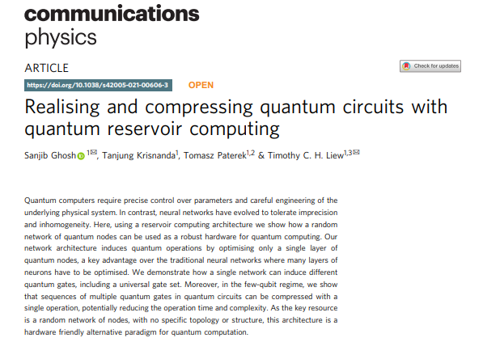
Outline
Introduction, basic theory and recent advances in QRC
Goal of this project, problems tackled and results
Potential future research endeavors and improvements

Slide 3
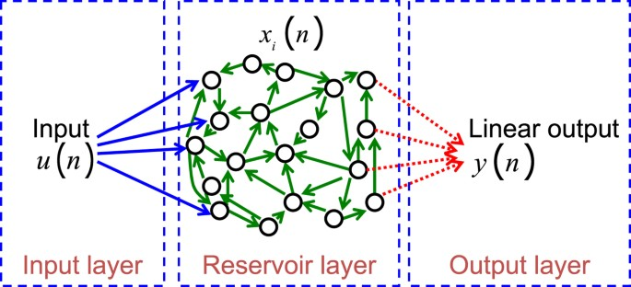
Introduction to Quantum Reservoir Computing (QRC)
Quantum Reservoir Computing →Reservoir Computing (RC) → Recurrent Neural Networks (RNN)
Connections between nodes
Output of nodes affect subsequent input to same nodes => training data to learn
Exhibits temporal dynamic behavior
Figure adapted from Daniel Brunner et al. (1)

Slide 4
Framework for computation based on RNN to create complex dynamical systems
Maps input signals to higher dimensional computational basis through reservoir
Key idea of RC => use fixed, randomly generated nodes/bits in reservoir
=> less computational cost, time and complexity
Reservoir = “black box”
Readout mechanism, obtains state of reservoir and maps it to output node
“Bucket of water” => Reservoir, perturbation on surface (2)
Figure adapted from Daniel Brunner et al. (1)

Slide 5
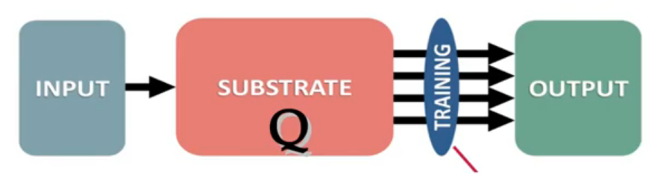
Where we at with QRC?
Figure adapted from Yudai Suzuki et al. (3)
Fast learning, resulting in low training cost
Mapping inputs into a high-dimensional space
Limitations on number of qubits, IBM 433 qubits 2022, by 2023 1000+ qubits? (article:1)
More qubits => higher chance to for states to decohere due to interaction with environment
Basically, lose its quantum property => noisy data!
Quantum Error Correction, minimize decoherence maximize coherence? Active area of research for all things quantum!
Some more information: https://arxiv.org/abs/1907.11157

Slide 6
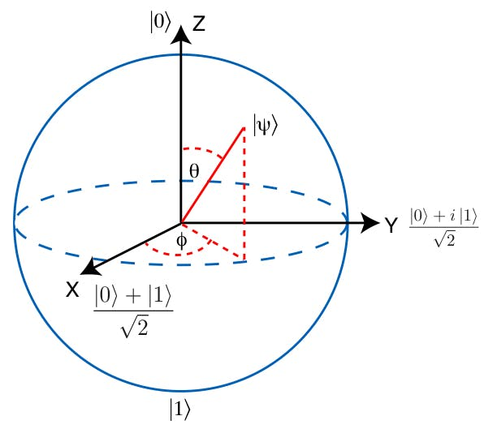
Quantum housekeeping
Figure adapted from Yudai Suzuki et al. (3)
Reservoir and input/output layer is in the quantum domain
Bits, quantum bits → qubits
Qubit can represent infinite # of states
Refrain from making a measurement, subject qubit to a series of quantum interactions
Interactions = rotate state vector, qubit evolving according to the quantum network subjected too
design a network where the final measurement will correspond to some information that you are looking for
Figure adapted from Quantum Inspire (4)

Slide 7
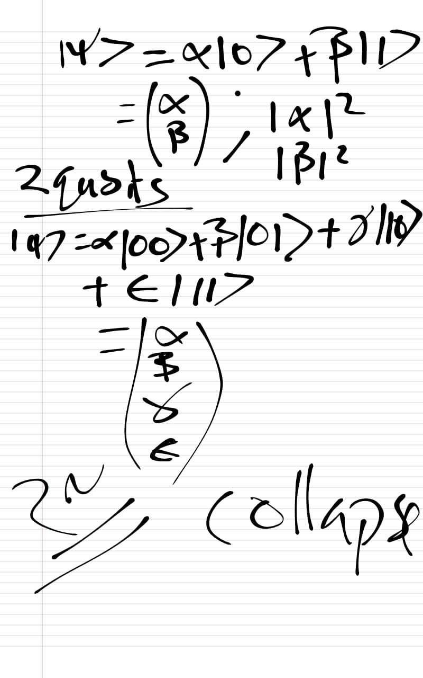
Extra information
2^n numbers to describe 'n’ qubits due to superposition of all possible states until measurement
Example: 2 qubit system => 4 states
00, 01, 10, 11 with some coefficients
4 numbers which characterise the quantum system
3 qubit system: 8 possible, 000, 001…111
Coefficients contain some information about quantum system
only on describing all the 2^n coefficients can we completely describe the system.

Slide 8
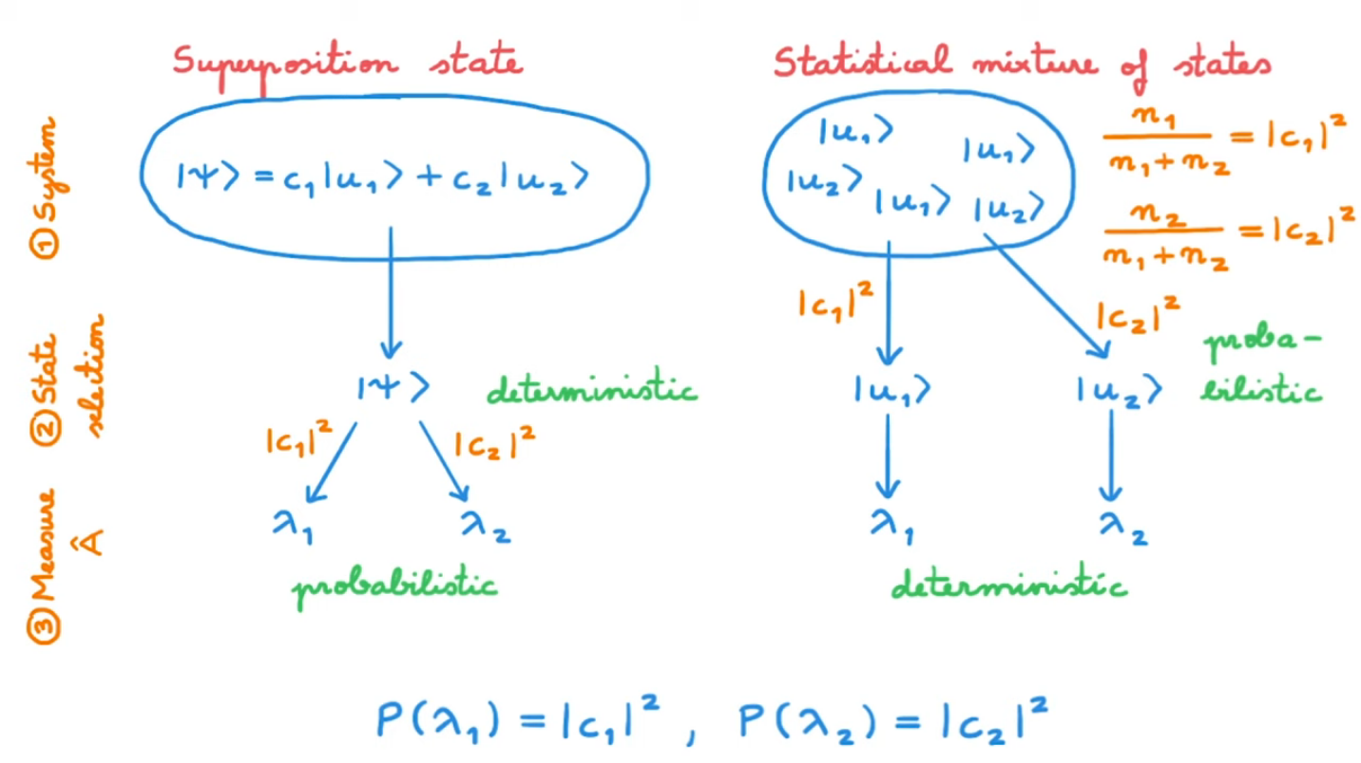
State and Density Matrix representation
In QM, two ways to represent a quantum system:
Wavefunction and Density Matrix representation
Wavefunction Representation:
A vector in Hilbert space which represents all possible states of a system
Can get probability of any measurement and time evolution of system based on some Hamiltonian
State of system completely determined by the wavefunction
Restricted to describing pure states with quantum probabilities
Density Matrix Representation
Mixed state representation, when system not in a pure state
Represents a statistical ensemble of pure states each with certain probability of occurring.
Describes the probability distribution of pure states that make up mixed state
Diagonal elements of matrix represent classical probabilities of finding system in certain state
Off diagonal elements represent coherence between states
Mixed state => partial information of system, do not know if you sample state u1 or u2 i.e
It is probabilistic
https://www.youtube.com/watch?app=desktop&v=DhLbVPn5838
https://www.youtube.com/watch?v=LR5kfhrs4Cc

Slide 9
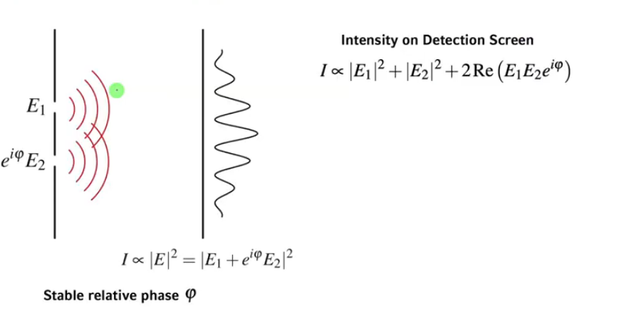
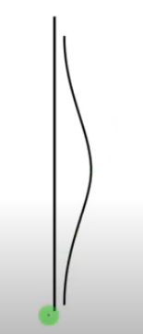
$phi_{t}$

Slide 10
Back to QRC
Figure adapted from Yudai Suzuki et al. (3)
Reservoir → qubits, for example
Reservoir replaced by a quantum circuit
Logic gates = Quantum Gates
And/Or gates → CNOT, CX and TOFFOLI
gates
Hadamard gate
Advantages of QRC is that it can perform both classical and quantum tasks faster due to efficiency of processing input data
Need to control and stabilize the quantum reservoir, as well as the susceptibility of quantum systems to decohere and produce noise
IBM software, simulation (5)

Slide 11
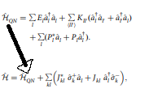
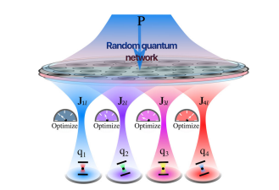
Dr. Ghosh et al. and their published paper: Realising and compressing quantum circuits with QRC
Quantum Network (QN) => Reservoir
Input Exitation terms ‘P’, non interacting reservoir qubits, only interaction is with the output computational qubits
Quantum Tunneling is the only interaction, governed by ‘J’ coefficient
QN acts like a quantum operation by tuning P and/or J values
Based on symmetry of system, certain P and J combination can be interpreted as an X gate, or Z phase gate
Figure excerpt from paper (6) (research paper)

Slide 12

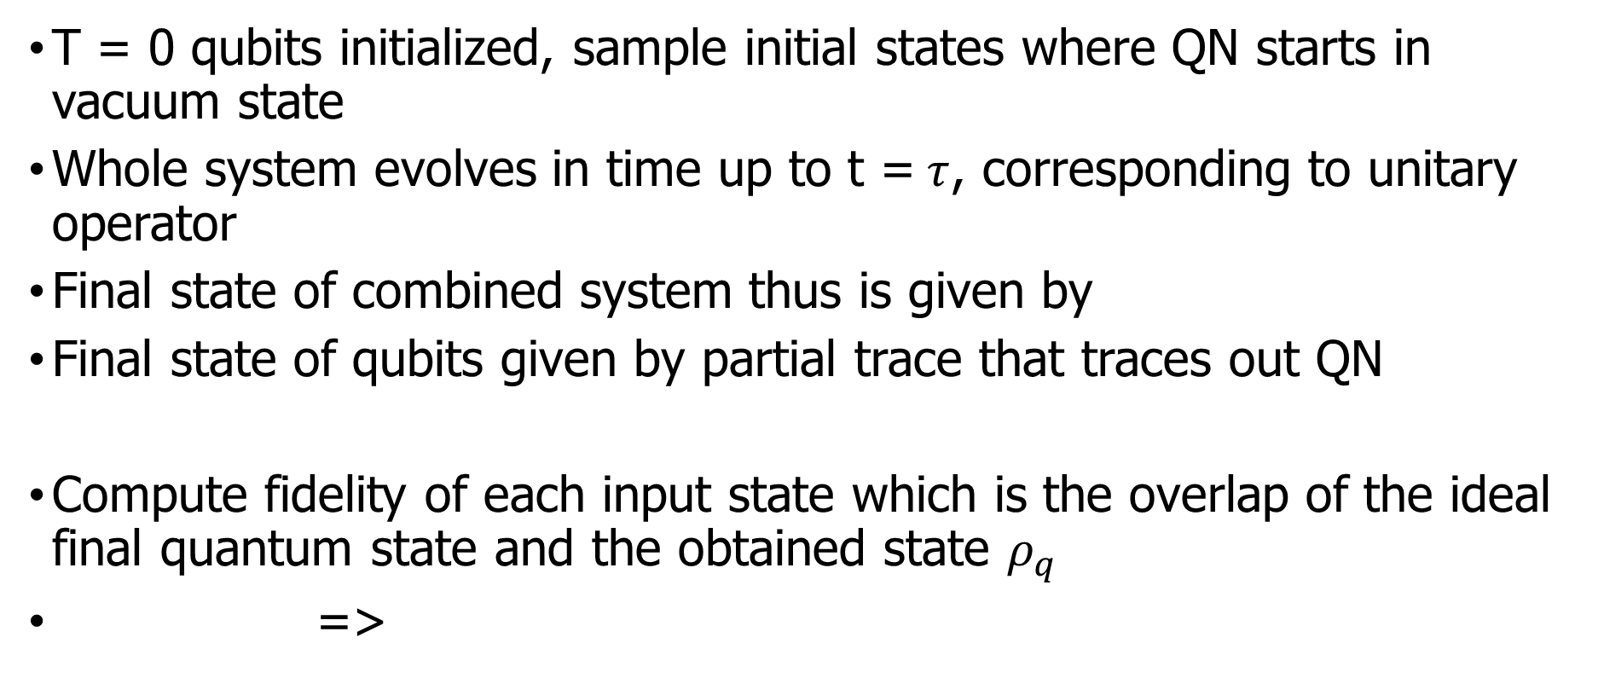
How is it done?
T = 0 qubits initialized, sample initial states where QN starts in vacuum state
Whole system evolves in time up to t =$τ$, corresponding to unitary operator
Final state of combined system thus is given by
Final state of qubits given by partial trace that traces out QN
Compute fidelity of each input state which is the overlap of the ideal final quantum state and the obtained state $ρ_{q}$
=>

Slide 13
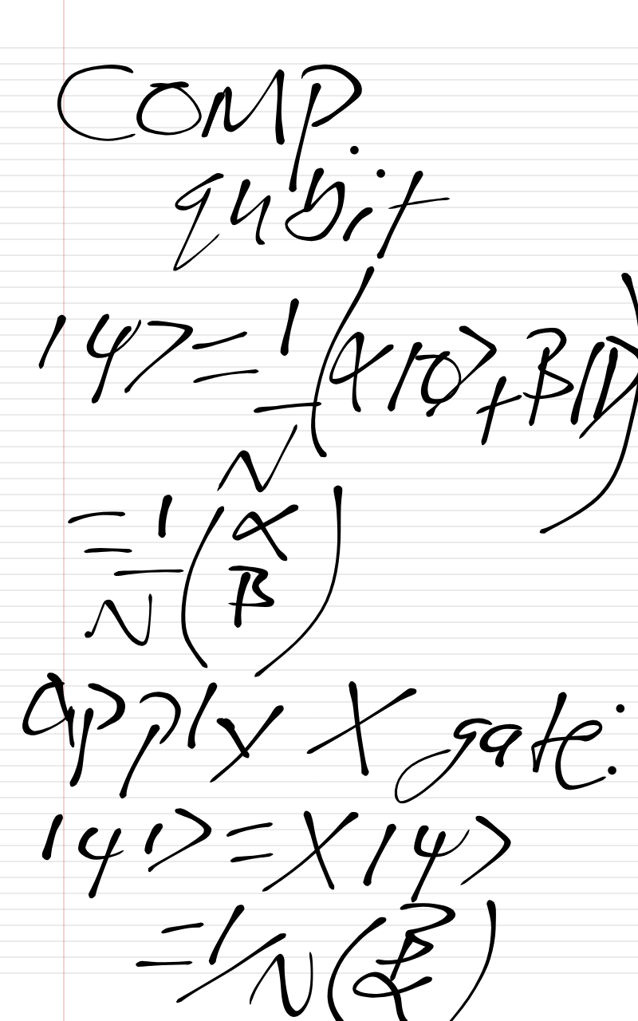
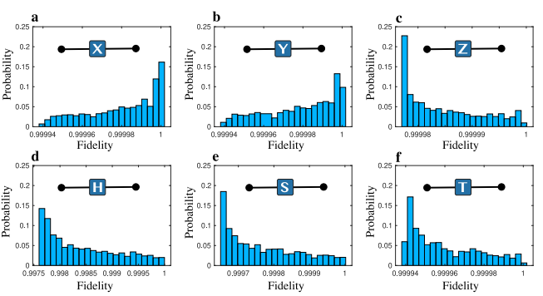
Simulation of Single qubit gates of over 2000 randomly generated states.
P/E0 = (60,60,0.1,4.96,0.1,0.1) &
t*E0/hbar = (3.08, 16.68, 6.28, 1.53, 3.07, 4.71)

Slide 14
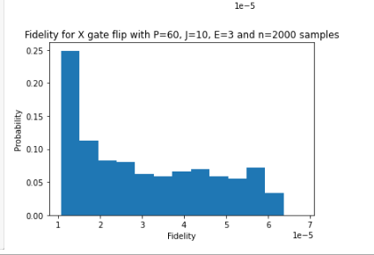
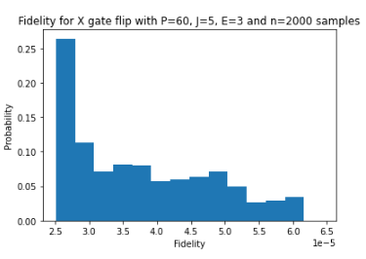
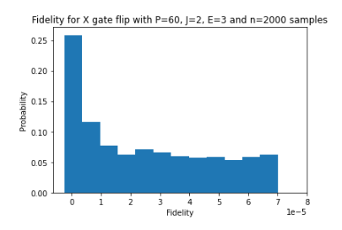
Keeping P,J,E constant and sampling 2000 initial states

Slide 15
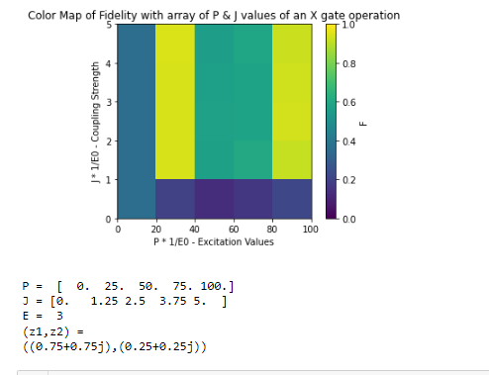
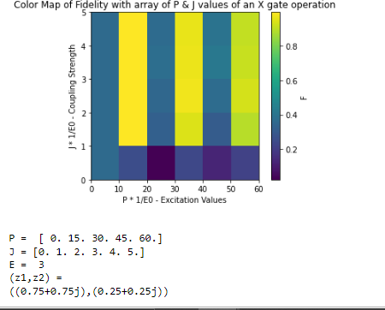
Keeping initial state constant (z1,z2) through iteration, phi_initial = z1|0>+z2|1>, our computational qubit sample
Figure (a)
Figure (b)

Slide 16
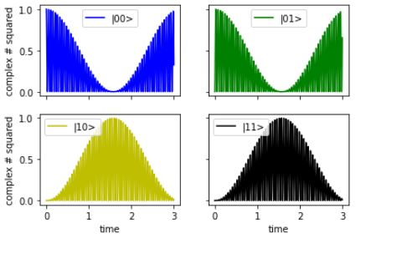
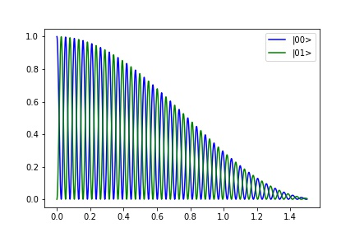
Rabii oscillations
Figure (a)
Figure (b)
1 RQ and 1 CQ
With initial state |00> = (1,0,0,0) &
P = (60/E0), J=(2/E0), E = (-0.5/E0)

Slide 17
Improvements, improvements and more Improvements…
Check phase diagrams and see if there is such phase flip for different phase gates
If so we can characterize our system in terms of this periodicity
Need further research in order to comfirm this idea/theory
Improvements on code and theory needed
Questions?

Slide 18
Supplementary
(1)https://www.degruyter.com/document/doi/10.1515/nanoph-2016-0132/html
(2) https://link.springer.com/chapter/10.1007/978-3-540-39432-7_63
(3) https://www.nature.com/articles/s41598-022-05061-w
(4) https://www.quantum-inspire.com/kbase/bloch-sphere/
More information on QEC:
https://arxiv.org/abs/1907.11157
Article1:IBM https://www.newscientist.com/article/2346074-ibm-unveils-worlds-largest-quantum-computer-at-433-qubits/#:~:text=Dial%20says%20that%20IBM's%20team,lowering%20noise%20and%20mitigating%20errors
(5) IBM Sim: https://www.quantum-inspire.com/kbase/bloch-sphere/
(6)Reasearch paper by Dr. Ghosh et al.
https://www.nature.com/articles/s42005-021-00606-3
Some useful videos:
https://www.youtube.com/watch?app=desktop&v=DhLbVPn5838
https://www.youtube.com/watch?v=LR5kfhrs4Cc

