Slide 1
Fluid 1.1.0
The CacheRuntime framework — onboard any cache system with zero controller code
🎉 Jan 2026 · promoted to a CNCF Incubating project
CNCF Cloud Native Data Orchestration · github.com/fluid-cloudnative/fluid

Slide 2
Release at a glance · since v1.0.8 (Oct 2025)
485
487
125
~9
Commits
Pull Requests
Contributors
months
An architectural leap: from "write a controller per cache system" to "onboard any cache system with a single template".
v1.0.8 (2025-10-30) → v1.1.0 (2026-07)

Slide 3
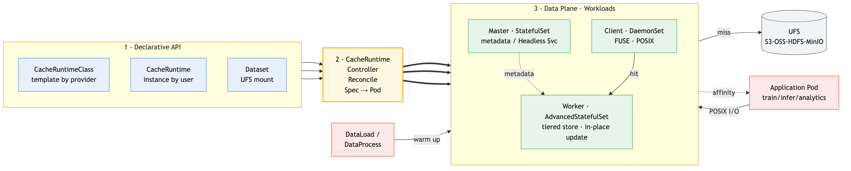
Flagship: the CacheRuntime generic cache-engine framework
CacheRuntimeClass (provider template) + CacheRuntime (user instance) + Dataset → Controller → Master / Worker / Client. Onboarding an engine drops from "write a Go controller" to "fill in a YAML template".

Slide 4
CacheRuntime · Core Capabilities
● Declarative & pluggable
● Built-in topologies
Two new CRDs: CacheRuntimeClass (template) + CacheRuntime (instance) — no controller code
MasterSlave / P2P·DHT / ClientOnly — covers mainstream cache architectures
● Tiered store
● In-place upgrade
Both worker and client support Mem / SSD / HDD multi-tier caching
Via AdvancedStatefulSet — image changes roll in place, less cache rebuild
● Data-flow ready
● Dynamic mount & self-heal
Natively wired to DataLoad / DataProcess for prefetch & processing
Auto-remount on mount change / master restart; cache state synced to Dataset

Slide 5
First engine: Curvine
Curvine — a high-performance, Rust-based cloud-native distributed cache; the first engine to land on the CacheRuntime framework
✓ Master / Worker architecture, Raft for metadata HA
✓ Multi-tier cache: memory / SSD / HDD
✓ POSIX-compatible access via FUSE
✓ Works with S3 / HDFS / OSS / MinIO backends
✓ Per community benchmarks: higher read throughput than open-source Alluxio on the same hardware
✓ A few lines of YAML spin up a full cache cluster via CacheRuntime

Slide 6
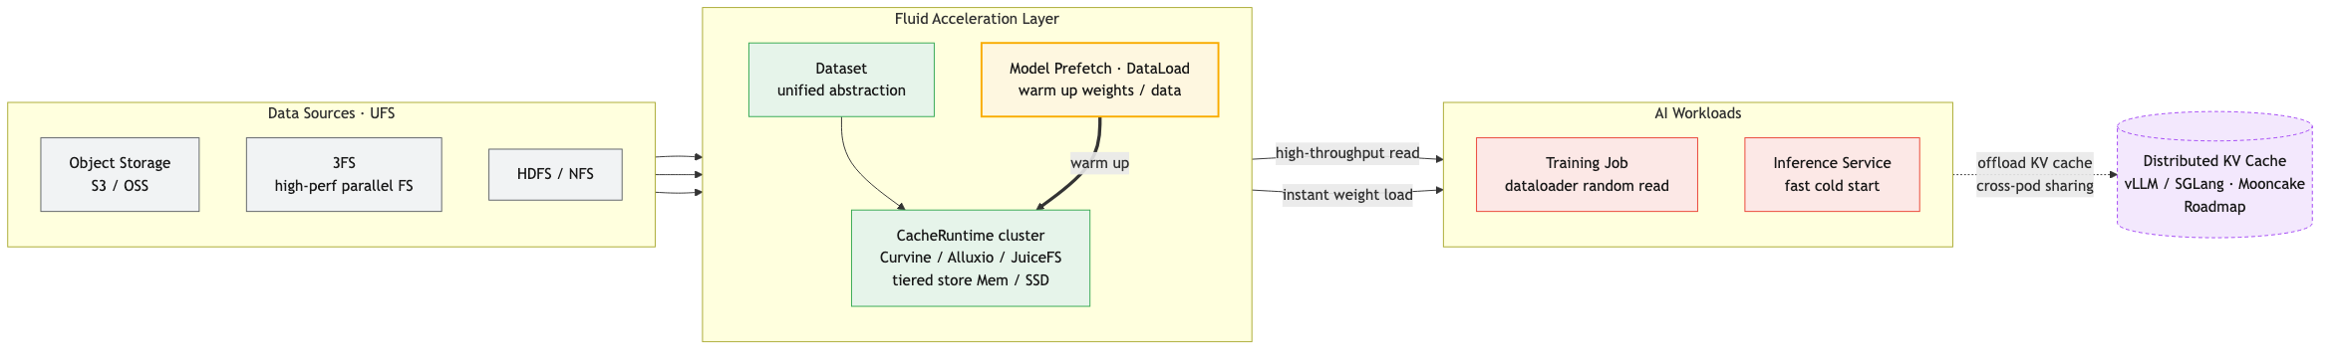
Data Acceleration for AI
Prefetch weights / training data into cache → cut inference cold-start, raise bandwidth use. High-performance stores (e.g. 3FS) integrate via ThinRuntime; KV-cache offload is a 2026 roadmap item.

Slide 7
Engine & Feature Enhancements
JindoCache
JuiceFSRuntime
DataProcess
RDMA support unlocks high-perf network read + master crash recovery
Worker volumeClaimTemplates more flexible persistence
Cron scheduling + OnEvent triggers fits automation pipelines
Also: global skip-runtime-sync switch · more resource names on runtime pods · host-PID feature gate · CSI fast node-label path & recovery loop · Jindo multi-mount OSS secrets

Slide 8
Reliability & Security Hardening
Reliability & quality
Security hardening
• 240+ testing / E2E improvements (largest ever)
• Least-privilege RBAC / ClusterRole
• Full test-suite migration to Ginkgo v2 + Gomega
• Tightened GitHub Actions permissions
• gohook → gomonkey for stubbing
• Fixed path-injection risk in addons
• Fixed data races and controller panics
• Base image bumped to alpine 3.23.3
• Retry-on-conflict on critical paths (UFS / webhook)
• Removed bundled Helm binaries from repo
• DataLoad/DataMigrate correctly watch Jobs
• Removed hardcoded Asia/Shanghai timezone

Slide 9
Deprecation & Upgrade
⚠ GooseFSRuntime is deprecated; its resources and docs are removed — plan migration
Upgrade:
helm repo add fluid https://fluid-cloudnative.github.io/charts helm repo update helm upgrade --install fluid fluid/fluid --version 1.1.0 -n fluid-system
Note: new CacheRuntime / CacheRuntimeClass CRDs — update CRDs on upgrade; using CacheRuntime requires the AdvancedStatefulSet (OpenKruise) controller.

Slide 10
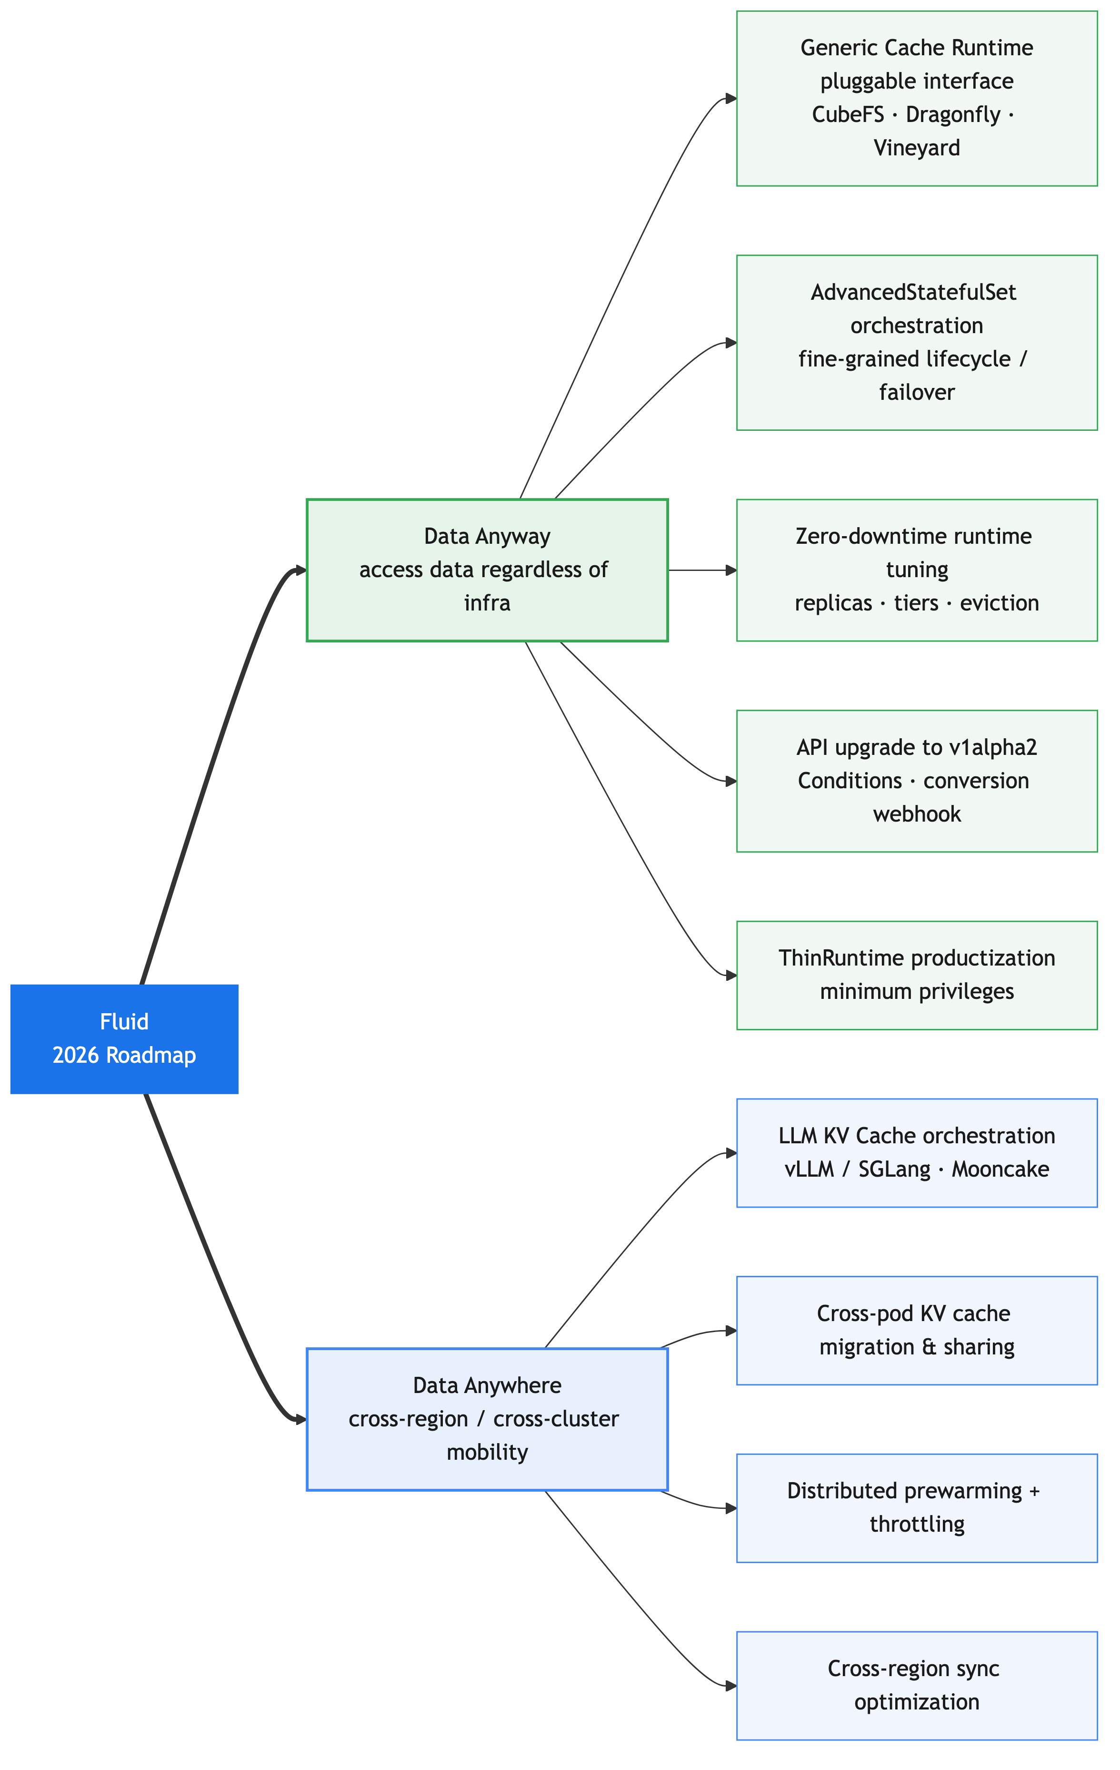
2026 Roadmap
Data Anyway · regardless of infra
▸ Generic Cache Runtime pluggable interface
▸ Full migration to AdvancedStatefulSet
▸ Zero-downtime runtime tuning
▸ API upgrade to v1alpha2 + webhook
▸ ThinRuntime productization (min privilege)
Data Anywhere · cross-region/cluster
▸ LLM KV Cache orchestration (vLLM/SGLang · Mooncake)
▸ Cross-pod KV cache migration & sharing
▸ Distributed prewarming + throttling
▸ Cross-region sync optimization

Slide 11
Get Involved
⭐ github.com/fluid-cloudnative/fluid 💬 Open issues / PRs — bring your cache engine to the CacheRuntime ecosystem 🙏 Thanks to the 125 contributors of this cycle
Fluid 1.1.0 · CNCF Incubating Project

