Slide 1
Query-Item Interaction Networks
Shiyun Chen
2018.08.09

Slide 2
Task Introduction

Slide 3
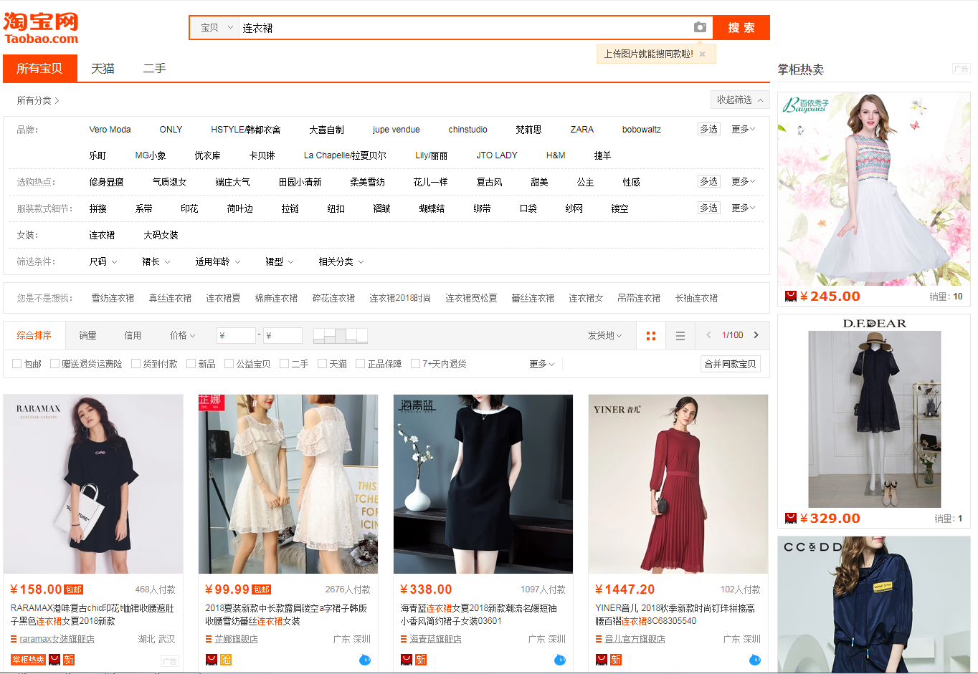
Item Recommendation Query Suggestion

Slide 4
Related Work (3)

Slide 5
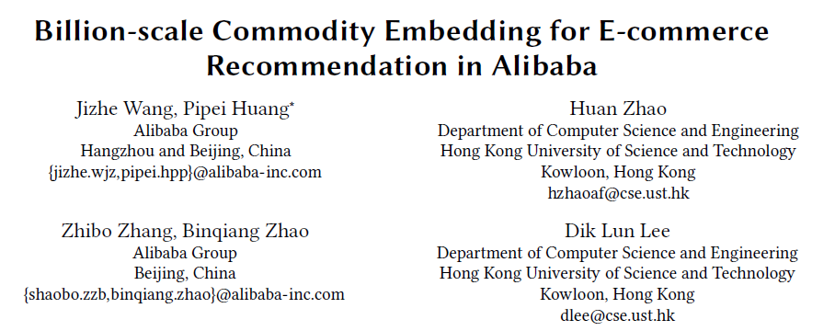
Related Work ¹
KDD 2018

Slide 6
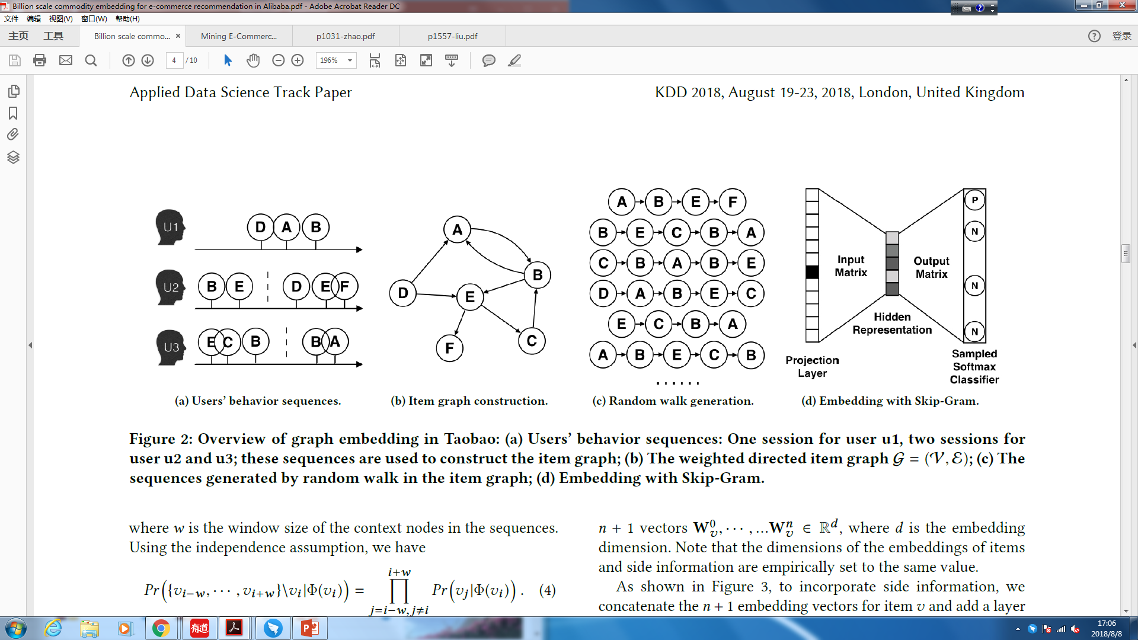
Related Work ¹

Slide 7
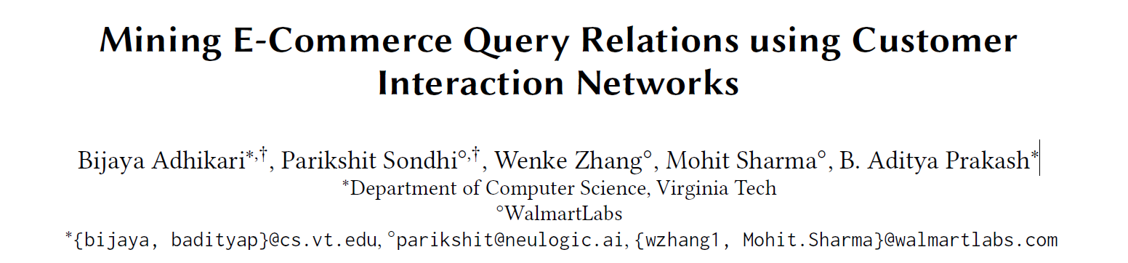
Related Work ²
International World Wide Web Conferences Steering Committee 2018

Slide 8
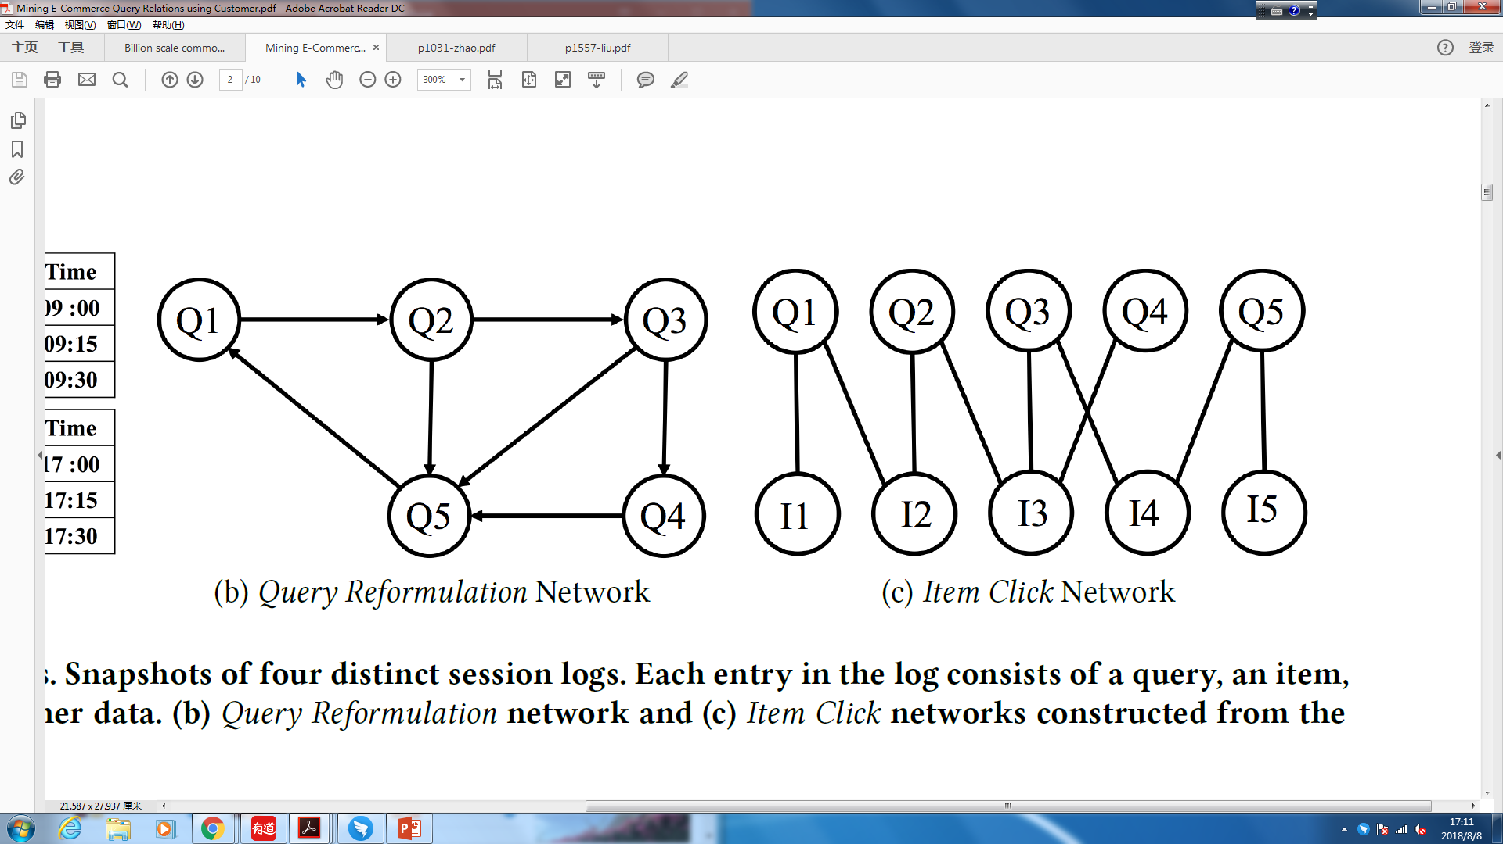
Related Work ²
Intent Based Query Clustering
Product Recommendation

Slide 9
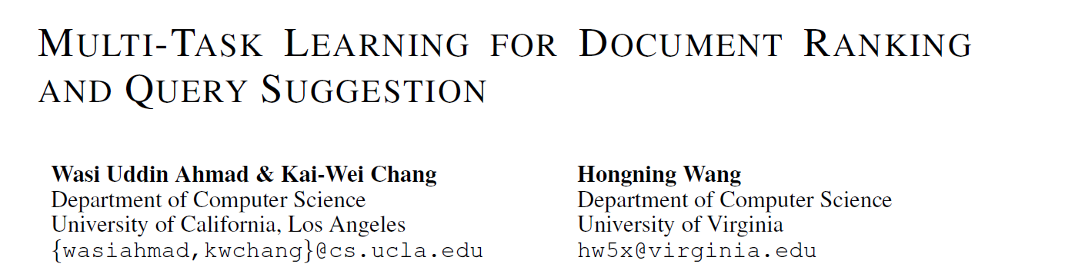
Related Work ³
ICLR 2018

Slide 10
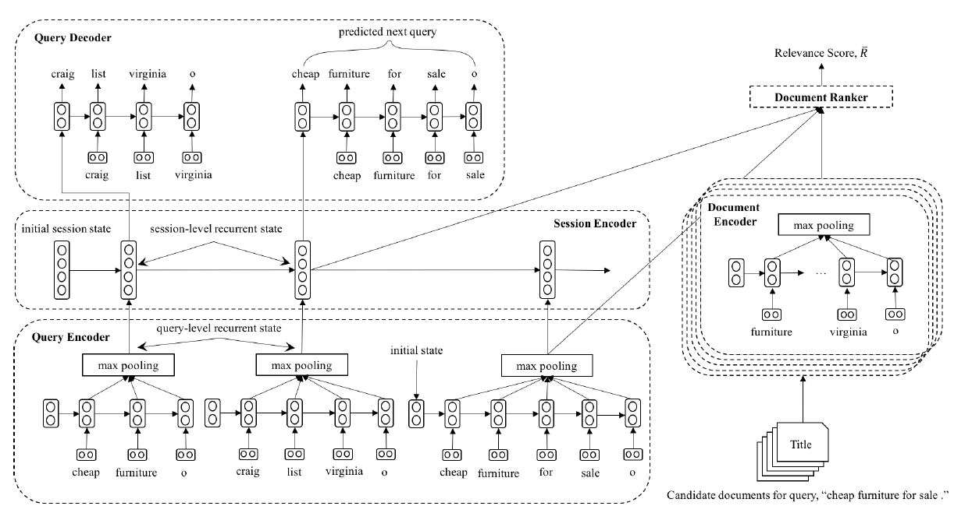
Related Work ³
^{IR}

Slide 11
Query-Item Interaction Networks

Slide 12
Q₁
Q₂
Q₂
Q₁
Q₃
Q₃
(1) Session Based
(2) Query-Item graph construction
(3) Random Walk Generation
(4) Embedding with Skip Gram

Slide 13
Conclusions
Item recommendation
Query suggestion
Multi-task learning

