Slide 1
KGR 基于知识图谱的推荐系统
立项报告（1）
林琛
厦门大学

Slide 2
大纲
场景指示性商品抽取
可解释推荐

Slide 3
场景指示性商品：定义
场景定义
A scenario is a semantically coherent cluster of items that are related to a specific type of user needs
指示物定义
A footprint of a scenario is a package of item categories which ``defines" a scenario
The item categories cover consistent user needs
The item categories are semantically correlated

Slide 4
研究意义
Example：
海边度假：泳衣+小白裙+草帽+防晒神器
相亲：连衣裙+斩男色+香水……
健身房：运动衣+水壶+速干毛巾……
Application
决定了入口的layout，无参数
以品类而不是item做最小单元，为个性化推荐留下余地

Slide 5
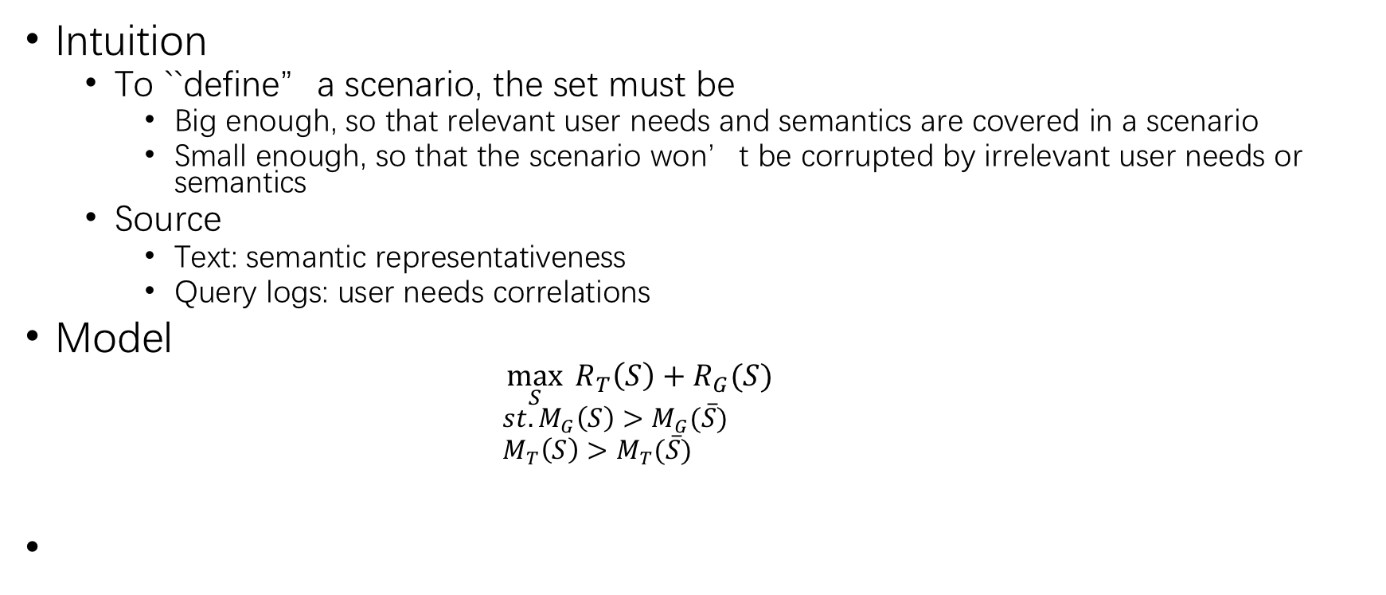
模型
Intuition
To ``define”a scenario, the set must be
Big enough, so that relevant user needs and semantics are covered in a scenario
Small enough, so that the scenario won’t be corrupted by irrelevant user needs or semantics
Source
Text: semantic representativeness
Query logs: user needs correlations
Model
$$\max_{S}{ R_{T}\left(S\right)+R_{G}(S)}$$
$$st. M_{G}\left(S\right)>M_{G}(\overline{S})$$
$$M_{T}\left(S\right)>M_{T}(\overline{S})$$
Text source, cover
Some sort of closeness measures on text and query graph
consistent
Query graph, cover

Slide 6
Baseline
Sample a collection of query logs (not labelled)
Domain:
Sample rate:
Build correlation graph, edge weight = co-occurrence
Crawl a collection of blogs
淘攻略
Represent semantics: chi-square based on relevant/irrelevant blogs
Rank category (leaf) based on chi-square
Greedy Solution
Top down
If edge weight > current mean, select
Until all documents are covered

Slide 7
Future Extension
目前因为log没有scenario label，所以目标函数里只考虑了text cover
约束利用的是最简单的measure
文本：chi-square
Query: co-occurrence
可以扩展用graph representation learning等
Behavior: action
Time: burstness?

Slide 8
Evaluation
还不知道，先自己跑出来看看

Slide 9
Explainable recommendation：定义
Problem1: Given a specific user-item recommendation, which path in KG explain the recommendation?
Input: user-item pair<u,i>, a knowledge base
Output: a path in KG.
Idea: deep match, attention on path to select the best path
Problem2: Given the path that best explain the recommendation, how to generation a natural sentence for the recommendation.
Input: a path in KG
Output: a sentence that best describes the path.
Idea: text generation model
Notes:
可解释性推荐。

Slide 10
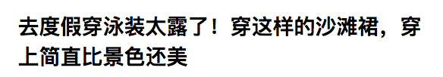
Explainable Recommendation：问题定义
Input: purchase in a session
Output: natural language explanation
Example

Slide 11
Framework
Template Based
Select a set of high quality sentences
i.e. match to a set of items/categories
Persuasive, e.g. in a title, etc.
Learn a set of templates
Define slots including relations, adjectives or items
Probability distribution of slot values
For any session
Locate path in KG
Compress path-> match best template

Slide 12
Baseline
Sentence Selection
Retrieve a sentence that covers at least one category/ item
Scoring: quality features including field, length, entropy, grammar etc.
Template extraction
Dependency parse tree
Frequent sub-tree
Template matching
Path location
Accessible to a set of template
Template ranking

