Slide 1
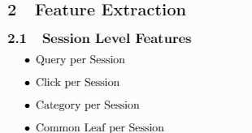
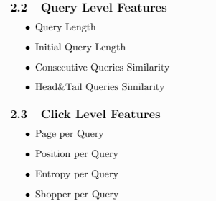
代替考虑大类和叶子节点，考虑整个类目树
代替bag of word，利用embedding捕捉同义词
代替直接考虑点击类别个数，利用熵和店家增加容忍度

Slide 2

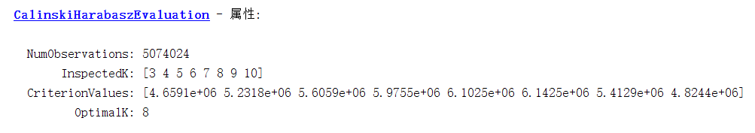
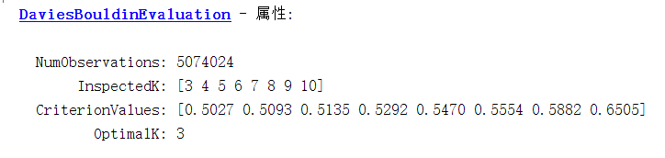

Slide 3
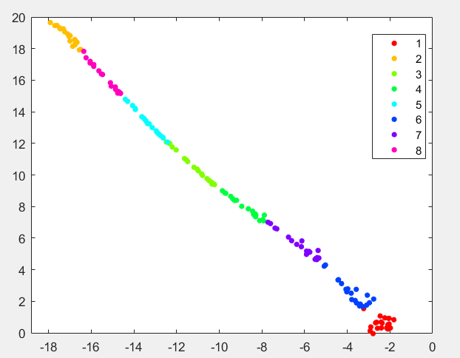

Slide 4
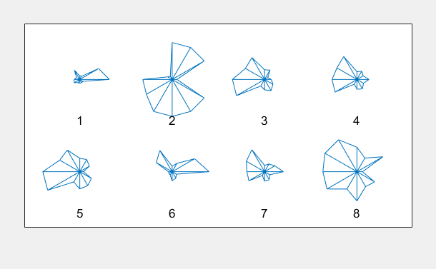

Slide 5
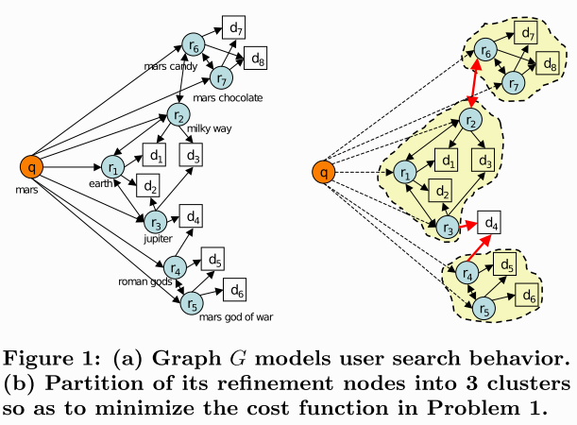
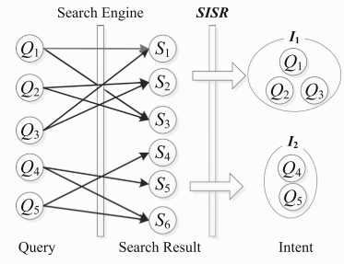
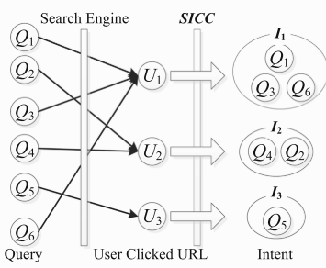
Clustering Query Refinements by User Intent.
Query Recommendation Based on User Intent Recognition.
Mining and ranking users’ intents behind queries.

Slide 6
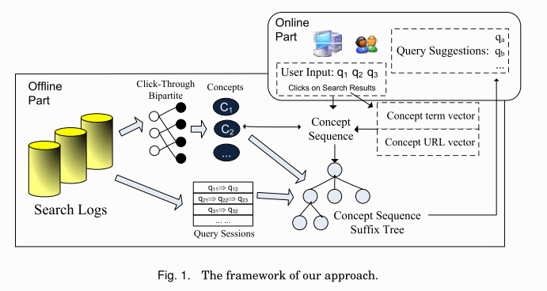
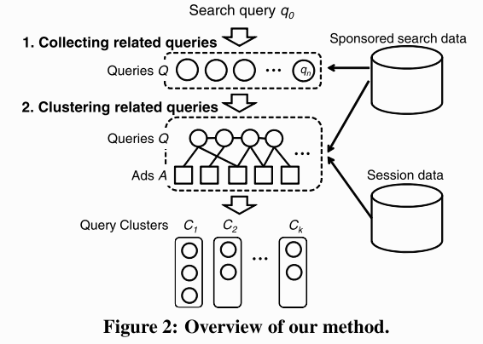
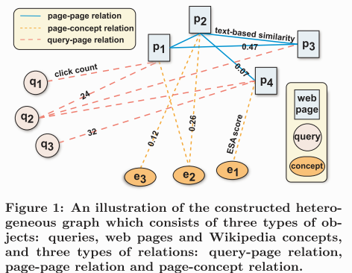
The Wisdom of Advertisers: Mining Subgoals via Query Clustering.
Heterogeneous Graph-Based Intent Learning with Queries, Web Pages and Wikipedia Concepts.

