Slide 1



National Outcome Forecast Assessment
Charles Rethman
SADC-RVAA/SAVAC

Slide 2

The NOFA: Why do it?
Presently, South Africa is experiencing the worst drought since 1992
Concurrently, the Rand is weak and the country needs to import food
Prices of food are rising fast
Clearly, this is enough justification!
Introduction
OFA Model
Methods
Discussion

Slide 3
The NOFA: What is it?
It is the next step after the baselines are completed
But this is a National Outcome & Forecast Assessment
It is a synthesis indicative analysis, we do not have all the primary information we need, we will rely instead on secondary sources
Introduction
OFA Model
Methods
Discussion

Slide 4
The NOFA: What is it?
An attempt to peer into a possible future ...
... but not too far! The coming “Consumption Year”: April ’16 to March ’17)
To understand how poorer people’s livelihoods could change given prevailing conditions
Introduction
OFA Model
Methods
Discussion

Slide 5
The NOFA: What is it?
Building scenarios:
Using what we know and making stated assumptions about what we don’t know ...
... we determine the outcome
Introduction
OFA Model
Methods
Discussion

Slide 6
The NOFA: What is it?
This is not the final say!
Our model only gives a possible outcome for a given set of conditions
Our assumptions will need to be tested and monitored
If reality is different, the model must be re-calibrated
Introduction
OFA Model
Methods
Discussion

Slide 7
The NOFA: What is it?
Why it is useful:
We can still plan ahead – devise solutions before adverse outcomes occur
We will also know the critical variables – the ones with the most impact – and these need to be watch more closely
Introduction
OFA Model
Methods
Discussion

Slide 8

How Outcome Forecasts Work
Introduction
OFA Model
Methods
Discussion

Slide 9
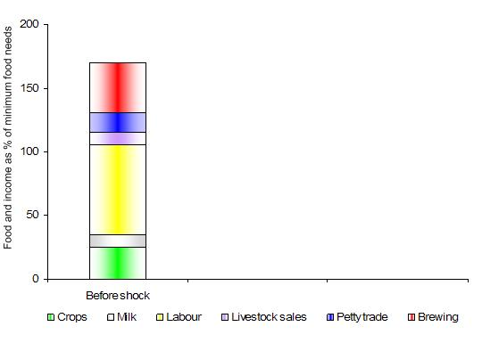
How Outcome Forecasts Work
Introduction
We start with an understanding of how households normally live (baseline)….
OFA Model
Methods
Discussion
=8,800 kJ /p/d
=12,848,000 kJ for a hh of 4 for a year

Slide 10
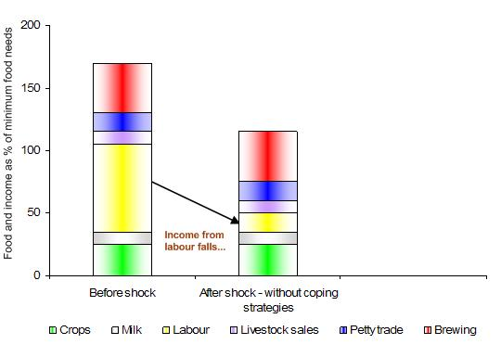
How Outcome Forecasts Work
Introduction
…then we incorporate the impact of a shock….
OFA Model
Methods
Discussion

Slide 11
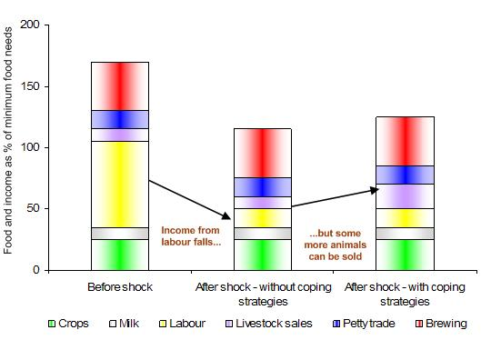
How Outcome Forecasts Work
e.g. this analysis suggests that post-shock, households will not be able to maintain themselves above the LBPL without assistance.
…and finally look at how people might be able to cope.
Introduction
Lower Bound Poverty Threshold
OFA Model
Gap
Food Poverty Threshold
Methods
Discussion

Slide 12

Methods and Approach
Two issues to deal with
Lack of Baselines (no disrespect to the hard work of my colleagues!)
Compiling credible problem specifications to define the hazard component entirely from secondary sources
Introduction
OFA Model
Methods
Discussion

Slide 13
Methods and Approach
It’s about POOR People!
First Big Issue:
Baselines not yet completed.
Divide into three categories:
Rural LZs with open access (traditional) tenure systems
Rural LZs with commercial farm land
Urban areas
Introduction
OFA Model
Methods
Discussion

Slide 14
Methods and Approach
Rural Open Access Zones with Open Access or Traditional Tenure:
We have baselines in 14 livelihood zones:
Some livestock-oriented, some mixed cropping and livestock, some more cropping.
Introduction
OFA Model
Methods
Discussion

Slide 15
Methods and Approach
Rural Open Access Zones with Open Access or Traditional Tenure:
In all LZs we see the poor depend:
Largely on social grants (pensions & child grants)
Some casual labour (for cash usually, occasionally for food)
A tiny bit of cropping
Sometimes, a few livestock
Kinship links
Introduction
OFA Model
Methods
Discussion

Slide 16
Methods and Approach
Rural Open Access Zones with Open Access or Traditional Tenure:
We are constructing some “typical” livestock, mixed crop and livestock and crop-based baselines to cover the remaining Livelihood zones.
The sources of livelihood are being adjusted to these types of LZs.
We are going to analyse the ‘poor’ and the ‘very poor’ ONLY
Introduction
OFA Model
Methods
Discussion

Slide 17
Methods and Approach
Rural Zones with Commercial Farming:
Focusing on farm workers (full time) Seasonal Workers and Casual workers
Their welfare is linked to the performance of the sectors
Introduction
OFA Model
Methods
Discussion

Slide 18
Methods and Approach
Rural Zones with Commercial Farming:
One approach:
Based on BFAP data, labour pay and labour requirements per Ha for ten most significant industries
Estimates of hectarage of each of those industries and, therefore,
Estimates of work opportunities
Introduction
OFA Model
Methods
Discussion

Slide 19
Methods and Approach
Rural Zones with Commercial Farming:
One approach:
Labour rates are available (BFAP)
Required: estimates of dependents per workers (for household composition)
Required: with seasonal work, comparison of seasonal employment vs full-time
Introduction
OFA Model
Methods
Discussion

Slide 20
Methods and Approach
Rural Zones with Commercial Farming:
One approach:
Two ‘typical’ households: A full time worker and a casual worker
Other components of livelihood can be included:
Social grants, loans, kinship, expenses
Introduction
OFA Model
Methods
Discussion

Slide 21
Methods and Approach
Urban Areas:
One approach:
‘Typical’ households: unemployed, employed (casual work)
Data from Stats SA, NIDS surveys
Livelihood components:
social grants, labour, petty business, kinship, loans, expenses
Introduction
OFA Model
Methods
Discussion

Slide 22
Methods and Approach
Second Big Issue:
Drafting credible problem specs
Main variables being studied:
Drought vs non-drought affected areas & impact of drought on crops, livestock
Price projections
Work opportunities, social grants policy, kinship links
Introduction
OFA Model
Methods
Discussion

Slide 23
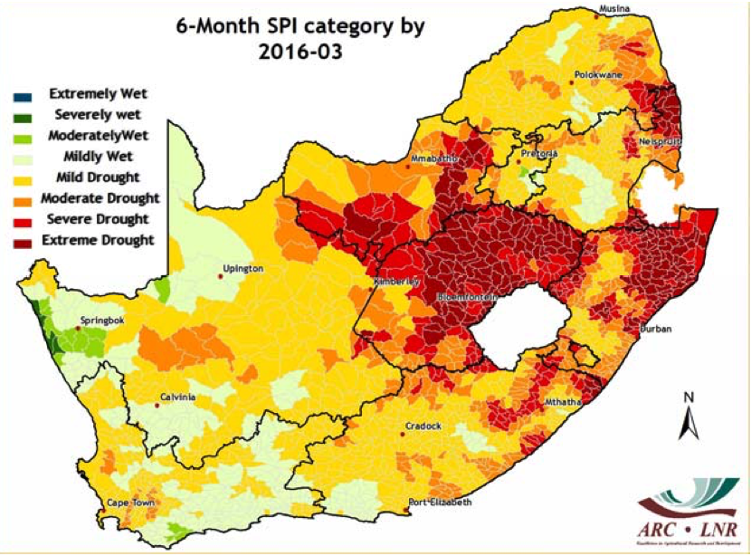
Methods and Approach
Drought areas, SPI – overlay onto LZs
Introduction
OFA Model
Methods
Discussion

Slide 24
Methods and Approach
Prices :
Data from NAMC, BFAP, Stats SA:
‘Forward’ models for key commodities -> use for scenario assumptions (BFAP, NAMC)
Influence of the exchange rate on other commodities (esp. imported)
Introduction
OFA Model
Methods
Discussion

Slide 25
Methods and Approach
Social grants:
Future payments --> DSD policy
Rate does not change, tracks inflation, tracks food prices
Casual work:
Pay rate & work available
Scenario
Introduction
OFA Model
Methods
Discussion

Slide 26
Methods and Approach
Putting it all together
This is, fortunately, a number-crunching exercise – Thanks to Mr Postgres
Analysis spread sheets
Outcomes at Hh level to Postgres table
Query linking outcomes with populations.
Introduction
OFA Model
Methods
Discussion

Slide 27

Thank you / Siyabonga /
Ke a Leboga / Dankie

Slide 28
Acknowledgements
DAFF (Crop Estimates Committee)
NAMC
BFAP
Statistics SA
ARC (Inst. for Soil, Climate & Water)
SA Weather Service

Slide 29

Discussion Points
What should we do?
Comments?
Introduction
OFA Model
Methods
Discussion

