Slide 1
National Outcome Forecast Analysis
South Africa
Presented by T. Dlamini
Analysis prepared by Charles Rethman

Slide 2
Reasons for the NOFA
South Africa is experiencing its worst drought in 23 years;
The poor crop performance dues to the drought has forced the need for massively increased imports;
Concurrently, commodity markets have slowed and the currency (Rand; ZAR) is weak;
Consequently, food prices have soared in local terms

Slide 3
Background
Although tremendous progress in the welfare of citizens has taken place since 1994, some of South Africa’s economic and social realities are:
Unemployment has remained stubbornly high (rising slightly over the last year);
Economic growth has been slowing;
Income inequality has widened;

Slide 4
Background
There are still apartheid and colonial legacies to be overcome—with racial disparities in spatial distribution, ownership, economic access and educational opportunities;
The country remains beset with deep-rooted social issues including excessive violence, crime and ugly racism

Slide 5
Reality Check
It’s not all doom and gloom.
Tremendous progress has been been in many areas: ranging from education to governance and the extension of services to formerly marginalised people.
But, given this background and the present economic and climatic outlook, what does this mean for the country’s poorest and most vulnerable citizens?

Slide 6
Analysis Process
This assessment was conducted to try answer this question.
It aims to gain some insight on a broad, national scale into what the near-future consequences of drought and economic turmoil might be for households.
It is a desk study. It draws heavily on secondary sources and is liberally sprinkled with assumptions. Many of these assumptions will be discarded with the arrival of new and better data.
Notes:
The written report will highlight many of these assumptions which cannot be covered in this presentation.

Slide 7
Analysis Process
Uses the same standard livelihoods-based approach that is used in other SADC member states. Steps:
Make use of existing baselines and data (14 LZs)
Extrapolate the existing data to include other similar (open access tenure) LZs
Construct baselines using secondary sources for two other livelihood types:
Farm workers
The urban poor

Slide 8
Analysis Process
Uses the same standard livelihoods-based approach that is used in other SADC member states. Steps:
Analyse rural productive systems to determine local problem specifications
Review economic data to determine reasonable price estimates and future price scenarios
The issue of social grants. They make an overwhelming difference, so what about those few people who have no access to them?

Slide 9
Baselines
Open access areas without existing baselines
Group LZs into three Livelihood Types:
Predominantly livestock-based
Predominantly cropping-based
A mixture of the two .

Slide 10
Baselines
Open access areas without existing baselines
Livelihood strategies were derived by aggregating the data from the same Livelihood Types:
Predominantly livestock-based
Predominantly cropping-based
A mixture of the two .

Slide 11
Baselines
Example of the mixed baseline (ZA2XX)

Slide 12
Farm workers & Urban Poor
Information was pieced together from survey data, mostly the Western Cape Farm Workers’ Conditions survey and the National Income Dynamics Survey
Usual wealth groups replaced with categories:
Farm workers: casuals, temporary workers and full-time employees
Urban: quintiles (we only looked at the bottom four)

Slide 13
Farm workers and Urban Poor
Example of the Farm Workers

Slide 14
The Drought
To determine the extent of the impact of the drought, we looked at many sources:
Standard Precipitation Indices (SPI) from ARC ;
Normalised Differential Vegetation Indices;
Vegetation Condition Index (VCI)

Slide 15
SPI
Notes:
“The Standardized Precipitation Index (SPI - McKee et al., 1993) was developed to monitor the occurrence of droughts from rainfall data. The index quantifies precipitation deficits on different time scales and therefore also drought severity. It pro- vides an indication of rainfall conditions per quaternary catchment (in this case) based on the historical distribution of rainfall.” – UMLINDI – The Watchman, Issue 2016-1.

Slide 16
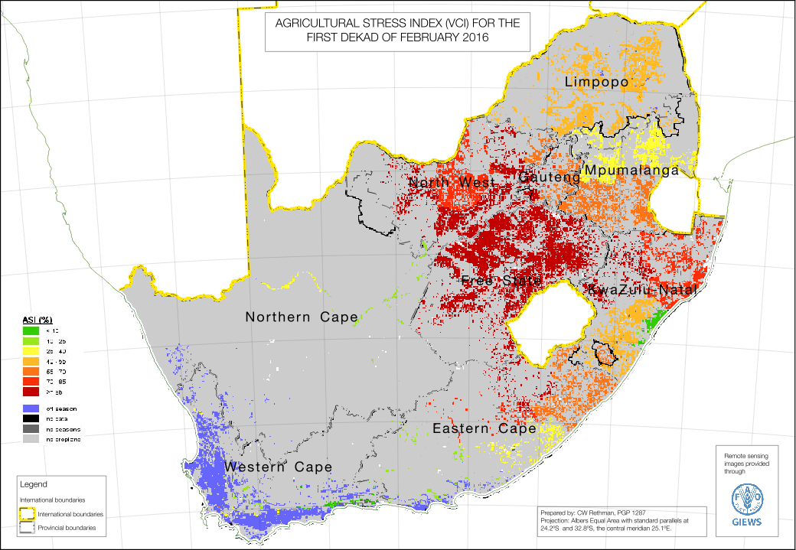
Agricultural Stress Index
Notes:
This image showed the development of the season just after the rains got underway in January.
The ASI is good for crop farming conditions but lacking for livestock areas.

Slide 17
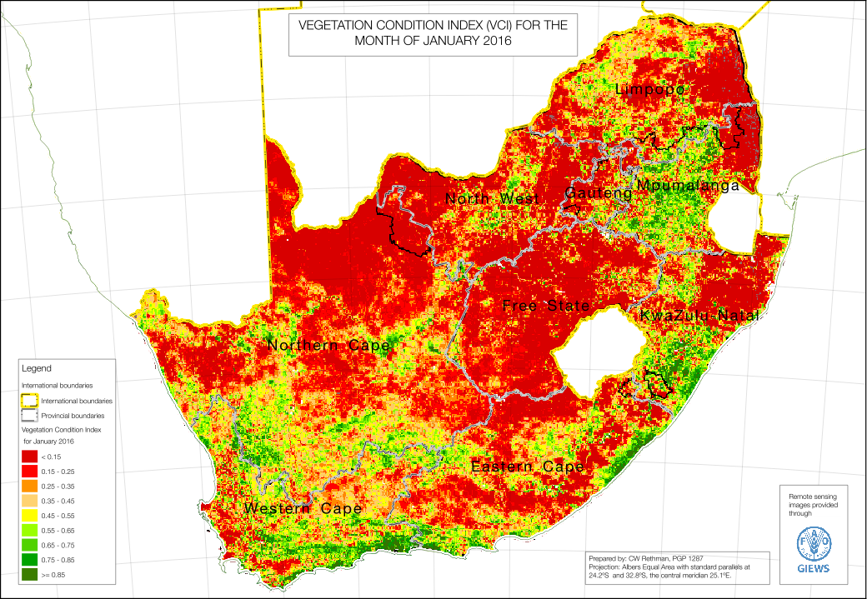
Vegetation Condition Index
Notes:
The analyst decided to use the image from January, as it shows the condition of the vegetation by the time the rains actually started in January. By then, it was too late for much of the crop farming areas and the impact on the livestock rangelands is visible too. However, some of the impact of the summer rains in January does also come through as well. This image therefore also distinguishes between those areas that received some summer rainfall and those that did not.
Previous VCI images (e.g. November and December) show a much worse situation.

Slide 18
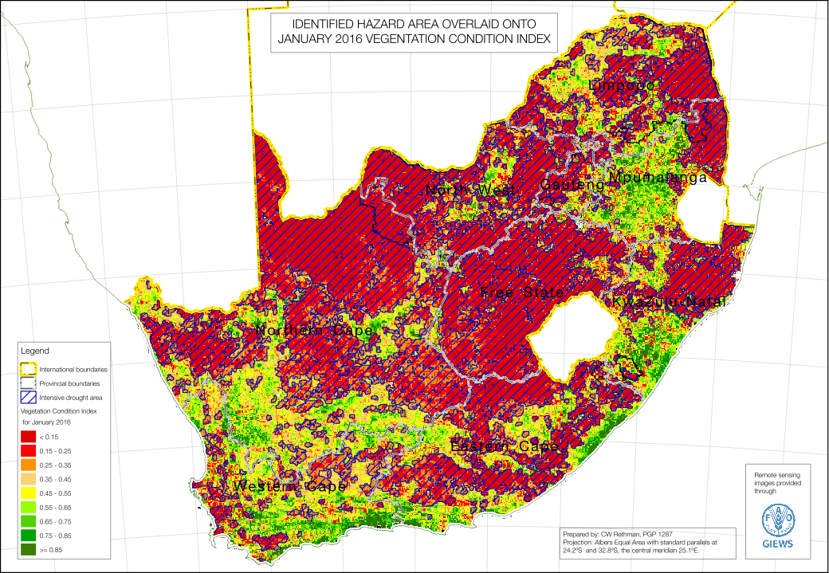
Vegetation Condition Index & Drought Hazard Area
Notes:
The ‘reddest areas’ (VCI < 0.35) were picked out and digitised (buffered for aggregation). These are presented as the cross-hatched area with the most intensive drought. The Hazard area was then used to determine problem specifications.

Slide 19
Problem Specifications
Crop estimates are provided by the CEC and they available data are detailed for commercial farming (exclusive access tenure).
However, detail in non-commercial crop farming areas is lacking.
To geographically disaggregate of crop data and obtain a problem spec the analyst overlaid the hazard are onto the agricultural regions.
This help quantify Prob Specs for basic crop groups, e.g. cereals, legumes, etc.

Slide 20
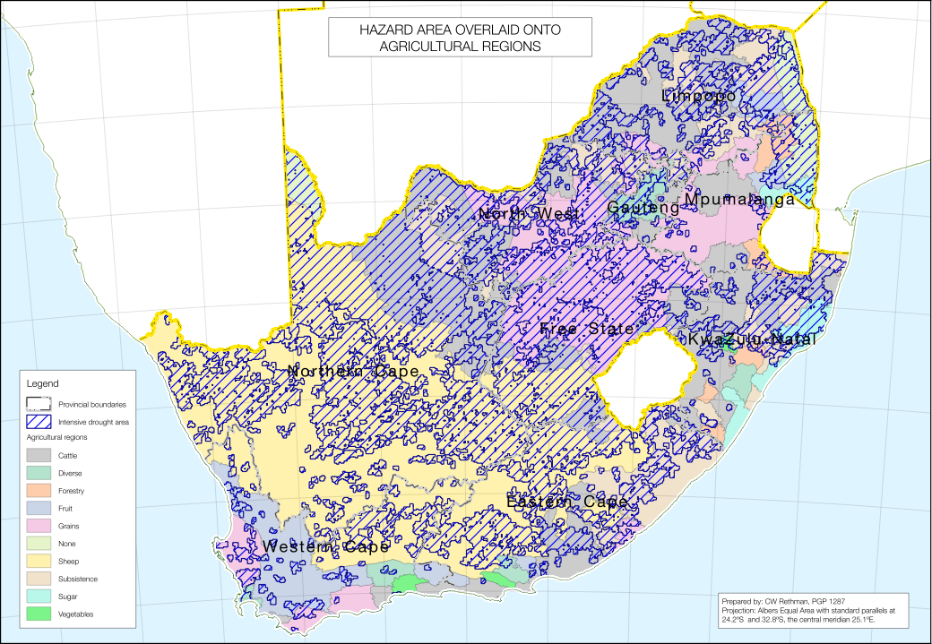
Hazard Area & Farming Regions
Notes:
The ‘reddest areas’ (VCI < 0.35) were picked out and digitised (buffered for aggregation). These are presented as the cross-hatched area with the most intensive drought. The Hazard area was then used to determine problem specifications.

Slide 21
Example Problem Specs for Grains
province | ag_type | hazard | local_probspec | local_probspec | area_local | area_total
---------------+---------+----------+----------------+----------------+-------------+-------------
Eastern Cape | Grains | drought | 54% | 35% | 1398441124 | 2885838187
Eastern Cape | Grains | less dry | 54% | 72% | 1487397063 | 2885838187
Free State | Grains | drought | 42% | 35% | 68047449948 | 79877460698
Free State | Grains | less dry | 42% | 82% | 11830010750 | 79877460698
Gauteng | Grains | drought | 56% | 35% | 1371549537 | 2710036181
Gauteng | Grains | less dry | 56% | 78% | 1338486645 | 2710036181
KwaZulu-Natal | Grains | drought | 75% | 35% | 195640 | 4918358
KwaZulu-Natal | Grains | less dry | 75% | 77% | 4722718 | 4918358
Limpopo | Grains | drought | 113% | 35% | 2850906266 | 10230620517
Limpopo | Grains | less dry | 113% | 143% | 7379714251 | 10230620517
Mpumalanga | Grains | drought | 66% | 35% | 2877212423 | 29746559200
Mpumalanga | Grains | less dry | 66% | 69% | 26869346777 | 29746559200
North West | Grains | drought | 59% | 35% | 30044157444 | 46400957667
North West | Grains | less dry | 59% | 103% | 16356800223 | 46400957667
Northern Cape | Grains | drought | 141% | 35% | 882984 | 969200
Northern Cape | Grains | less dry | 141% | 1227% | 86215 | 969200
Western Cape | Grains | drought | 167% | 35% | 5082279753 | 20977128675
Western Cape | Grains | less dry | 167% | 209% | 15894848922 | 20977128675

Slide 22
Prices
Price trends for main household commodities were considered, example here is for maize meal
Notes:
The dotted line at the top show the expected prices for 2016 to 2017.
This graph factors in the recent jump in maize prices on the SAFEX (35% over the last year). There is a slight rise in price trends through the year, leading up to the harvest.

Slide 23
Social Grants
Two social grants in South Africa make a substantive difference for households’ consumption: the Child Grant and the Old Age Grant
The majority of poor rural households have access to these grants; it is reflected in the baselines
However, there is still a minority of households that do not receive these grants (do not qualify or exclusion error)
To manage this situation in the analysis, two ‘scenarios’ for social grants were used: receive and do not receive.

Slide 24
Thresholds in South Africa
In order to inform policy, the SAVAC has base its outcomes in terms of the poverty lines defined by Statistics South Africa’s Income-Expenditure Surveys. There are
Food Poverty Line
Lower Bound Poverty Line
Upper Bound Poverty Line
This is:
To enable comparison’s of SAVAC forecasts with other survey data;
To link the VA with the National Development Plan objectives – impact on policy
Food Poverty Line: SAVAC takes this as “survival threshold” although strictly it is not. It includes basket with a wide range of commodities and people could “survive” on a much smaller, cheaper set of commodities;
This is because we are concerned with inequality and living standards; it is unacceptable that people show only just survive.

Slide 25
Analysis
Examples of impact on household total income: Okahlamba open-access intense crops and livestock
Hazard-affected area, household receiving grants

Slide 26
Analysis
Examples of impact on household total income: Okahlamba open-access intense crops and livestock
Hazard-affected area, household not receiving grants
Grants have a huge impact!
Notes:
Food Poverty line is survival

Slide 27
Analysis
Examples of impact on household total income: farm workers
Hazard-affected area, household receiving grants
Notes:
Casual workers fall below the FPL and temporary workers are right on the FPL.

Slide 28
Analysis
Examples of impact on household total income: farm workers
Hazard-affected area, household not receiving grants
Notes:
Food Poverty line is survival

Slide 29
Analysis
Examples of impact on household total income: urban poor
Hazard not so significant, household receiving grants
Notes:
The urban poor do not include people living in prosperous suburbs or city apartments.

Slide 30
Analysis
Examples of impact on household total income: urban poor
Hazard not so significant, household not receiving grants
Notes:
Food Poverty line is survival

Slide 31
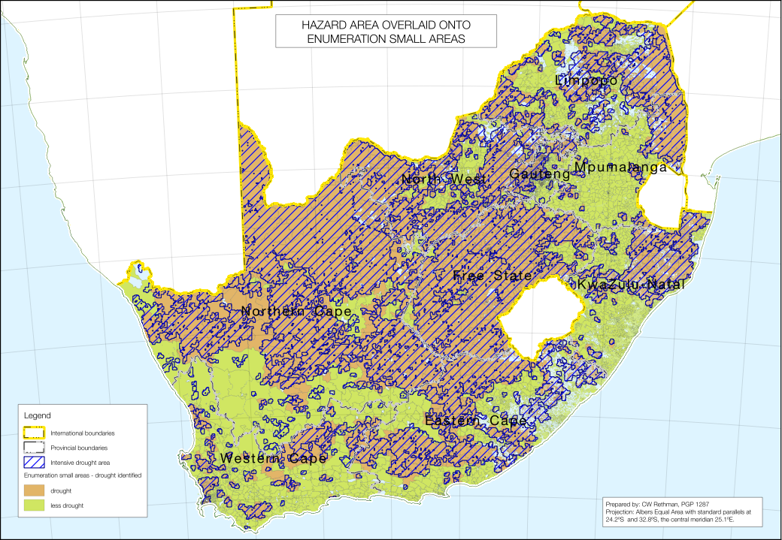
So how does it all add up?
The hazard and analysis can be overlaid onto the Enumeration small areas; populations and deficits can then be summed over the whole country

Slide 32
Food Poverty Line Deficit Totals
Province | Pop at Risk | FPL Deficit
Eastern Cape | 521,889 | 992,476,678
Free State | 68,318 | 107,568,303
Gauteng | 18,136 | 21,791,592
KwaZulu-Natal | 1,626,157 | 2,753,551,121
Limpopo | 467,766 | 1,037,630,165
Mpumalanga | 314,481 | 618,120,122
North West | 291,624 | 596,371,762
Northern Cape | 177,314 | 234,940,381
Western Cape | 53,957 | 51,460,699
Grand Total | 3,539,642 | 6,413,910,824

Slide 33
Lower Bound Poverty Line Deficit Totals
Province | Pop at Risk | LBPL Deficit
Eastern Cape | 2,112,132 | 4,306,200,620
Free State | 489,207 | 370,289,310
Gauteng | 275,235 | 76,053,790
KwaZulu-Natal | 4,006,428 | 9,487,561,101
Limpopo | 2,002,784 | 4,170,699,730
Mpumalanga | 1,640,691 | 2,604,395,509
North West | 2,181,987 | 2,399,275,038
Northern Cape | 399,567 | 1,015,768,406
Western Cape | 2,117,129 | 141,095,760
Grand Total | 3,539,642 | 6,413,910,824

