Slide 1
Interior
Boundary
Exterior
Point
Line
Polygon

Slide 2
POLYGON_A
Interior
Boundary
Exterior
Interior
dim[I(a) ∩ I(b)]=2
dim[I(a) ∩ I(b)]=1
dim[I(a) ∩ I(b)]=2
POLYGON_B
Boundary
dim[I(a) ∩ I(b)]=1
dim[I(a) ∩ I(b)]=0
dim[I(a) ∩ I(b)]=1
Exterior
dim[I(a) ∩ I(b)]=2
dim[I(a) ∩ I(b)]=1
dim[I(a) ∩ I(b)]=2

Slide 3
 | I | B | E
I | 1 | 0 | 1
B | 0 | F | 0
E | 2 | 1 | 2
DE9IM矩阵

Slide 4
Y
0,0
X

Slide 5
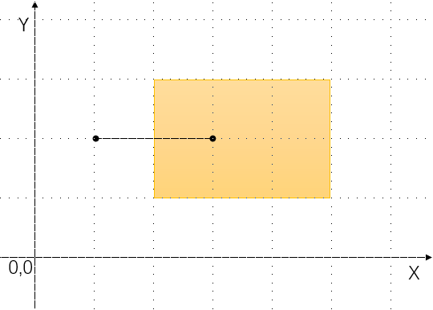

Slide 6
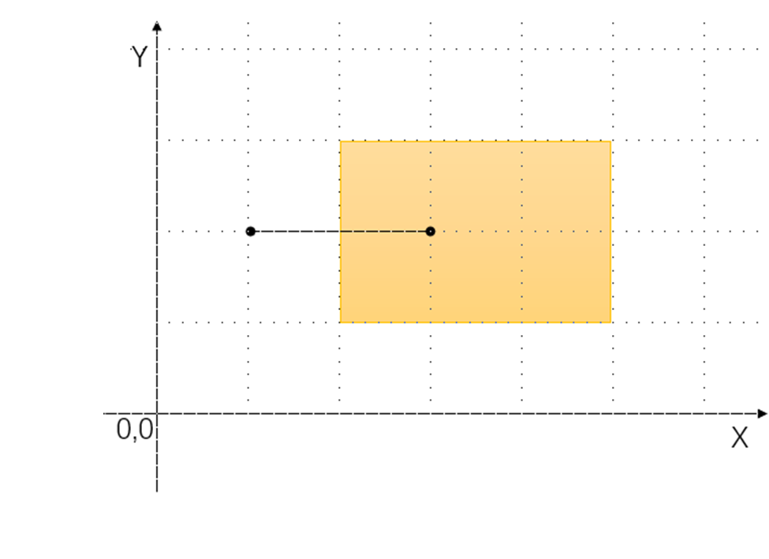

Slide 7
 | I | B | E
I | 1 | F | F
B | 0 | 0 | F
E | 2 | 1 | 2

Slide 8
 | I | B | E
I | 1 | * | F
B | 0 | 0 | F
E | 2 | 1 | 2

