Slide 1

My Commute is a Train Wreck
Cleo Falvey
Math 448
Spring 2020

Slide 2
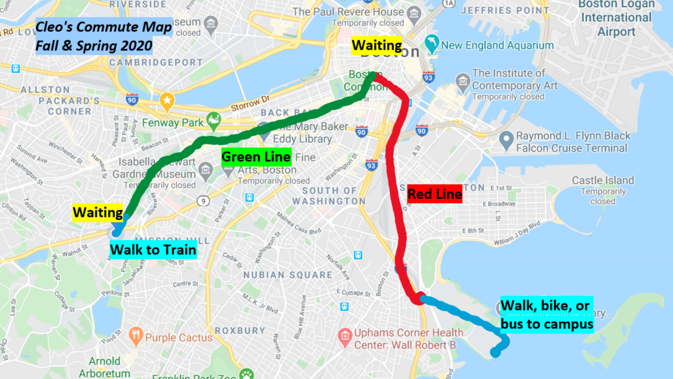

Slide 3
How long are the different segments of my commute?
Section I of IV

Slide 4
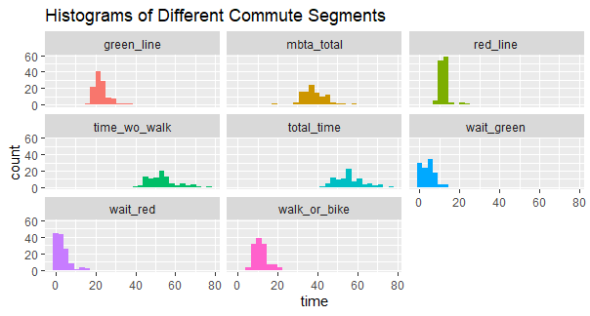

Slide 5
What probability distribution can we use to model commute segments?
Section II of IV

Slide 6
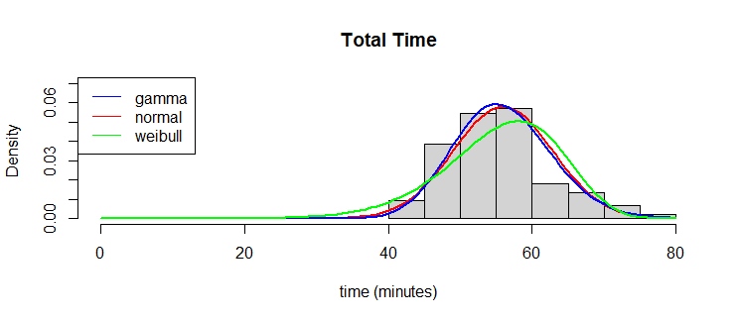
To start, let’s try some common distributions using MLE.

Slide 7
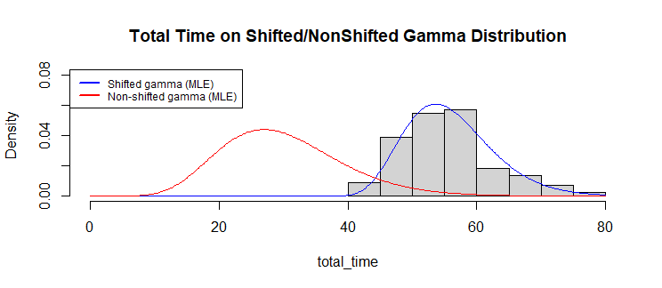
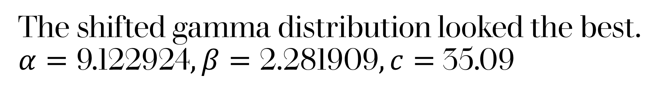
The shifted gamma distribution looked the best. $α=\text{9.122924}, β=\text{2.281909}, c=$35.09

Slide 8
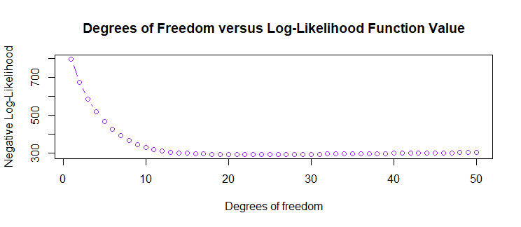
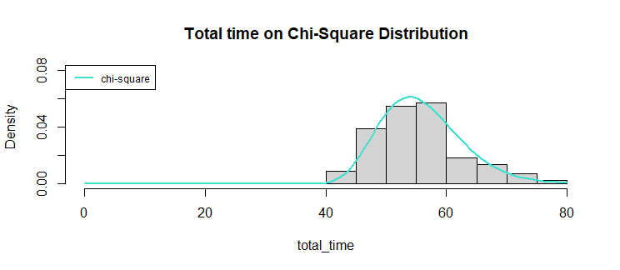
Here’s a Chi-square with 23 degrees of freedom (minimized log-likelihood).

Slide 9
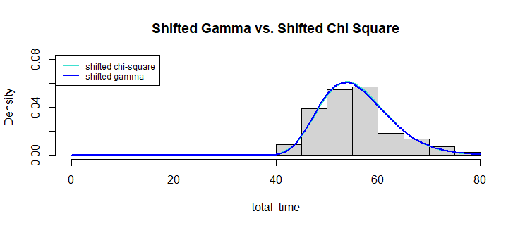
Was the shifted gamma or the shifted chi-square better? p=.75; the shifted chi-square is better!

Slide 10
Which direction (going to school vs. coming home) has more variance?
Section III of IV

Slide 11
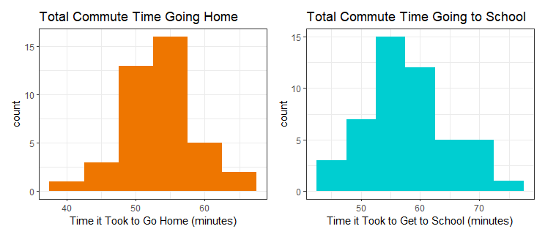
F=.5366, df=30,47, p=.04811; there is a marginally significant difference (larger variance coming home b/c of rush hour!).

Slide 12
Linear Modelling
Section IV of IV

Slide 13
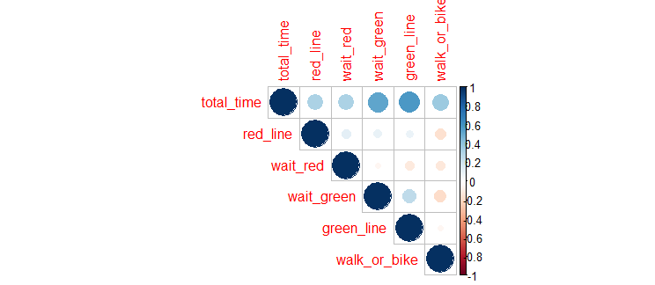
First, let’s figure out which segments have the greatest impact on length.
Waiting for the green line and taking the green line had the greatest association with length.

Slide 14
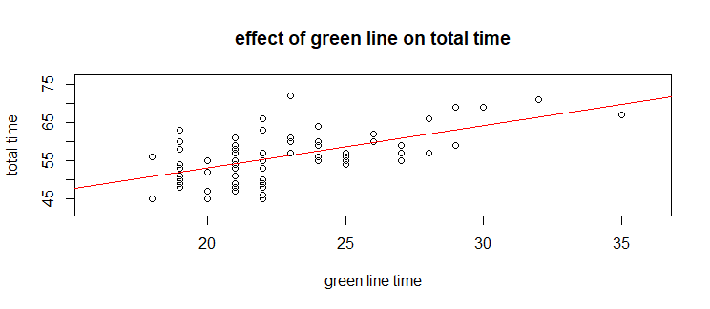
Now, we can plot! Total time = 30.965+1.1062(green line)
R-squared = .3323

Slide 15
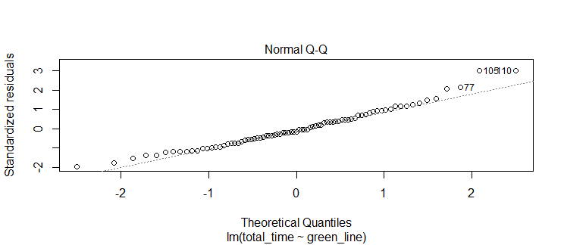
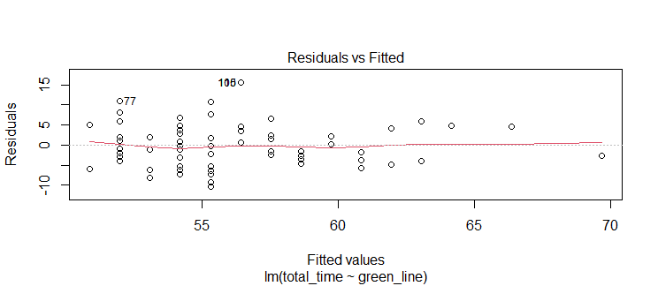
But wait! Are the residuals normal?

Slide 16
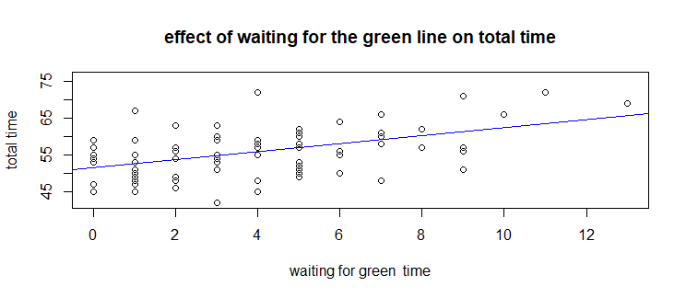
Waiting for the green line was also correlated! Total time = 51.4505+1.0897(waiting for green line)
R-squared =.2642

Slide 17
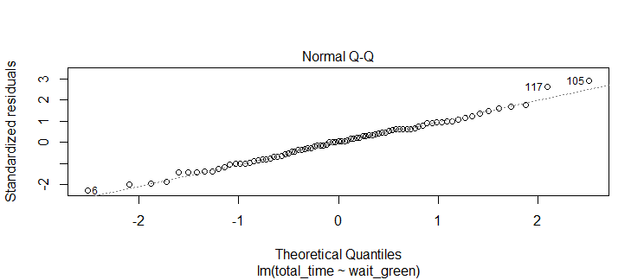
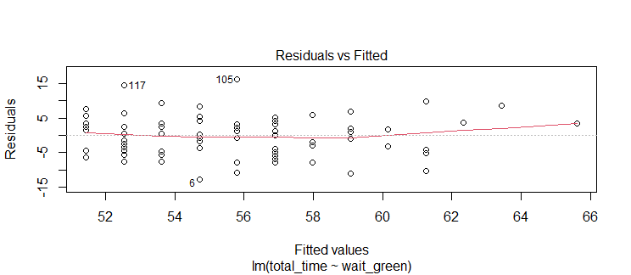
Again, we ask if the residuals are normal. And they seem to be!

Slide 18
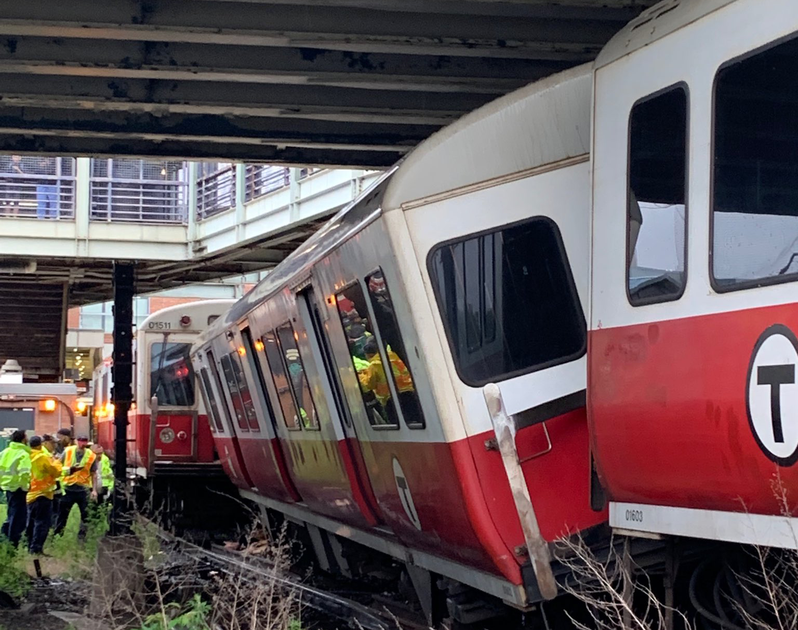
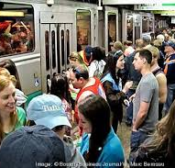
Takeaways
My commute is long (between 45 and 70 minutes).
A good distribution is a shifted chi-square distribution.
Factors that matter when contributing to the length of it are:
The green line
Rush hour

Slide 19
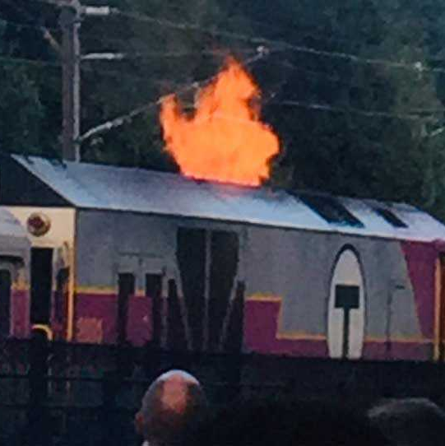
Limitations
Bias / convenience sample
Inaccuracy in timing
Covid – 19 limited sample size

Slide 20
Any questions?

Slide 21
Citations
Marie Laure Delignette-Muller, Christophe Dutang (2015). fitdistrplus: An R Package for Fitting Distributions. Journal of Statistical Software, 64(4), 1-34. URL http://www.jstatsoft.org/v64/i04/.
Owen, W. J., & Wackerly, D. D. (2008). _Mathematical statistics with applications, seventh edition, Dennis Wackerly, William Mendenhall, Richard L. Scheaffer._ Belmont, CA: Brooks/Cole Cengage Learning.
R Core Team (2020). R: A language and environment for statistical computing. R Foundation for Statistical Computing, Vienna, Austria. URL https://www.R-project.org/.
Taiyun Wei and Viliam Simko (2017). R package "corrplot": Visualization of a Correlation Matrix (Version 0.84). Available from https://github.com/taiyun/corrplot
Thomas Lin Pedersen (2019). patchwork: The Composer of Plots. R package version 1.0.0. https://CRAN.R-project.org/package=patchwork
Wickham et al., (2019). Welcome to the tidyverse. Journal of Open Source Software, 4(43), 1686, https://doi.org/10.21105/joss.01686
Millard SP (2013). _EnvStats: An R Package for Environmental Statistics_. Springer, NewYork. ISBN 978-1-4614-8455-4, <URL: http://www.springer.com>.
Yihui Xie (2020). knitr: A General-Purpose Package for Dynamic Report Generation in R. Rpackage version 1.28.

