Slide 1
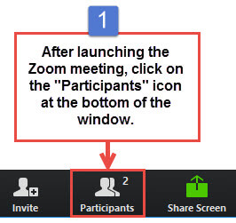
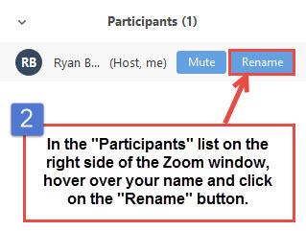
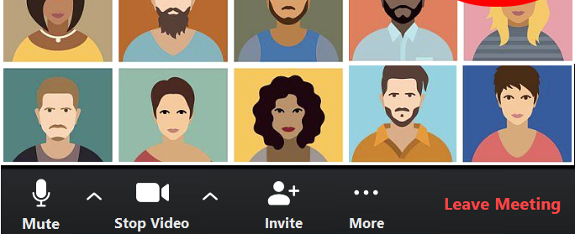
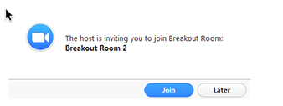
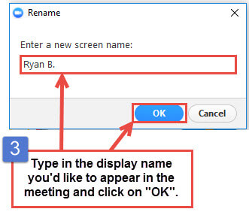
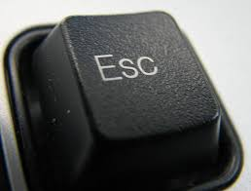
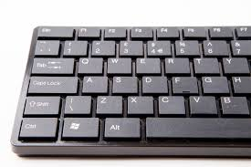
Microphone
Video
How to Zoom
t
Gallery View
Speaker View
See a list of all participants
(and how to raise your hand)
Chat: Send a message
Chat: Send it
Chat: Get a message
t
Rename yourself
See all participants
Use arrows in gallery view
Join a breakout room
Exit Full Screen (when you
can’t see your toolbars)
Hit Esc Key (escape)
on your keyboard

