Slide 1

Probabilistic Omnidirectional Path Loss Models for Millimeter-Wave Outdoor Communications
Mathew K. Samimi, Theodore S. Rappaport, and George R. MacCartney, Jr.
Polytech. Sch. of Eng., Wireless Res. Center, NYU, New York, NY, USA
IEEE Wireless Communications Letters ( Volume: 4, Issue: 4, Aug. 2015 )
Hong Cheng
chenghong@kw.ac.kr
Advisor: Prof. Hyukjoon Lee
Computer Intelligence Network Laboratory, Dept. of CE, KwangWoon University

Slide 2
Previous Work
INTRODUCTION
Floating-intercept Model
Fitting a minimum mean square error (MMSE) best ﬁt line to the measured path losses (with distances in log- scale), yielding a mathematically-based omnidirectional path loss model, applicable over the range of measured distance
Close-in Free Space Reference Distance Model
Arising from electromagnetic theory
using a constraint anchor point at the close-in reference distance d0 (assuming free space propagation up to d0) when ﬁtting the MMSE best ﬁt line, where the slope of the best ﬁt line and standard deviation beyond d0 are commonly known as the path loss exponent (PLE) and shadowing factor, respectively.
Notes:
synthesized from the collected unique pointing angle从收集的唯一指向角度合成

Slide 3
Works In The Paper
INTRODUCTION
We present omnidirectional path loss models based on the same new york city data from both line-of-sight (LOS) and non-line-of-sight (NLOS) locations,
But consider a site-specific function that describes the probability of having a LOS path for a given transmitter-receiver (T-R) separation distance.
In this new “hybrid” path loss model, the mean estimated path loss is probabilistic.

Slide 4
Obtained the LOS probabilities
PROBABILITY OF LOS
As the T-R separation distance increases from 10 m to about 30 m, the probability of LOS remains constant with a value of 100%
And it decreases monotonically after 30 m, as the environment becomes denser with more path obstructions.
The mean LOS probability was computed from the four distinct LOS probability curves from the four physical TX locations used in [3] and [4].
The mean LOS probability curve was fit to an analytical function.
Fig. 2. LOS probability curves from ray-tracing as a function of T-R separation distance for TX locations
Notes:
The mean LOS probability curve was obtained by averaging the four LOS probability curves.
The MMSE curve was computed using the mean LOS probability, which yielded α and dBP in (1).
Coles 1 (COL1), Coles 2 (COL2), Kaufman (KAU), and Kimmel 2 (KIM2)
obtained from a 3-D site-specific database modeling the downtown Manhattan area in which the measurements were obtained [3], [4].

Slide 5
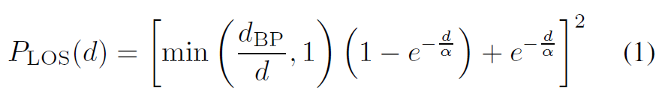
Obtained the LOS probabilities
PROBABILITY OF LOS
dBP is the breakpoint distance at which the LOS probability is no longer equal to 1,
α (m) is a decay parameter.
In this work, we applied the minimum mean square error (MMSE) method, which yielded values of dBP = 27 m and α = 71 m that minimize the mean square error between the mean LOS curve in Fig. 2 and (1)
Other cities and environments will likely have different values of dBP and α , based on the density of buildings, the width of streets, and the heights of TX and RX antennas.
Notes:
the LOS probability is determined from ray-tracing simulations
Note that the WINNER probability function in the LOS microcellular environment [7] uses the same form as in (1) but without the square exponent, which yielded a greater error to the mean LOS curve (in Fig. 2) than (1).

Slide 6
Obtained the LOS probabilities
Simulation
clear
clc
d= 1:1:200 ;
d_BP = 27;
alpha = 71;
d0 = 1;
c = 3*10^8;
P_LOS = zeros(200,1);
for d=1:1:200
P_LOS(d) = (min(d_BP/d,1)*(1-exp(-d/alpha))+exp(-d/alpha))^2;
end
t = 1:1:200;figure;axis([0,100,1,200]);
plot(t,P_LOS*100,'r--','LineWidth',2);
lgd=legend('\fontsize {12}MMSE Fit');
lgd.FontWeight = 'bold';
xlabel('T-R Separation(m)','FontSize',12,'FontWeight','bold')
ylabel('LOS Probability(%)','FontSize',12,'FontWeight','bold')
grid on;
https://matlab.mathworks.com/

Slide 7
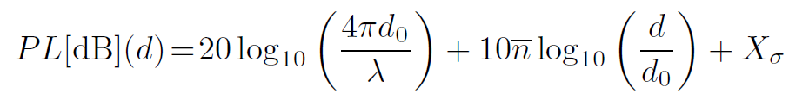

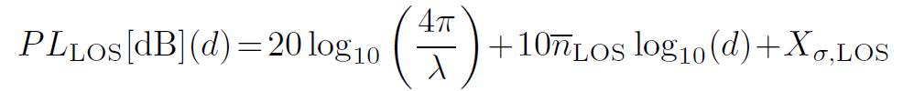

Measurements Parameters
PROBABILISTIC MODEL
A fixed reference distance of d0 = 1 m , and the probability of LOS shown in (1).
The LOS and NLOS path loss equation lines are of this form :
PLLOS is the LOS free space path loss
Notes:
We also estimate the probabilistic path loss by combining the LOS and NLOS close-in reference distance path loss models with respect to
a viable approach 一种可行的方法
Establishing a fixed reference distance of d0 = 1 m is also a viable approach for both LOS and NLOS modeling, and
The reason for this ????
We validate our new probabilistic propagation modeling scheme to demonstrate the flexibility of our approach, while showing the inherent simplicity (with very little loss of accuracy)
of using a simple 1 m close-in free space reference distance model for both LOS and NLOS environments.

Slide 8
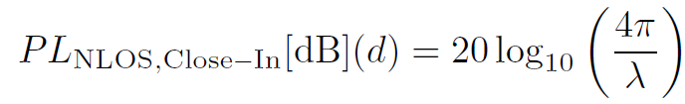


Measurements Parameters
PROBABILISTIC MODEL
PLNLOS,Close−In and PLNLOS,Floating are the NLOS path losses computed using the 1 m close-in free space reference distance and the floating-intercept models, respectively,
λ is the carrier wavelength
are the average (over distance) path loss exponents in LOS and NLOS, respectively·
α and β are the intercept and slope of the floating-intercept model parameters
Xσ is the lognormal random variable (normal in dB) with standard deviation σ (dB) to model largescale shadowing. lognpdf(d,mean,variance)
Notes:
where d0 = 1 m,it follows that由此得出结论…，因而断定…;

Slide 9

Measurements Parameters
PROBABILISTIC MODEL
Statistic and Machine Learning Toolbox
https://cn.mathworks.com/products/statistics/

Slide 10
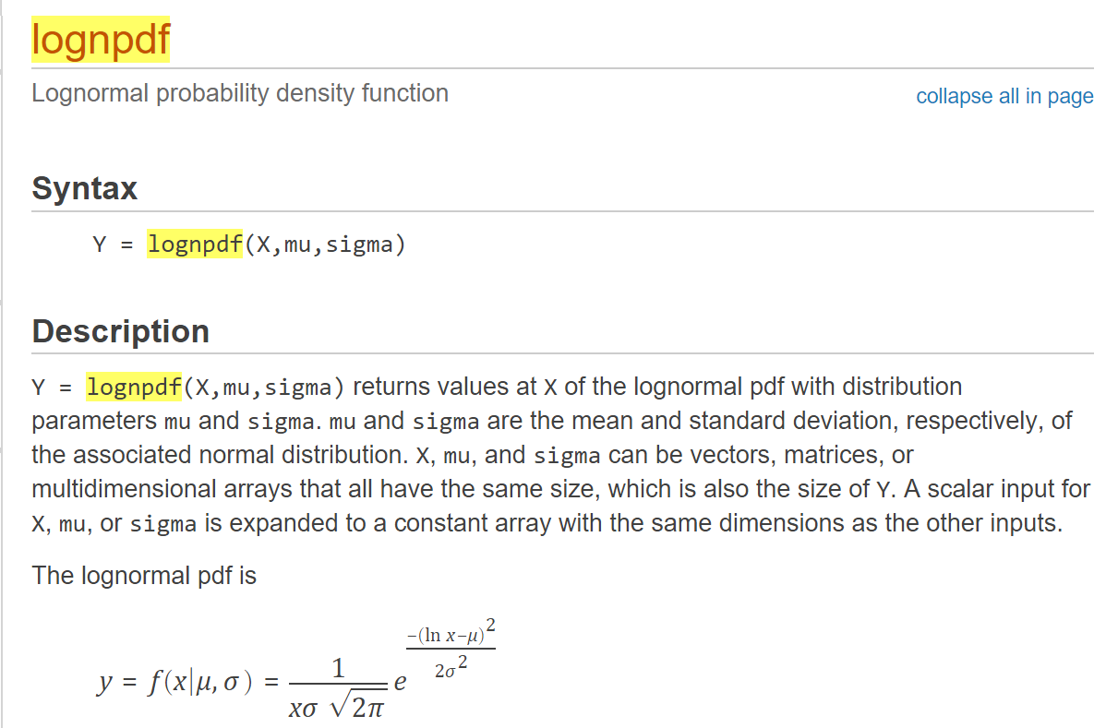
Measurements Parameters
PROBABILISTIC MODEL

Slide 11
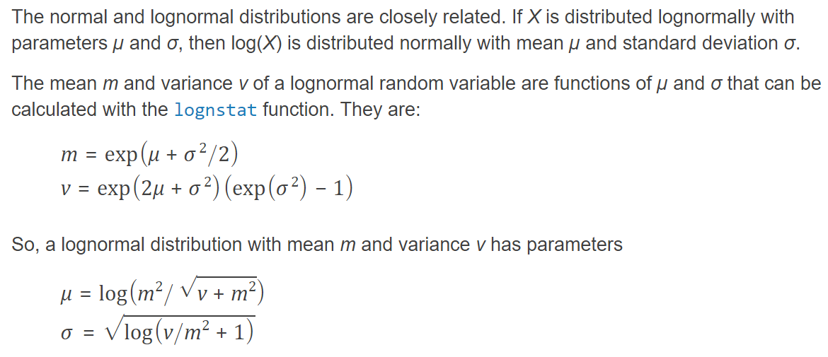
Measurements Parameters
PROBABILISTIC MODEL
If you do not know the population mean and variance, m and v, for the lognormal distribution, you can estimate μ and σ in the following way:
mu = mean(log(X)) sigma = std(log(X))
The lognormal distribution is applicable when the quantity of interest must be positive, since log(X) exists only when X is positive.
Notes:
If you do not know the population mean and variance, m and v, for the lognormal distribution, you can estimate μ and σ in the following way:
mu = mean(log(X)) sigma = std(log(X))
The lognormal distribution is applicable when the quantity of interest must be positive, since log(X) exists only when X is positive.

Slide 12
Measurements Parameters
PROBABILISTIC MODEL
The omnidirectional LOS path loss exponent and shadowing factor with respect to a 1 m free space reference distance were computed to be
nLOS = 2.1 and σLOS = 3.6 dB at 28 GHz
nLOS = 2.0 and σLOS = 4.8 dB at 73 GHz
For the NLOS，
nNLOS = 3.4 and σNLOS = 9.7 dB at 28 GHz
nNLOS = 3.4 and σNLOS = 7.9 dB at 73 GHz
The NLOS floating-intercept path loss equation lines produced the following parameters
α = 79.2 dB, β = 2.6 and σNLOS = 9.6 dB at 28 GHz
α = 80.6 dB, β = 2.9 and σNLOS = 7.8 dB at 73 GHz
Notes:
indicating a close match with true free space propagation (n = 2)[2][5].
,indicating greater signal attenuation over distance as compared to LOS conditions.
表示更大的信号衰减随距离而条件。

Slide 13

Measurements Parameters
PROBABILISTIC MODEL
Figs. 3 and 4 show the 28 GHz and 73 GHz omnidirectional path loss scatter plots and corresponding mean path loss equation lines,
Using Eqs. (3), (4), and (5), in conjunction with (1), it is possible to implement a general probabilistic path loss model,
where PLOS(d), PLLOS(d), and PLNLOS(d) are given in Eqs. (1), (3), and (4) or (5),
Notes:
omnidirectional path loss scatter plots
全向路径损耗散点图
in conjunction with 连同
As presented in [4], [5], 74 TX-RX outdoor location combinations were measured at both 28 GHz and 73 GHz, of which 13 and 5 locations, respectively, provided no measurable path loss over T-R distances of 200 m.
where in this letter we show, by example,
that uses the 1 m close-in free space reference distance in LOS conditions and the NLOS floating-intercept path loss model,
whereas the other approach
where the LOS path loss line was obtained using the close-in free space reference distance path loss model with respect to a 1 m free space reference distance, and the NLOS path loss lines were obtained using the 1 m close-in free space reference distance model and floating-intercept path loss model.
One approach uses the 1 m close-in free space reference distance models in both LOS and NLOS conditions,

Slide 14
Measurements Parameters
PROBABILISTIC MODEL
Notes:
omnidirectional path loss scatter plots
全向路径损耗散点图
in conjunction with 连同
As presented in [4], [5], 74 TX-RX outdoor location combinations were measured at both 28 GHz and 73 GHz, of which 13 and 5 locations, respectively, provided no measurable path loss over T-R distances of 200 m.
where in this letter we show, by example,
that uses the 1 m close-in free space reference distance in LOS conditions and the NLOS floating-intercept path loss model,
whereas the other approach
where the LOS path loss line was obtained using the close-in free space reference distance path loss model with respect to a 1 m free space reference distance, and the NLOS path loss lines were obtained using the 1 m close-in free space reference distance model and floating-intercept path loss model.
One approach uses the 1 m close-in free space reference distance models in both LOS and NLOS conditions,

Slide 15
Measurements Parameters
PROBABILISTIC MODEL

Slide 16
Measurements Parameters
Simulation
clear
clc
d= 1:1:200 ;
d_BP = 27;
alpha = 71;
d0 = 1;
c = 3*10^8;
f = 28*10^9;
n_LOS = 2.1;
Sigma_LOS = 3.6;
n_NLOS = 3.4;
Sigma_NLOS = 9.7;
alpha2 = 79.2;
Beta = 2.6;
Sigma2_NLOS = 9.6;
Lambda =c/f ;
P_LOS = zeros(200,1);
PL_LOS = zeros(200,1);
PL_NLOS = zeros(200,1);
PL_Prob = zeros(200,1);
PL_NLOS_CloseIn = zeros(200,1);
PL_NLOS_Floating = zeros(200,1);
https://matlab.mathworks.com/

Slide 17
Measurements Parameters
Simulation
for d=1:1:200
P_LOS(d) = (min(d_BP/d,1)*(1-exp(-d/alpha))+exp(-d/alpha))^2;
PL_LOS(d) = 20*log10(4*pi/ Lambda)+10*n_LOS *log10(d)+lognpdf(d,0,Sigma_LOS );
PL_NLOS_CloseIn(d) = 20*log10(4*pi/ Lambda)+10*n_NLOS *log10(d)+lognpdf(d,0,Sigma_NLOS );
PL_NLOS_Floating(d) = alpha2 +10* Beta *log10(d)+lognpdf(d,0,Sigma2_NLOS );
if d<= 30
PL_NLOS(d) = PL_NLOS_CloseIn(d);
else
PL_NLOS(d) = PL_NLOS_Floating(d);
end
PL_Prob(d) = P_LOS(d)*PL_LOS(d)+(1-P_LOS(d))*PL_NLOS(d);
PL_Prob_CloseIn(d) = P_LOS(d)*PL_LOS(d)+(1-P_LOS(d))*PL_NLOS_CloseIn(d);
PL_Prob_Floating(d) = P_LOS(d)*PL_LOS(d)+(1-P_LOS(d))*PL_NLOS_Floating(d);
end

Slide 18
Measurements Parameters
Simulation
figure;t = 1:1:50;%in fact it should be 30
s1 = semilogx(t,PL_LOS(1:50),'b-','LineWidth',2);grid on;hold on;
t = 31:1:200;%in the paper it begin at 51
p1 = plot(t,PL_NLOS_Floating(31:200),'r-','LineWidth',2);
t = 1:1:200;
p2 = plot(t, PL_NLOS_CloseIn,'r--','LineWidth',2);
p3 = plot(t,PL_Prob_Floating,'k-','LineWidth',2);
p4 = plot(t,PL_Prob_CloseIn,'k--','LineWidth',2);
axis([1,250,55,150]);
xlabel('T-R Separation(m)','FontSize',12,'FontWeight','bold')
ylabel('Total Path Loss (dB)','FontSize',12,'FontWeight','bold')
title('28GHz Omnidirectional Path Loss Models','FontSize',12,'FontWeight','bold')
grid on;
t1 = 'n_L_O_S=2.1 \sigma_L_O_S=3.6dB';
t2 = ['(\alpha _N_L_O_S, \beta_N_L_O_S)=(79.2dB,2.6) ', sprintf('\n'), '\sigma_N_L_O_S=9.6dB'];
t3 = ['n_N_L_O_S=3.4 \sigma_N_L_O_S=9.7dB'];
t4 = ['Probabilistic Path Loss (Floating)' ];
t5 = ['Probabilistic Path Loss (Close-In)' ];
line_handles = [s1,p1,p2,p3,p4];
legend_texts = {t1, t2, t3, t4,t5};
h_leg = legend(line_handles, legend_texts);
h_leg.FontWeight = 'bold';
h_leg.Location = 'best';

Slide 19
Measurements Parameters
PROBABILISTIC MODEL

Slide 20
Measurements Parameters
Simulation

Slide 21


Measurements Parameters
PROBABILISTIC MODEL
It is clear that any other distance-dependent path loss model or other propagation models, could be used here .Eq. (6) can be rewritten as
are the mean LOS and NLOS distance-dependent path loss equations from Eqs. (3), and (4) or (5)
Xσ(d) is the sum of two independent 0 dB mean lognormal random variables, also with 0 dB mean
Distance-dependent standard deviation, i.e., shadow factor, (in dB)
Notes:
Eq. (6) can be rewritten as

Slide 22
THANK YOU
Computer Intelligence Network Laboratory, Dept. of CE, KwangWoon University

