Slide 1
TEACHING ASSISTANT EVALUATION USING
RANDOM FOREST CLASSIFIER
Project Supervisior : Ms.Sankari M,M.E.,(Ph.D).,
Name : Mr.Chinthalacheruvu Govardhan reddy.
Reg no : 39110235.
Branch : Computer Science & Enginnering.

Slide 2
Presentation Outline :
Course certificate
Introducton
Objectives
System Architecture / Ideation map
Module Implementation
Application Snapshots
Results & Discussions
Conclusion & Future work
References

Slide 3

Course Certificate:

Slide 4
Introduction :
Random forest is a supervised learning algorithm which is used for both classification as well as regression.
It is based on the concept of ensemble learning, which is a process of combining multiple classifiers to solve a complex problem and to improve the performance of the model.
The Project main theme is to give a Distinction to a teacher based on their skill by using Random Forest Classifier Algorithm.
The project is related to machine learning and It mainly deals about the ranking of the teachers based on their skill.

Slide 5
Objectives:
The project is mainly based on the teaching Assistance evaluation to increase the accuracy of the model and decrease the time consumption by using the machine learning algorithm
The main achievement is to identifying the best teacher by using the machine learning.
To gain complete Knowledge on Python Libraries and Ready to solve any classifier Algorithm Problems.

Slide 6
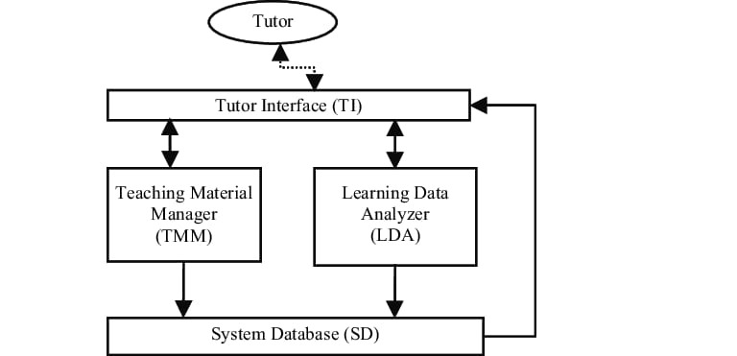
System Architecture :

Slide 7

Hardware Configuration :
Hardware Requiriments : A laptop with good internet connection.
Processor : Intel core i7
Speed : 1.19GHz
Ram : 12.0 GB
Memory usage : 7.2kb
Keyboard : Standard Keyboard
Monitor : 15 VGA color

Slide 8


Software Configuration :
Software Requriments : Anaconda software &jupter notebook
Operating System : Windows 10
Coding Language : Python 3.7

Slide 9
Methodology and Algorithm :
Random Forest Algorithm:-
Random Forest is a popular machine learning algorithm that belongs to the supervised learning technique.
It can be used for both Classification and Regression problems in Machine learning(ML).
It is based on the concept of ensemble learning, which is a process of combining multiple classifiers to solve a complex problem and to improve the performance of the model.

Slide 10
Continue:
How does Random Forest algorithm work?
Random Forest works in two-phase first is to create the random forest by combining N decision tree, and second is to make predictions for each tree created in the first phase.
The Working process can be explained in the below steps and diagram:
Step-1: Select random K data points from the training set.
Step-2: Build the decision trees associated with the selected data points (Subsets).
Step-3: Choose the number N for decision trees that you want to build.
Step-4: Repeat Step 1 & 2.
Step-5: For new data points, find the predictions of each decision tree, and assign the new data points to the category that wins the majority votes.

Slide 11
Modules :
Modules | Definition
numpy | It supports large, multi-dimensional arrays and matrices, along with a large collection of high-level mathematical functions to operate on these arrays.
pandas | pandas is a software library written for the Python programming language for data manipulation and analysis.
matplotlib | Matplotlib is a plotting library for the Python programming language and its numerical mathematics extension NumPy.
seaborn | Seaborn is a Python data visualization library based on matplotlib. It provides a high-level interface for drawing attractive and informative statistical graphics.
sklearn | Scikit-learn is a free software machine learning library for the Python programming language.
math | Built-in module that you can use for mathematical tasks.

Slide 12
Module Implementation :
Data preprocessing:
Analyze the rows and columns in the dataset.
Drop unnecessary columns from the dataset.
Check if there are any null values in dataset.
If null values exist fill it with average value of that column or drop the entire row that consisting null value.
Fitting the model:
Split the given data set into Training and Testing data.
Fit the independent and dependent variables of Training data into the model(Train the machine with data).
Measure the accuracy score of the model.

Slide 13
Continue:
Visualization:
Plot the graph between X_trained Data And Y_trained Data.
Plot the graph between Y_tested and Y_predicted data.
Plot the graph between Accuracy and n_estimators

Slide 14
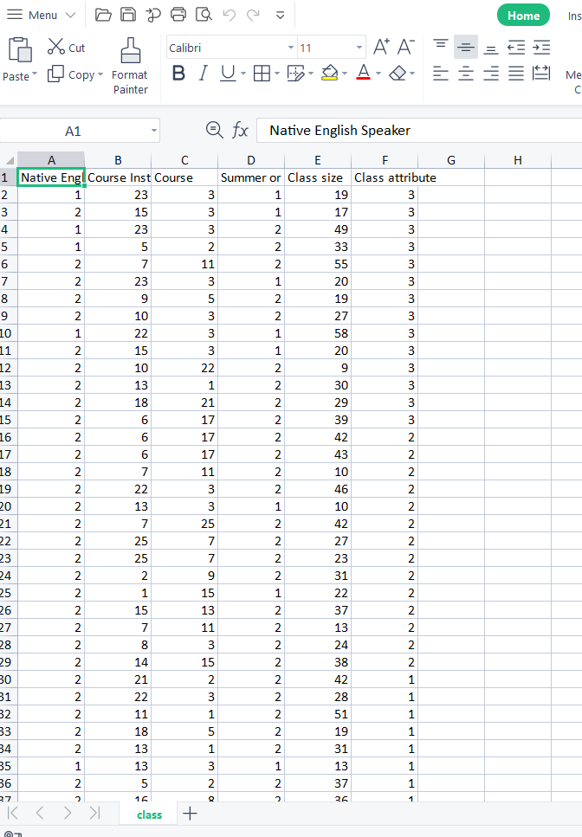
Application Of Snapshots :
Getting data set

Slide 15
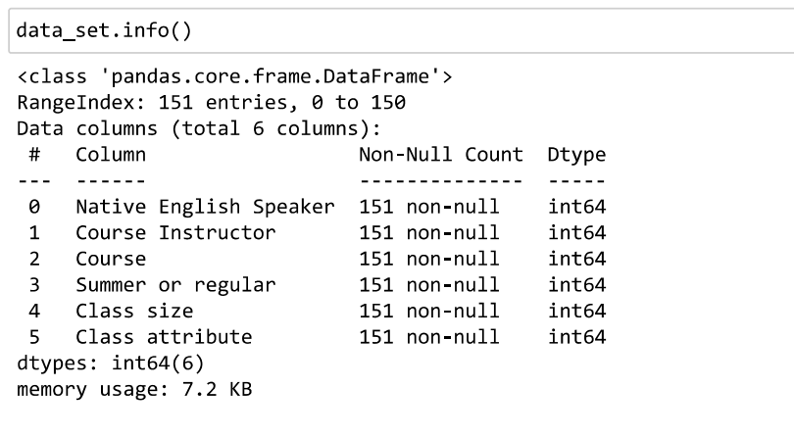
Application Of Snapshots :
Data Set Information

Slide 16
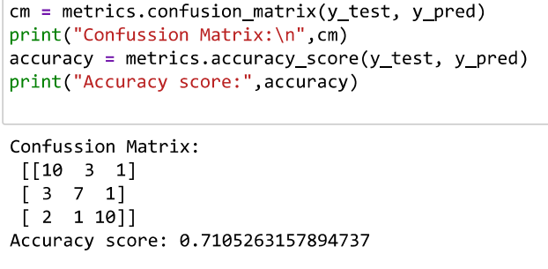
Application Of Snapshots :
Confused matrix And Accuracy

Slide 17
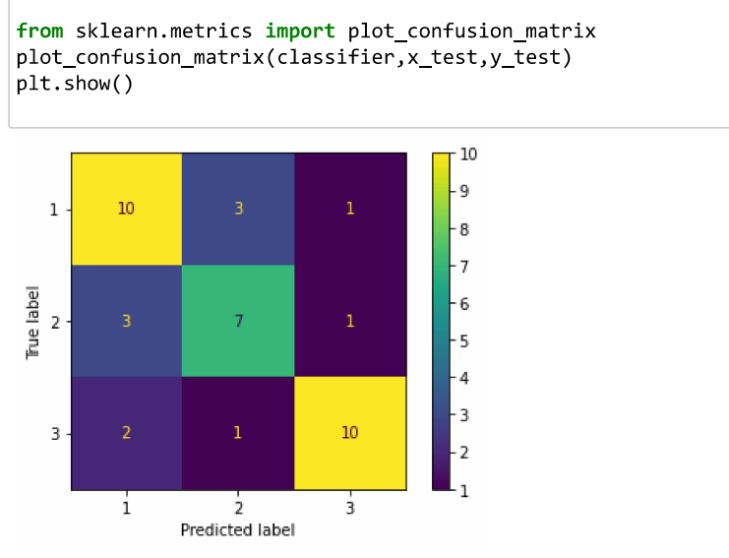
Application Of Snapshots :
Picrtorial Representation of Confusion matrix

Slide 18
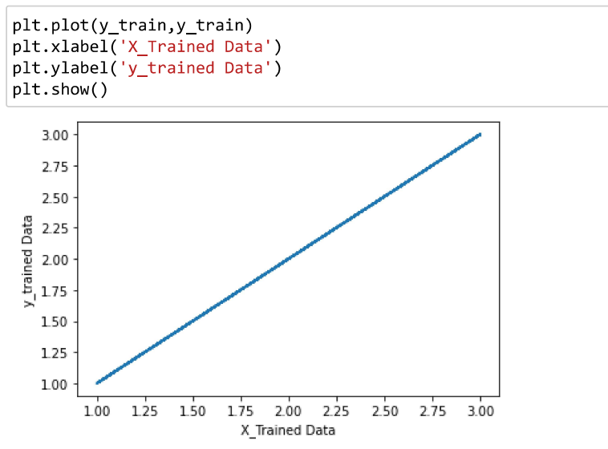
Application Of Snapshots :
Plot of x_trained and Y_trained Data

Slide 19
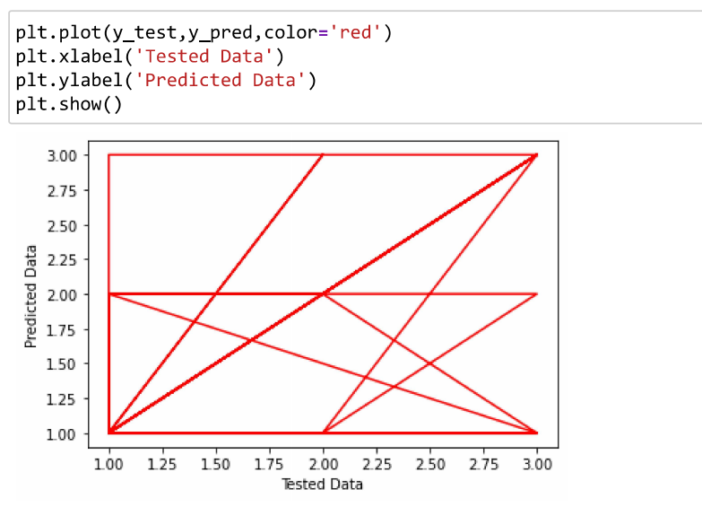
Application Of Snapshots :
Plot of Y_tested and Y_Predicted Data

Slide 20
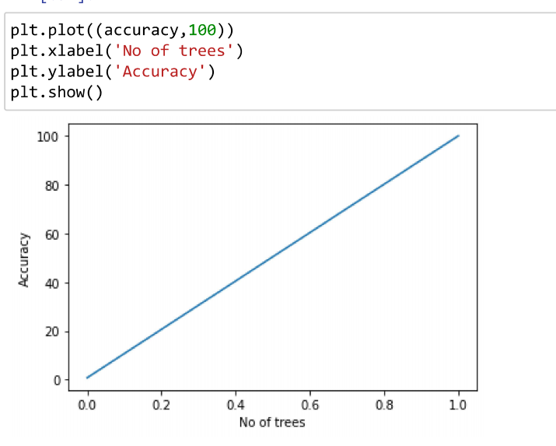
Application Of Snapshots :
Plot Between Accuracy And N_estimators

Slide 21
Results and Discussion
The main goal of this dataset is accurate classification of the class by considering the given attributes.
The input data is clean without any missing values or outliers and we considered 80% as training data and 20% as test data.
From the random forest classification model, the predicted accuracy score on test data is 70%

Slide 22
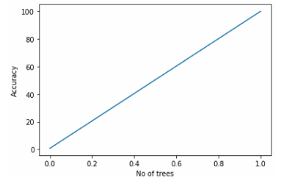
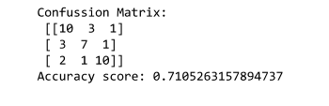
Results
Plot Between Accuracy And N_estimators
Confused matrix And Accuracy

Slide 23
Conclusion
Machine learning model That can be conveniently developed for estimating the rank (Performance) of a teacher based on their English skills ,Experience etc.
The model predicts the Performance of teacher by taking inputs of Native English Speaker, Class Size, Course,Summer/Regular etc.
The model Accuracy is much far better to implement the model and predict the performance of teacher.
Finally, reduced the time and memory .
Finally, increase the performance and I achive the good accuracy when compare to the other algorithms.

Slide 24
References:
[1]Yang, J., Jiang, H., & Zhang, H. (2011). Teaching Assistant Evaluation Based on Support Vector Machines with Parameters Optimization. Information Technology Journal, 10(11), 2140-2146.
[2] Badur, B., & MARDIKYAN, S. (2011). Analyzing teaching performance of instructors using data mining techniques. Informatics in Education-An International Journal, (Vol 10_2), 245-257.
[3] Bao, Q., Newport, D., Chen, M., Stout, D. B., & Chatziioannou, A. F. (2009). Perfor
mance evaluation of the inveon dedicated PET preclinical tomograph based on the
NEMA NU-4 standards. Journal of Nuclear Medicine. 50(3), 401-408.
[4] Baradwaj, B. K., & Pal, S. (2012). Mining educational data to analyze students' performance. arXiv preprint arXiv:1201.3417
[5] Yadav, S. K., & Pal, S. (2012). Data mining: A prediction for performance improvement of engineering students using classification. arXiv preprint arXiv:1203.3832.

Slide 25



