Slide 1

CHATBOT USING
MACHINE LEARNING
Project Supervisor: Ms.Vinodhini
Name of the Student: Chinthalacheruvu Govardhan Reddy
Register Number: 39110235

Slide 2
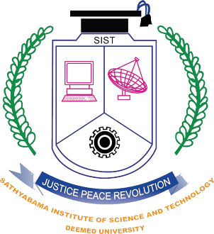
Presentation Outline
Certificate
Introduction
Objectives
project Implementation
Methodology
Results and Discussions
Conclusion & Future work
References

Slide 3
Certificate

Slide 4

Introduction
A chatbot is artificial intelligence (AI) software that can imitate a natural language discussion (or chat) with a user via messaging apps, websites or mobile apps.
A chatbot is frequently described as one of the most advanced and promising forms of human-machine interaction. Chatbots can automatically simulate interactions with customers based on a set of predefined conditions or events.

Slide 5
Introduction
From a technology standpoint, however, a chatbot is simply the next step in the evolution of a Question Answering system that uses Natural Language Processing (NLP). One of the most common examples of Natural Language Processing is usage in many organizations' end-use applications in formulating responses to inquiries in natural language.

Slide 6
Objectives
Chatbots are mainly used to provide customer support.
Create conversational forms and saving all the data on spreadsheets.
Chatbots are very intelligent. You train them once and they will communicate with your target audience in their language.
Multilingual chatbots have saved you from investing much on hiring different languages resources.
Chat bot is mainly intractive between human and computer.

Slide 7
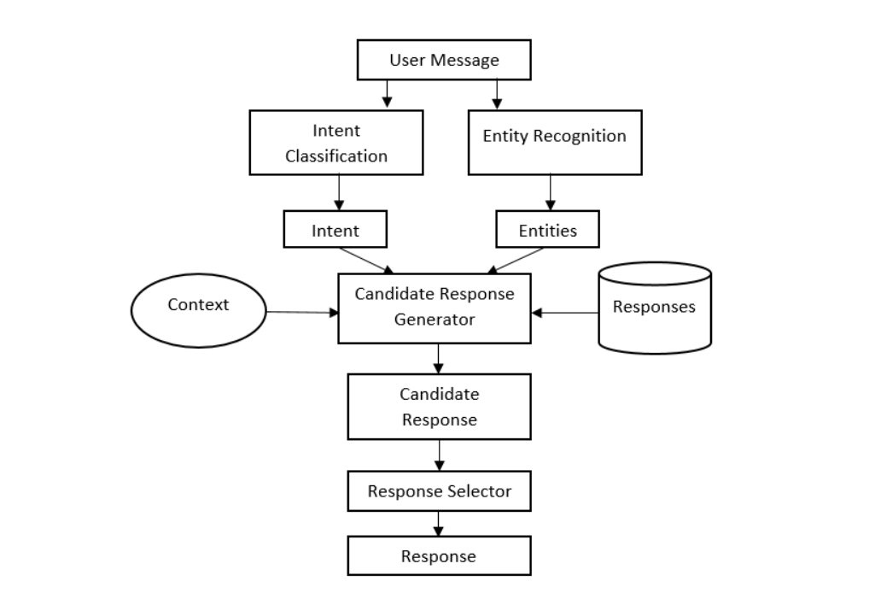
System Architecture

Slide 8

Hardware Requriments:
Hardware Requiriments :
A laptop with good internet connection.
Processor : Intel core i7
Speed : 1.19GHz
Ram : 12.0 GB
Memory usage : 7.2kb
Keyboard : Standard Keyboard
Monitor : 15 VGA color

Slide 9


Software Requriments:
Software Requriments :
Anaconda software &jupter notebook
Operating System : Windows 10
Coding Language : Python 3.7

Slide 10
Methodology
Tokenization – splitting a sentence into different parts, words or “tokens”
Part of speech tagging – determines which words are nouns, verbs, adjectives, etc.
Stemming – shortening a word to its basic form.
Named entity recognition – finds entities in the text that the user has typed.
Sentiment Analysis – the ability of the computer to recognise users emotions and mood.

Slide 11
Project Implementation
First instal the python 3.7 and anconda software.
First load all the libaries in the juputer notebook.
Downloading model to tokenize message,Stop words.
Downloading wordnet, which contains all lemmas of english language.
Load the json file and cleaning and intents.
Train the neural network and load all the chatbot functions
and comments which are used in chatbot.
Create the final chabot to intractive the bot and human.

Slide 12
Methodology and Algorithm
Natural language processing (NLP) refers to the branch of computer science—and more specifically, the branch of artificial intelligence or AI—concerned with giving computers the ability to understand text and spoken words in much the same way human beings can.
NLP combines computational linguistics—rule-based modeling of human language— with statistical, machine learning, and deep learning models.
NLP drives computer programs that translate text from one language to another, respond to spoken commands, and summarize large volumes of text rapidly—even in real time.

Slide 13
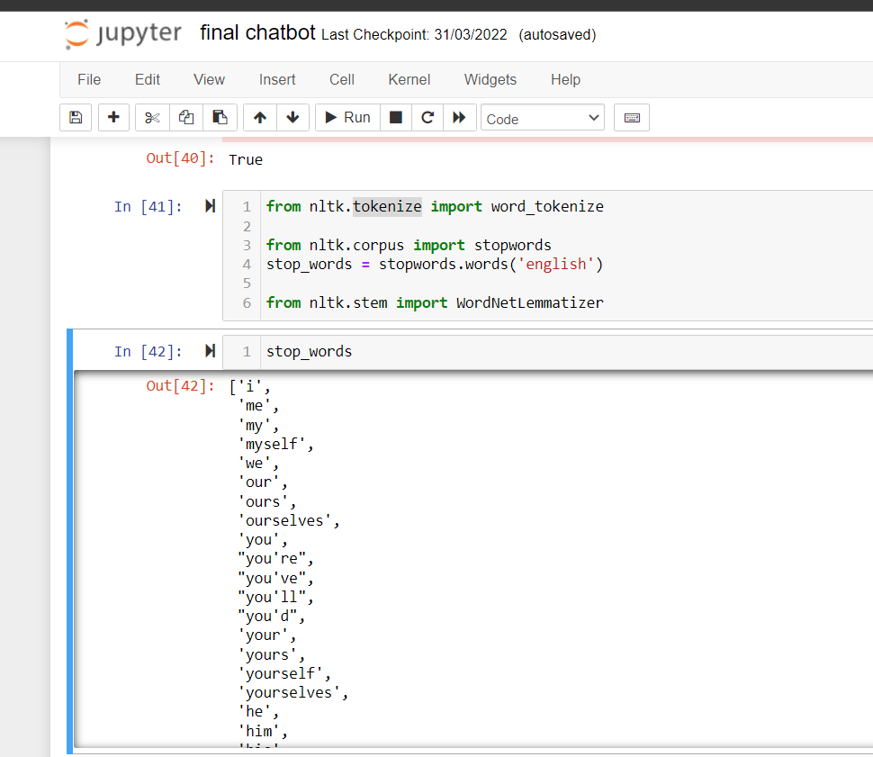
Results and Discussion
STOP WORDS

Slide 14
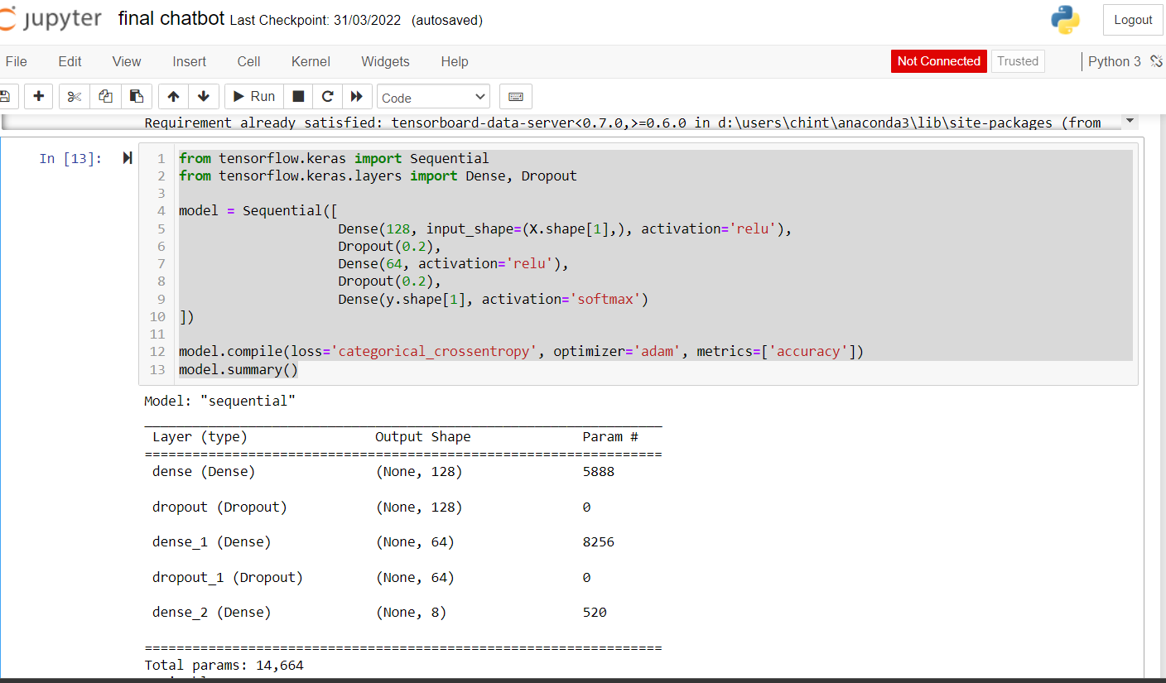
Results and Discussion

Slide 15
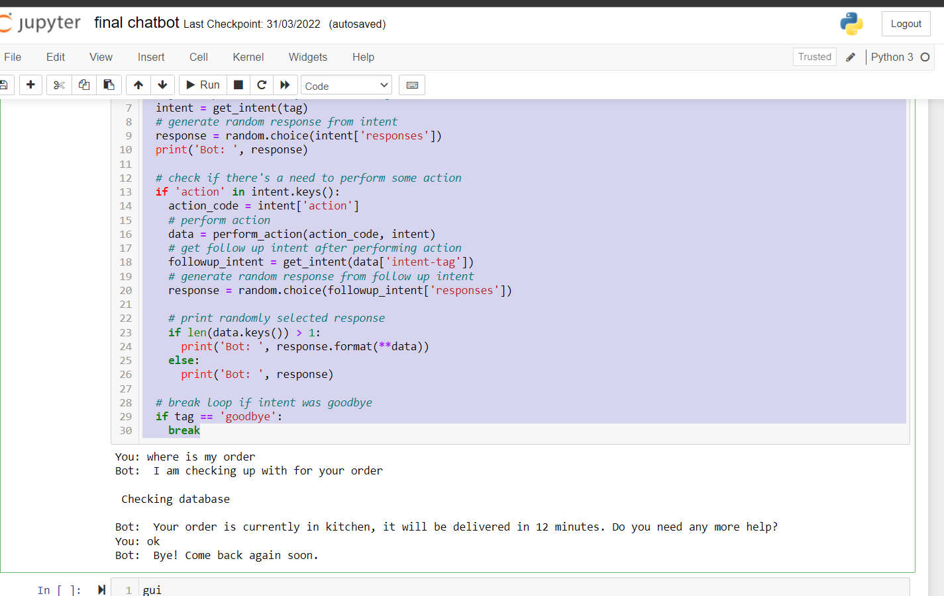
Results and Discussion
COMPLETE CHATBOT

Slide 16
Conclusion & future work
At the beginning of the project, User Stories are best suited for the understanding and getting clarity for the complicated requirements. Incase of Rule based Bots, Flow charts are helpful in getting the entire workflow on the chart. When it comes to NLP based Bots, it required unconventional method to prepare requirements considering Intents and Entities.However based on size of the projects and time frame, best approach should be selected.Happy Chatting !!!

Slide 17
Conclusion & future work
Finally, chatbot is checking intracting between the system
and humans , When the human message to the bot the bot
will given very quickly answer to the human,the chatbot.
Thus,the bot is very esay to check the order of food to intract the bot and check the order.

Slide 18
References
Alepis, E., & Virvou, M. (2011). Automatic generation of emotions in tutoring agents for affective e-learning in medical education. Expert Systems with Applications, 38(8):9840–9847. 2. Ashok, G., Brian, C., Mithun, K., Shanu, S., Abhinaya, S., & Bryan, W. (2015). Using Watson for Enhancing Human-Computer Co-Creativity. AAAI Symposium: 22–29. 3. Avalverde, D. (2019). A Brief History of Chatbots. Perception, Control, Cognition. Retrieved March 9, 2019 from: https://pcc.cs.byu.edu/2018/03/26/a-brief-history- of-chatbots/ 4. Ayedoun, E., Hayashi, Y., & Seta, K. (2015). A Conversational Agent to Encour age Willingness to Communicate in the Context of English as a Foreign Language.

Slide 19


