Slide 1


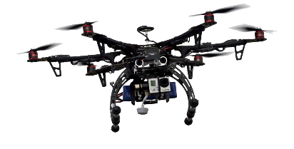

.
.
.

Slide 2
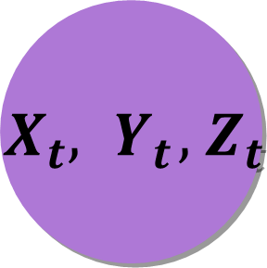
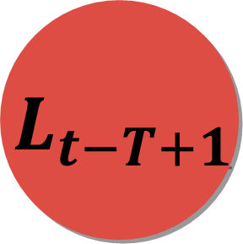

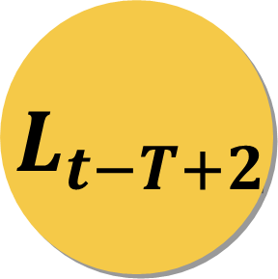
$${ X}_{t},{ Y}_{t},{ Z}_{t}$$
LSTM
LSTM
LSTM
$${ L}_{t−T+1}$$
$${ L}_{t−T+2}$$
.
.
.
$${ L}_{t}$$

