Slide 1
Linear Regression

Slide 2
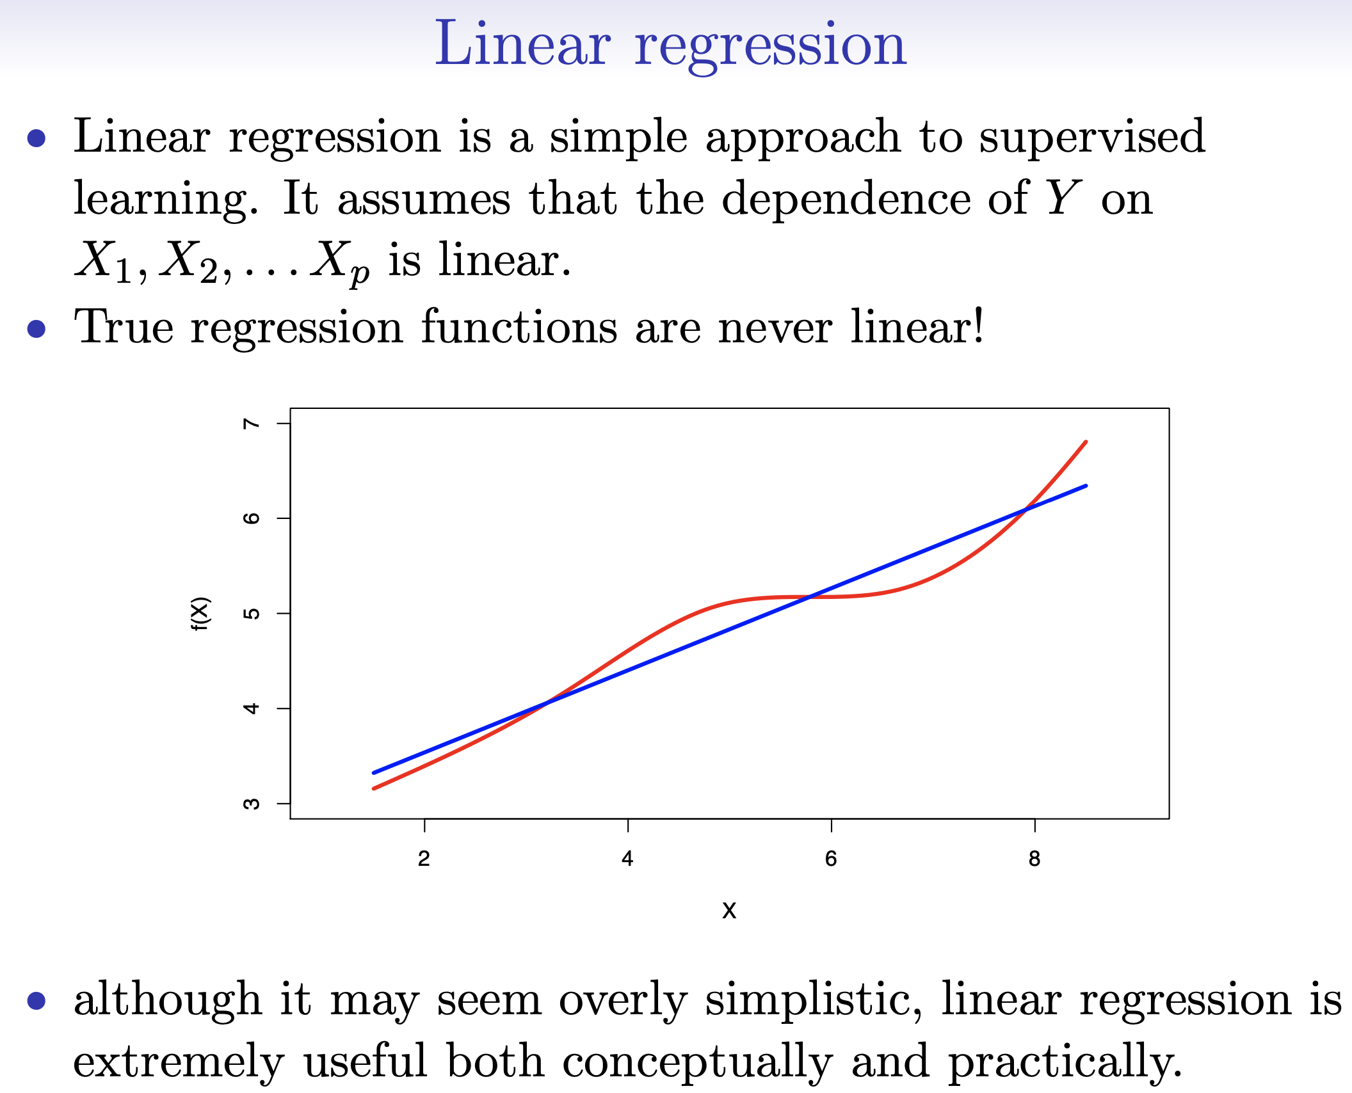
Supervised
Parametric
Linear

Slide 3
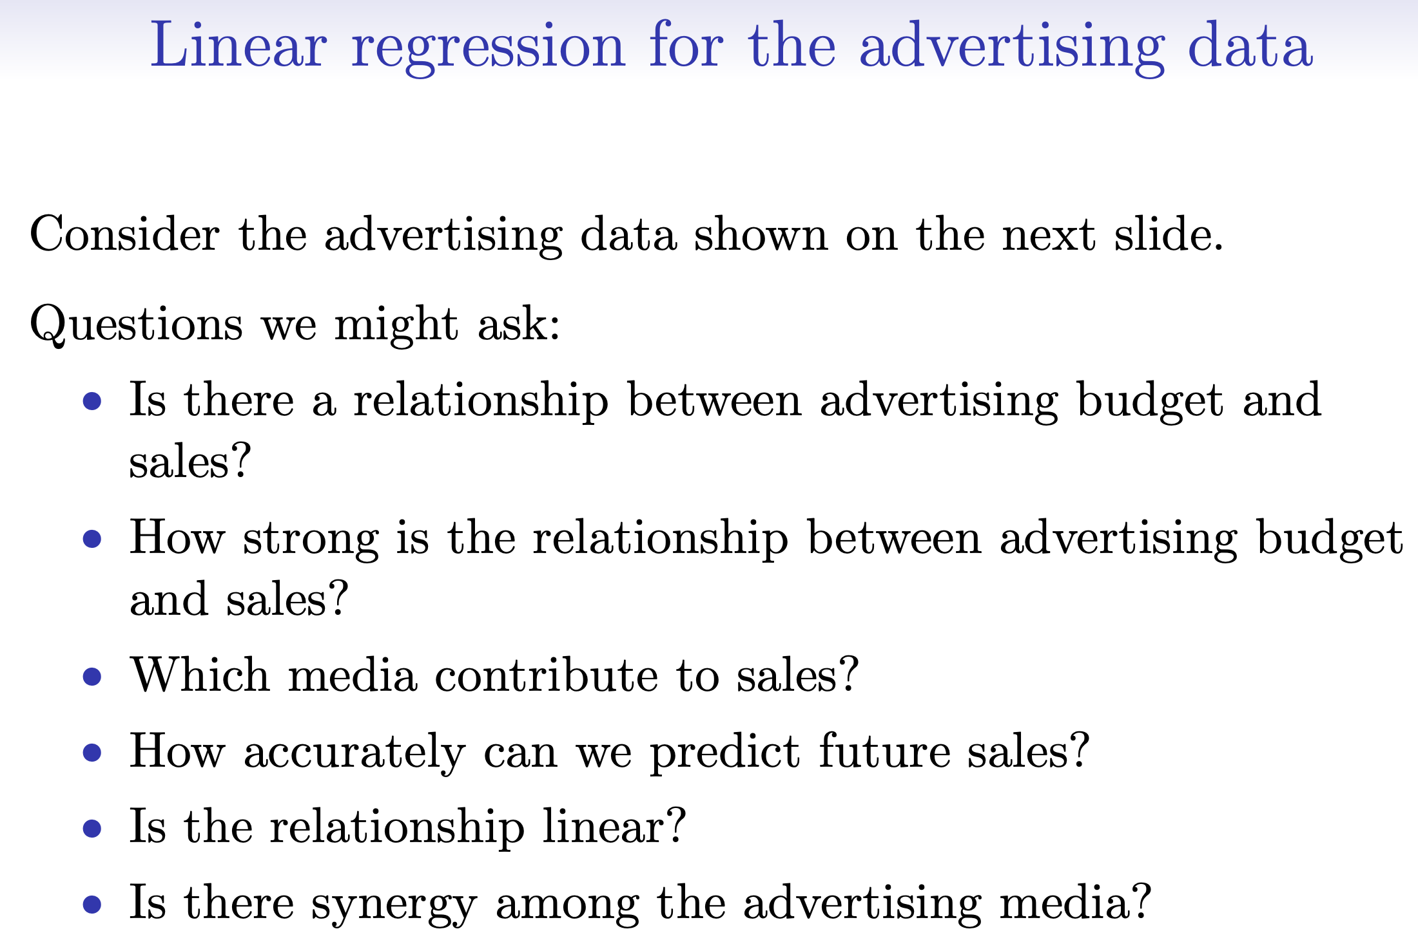
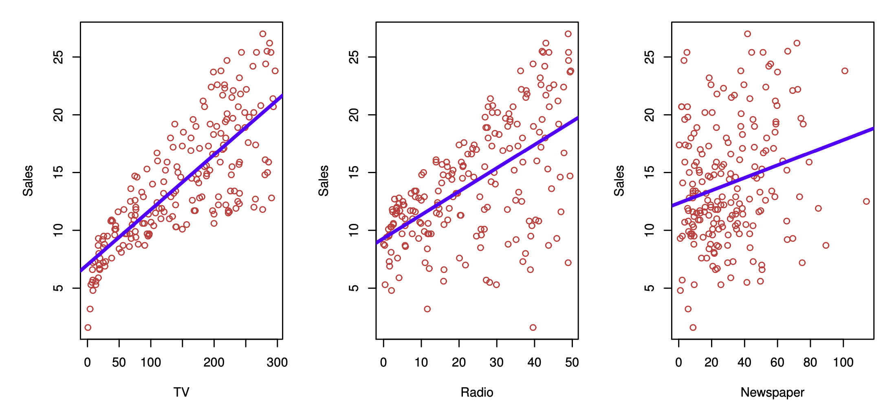
Simple and parametric ➔ good for inference

Slide 4
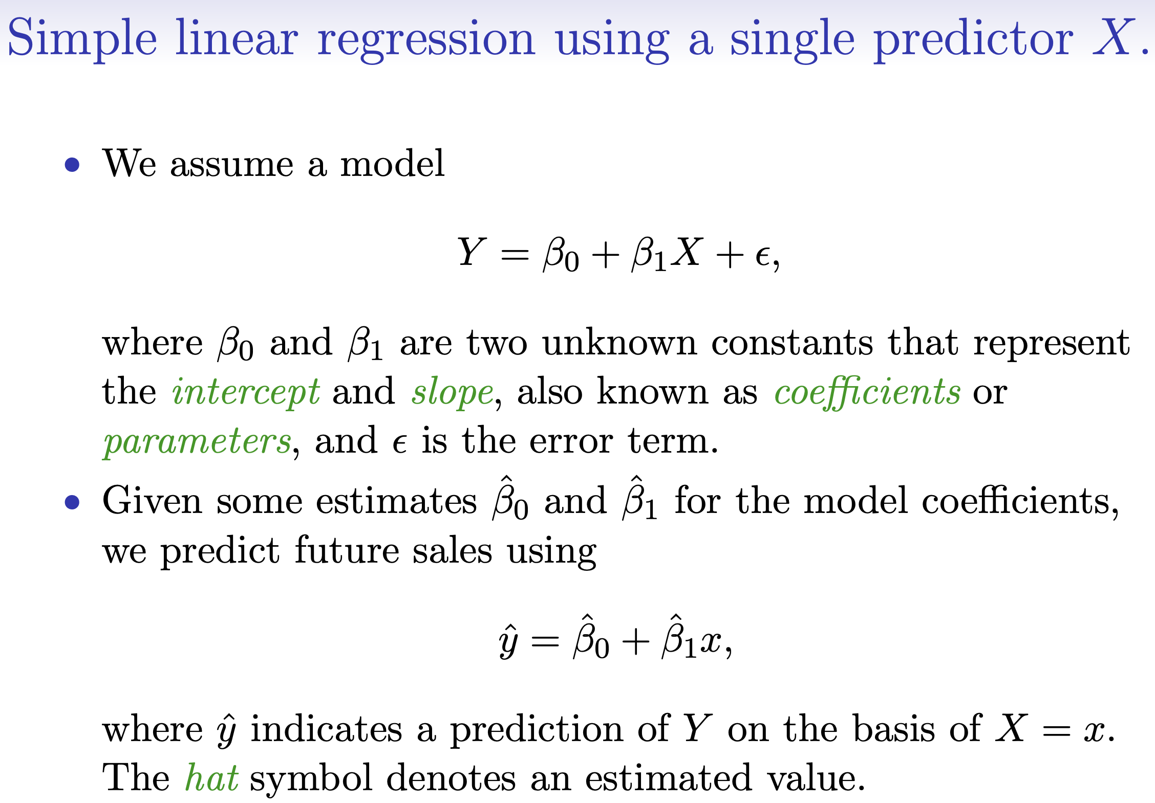
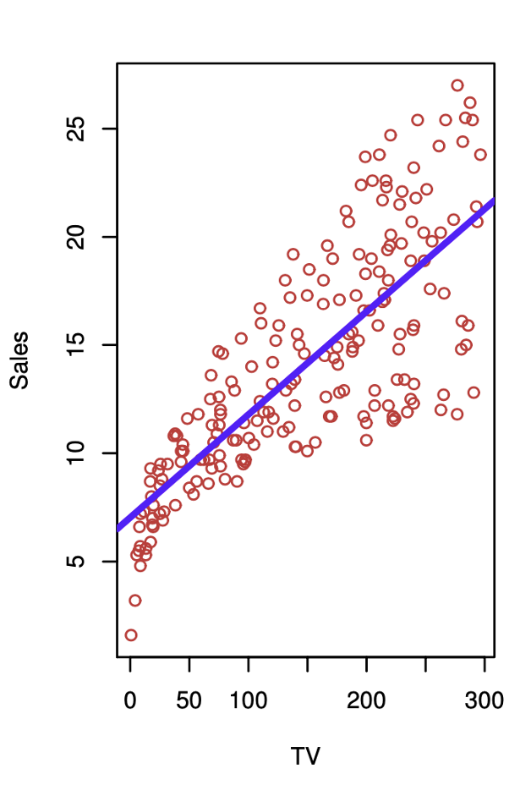


Slide 5
How do we estimate the coefficients?
How accurate are the coefficient estimates?
  Are they biased or not?
  How close are them to the true (unknown) value?
How accurate is the model? [Prediction]

Slide 6
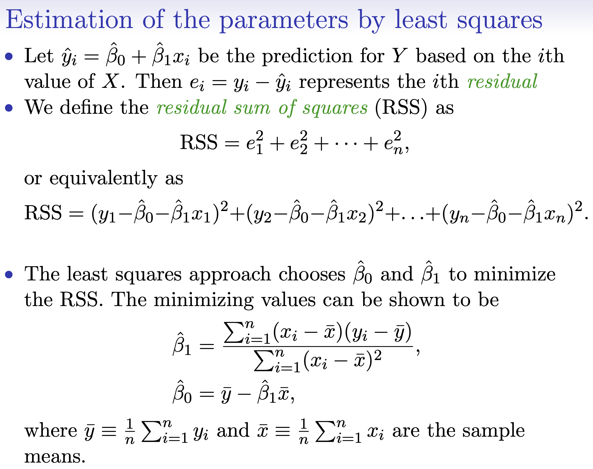
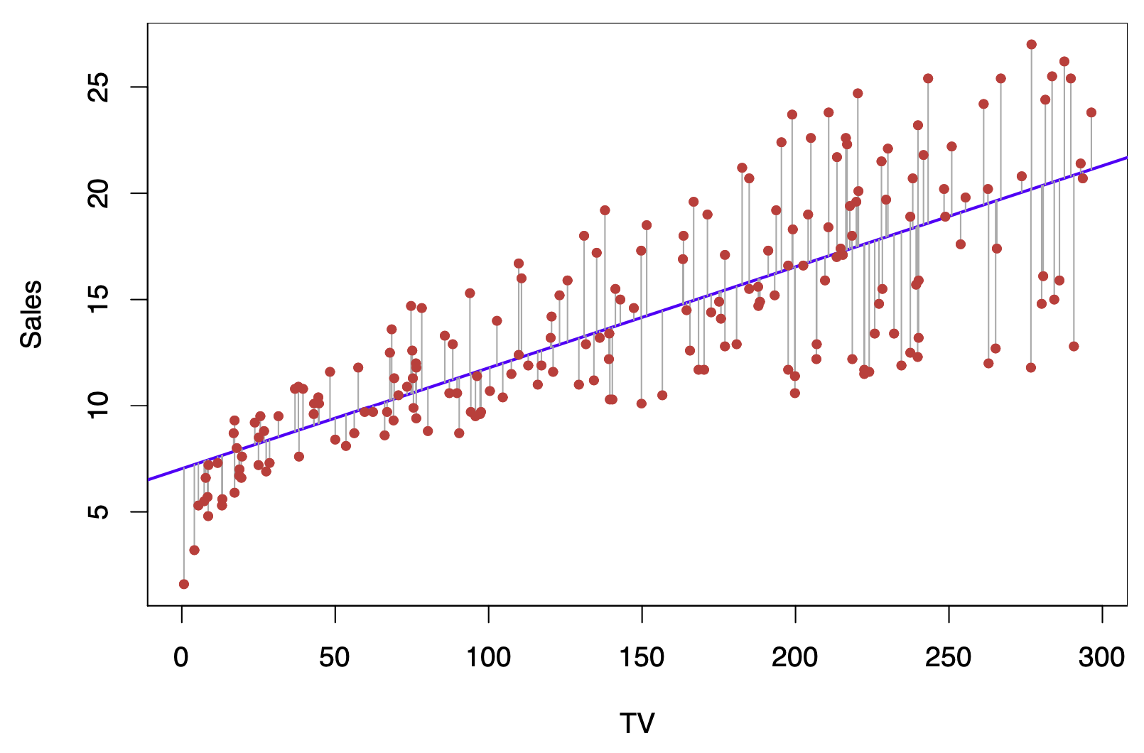
Later in the course we will see other ways of estimating the coefficients

Slide 7
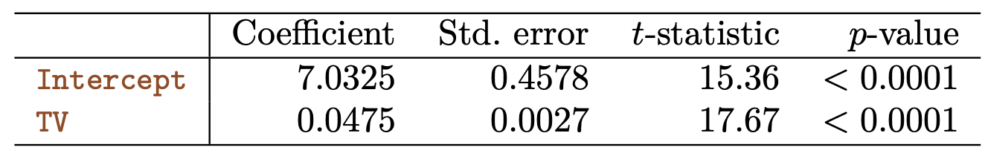

Slide 8
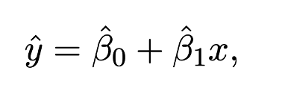
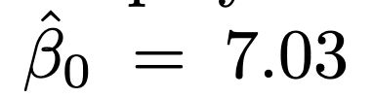
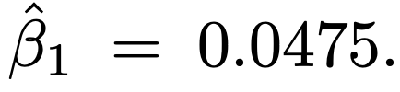
What do these values mean, practically?
Notes:
Additional $1000 dollars spent on TV advertising is associated with selling approximately 47.5 additional units of the product

Slide 9
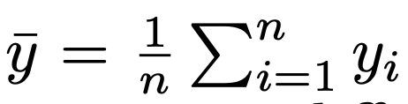
Random variables and estimators…
Y is a random variable, its mean is generally unknown
If we have access to n observations y₁,…,y_{n} from Y, we can estimate the mean of Y using the population mean:
The population mean is an “unbiased” estimator: for some populations the mean overestimates the true one, for others it underestimates, but if if we could average the mean of a large number of populations, we will obtain exactly the mean of Y
Notes:
This is statistics 101, not data mining!

Slide 10
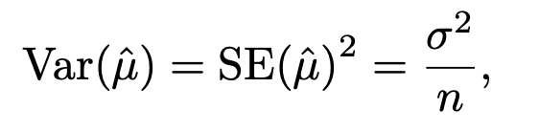
Random variables and estimators (continued)
If we have access to only one population, how far is the population mean from the true mean of the random variable Y?

Slide 11
Assessing the accuracy of the coefficients in simple linear regression
What about the coefficients of a simple regression model calculated from a set of observations…
Are they unbiased?
How far are they from the true value?

Slide 12
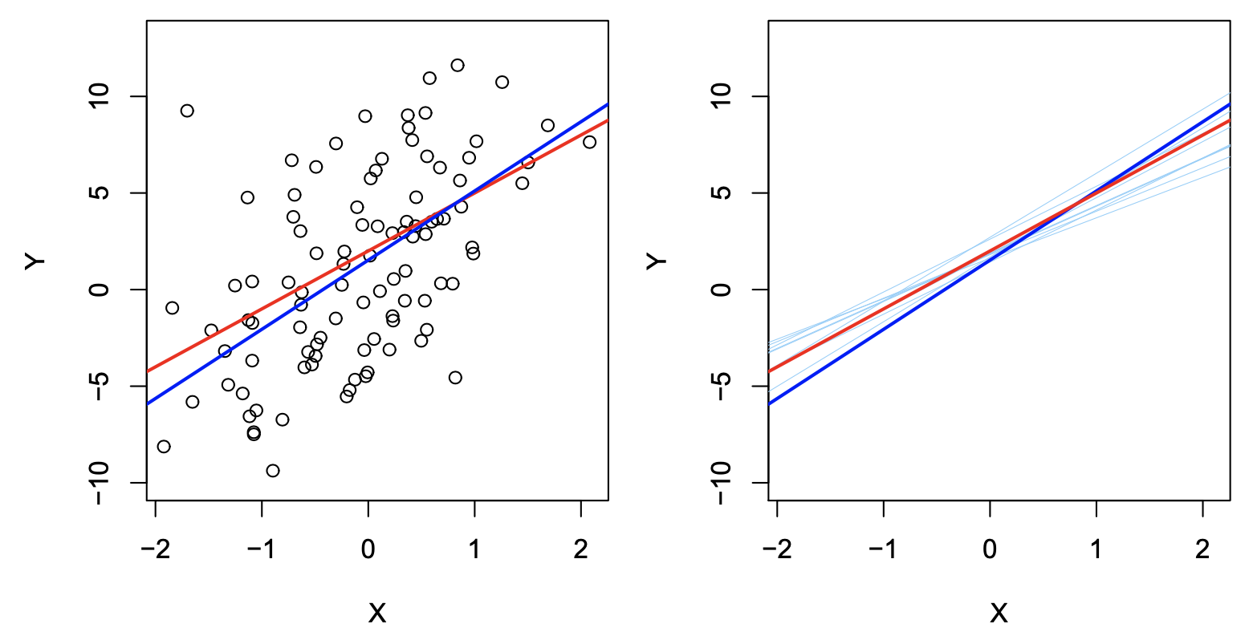
The coefficient estimates are unbiased

Slide 14
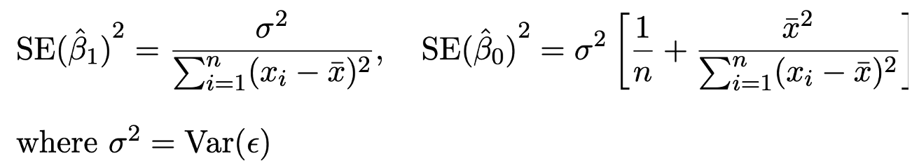

Standard errors of the coefficients
The variance of the standard error σ² is unknown, but we can estimate it from the data as

Slide 15
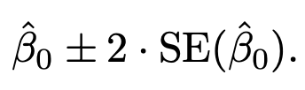
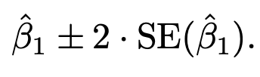
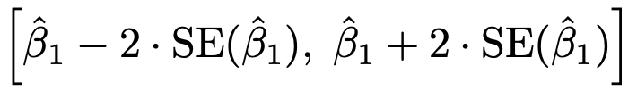
Confidence intervals
Given an estimate of the coefficients from a set of observations, we can compute 95% confidence intervals as follows:
There is a 95% chance that the true value of β₁ (similar for β₀) falls in the interval:

Slide 16
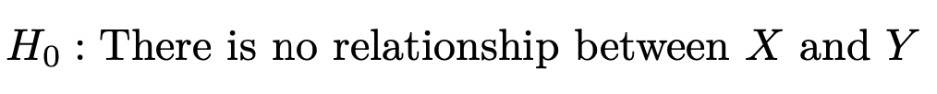
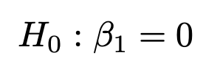
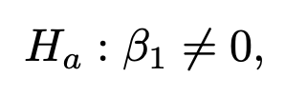
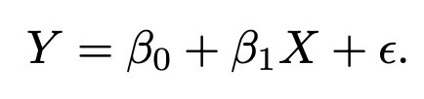
Hypothesis testing
With SEs, we can also test the following null and alternative hypothesis:

Slide 17
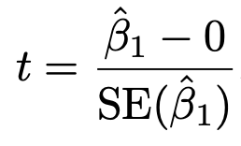
Hypothesis testing
We compute the t-statistic:
It measures the number of standard deviations that β₁ is away from 0
If there is no relations between X and Y, we expect a t-distribution with n-2 degrees of freedom

Slide 19
How accurate is the model?
Residual Standard Error (RSE)
R² statistic

Slide 20
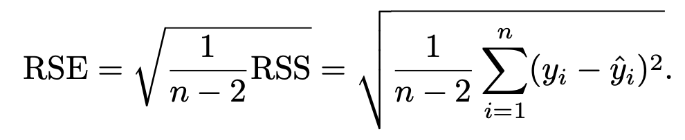
Residual Standard Error

Slide 21
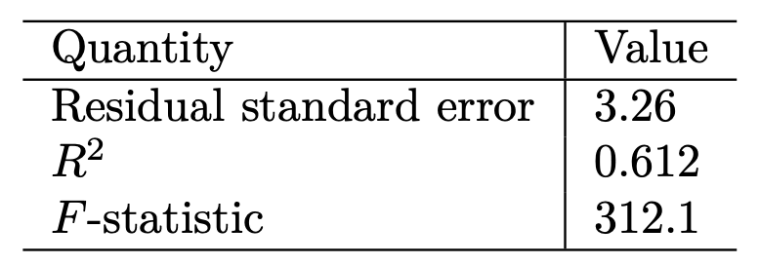
How to interpret the RSE?
Actual sales deviate from the true regression line by approximately 3260 units on average
Even if we estimated the true values of the coefficients correctly, any prediction made using the model will be still be wrong by 3260 units on average
Is this error acceptable?
  Mean value of sales is ~14000 units per market, so the average error is 3260/14000 = 23%

Slide 22
Problems with RSE
RSE measure the “lack of fit of the model”, but…
… it is measured in the units of Y, so…
…it is not always clear what constitutes an acceptable RSE
We would like a proper “statistic” measured on a standard scale (for example, between 0 and 1)

Slide 23
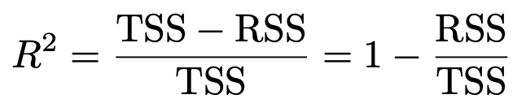

The R² statistic
Where TSS is the total sum of squares

Slide 24
Interpreting R²
TSS measures the total variance of the response Y in the population
RSS measures the amount of variability of the model error
  That is, the variability that the model cannot explain
R² measures the proportion of variability of Y that can be explained using X

Slide 25
Interpreting R²
About 61% of the variability of sales can be explained by the $$ spent on TV advertising

Slide 26
What is a good value of R²?
It depends on the application
Controlled experiments in physics
  RSEs are very low
  Not unusual to see R² value close to 1
Marketing, psychology (social sciences)
  Complex social phenomena
  We focus on a variable X, but many other variables may affect Y
  A value of R² around 0.2 may be very high!

Slide 27
Multiple linear regression
Simple regression focuses on one predictor X
Often, we have several predictors

Slide 28
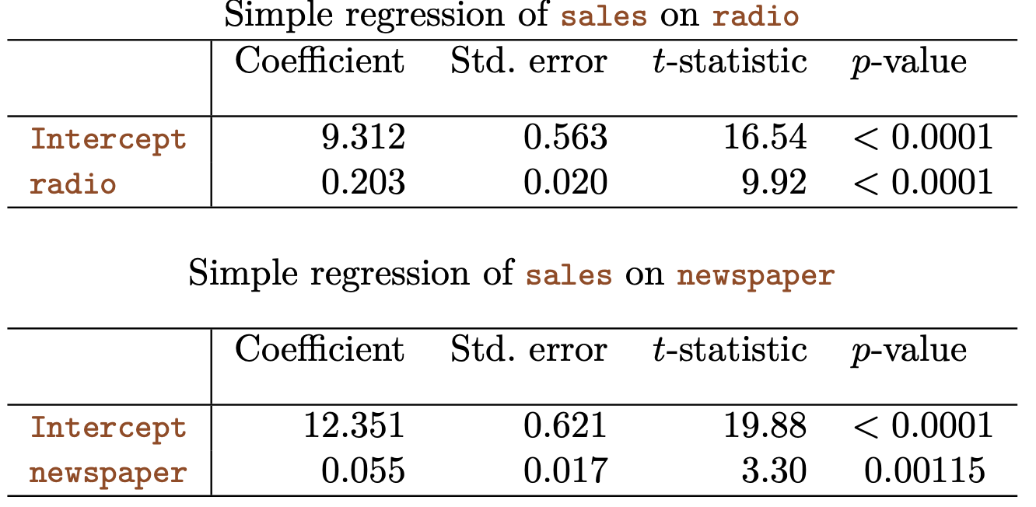
Option 1: run separate simple linear regressions

Slide 29
Problems with single regressions?
Notes:
Each of the regressions ignores the other predictors (media in the example).
How can we make one single prediction given the value of all the predictors?

Slide 30

Option 2: extend the simple regression to many predictors (p>1)
β_{j} captures the average effect on Y of one unit increase of X_{j}, holding all other predictors fixed

Slide 31

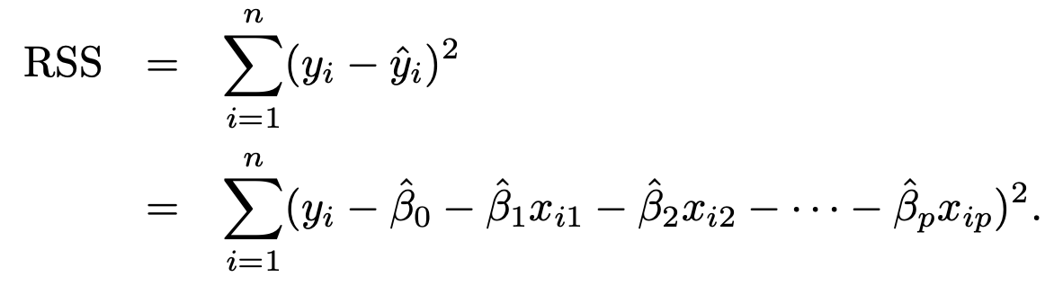
Estimating the coefficients
Minimise the residual squared errors (least square errors)
Complex formula, but can be calculated by any statistical software package

Slide 32
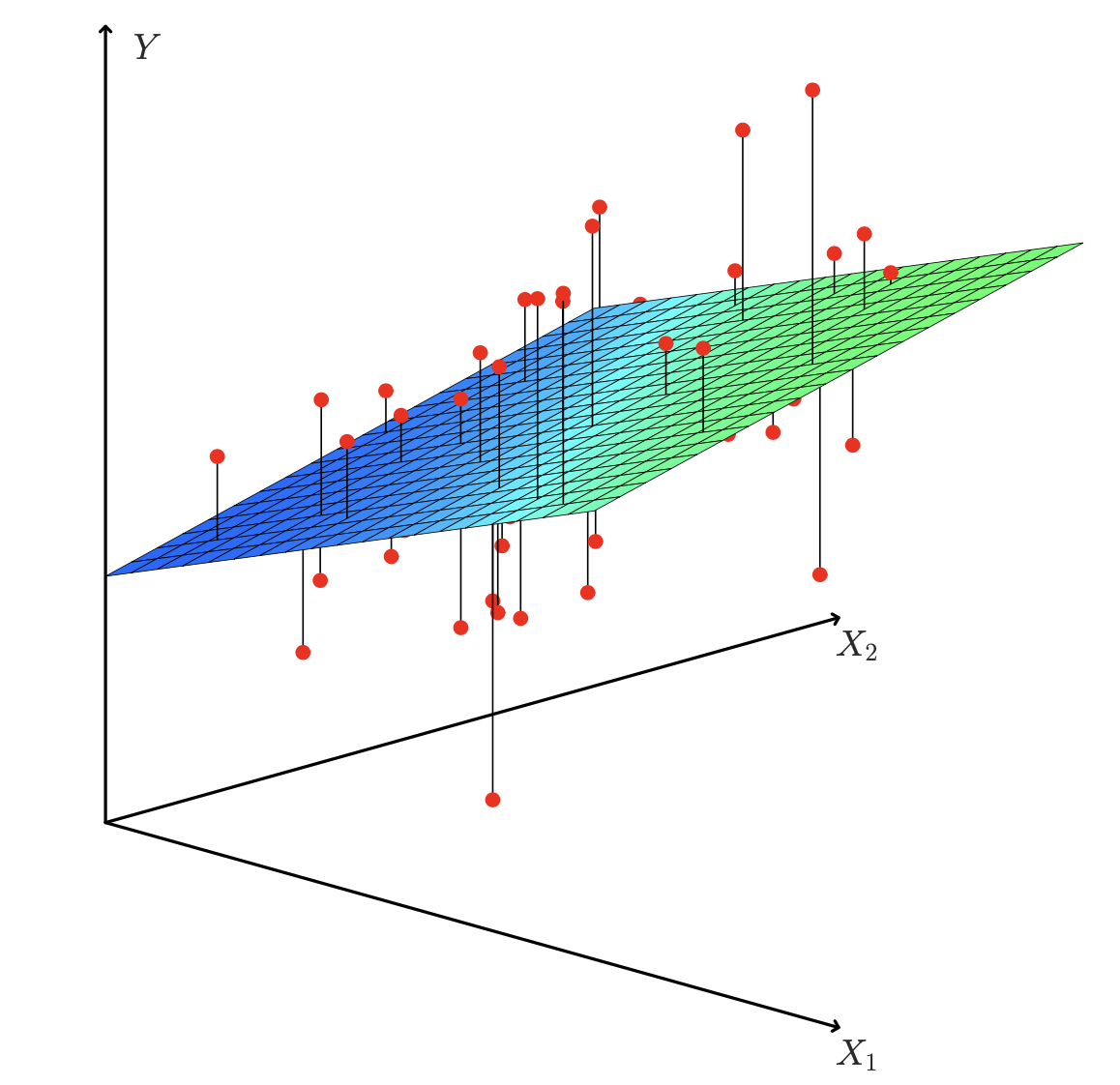
Visual representation for p=2

Slide 33
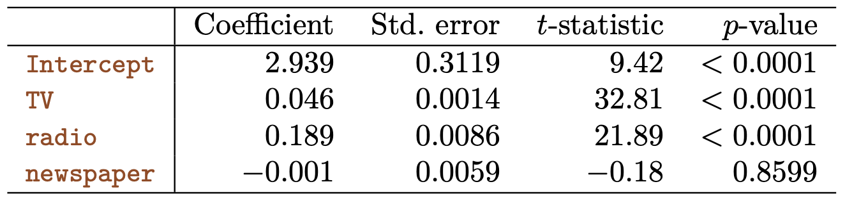
An additional 1000$ spending on radio results on average in additional sales of 189 units
An additional 1000$ spending on TV results on average in additional sales of 46 units
The newspaper coefficient is close to zero and not significant

Slide 34
Multiple v. many single regressions
How do we explain this?

Slide 35
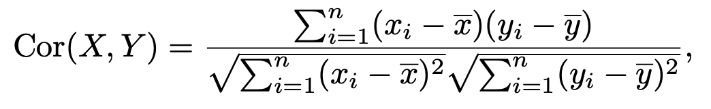
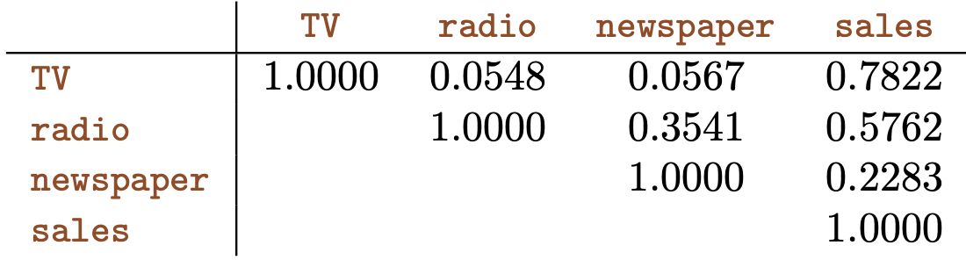
Let’s look at correlations of predictors
Correlation coefficient evaluates the linear correlation between values of populations of X and Y (how much the values of X and Y are similar)
Radio and newspaper are highly correlated (~35%)
Notes:
If we ignore radio (single regression), then newspaper seems to influence sales because it benefits from being correlated with radio. If we consider all the predictors at the same time, we can spot the spurious correlation.

Slide 36
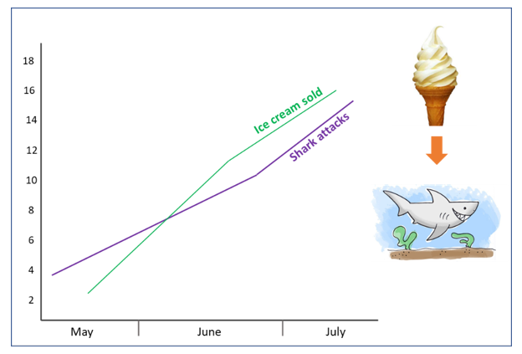
Spurious correlations are everywhere…
Ice cream sales can be a good predictor of shark attacks in a single regression model
  Ban ice cream sales to reduce shark attacks?
Or, better, run a multiple regression with temperature as a predictor ☺

Slide 37
Important questions with multiple regression
Is there a (significant) relationship between the response and the predictors?
Which are the important predictors?
How to assess model fit?
How to make predictions?

Slide 38


Is there a relationship between the response and the predictors?
We need to reject the null hypothesis that *all* the coefficients are zero

Slide 39
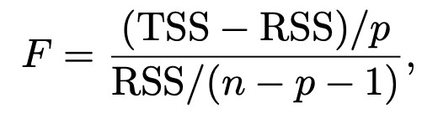
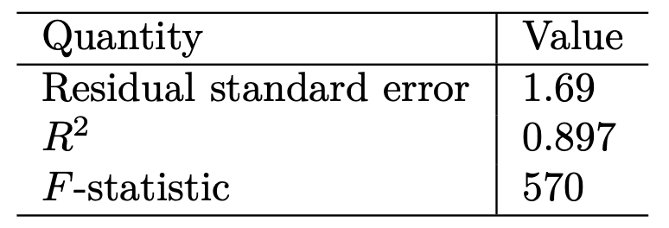
We use the F statistic
If H₀ is true, we would expect a value of F close to 1
If H_{a} is true, we expect a value of F greater than 1

Slide 41
Important questions with multiple regression
Is there a (significant) relationship between the response and the predictors?
Which are the important predictors?
How to assess model fit?
How to make predictions?

Slide 42
Which are the important predictors?
If we reject H₀, we know that there is a relationship between the response and the predictors
.. but which predictors are (more) important?
This is the “variable selection” problem
Notes:
In our example, we should probably not consider newspaper

Slide 43
Ideal solution to the variable selection problem
Given the p predictors, we can consider all the possible models including them
  P=2, 4 models
    No variables (null model)
    Only X1
    Only X2
    X1 and X2
2p models to be considered
  P=30, then ~1 billion models!

Slide 44
Reasonable solutions to the variable selection problem
Forward selection
Backward selection
Mixed selection

Slide 45
Forward selection
Start with null model
Fit p simple linear regressions
Add to the null model the variable X with lowest RSS
Fit p-1 2-variable linear regressions
Add the variable X with lowest RSS
… (iterate 4,5 until a terminating condition is met)
Terminating condition: RSS low enough, target number of variables reached, …

Slide 46
Backward selection
Start with all variables in the model
Remove the variable with largest p-value (the least statistically significant)
Fit the (p-1)-variable model
Iterate (2,3) until a terminating condition is met
Terminating condition: all variables in the model have a p-value below some threshold, target number of variables reached

Slide 47
Mixed selection
Combine forward and backward

Slide 48
Important questions with multiple regression
Is there a (significant) relationship between the response and the predictors?
Which are the important predictors?
How to assess model fit?
How to make predictions?

Slide 49
Important questions with multiple regression
Is there a (significant) relationship between the response and the predictors?
Which are the important predictors?
How to assess model fit?
How to make predictions?

Slide 50
Final considerations on regression models
Qualitative predictors
Extensions
  Removing additive assumptions
  Non-linear relations
Potential problems of regression models

Slide 51
Final considerations on regression models
Qualitative predictors
Extensions
  Removing additive assumptions
  Non-linear relations
Potential problems of regression models

Slide 52
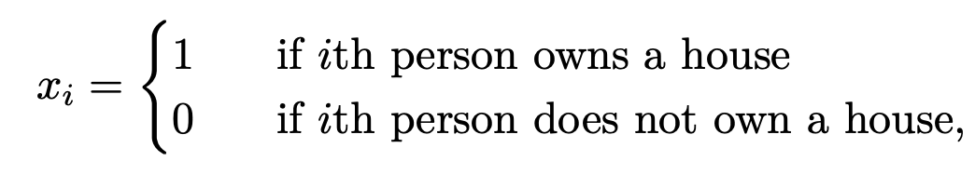
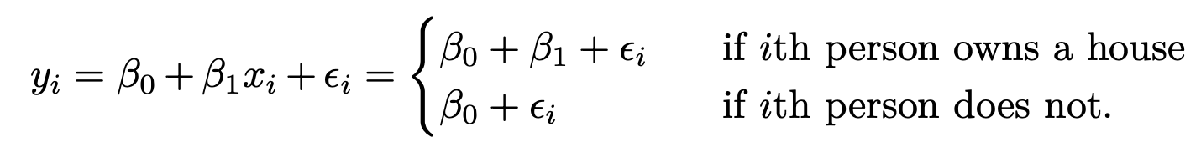
Predictors with 2 levels
If a predictor (or “factor”) has 2 levels, we can incorporate it using a so-called dummy variable
Example: predict the average bank account balance based on whether (or not) one owns a house:

Slide 53
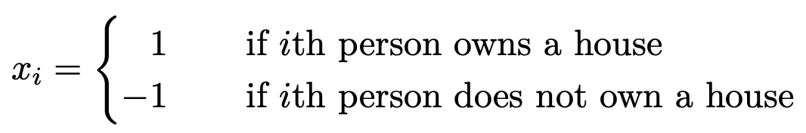
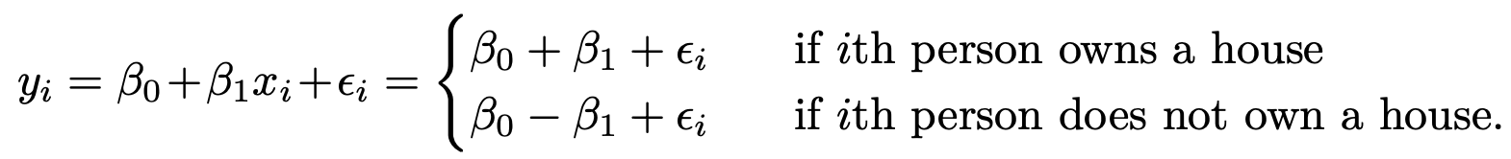
How to code the dummy variable?
The numerical values assigned to the dummy variables have no effect on the regression model fit
They do impact the interpretation of the coefficients!
What do β₀ and β₁ mean in these two models?
Notes:
B0 average cc balance among those who do not own, b0 + b1 among who own

Slide 54
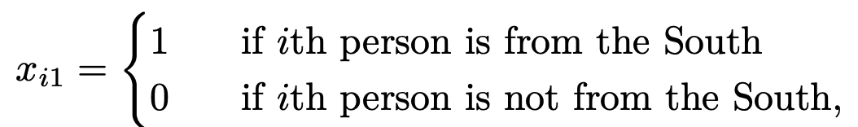
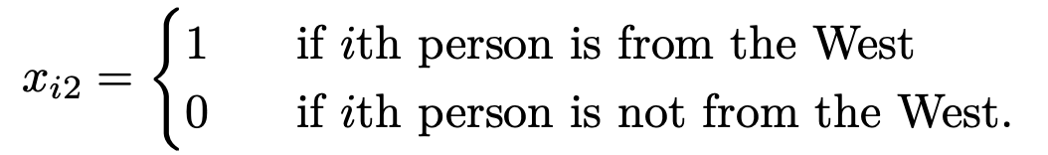
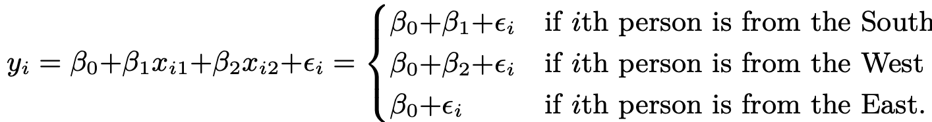
Predictors with 2+ levels
We can create additional dummy variables
Example: a person can be from the South, West or East (3 levels)
Being from the East, in this example, is the “baseline”

Slide 55
What if the response is qualitative?
Can we still use the regression model?
Later in the course

Slide 56
Final considerations on regression models
Qualitative predictors
Extensions
  Removing additive assumptions
  Non-linear relations
Potential problems of regression models

Slide 57
Extending the linear regression
Linear regression makes two strong assumptions on the relation between the predictors and the response
  Additivity: the relation between a predictor X_{j} and the response Y does not depend on the values of the other predictors
  Linearity: the change in the response Y associated with a one-unit change of X_{j} is constant, regardless of the value of X_{j}

Slide 58

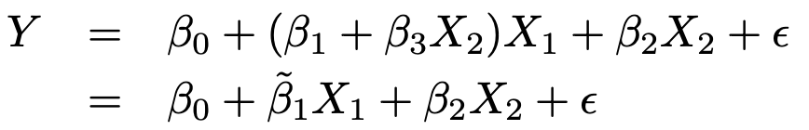

Removing the additive assumption
We can include “interaction terms” as additional predictors
The relation between X1 and Y is no longer constant, but influenced by changes of X2

Slide 59
Non-linear relations
A simple way is to consider polynomial regression
Example: predicting gas mileage based on vehicle horsepower
We predict mpg as a quadric function of horsepower
But it is still a linear model!
  X1 = horsepower
  X2 = horsepower²

Slide 60
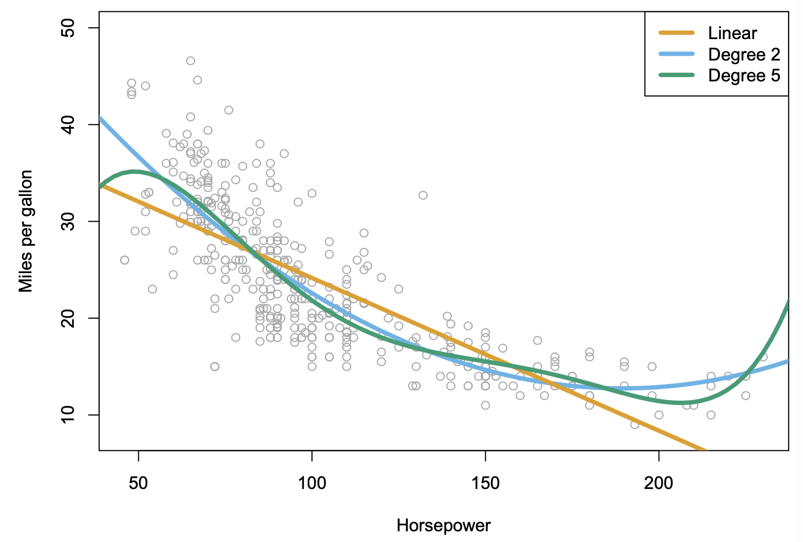
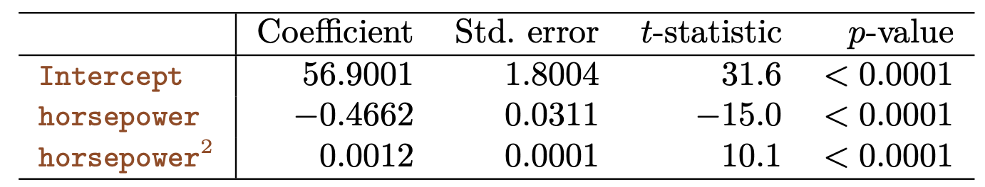

Slide 61
Final considerations on regression models
Qualitative predictors
Extensions
  Removing additive assumptions
  Non-linear relations
Potential problems of regression models

Slide 62
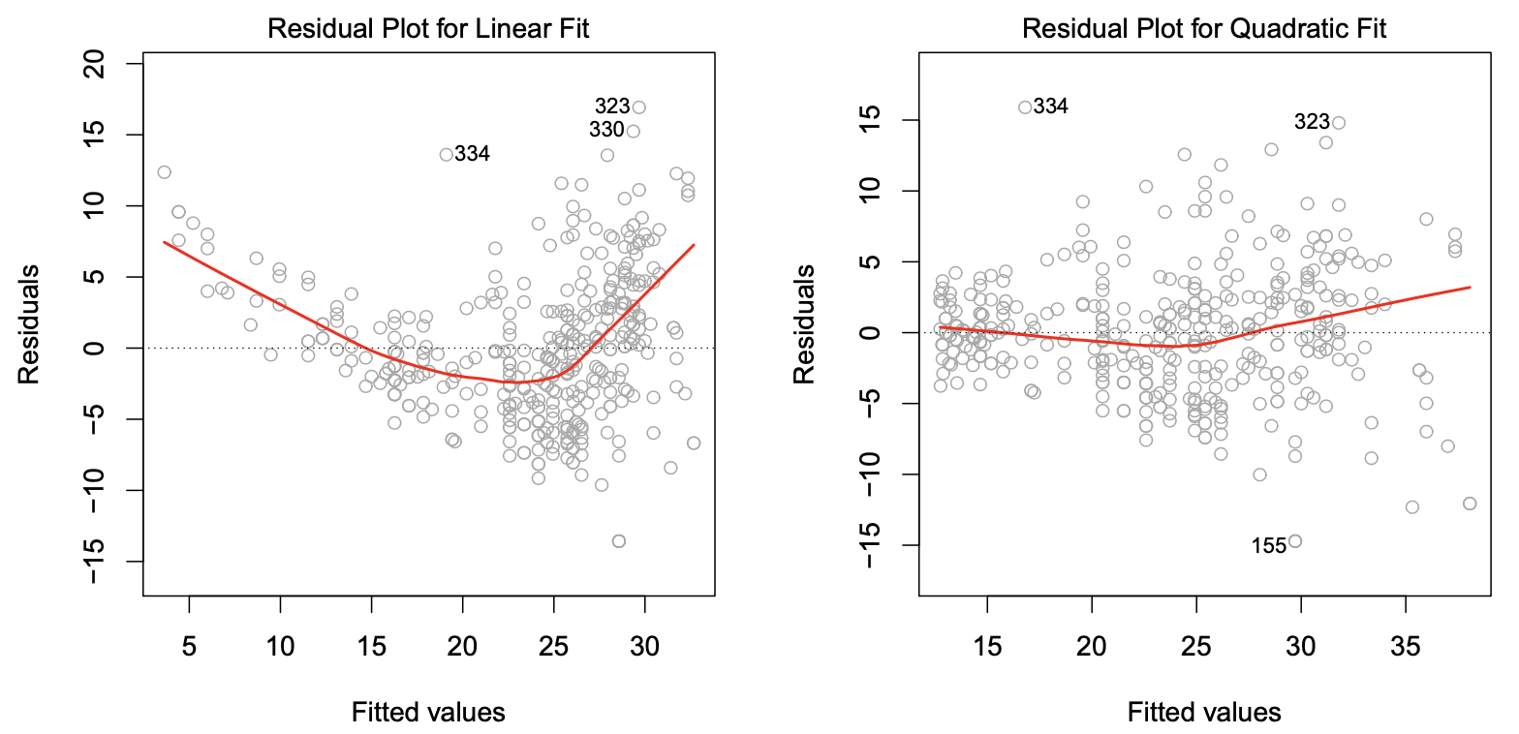
Non-linearity of the data
The true relation between the response Y and the predictors X_{j} may be far from linear
Linear regression will always enforce a linear relation, leading to large errors
mpg=f(horsepower)
mpg=f(horsepower, horsepower2)

Slide 63
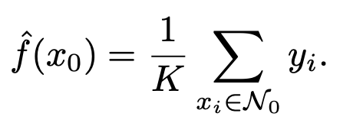
Linear v. KNN Regression
Linear regression is parametric
KNN regression as an example of non-parametric method
  Given K, x₀, N₀ are the K closest observations to x₀ in the training set

Slide 64
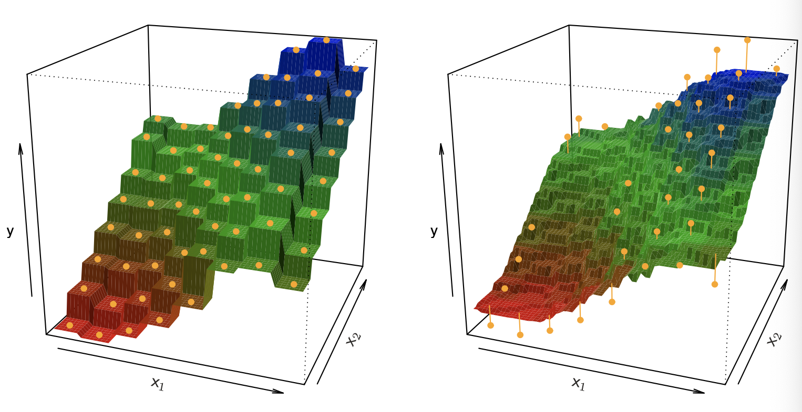
Characteristics of KNN regression
K=1: perfect fit of the data
Higher K, smoother fit
K to control the bias-variance trade-off
K=1
K=9

Slide 65
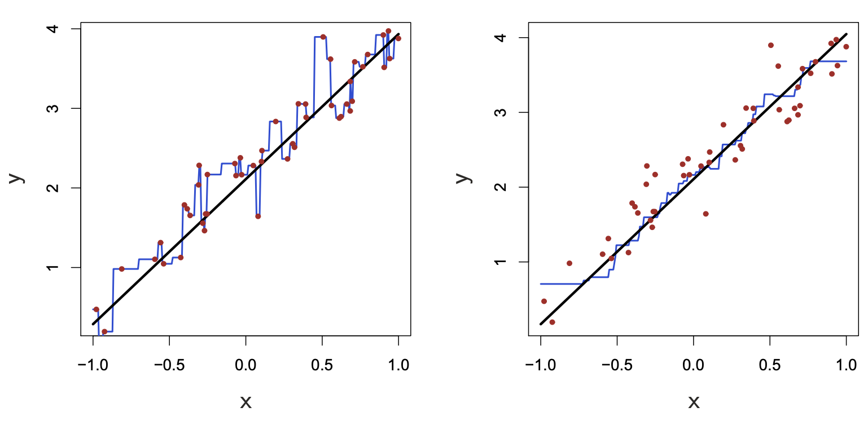
K=1
K=9

