Slide 1


TE Mini Project
I-Detox
Domain:-AI, Deep learning and DWH Mining.
Inhouse Research Project
Sustainable Goal : Good Health and Digital
Wellbeing.
Review - II
Project Mentor :GEOCEY SHEJY
Group Number : 19
Group Members :
Muskan Chhabria (13)
Divesh Chhoda (14)
Varun Salvi (51)
Athurva Sawant (63)

Slide 2
Content
Introduction to Project
Lacuna in the existing systems
Problem Definition
Literature Survey
Methodology employed
Hardware, Software, tools and the constraints
Block Diagram
Modular Diagram
Next Work Plan
Conclusion
References

Slide 3
Introduction to Project
Addictive digital experiences are becoming extremely common in the tech industry and the adjective “addictive” is now considered one of the highest compliments paid to an artifact .
To counter digital addiction, we present a system we call “I-Detox”.
The important feature of “I-Detox” is compatibility, young to old can become familiar and use this system.
“I-Detox” will serve as a tracker for a user’s internet use, his browsing and the time he spends on a particular content only to provide it back to the user in a document/workbook format so that he/she can track and monitor their use accordingly.

Slide 4
Lacuna in the existing system
On analysing the current systems existing in the market , we find that the system’s do track their history into a file/text document but don’t go further to categorise it. This may serve as a problem since not every website can be identified by it’s url.
“I - detox” not only provides the history information to the user via mail file also categorises the url into different types of websites adding onto the display of bag of words searched on a particular website.
Thus, this makes the system user-friendly providing clarity which website provides what purpose and service and further analysing the visit_count of the websites.
Browsing history/ or what does the user access internet for can prove a major aspect to analyse the human-being as a whole and what he/she is thinking. On analysing one can find if he/she is facing some mental problems.
Currently, no system or software goes out of the way to analyse a user’s browsing history and analyze their mental health.
That’s what “I-detox” brings to the table mixing both mental health and history tracker together and co-existing a space between the two.

Slide 5
Problem Definition
“I-detox” hopes to provide the user with an analysis of the number of websites visited by the user, the visit count of the user for each website and thus giving him an idea of his browsing method and the probability of being addicted to any of them.

Slide 6
Literature Survey
Research Paper | Publication details | Description
A study on rough set-aided feature selection for automatic web-page classification. https://www.researchgate.net/publication/220298511_A_study_on_rough_set-aided_feature_selection_for_automatic_Web-page_classification | Wakaki, T., Itakura, H., Tamura, M., Motoda, H., & Washio, T. (2006). | A basic idea about how the web-pages are classified based on various categories.
Keras: The Python Deep Learning library, https://keras.io/ | Son Erişim: Mayıs 2018. | A well built python library which makes our thoughts clear on the concepts of deep learning and provides API for implementing so.
A study on Internet addiction and its relation to psychopathology and self-esteem among college students. https://www.ncbi.nlm.nih.gov/pmc/articles/PMC6198588/ | Kumar M, Mondal A.Ind Psychiatry J. 2018 Jan-Jun;27(1):61-66. doi: 10.4103/ipj.ipj_61_17. PMID: 30416293; PMCID: PMC6198588. | The main objective of this study is to explore the Internet use and its relation to psychopathology and self-esteem among college students.
Internet Addiction Facts and Statistics By The Recovery Village. Internet Addiction Facts & Statistics | Serious Social Problem | Learn More (therecoveryvillage.com) | Editor Megan Hul. Medically Reviewed By Dr. Andrew Proulx, MD | This helps us to understand what is internet addiction how it is caused what are the symptoms for understanding this addiction.

Slide 7
Literature Survey
Research Paper | Publication details | Description
Large Scale Text Classification using Semi-supervised Multinomial Naive Bayes https://icml.cc/2011/papers/93_icmlpaper.pdf | Jiang Su,Jelber Shirabad,Stan Matwin | A research paper which clearly specifies how multi-novial Naive Bayes can be used for effective classification with outstanding results.
Logistic regression and artificial neural network classification models: a methodology review https://www.sciencedirect.com/science/article/pii/S1532046403000340 | Stephan Dreiseitl, Lucila Ohno-Machado | A well Explained Resource paper which discusses about various algorithms like knn, svm, logistic regression.
Text classification techniques: A literature review. https://www.proquest.com/openview/b207fca7feb7fe6a69dca55c3e84e525/1?pq-origsite=gscholar&cbl=5314838 | M. Thangaraj, M. Sivakami | A paper which explains the background of various classification techniques their uses way of functioning and their implementation.

Slide 8
Literature Survey
Research Paper | Publication details | Description
Internet Addiction: A Handbook and Guide to Evaluation and Treatment. by Kimberly S. Young (Editor), Cristiano Nabuco de Abreu (Editor) https://books.google.co.in/books?id=C_omSZQyfYcC&lpg=PA1&pg=PT7#v=onepage&q&f=false | Dr. Larry Rosen, Past Chair and Professor of Psychology at California State University. Hilarie Cash, PhD, coauthor of Video Games and Your Kids: How Parents Stay in Control, and cofounder of reSTART: Internet Addiction Recovery Program. Ran Tao, MD, Professor and Director, and Xiuqin Huang, MD, Associate Professor, Treatment Center for Internet Addiction, General Hospital of Beijing Military Region, China.( 9 Nov 2010). | This book provides cutting-edge coverage by expanding the field to include specific problems such as online gaming, cybersex addiction, and gambling addiction. Its extensive attention to dealing with adolescents is essential, given the rapid rise in media and technology use by both Net Generation young adults and iGeneration teenagers.I am thrilled to have this invaluable, comprehensive, well-written resource for my own work and recommend it to people who need to understand this unique form of addiction.
Internet addiction and problematic Internet use: A systematic review of clinical research. https://pubmed.ncbi.nlm.nih.gov/27014605/ | Daria J Kuss and Olatz Lopez-Fernandez (2016 March). | comprehensive overview of clinical studies on the clinical picture of Internet-use related addictions from a holistic perspective. A literature search was conducted using the database Web of Science.

Slide 9
Methodology Employed
Artificial Intelligence and Machine learning-based approaches for the prediction of addiction and to classify the websites into categories. Based upon the data extracted from the user’s browsing history which includes the websites, the types of websites, the number of visits or we can say the view count and categories the model would test the data and give the user the exact idea of his browsing pattern. The solution will focus on both the categories and the view-count. For the categories, the solution will take into consideration the URLs and the bag of words from the websites. “I-detox” would thus indicate to the user if he requires any help to stop himself from being addicted to any harmful website.
“I-detox” basically operates on the classification of websites. This website classification is based on the categorization of the websites. This categorization takes place on the content of the website, or the bag of words.If the URL is not accessible then we divide the URL into its component strings, create an array of that string and on the basis of this array we classify that particular website.

Slide 10
Methodology Employed
The metadata of the website is extracted from the website using request and beautifulsoup (bs4) library used for scraping. “Request” will send the request to the website to get the HTML page ; this HTML page will then be used by the bs4 library to extract the metadata from the website. The metadata contains a tag called description, on the basis of the content in the description tag the website is categorized.
Whilst we browse through the internet browsers such as Google Chrome, Mozilla Firefox or Microsoft Edge; the user’s browser history is stored in the root directory of the browser. This generally exists in the Local Disk of the system(C:\Users\<username>\AppData\Local\Google\Chrome\User Data\Default\History). Through this directory one can obtain the user history.
This browsing history contains three tables namely urls, visit_source and visits. In the urls table, there is a column called visit count for each website. We take this visit count and then we sort the visit count, from that we get the top “y” (where y is the number of specified websites). We take these top y websites and assign the url to these websites using the model which is trained above.

Slide 11
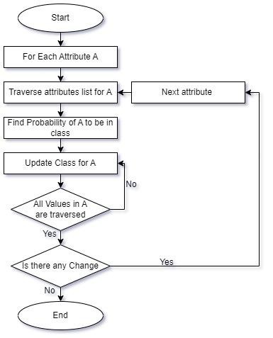
Methodology Employed
Flow Chart for Naive Bayes

Slide 12

Block Diagram

Slide 13
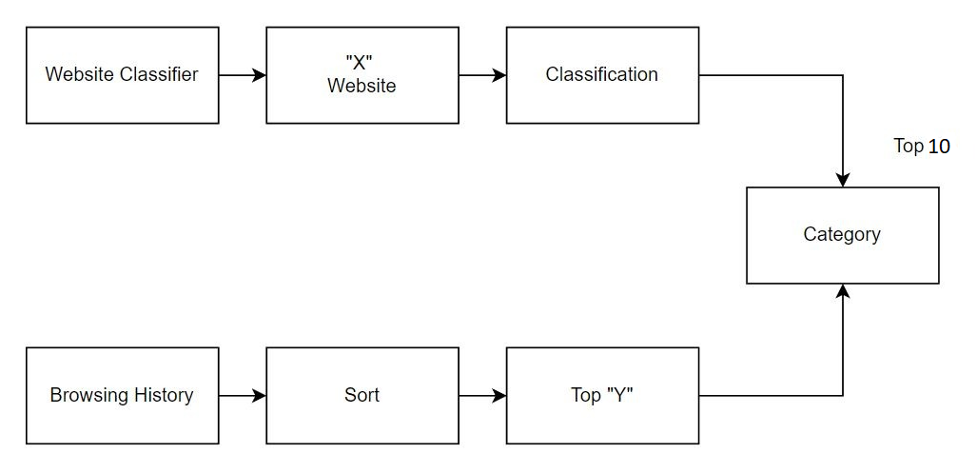
Modular Diagram

Slide 14
Hardware, Software, Tools and constraint
Software Requirements:
• Language: Python
• IDE: Spyder
• ML Model Platform: Google Colab
Hardware Requirements:
• 2Gb Ram
• Intel Pentium Gold Processor and above / Ryzen Athlon and above
• 512 Mb Physical Storage and above.

Slide 15
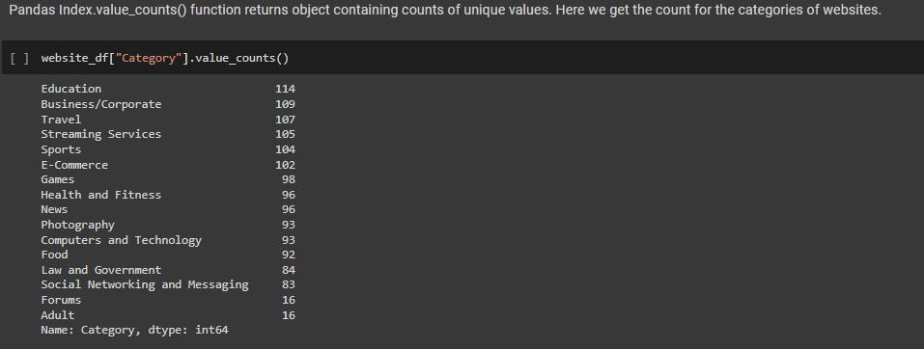
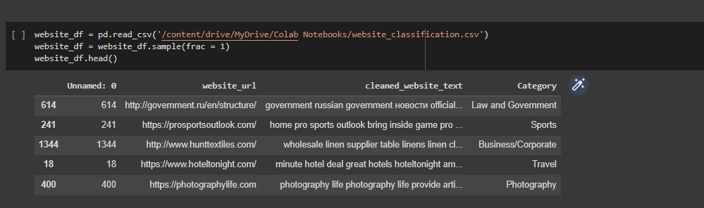
Proposed System
Reading Dataset
Categories to be predicted

Slide 16
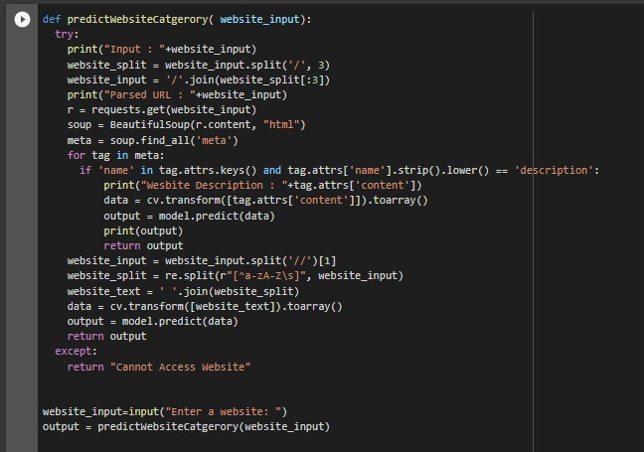
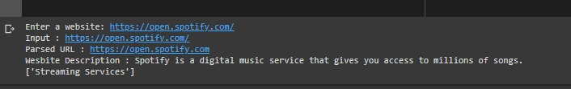
Proposed System
Classification result

Slide 17
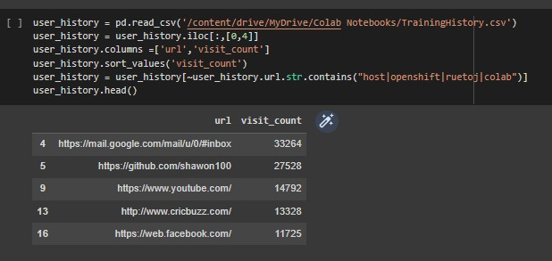
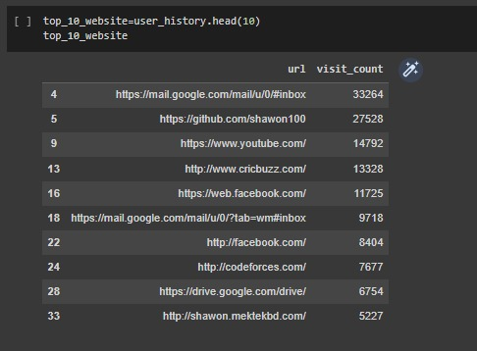
Proposed System
Browsing history dataset
Top 10 websites visited

Slide 18
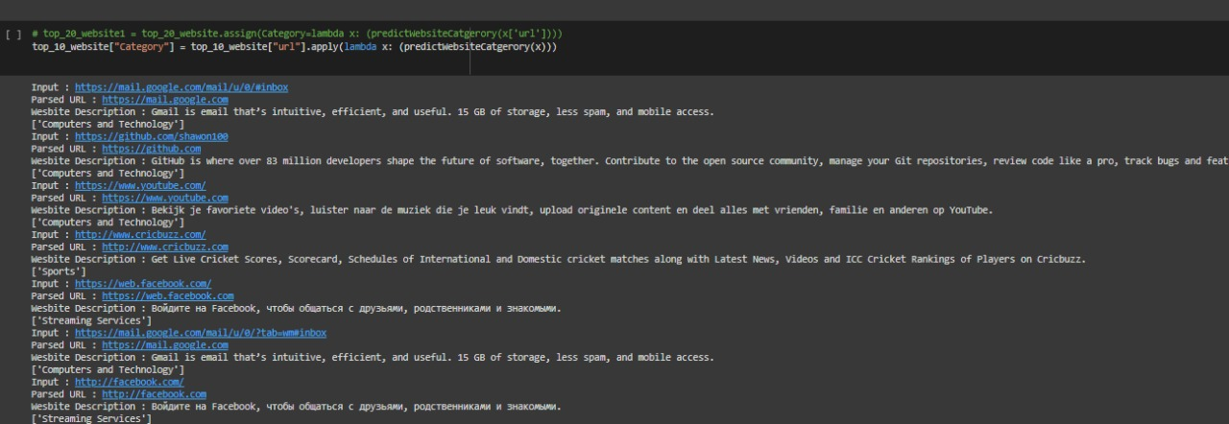
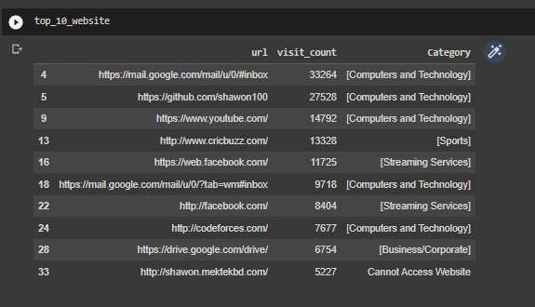
Proposed System
Assigning categories to top 10 websites
Final Output

Slide 19
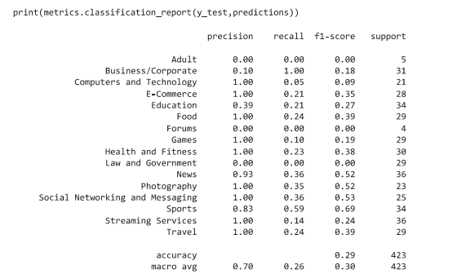
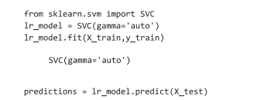

Proposed System
Implementation through svm
Matrix representation of classification
Accuracy of Svm

Slide 20
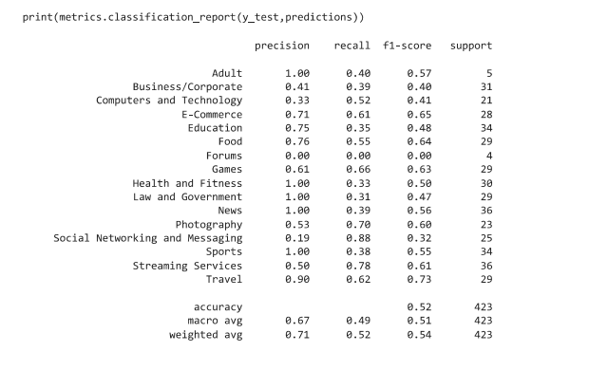


Proposed System
Implementation using knn
Prediction accuracy of knn
Matrix representation of classification

Slide 21

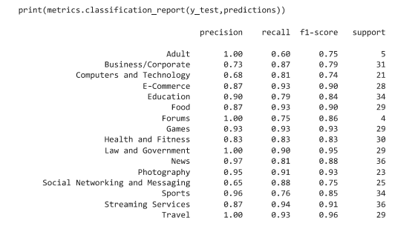

Proposed System
Implementation using Logistic Regression
Prediction accuracy of Logistic Regression
Matrix representation of classification

Slide 22

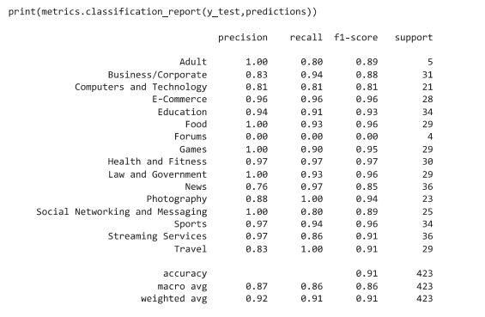

Proposed System
Implementation using Naive Bayes
Prediction accuracy using Naive Bayes
Matrix Representation of classification

Slide 23
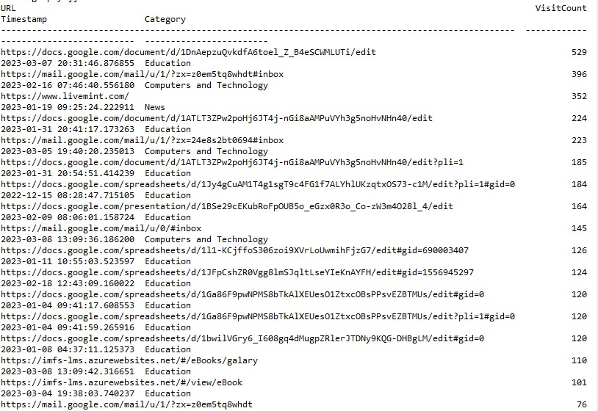
Proposed System
The output of our program displaying url timestamp, category, visit count.

Slide 24
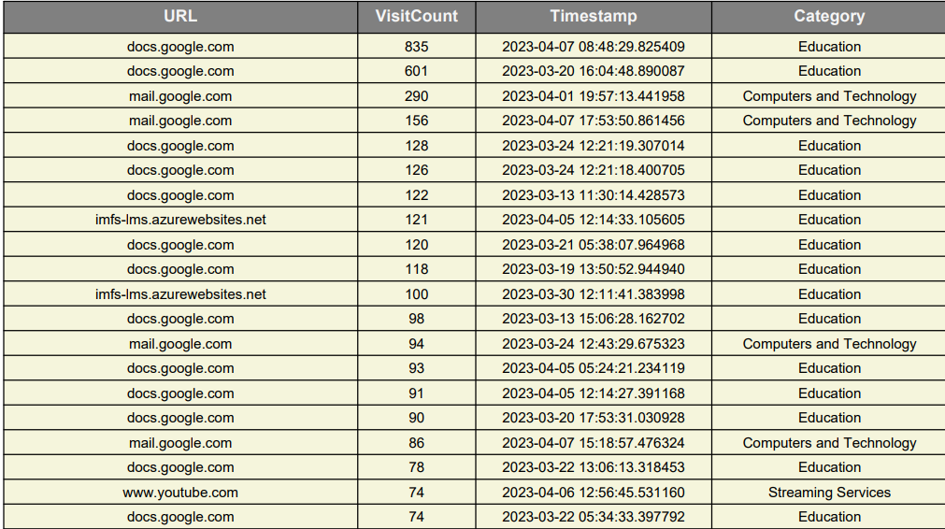
Proposed System
A snapshot of the pdf sent to the mail mentioned by the user

Slide 25
Next Work Plan
To introduce a module which would focus and target the mental health concept based on user data.

Slide 26
Conclusion
As technology advances, so will the number of people who use the internet browser. Internet web addiction should not be automatically thrown into an existing diagnostic category, but should be studied, picked apart, and explored, until a clear and concise definition is established.

Slide 27
References
Wakaki, T., Itakura, H., Tamura, M., Motoda, H., & Washio, T. (2006). A study on rough set-aided feature selection for automatic web-page classification. Web Intelligence and Agent Systems: An International Journal, 4, 431–441.
Internet Addiction Facts and Statistics By The Recovery Village | Editor Megan Hull.
https://www.helpguide.org/articles/addictions/smartphone-addiction.htm (Signs & Symptoms)
Kumar M, Mondal A. A study on Internet addiction and its relation to psychopathology and self-esteem among college students. Ind Psychiatry J. 2018 Jan-Jun;27(1):61-66. doi: 10.4103/ipj.ipj_61_17. PMID: 30416293; PMCID: PMC6198588.
Internet Addiction: Definition, Assessment, Epidemiology and??Clinical Management by Donald Black.
https://comparecamp.com/internet-addiction-statistics/ (STATISTICS: 2020/2021 DATA, FACTS & PREDICTIONS)
https://pypi.org/project/browserhistory/ (This website helps us to understand how we can collect browser history from a pc and convert it into a proper csv format.)
Website Classification using Naive Bayes | Kaggle (Dataset).
https://www.kaggle.com/datasets/shawon10/browser-history

