Slide 1
Five Kingdom Classifications
CLASS Reptilia
Zohaan _8B

Slide 2
Characteristics of class REPTILIA
These are creeping and burrowing terrestrial animals with scales on their body.
They are cold-blooded animals found in most of the warmer regions of the world.
Their skin is dry, and rough, without any glands.
The body is divided into head, neck, trunk, and tail.
Few of these shed the scales on their skin as skin cast.
The respiration takes place with the help of the lungs.
The skull is monocondylic.
They have two pairs of pentadactyl limbs, each bearing claws. Snakes are an exception.
The heart is 3 chambered. However, crocodiles have a 4-chambered heart.

Slide 3
Continued…….
The nervous system comprises of 12 pairs of cranial nerves.
The lateral line system is absent in reptiles.
Except for snakes, all the reptiles have well-developed ears.
They possess a typical cloaca.
Reptiles are ureotelic, uricotelic, and ammonotelic.
Fertilization is internal.
They exhibit a meroblastic segmentation.
They are oviparous and the eggs are very yolky.
Eg., Snakes, Turtles, Lizards, Crocodiles

Slide 4
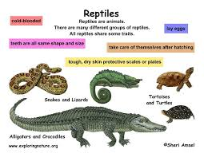
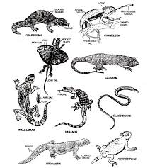
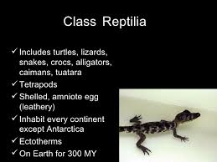
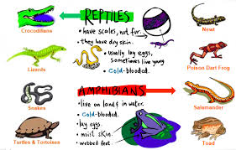
Some Pictures……….

Slide 5
Reference
https://byjus.com/biology/reptilia/#:~:text=Characteristics%20of%20Reptilia&text=These%20are%20creeping%20and%20burrowing,neck%2C%20trunk%2C%20and%20tail.
https://www.google.com/url?sa=i&url=https%3A%2F%2Fwww.slideshare.net%2FerinNly%2Fclass-reptilia&psig=AOvVaw3Zrkla2sz_T5BmQogFCBGU&ust=1611741514147000&source=images&cd=vfe&ved=2ahUKEwj7idGUq7nuAhWbTSsKHZA9ALYQr4kDegUIARCmAQ

