Slide 1


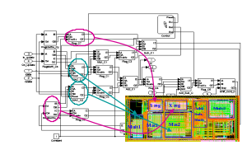
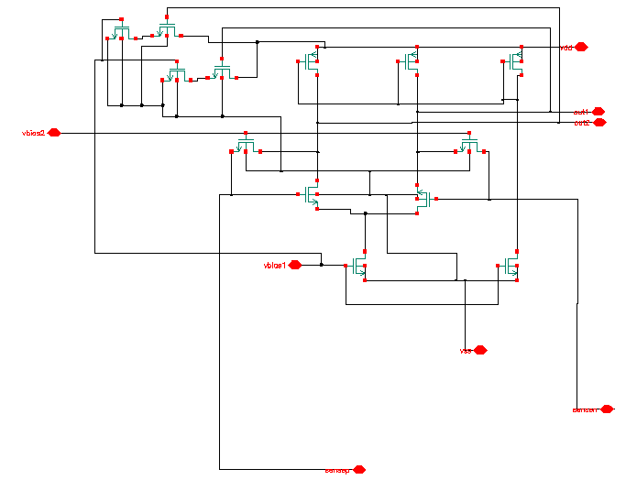
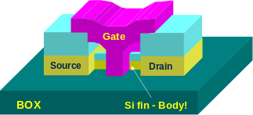
The Big Picture
SPEC
Requirements
Problem Focus
f1
f2
Algorithms
i
p
f5
f3
s
q
j
f2() {
f3(s2, &j, &i);
*s2->p = 10;
i = *s2->q + i;
}
fp
f3
Prog. Lang./OS
f4
ISA
i1: ld r1, b <p1>
i2: ld r2, c <p1>
i3: ld r5, z <p3>
i4: mul r6, r5, 3 <p3>
i5: add r3, r1, r2 <p1>
uArch
Performance Focus
Circuit
Device
Notes:
The big picture. Talk about the levels of abstraction. Talk about the fact that this is where all programs get ushered into hardware execution.
Circuits are increasing providing both opportunities (resources, bandwidth) and challenges (noise, power).
Circuits are locally designed; software is globally intertwined
Software is increasingly over designed for portability and productivity.
The path between the two domains is increasingly stressed and inadequate due to this mismatch.
The focus of the thrust is to provide a very strong path from the productivity oriented software domain into the performance oriented hardware domain.
Translate device/circuit level innovations into visible benefit at the application/software level!

Slide 2
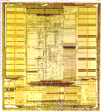
Instruction Set Architecture
Application
Instruction Set Architecture
…SPARC MIPS ARM x86 HP-PA IA-64…
Intel Pentium X
AMD K6, Athlon, Opteron
Transmeta Crusoe TM5x00
Implementation

Slide 3
Instruction Set Architecture
Strong influence on cost/performance
New ISAs are rare, but versions are not
  16-bit, 32-bit and 64-bit X86 versions
Longevity is a strong function of marketing prowess

Slide 4
Traditional Issues
Strongly constrained by the number of bits available to instruction encoding
Opcodes/operands
Registers/memory
Addressing modes
Orthogonality
0, 1, 2, 3 address machines
Instruction formats
Decoding uniformity

Slide 5
Introduction
A.1 What is Pipelining?
A.2 The Major Hurdle of Pipelining-Structural Hazards
  Data Hazards
  Control Hazards
A.3 How is Pipelining Implemented
A.4 What Makes Pipelining Hard to Implement?
A.5 Extending the MIPS Pipeline to Handle Multi-cycle Operations

Slide 6
What Is Pipelining
Laundry Example
Ann, Brian, Cathy, Dave
each have one load of clothes
to wash, dry, and fold
Washer takes 30 minutes
Dryer takes 40 minutes
“Folder” takes 20 minutes
A
B
C
D

Slide 7
What Is Pipelining
6 PM
7
8
9
10
11
Midnight
Time
30
40
20
30
40
20
30
40
20
30
40
20
T
a
s
k
O
r
d
e
r
A
B
C
D
Sequential laundry takes 6 hours for 4 loads
If they learned pipelining, how long would laundry take?

Slide 8
What Is Pipelining
Start work ASAP
6 PM
7
8
9
10
11
Midnight
Time
30
40
40
40
40
20
T
a
s
k
O
r
d
e
r
A
Pipelined laundry takes 3.5 hours for 4 loads
B
C
D

Slide 9
Pipelining Lessons
What Is Pipelining
6 PM
7
8
9
Pipelining doesn’t help latency of single task, it helps throughput of entire workload
Pipeline rate limited by slowest pipeline stage
Multiple tasks operating simultaneously
Potential speedup = Number pipe stages
Unbalanced lengths of pipe stages reduces speedup
Time to “fill” pipeline and time to “drain” it reduces speedup
Time
T
a
s
k
O
r
d
e
r
30
40
40
40
40
20
A
B
C
D

Slide 10
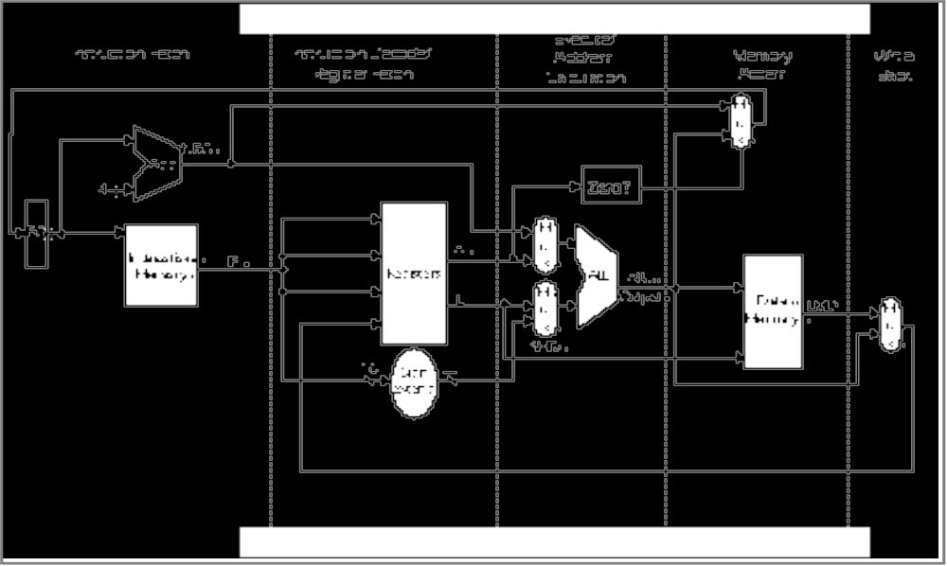
MIPS Without Pipelining
What Is Pipelining
Instruction
Fetch
Instr. Decode
Reg. Fetch
Execute
Addr. Calc
Memory
Access
Write
Back
IR
L
M
D

Slide 11
MIPS Functions
What Is Pipelining
Instruction
Fetch
Instr. Decode
Reg. Fetch
Execute
Addr. Calc
Memory
Access
Write
Back
Passed To Next Stage
IR <- Mem[PC]
NPC <- PC + 4
IR
L
M
D
Instruction Fetch (IF):
Send out the PC and fetch the instruction from memory into the instruction register (IR); increment the PC by 4 to address the next sequential instruction.
IR holds the instruction that will be used in the next stage.
NPC holds the value of the next PC.

Slide 12
MIPS Functions
What Is Pipelining
Instruction
Fetch
Instr. Decode
Reg. Fetch
Execute
Addr. Calc
Memory
Access
Write
Back
Passed To Next Stage
A <- Regs[IR6..IR10];
B <- Regs[IR10..IR15];
Imm <- ((IR16) ##IR16-31
IR
L
M
D
Instruction Decode/Register Fetch Cycle (ID):
Decode the instruction and access the register file to read the registers.
The outputs of the general purpose registers are read into two temporary registers (A & B) for use in later clock cycles.
We extend the sign of the lower 16 bits of the Instruction Register.

Slide 13
MIPS Functions
What Is Pipelining
Instruction
Fetch
Instr. Decode
Reg. Fetch
Execute
Addr. Calc
Memory
Access
Write
Back
Passed To Next Stage
A <- A func. B
cond = 0;
IR
L
M
D
Execute Address Calculation (EX):
We perform an operation (for an ALU) or an address calculation (if it’s a load or a Branch).
If an ALU, actually do the operation. If an address calculation, figure out how to obtain the address and stash away the location of that address for the next cycle.

Slide 14
MIPS Functions
What Is Pipelining
Instruction
Fetch
Instr. Decode
Reg. Fetch
Execute
Addr. Calc
Memory
Access
Write
Back
Passed To Next Stage
A = Mem[prev. B]
or
Mem[prev. B] = A
IR
L
M
D
MEMORY ACCESS (MEM):
If this is an ALU, do nothing.
If a load or store, then access memory.

Slide 15
MIPS Functions
What Is Pipelining
Instruction
Fetch
Instr. Decode
Reg. Fetch
Execute
Addr. Calc
Memory
Access
Write
Back
Passed To Next Stage
Regs <- A, B;
IR
L
M
D
WRITE BACK (WB):
Update the registers from either the ALU or from the data loaded.

Slide 16
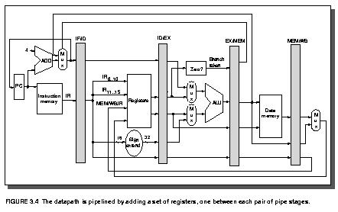
The Basic Pipeline For MIPS
Latches between each stage provide pipelining.

Slide 17
The Basic Pipeline For MIPS
Cycle 1
Cycle 2
Cycle 3
Cycle 4
Cycle 5
Cycle 6
Cycle 7
I
n
s
t
r.
O
r
d
e
r
Ifetch
Reg
ALU
DMem
Reg
Ifetch
Reg
ALU
DMem
Reg
Ifetch
Reg
ALU
DMem
Reg
Ifetch
Reg
ALU
DMem
Reg
Figure 3.3

Slide 18
Pipeline Hurdles
A.1 What is Pipelining?
A.2 The Major Hurdle of Pipelining-Structural Hazards
-- Structural Hazards
  Data Hazards
  Control Hazards
A.3 How is Pipelining Implemented
A.4 What Makes Pipelining Hard to Implement?
A.5 Extending the MIPS Pipeline to Handle Multi-cycle Operations
Limits to pipelining: Hazards prevent next instruction from executing during its designated clock cycle
  Structural hazards: HW cannot support this combination of instructions (single person to fold and put clothes away)
  Data hazards: Instruction depends on result of prior instruction still in the pipeline (missing sock)
  Control hazards: Pipelining of branches & other instructions that change the PC
  Common solution is to stall the pipeline until the hazard is resolved, inserting one or more “bubbles” in the pipeline

Slide 19
Pipeline Hurdles
Definition
conditions that lead to incorrect behavior if not fixed
Structural hazard
  two different instructions use same h/w in same cycle
Data hazard
  two different instructions use same storage
  must appear as if the instructions execute in correct order
Control hazard
  one instruction affects which instruction is next
Resolution
Pipeline interlock logic detects hazards and fixes them
simple solution: stall ­
increases CPI, decreases performance
better solution: partial stall ­
some instruction stall, others proceed better to stall early than late

Slide 20
Structural Hazards
When two or more different instructions want to use same hardware resource in same cycle
e.g., MEM uses the same memory port as IF as shown in this slide.
Time (clock cycles)
Cycle 1
Cycle 2
Cycle 3
Cycle 4
Cycle 5
Cycle 6
Cycle 7
I
n
s
t
r.
O
r
d
e
r
Load
Ifetch
Reg
ALU
DMem
Reg
Instr 1
Ifetch
Reg
ALU
DMem
Reg
Instr 2
Ifetch
Reg
ALU
DMem
Reg
Instr 3
Ifetch
Reg
ALU
DMem
Reg
Instr 4
Ifetch
Reg
ALU
DMem
Reg
Figure 3.6

Slide 21
Structural Hazards
Time (clock cycles)
Cycle 1
Cycle 2
Cycle 3
Cycle 4
Cycle 5
Cycle 6
Cycle 7
This is another way of looking at the effect of a stall.
I
n
s
t
r.
O
r
d
e
r
Load
Ifetch
Reg
ALU
DMem
Reg
Instr 1
Ifetch
Reg
ALU
DMem
Reg
Instr 2
Ifetch
Reg
ALU
DMem
Reg
Stall
Bubble
Bubble
Bubble
Bubble
Bubble
Instr 3
Ifetch
Reg
ALU
DMem
Reg
Figure 3.7

Slide 22
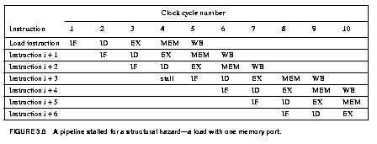
Structural Hazards
This is another way to represent the stall we saw on the last few pages.

Slide 23
Structural Hazards
Dealing with Structural Hazards
Stall
low cost, simple
Increases CPI
use for rare case since stalling has performance effect
Pipeline hardware resource
useful for multi-cycle resources
good performance
sometimes complex e.g., RAM
Replicate resource
good performance
increases cost (+ maybe interconnect delay)
useful for cheap or divisible resources

Slide 24
Structural Hazards
Structural hazards are reduced with these rules:
Each instruction uses a resource at most once
Always use the resource in the same pipeline stage
Use the resource for one cycle only
Many RISC ISA’a designed with this in mind
Sometimes very complex to do this. For example, memory of necessity is used in the IF and MEM stages.
Some common Structural Hazards:
Memory - we’ve already mentioned this one.
Floating point - Since many floating point instructions require many cycles, it’s easy for them to interfere with each other.
Starting up more of one type of instruction than there are resources. For instance, the PA-8600 can support two ALU + two load/store instructions per cycle - that’s how much hardware it has available.

Slide 25
Structural Hazards
This is the example on Page 144.
We want to compare the performance of two machines. Which machine is faster?
Machine A: Dual ported memory - so there are no memory stalls
Machine B: Single ported memory, but its pipelined implementation has a 1.05 times faster clock rate
Assume:
Ideal CPI = 1 for both
Loads are 40% of instructions executed
SpeedUp_{A} = Pipeline Depth/(1 + 0) x (clock_{unpipe}/clock_{pipe})
= Pipeline Depth
SpeedUp_{B} = Pipeline Depth/(1 + 0.4 x 1)
x (clock_{unpipe}/(clock_{unpipe} / 1.05)
= (Pipeline Depth/1.4) x 1.05
= 0.75 x Pipeline Depth
SpeedUp_{A} / SpeedUp_{B} = Pipeline Depth / (0.75 x Pipeline Depth) = 1.33
Machine A is 1.33 times faster

Slide 26
Data Hazards
A.1 What is Pipelining?
A.2 The Major Hurdle of Pipelining-Structural Hazards
-- Structural Hazards
  Data Hazards
  Control Hazards
A.3 How is Pipelining Implemented
A.4 What Makes Pipelining Hard to Implement?
A.5 Extending the MIPS Pipeline to Handle Multi-cycle Operations
These occur when at any time, there are instructions active that need to access the same data (memory or register) locations.
Where there’s real trouble is when we have:
instruction A
instruction B
and B manipulates (reads or writes) data before A does. This violates the order of the instructions, since the architecture implies that A completes entirely before B is executed.

Slide 27
Data Hazards
Execution Order is:
Instr_{I}
Instr_{J}
Read After Write (RAW)
Instr_{J} tries to read operand before Instr_{I} writes it
Caused by a “Dependence” (in compiler nomenclature). This hazard results from an actual need for communication.
I: add r1,r2,r3
J: sub r4,r1,r3

Slide 28
Data Hazards
Execution Order is:
Instr_{I}
Instr_{J}
Write After Read (WAR)
Instr_{J} tries to write operand before Instr_{I} reads i
  Gets wrong operand
  Called an “anti-dependence” by compiler writers.
  This results from reuse of the name “r1”.
Can’t happen in MIPS 5 stage pipeline because:
  All instructions take 5 stages, and
  Reads are always in stage 2, and
  Writes are always in stage 5
I: sub r4,r1,r3
J: add r1,r2,r3
K: mul r6,r1,r7

Slide 29
Data Hazards
Execution Order is:
Instr_{I}
Instr_{J}
Write After Write (WAW)
Instr_{J} tries to write operand before Instr_{I} writes it
  Leaves wrong result ( Instr_{I} not Instr_{J} )
Called an “output dependence” by compiler writers
This also results from the reuse of name “r1”.
Can’t happen in MIPS 5 stage pipeline because:
  All instructions take 5 stages, and
  Writes are always in stage 5
Will see WAR and WAW in later more complicated pipes
I: sub r1,r4,r3
J: add r1,r2,r3
K: mul r6,r1,r7

Slide 30
Data Hazards
Simple Solution to RAW
Hardware detects RAW and stalls
Assumes register written then read each cycle
  + low cost to implement, simple
  -- reduces IPC
Try to minimize stalls
Minimizing RAW stalls
Bypass/forward/short­circuit (We will use the word “forward”)
Use data before it is in the register
  + reduces/avoids stalls
  -- complex
Crucial for common RAW hazards

Slide 31
Data Hazards
Time (clock cycles)
IF
ID/RF
EX
MEM
WB
I
n
s
t
r.
O
r
d
e
r
add r1,r2,r3
Ifetch
Reg
ALU
DMem
Reg
sub r4,r1,r3
Ifetch
Reg
ALU
DMem
Reg
and r6,r1,r7
Ifetch
Reg
ALU
DMem
Reg
or r8,r1,r9
Ifetch
Reg
ALU
DMem
Reg
xor r10,r1,r11
Ifetch
Reg
ALU
DMem
Reg
The use of the result of the ADD instruction in the next three instructions causes a hazard, since the register is not written until after those instructions read it.
Figure 3.9

Slide 32
Data Hazards
Forwarding is the concept of making data available to the input of the ALU for subsequent instructions, even though the generating instruction hasn’t gotten to WB in order to write the memory or registers.
Forwarding To Avoid
Data Hazard
Time (clock cycles)
I
n
s
t
r.
O
r
d
e
r
add r1,r2,r3
Ifetch
Reg
ALU
DMem
Reg
sub r4,r1,r3
Ifetch
Reg
ALU
DMem
Reg
and r6,r1,r7
Ifetch
Reg
ALU
DMem
Reg
or r8,r1,r9
Ifetch
Reg
ALU
DMem
Reg
xor r10,r1,r11
Ifetch
Reg
ALU
DMem
Reg
Figure 3.10

Slide 33
Data Hazards
The data isn’t loaded until after the MEM stage.
Time (clock cycles)
I
n
s
t
r.
O
r
d
e
r
lw r1, 0(r2)
Ifetch
Reg
ALU
DMem
Reg
sub r4,r1,r6
Ifetch
Reg
ALU
DMem
Reg
and r6,r1,r7
Ifetch
Reg
ALU
DMem
Reg
or r8,r1,r9
Ifetch
Reg
ALU
DMem
Reg
There are some instances where hazards occur, even with forwarding.
Figure 3.12

Slide 34
Data Hazards
The stall is necessary as shown here.
Time (clock cycles)
I
n
s
t
r.
O
r
d
e
r
lw r1, 0(r2)
Ifetch
Reg
ALU
DMem
Reg
Bubble
sub r4,r1,r6
Ifetch
Reg
ALU
DMem
Reg
Bubble
and r6,r1,r7
Ifetch
Reg
ALU
DMem
Reg
Bubble
or r8,r1,r9
Ifetch
Reg
ALU
DMem
There are some instances where hazards occur, even with forwarding.
Figure 3.13

Slide 35
Data Hazards
This is another representation of the stall.
LW R1, 0(R2) | IF | ID | EX | MEM | WB
SUB R4, R1, R5 |  | IF | ID | EX | MEM | WB
AND R6, R1, R7 |  |  | IF | ID | EX | MEM | WB
OR R8, R1, R9 |  |  |  | IF | ID | EX | MEM | WB
LW R1, 0(R2) | IF | ID | EX | MEM | WB
SUB R4, R1, R5 |  | IF | ID | stall | EX | MEM | WB
AND R6, R1, R7 |  |  | IF | stall | ID | EX | MEM | WB
OR R8, R1, R9 |  |  |  | stall | IF | ID | EX | MEM | WB

Slide 36
Data Hazards
Pipeline Scheduling
Instruction scheduled by compiler - move instruction in order to reduce stall.
  lw Rb, b ­­ code sequence for a = b+c before scheduling
  lw Rc, c
  Add Ra, Rb, Rc ­­ stall
  sw a, Ra
  lw Re, e ­­ code sequence for d = e+f before scheduling
  lw Rf, f
  sub Rd, Re, Rf ­­ stall
  sw d, Rd
Arrangement of code after scheduling.
  lw Rb, b
  lw Rc, c
  lw Re, e
  Add Ra, Rb, Rc
  lw Rf, f
  sw a, Ra
  sub Rd, Re, Rf
  sw d, Rd

Slide 37
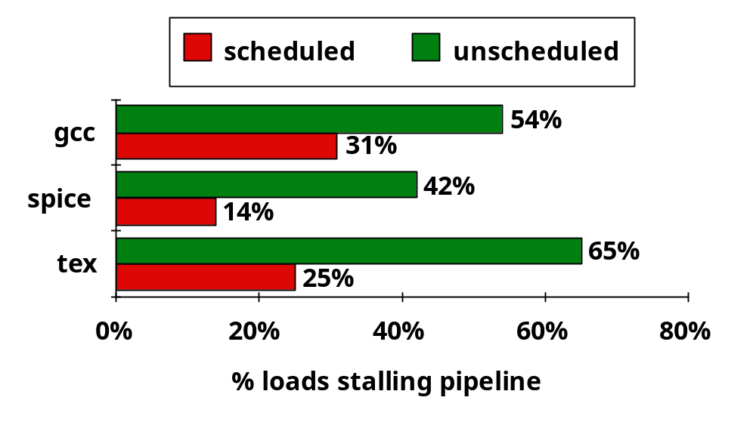
Data Hazards
Pipeline Scheduling

Slide 38
Control Hazards
A.1 What is Pipelining?
A.2 The Major Hurdle of Pipelining-Structural Hazards
-- Structural Hazards
  Data Hazards
  Control Hazards
A.3 How is Pipelining Implemented
A.4 What Makes Pipelining Hard to Implement?
A.5 Extending the MIPS Pipeline to Handle Multi-cycle Operations
A control hazard is when we need to find the destination of a branch, and can’t fetch any new instructions until we know that destination.

Slide 39
Control Hazard on Branches
Three Stage Stall
Control Hazards
10: beq r1,r3,36
Ifetch
Reg
ALU
DMem
Reg
14: and r2,r3,r5
Ifetch
Reg
ALU
DMem
Reg
18: or r6,r1,r7
Ifetch
Reg
ALU
DMem
Reg
22: add r8,r1,r9
Ifetch
Reg
ALU
DMem
Reg
36: xor r10,r1,r11
Ifetch
Reg
ALU
DMem
Reg

Slide 40
Branch Stall Impact
Control Hazards
If CPI = 1, 30% branch, Stall 3 cycles => new CPI = 1.9!
    (Whoa! How did we get that 1.9???)
Two part solution to this dramatic increase:
  Determine branch taken or not sooner, AND
  Compute taken branch address earlier
MIPS branch tests if register = 0 or ^ 0
MIPS Solution:
  Move Zero test to ID/RF stage
  Adder to calculate new PC in ID/RF stage
    must be fast
    can't afford to subtract
    compares with 0 are simple
    Greater-than, Less-than test sign­bit, but not-equal must OR all bits
    more general compares need ALU
  1 clock cycle penalty for branch versus 3
In the next chapter, we’ll look at ways to avoid the branch all together.

Slide 41
Five Branch Hazard Alternatives
Control Hazards
#1: Stall until branch direction is clear
#2: Predict Branch Not Taken
  Execute successor instructions in sequence
  “Squash” instructions in pipeline if branch actually taken
  Advantage of late pipeline state update
  47% MIPS branches not taken on average
  PC+4 already calculated, so use it to get next instruction
#3: Predict Branch Taken
  53% MIPS branches taken on average
  But haven’t calculated branch target address in MIPS
    MIPS still incurs 1 cycle branch penalty
    Other machines: branch target known before outcome

Slide 42
Control Hazards
Five Branch Hazard Alternatives
#4: Execute Both Paths
#5: Delayed Branch
  Define branch to take place AFTER a following instruction
  branch instruction
  sequential successor₁
  sequential successor₂
  ........
  sequential successor_{n}
  branch target if taken
  1 slot delay allows proper decision and branch target address in 5 stage pipeline
  MIPS uses this
Branch delay of length n

Slide 43
Delayed Branch
Control Hazards
Where to get instructions to fill branch delay slot?
  Before branch instruction
  From the target address: only valuable when branch taken
  From fall through: only valuable when branch not taken
  Cancelling branches allow more slots to be filled
Compiler effectiveness for single branch delay slot:
  Fills about 60% of branch delay slots
  About 80% of instructions executed in branch delay slots useful in computation
  About 50% (60% x 80%) of slots usefully filled
Delayed Branch downside: 7-8 stage pipelines, multiple instructions issued per clock (superscalar)

Slide 44
Evaluating Branch Alternatives
Control Hazards
Scheduling Branch CPI speedup v. Speedup v.
scheme penalty unpipelined stall
Stall pipeline 3 1.42 3.5 1.0
Predict taken 1 1.14 4.4 1.26
Predict not taken 1 1.09 4.5 1.29
Delayed branch 0.5 1.07 4.6 1.31
Conditional & Unconditional = 14%, 65% change PC

Slide 45
Pipelining Introduction Summary
Control Hazards
Just overlap tasks, and easy if tasks are independent
Speed Up Š Pipeline Depth; if ideal CPI is 1, then:
Hazards limit performance on computers:
  Structural: need more HW resources
  Data (RAW,WAR,WAW): need forwarding, compiler scheduling
  Control: delayed branch, prediction
Pipeline Depth
Clock Cycle Unpipelined
Speedup =
X
1 + Pipeline stall CPI
Clock Cycle Pipelined

Slide 46
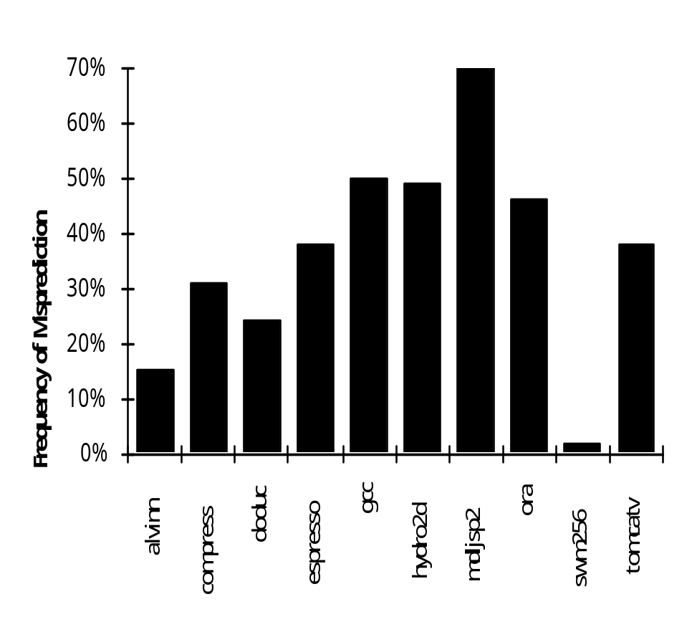
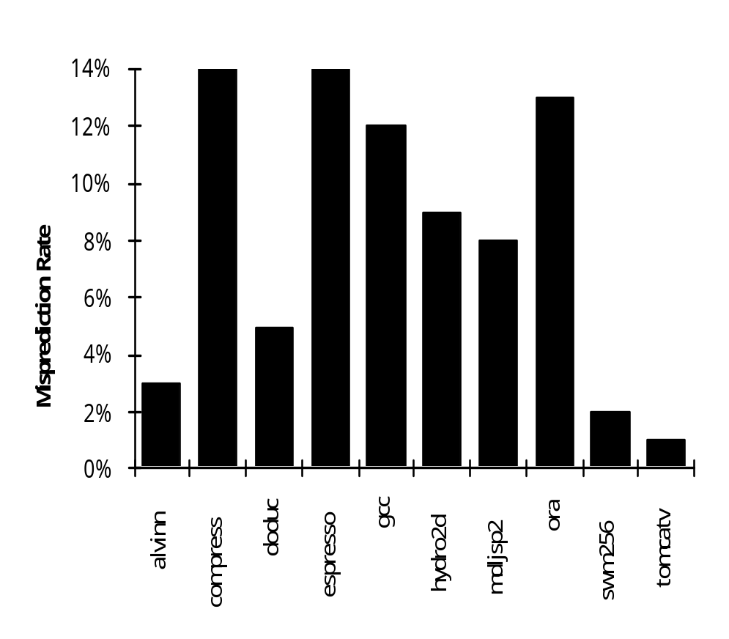
Compiler “Static” Prediction of
Taken/Untaken Branches
Control Hazards
The compiler can program what it thinks the branch direction will be. Here are the results when it does so.
Always taken
Taken backwards
Not Taken Forwards

Slide 47
Compiler “Static” Prediction of
Taken/Untaken Branches
Control Hazards
Improves strategy for placing instructions in delay slot
Two strategies
  Backward branch predict taken, forward branch not taken
  Profile-based prediction: record branch behavior, predict branch based on prior run

Slide 48
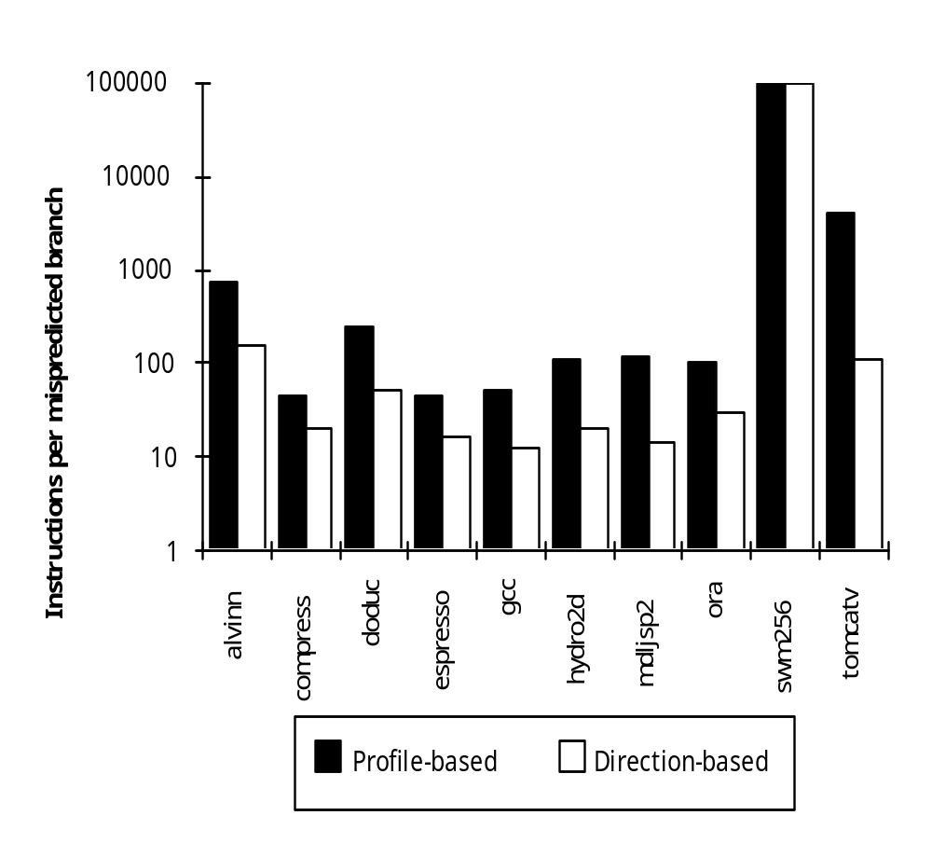
Evaluating Static Branch Prediction Strategies
Control Hazards
Misprediction ignores frequency of branch
“Instructions between mispredicted branches” is a better metric

Slide 49
What Makes Pipelining Hard?
A.1 What is Pipelining?
A.2 The Major Hurdle of Pipelining-Structural Hazards
  Data Hazards
  Control Hazards
A.3 How is Pipelining Implemented
A.4 What Makes Pipelining Hard to Implement?
A.5 Extending the MIPS Pipeline to Handle Multi-cycle Operations

Slide 50
What Makes Pipelining Hard?
Interrupts cause great havoc!
Examples of interrupts:
Power failing,
Arithmetic overflow,
I/O device request,
OS call,
Page fault
Interrupts (also known as: faults, exceptions, traps) often require
surprise jump (to vectored address)
linking return address
saving of PSW (including CCs)
state change (e.g., to kernel mode)
There are 5 instructions executing in 5 stage pipeline when an interrupt occurs:
How to stop the pipeline?
How to restart the pipeline?
Who caused the interrupt?

Slide 51
What Makes Pipelining Hard?
Interrupts cause great havoc!
What happens on interrupt while in delay slot ?
Next instruction is not sequential
solution #1: save multiple PCs
Save current and next PC
Special return sequence, more complex hardware
solution #2: single PC plus
Branch delay bit
PC points to branch instruction
Stage Problem that causes the interrupt
IF Page fault on instruction fetch; misaligned memory access; memory-protection violation
ID Undefined or illegal opcode
EX Arithmetic interrupt
MEM Page fault on data fetch; misaligned memory access; memory-protection violation

Slide 52
What Makes Pipelining Hard?
Interrupts cause great havoc!
Simultaneous exceptions in more than one pipeline stage, e.g.,
  Load with data page fault in MEM stage
  Add with instruction page fault in IF stage
  Add fault will happen BEFORE load fault
Solution #1
  Interrupt status vector per instruction
  Defer check until last stage, kill state update if exception
Solution #2
  Interrupt ASAP
  Restart everything that is incomplete
Another advantage for state update late in pipeline!

Slide 53
What Makes Pipelining Hard?
Interrupts cause great havoc!
Here’s what happens on a data page fault.
1 2 3 4 5 6 7 8 9
i F D X M W
i+1 F D X M W <­ page fault
i+2 F D X M W <­ squash
i+3 F D X M W <­ squash
i+4 F D X M W <­ squash
i+5 trap ­> F D X M W
i+6 trap handler ­> F D X M W

Slide 54
What Makes Pipelining Hard?
Complex Instructions
Complex Addressing Modes and Instructions
Address modes: Autoincrement causes register change during instruction execution
  Interrupts? Need to restore register state
  Adds WAR and WAW hazards since writes are no longer the last stage.
Memory-Memory Move Instructions
  Must be able to handle multiple page faults
  Long-lived instructions: partial state save on interrupt
Condition Codes

Slide 55
Handling Multi-cycle Operations
A.1 What is Pipelining?
A.2 The Major Hurdle of Pipelining-Structural Hazards
  Data Hazards
  Control Hazards
A.3 How is Pipelining Implemented
A.4 What Makes Pipelining Hard to Implement?
A.5 Extending the MIPS Pipeline to Handle Multi-cycle Operations
Multi-cycle instructions also lead to pipeline complexity.
A very lengthy instruction causes everything else in the pipeline to wait for it.

Slide 56
Multi-Cycle Operations
Floating Point
Floating point gives long execution time.
This causes a stall of the pipeline.
It’s possible to pipeline the FP execution unit so it can initiate new instructions without waiting full latency. Can also have multiple FP units.
FP Instruction Latency Initiation Rate
Add, Subtract 4 3
Multiply 8 4
Divide 36 35
Square root 112 111
Negate 2 1
Absolute value 2 1
FP compare 3 2

Slide 57
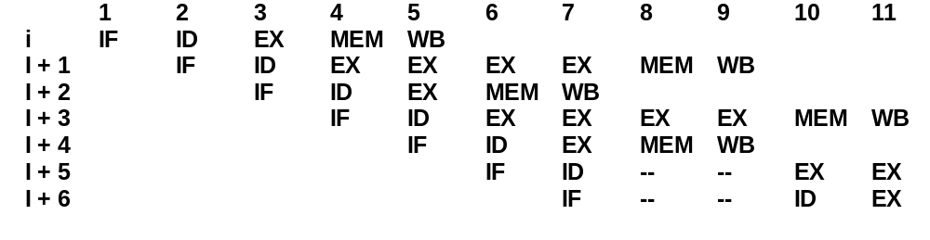
Floating Point
Multi-Cycle Operations
Divide, Square Root take ­10X to ­30X longer than Add
  Interrupts?
  Adds WAR and WAW hazards since pipelines are no longer same length
Notes:
I + 2: no WAW, but this complicates an interrupt
I + 4: no WB conflict
I + 5: stall forced by structural hazard
I + 6: stall forced by in-order issue

Slide 58
Summary of Pipelining Basics
Hazards limit performance
  Structural: need more HW resources
  Data: need forwarding, compiler scheduling
  Control: early evaluation & PC, delayed branch, prediction
Increasing length of pipe increases impact of hazards; pipelining helps instruction bandwidth, not latency
Interrupts, Instruction Set, FP makes pipelining harder
Compilers reduce cost of data and control hazards
  Load delay slots
  Branch delay slots
  Branch prediction

