Slide 1
Tutorial – Normal Distribution – Bayes classifier – Various cases

Slide 2
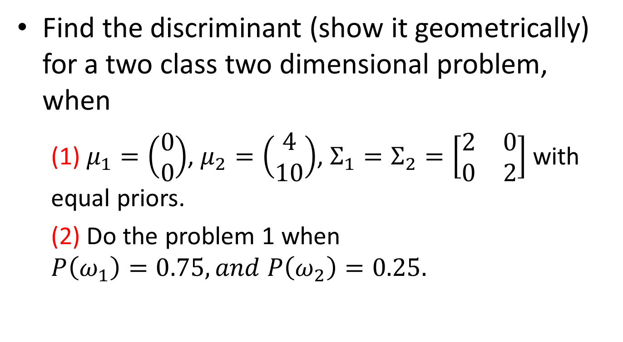
Find the discriminant (show it geometrically) for a two class two dimensional problem, when
(1) $μ_{1}=\left(\begin{matrix}0 \\ 0\end{matrix}\right)$, $μ_{2}=\left(\begin{matrix}4 \\ 10\end{matrix}\right)$, $Σ_{1}=Σ_{2}=\left[\begin{matrix}2 & 0 \\ 0 & 2\end{matrix}\right]$ with equal priors.
(2) Do the problem 1 when $P\left(ω_{1}\right)=0.75, and P\left(ω_{2}\right)=0.25.$

Slide 3
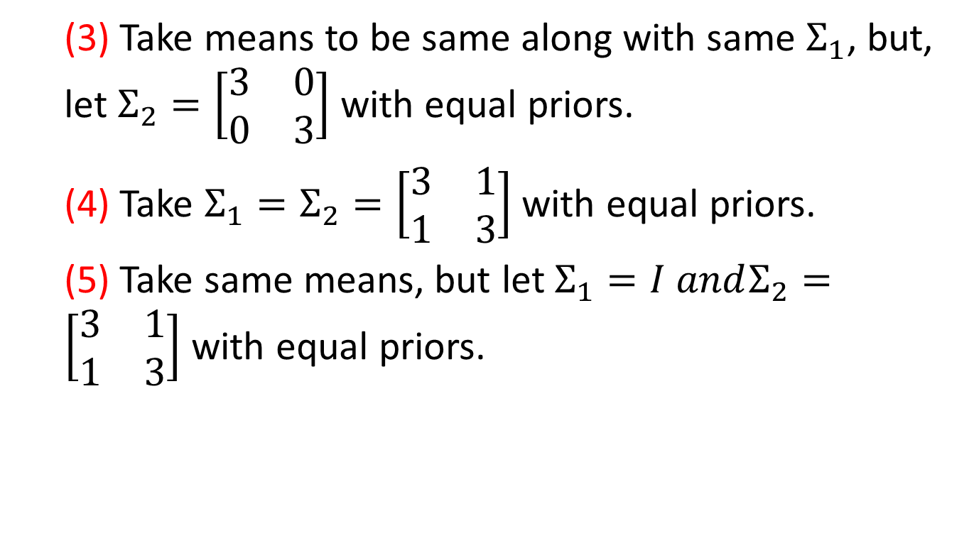
(3) Take means to be same along with same $Σ_{1}$, but, let $Σ_{2}=\left[\begin{matrix}3 & 0 \\ 0 & 3\end{matrix}\right]$ with equal priors.
(4) Take $Σ_{1}=Σ_{2}=\left[\begin{matrix}3 & 1 \\ 1 & 3\end{matrix}\right]$ with equal priors.
(5) Take same means, but let $Σ_{1}=I andΣ_{2}=\left[\begin{matrix}3 & 1 \\ 1 & 3\end{matrix}\right]$ with equal priors.

