Slide 1

ECE 540 Virtual Rubik’s Cube
Gunadeep Reddy Bade
Sai Chaitanya Varma Kalidindi
Haranadh chintapalli
Shruthi Narayana Reddy

Slide 2

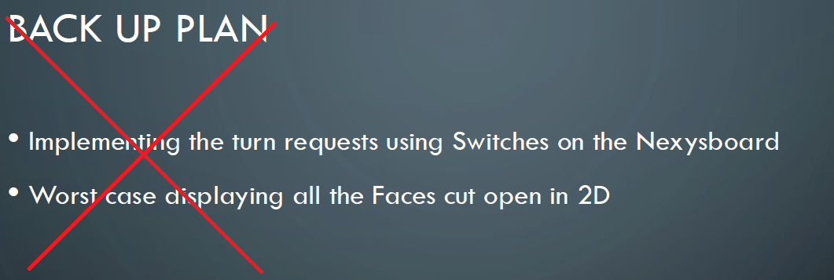
PROJECT GOALS
Implement virtual Rubik's cube
Control logic is through blynk app
Interface ESP8266 with Nexys4DDR board
Logic to determine turn requested and calculate updated cube positions
Display updated cube on VGA display

Slide 3
Work division
VGA : Gunadeep
CUBE LOGIC AND FIRMWARE : Chaitanya
BLYNK API: Haranadh
AHB Interface: Shruthi

Slide 4
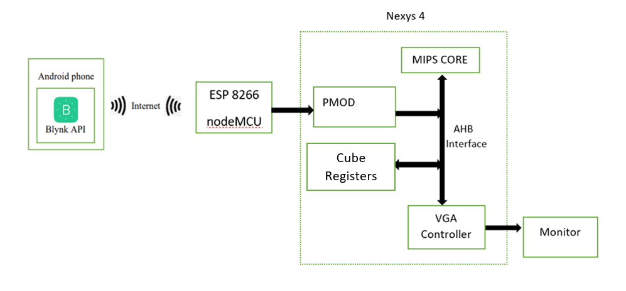
BLoCK Diagram

Slide 5
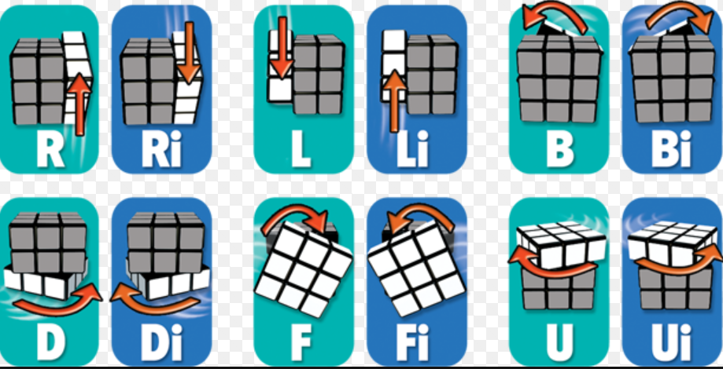
Rubik’s Cube Possible Moves

Slide 6
MIPS ASSEMBLY
Control logic for giving decoded turn requests to the Cube.
Logic to check if the cube is solved.
Initial cube configuration

Slide 7
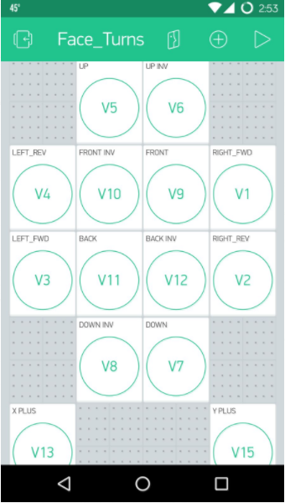
Input using blynk API
Configured Blynk app with ESP8266(NodeMCU) and ran default test program (Blinking LED).
Interfaced with Nexys4DDR board using PMOD port and able to drive LED’s on the board.
Encoding virtual pins in controller to transfer using GPIO pins.

Slide 8
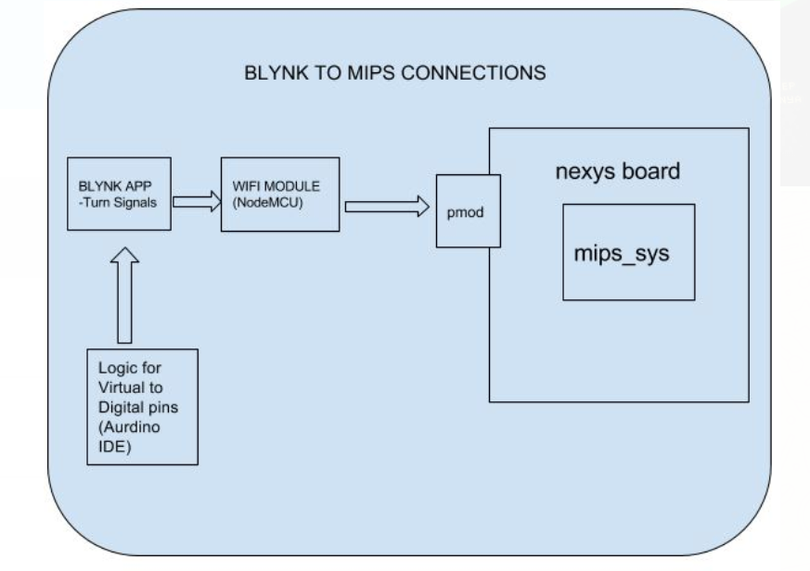
BLYNK

Slide 9
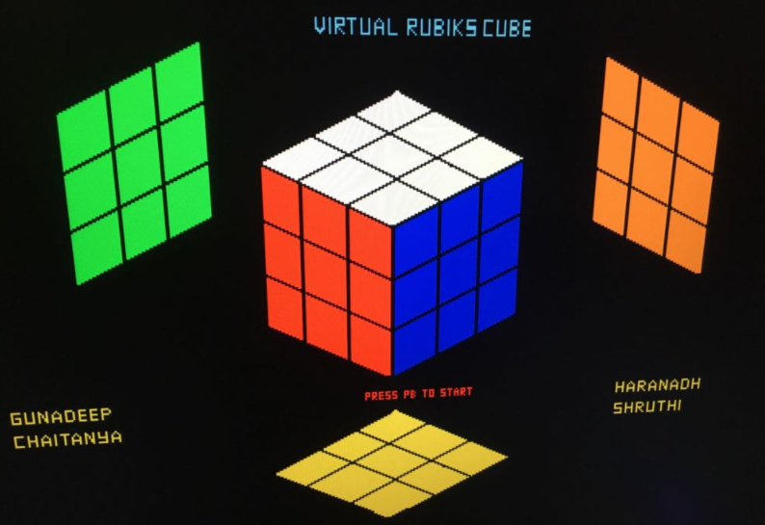
Vga
We are Displaying all the 6 faces as shown in this figure.
Update the faces based on the cube turns and show new orientations.

Slide 10
Thank You

