Slide 1

Seasonal Agriculture Performance Analysis
Ch. Harshitha
CMR Institute of Technology, Hyderabad
AICTE STU ID : STU69ef52de89f961777291998

Slide 2

PROBLEM STATEMENT
Agricultural activities are influenced by seasonal variations in environmental conditions, farming practices, resource availability and market conditions. As a result, agricultural performance may differ from one season to another.
However, raw agricultural data does not clearly explain how agricultural performance changes across seasons or what patterns can be observed in different seasonal conditions.
The problem is to analyze the given agricultural dataset and investigate seasonal differences in agricultural performance by identifying meaningful patterns, trends, relationships and variations within the available data.

Slide 3
Project Description Agricultural performance can vary due to seasonal conditions, farming practices, resource availability and market conditions. The project analyzes the dataset to identify seasonal patterns, trends, relationships and differences in agricultural performance. The analysis includes data cleaning, exploratory analysis, statistical analysis, outlier investigation, correlation analysis and seasonal comparisons. The goal is to transform raw agricultural data into meaningful insights that can support evidence-based agricultural planning.

Slide 4

WHO ARE THE END USERS?
Farmers and farm managers – to understand seasonal performance and resource usage.
Agricultural planners and decision-makers – to support evidence-based seasonal planning.
Agricultural researchers and analysts – to study relationships between environmental conditions and outcomes.
Agricultural organizations – to compare production, profitability and efficiency across categories and seasons.
Students and data analysts – as a real-world case study in data analytics.

Slide 5

Technology Used
Python – core programming language for analysis.
Pandas – dataset loading, cleaning, transformation and aggregation.
NumPy – numerical operations and calculations.
Matplotlib – charts and visualizations.
Jupyter Notebook / Google Colab – interactive analysis and documentation.
CSV Dataset – source of agricultural, environmental, production and economic data.

Slide 6
RESULTS
Dataset successfully analyzed with 4,000 records and 28 columns.
Missing values were identified in 3 numerical variables and handled using median imputation.
Duplicate records were checked and removed before analysis.
Descriptive statistics, distributions and outlier checks were used to understand data quality and variability.
The dataset enables comparison of environmental conditions, production, resource usage and economic outcomes.

Slide 7
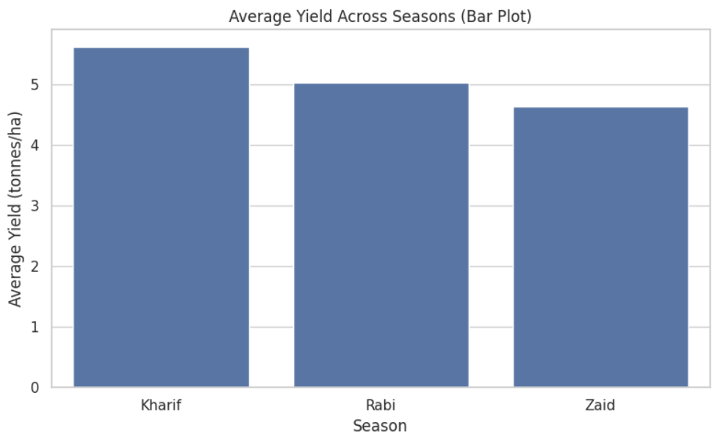
RESULTS
Highest average yield was observed in the Kharif season.
Highest average profit was observed in the Kharif season.
Seasonal comparisons reveal that agricultural outcomes are not uniform across seasons.

Slide 8
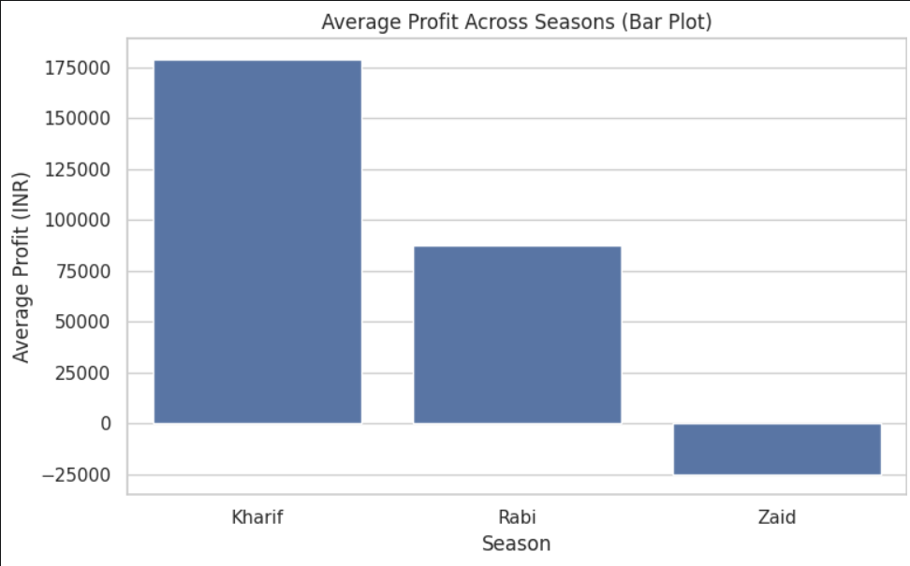
RESULTS
[Add screen shots of your code ]

Slide 9

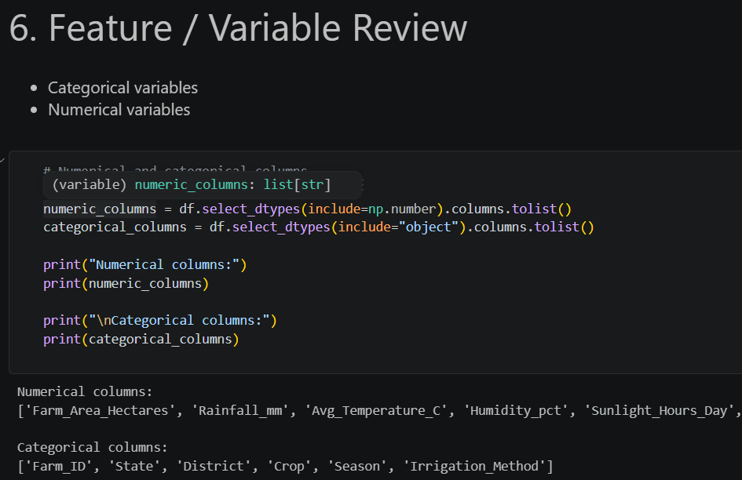
RESULTS
[Add screen shots of your code ]
Season has a measurable relationship with agricultural performance indicators such as yield, production and profit.
Environmental variables such as rainfall, temperature, humidity and soil moisture can be compared with agricultural outcomes.
Resource usage varies across farming conditions and irrigation methods.
Sugarcane recorded the highest average profit among the crop categories in this analysis.
Correlation analysis helps identify variables that move together and deserve further investigation.
Outlier analysis highlights unusual observations that may require additional investigation rather than automatic removal.

Slide 10
Future scope
Build machine learning models to predict crop yield, production or profit.
Integrate real-time weather and rainfall data for dynamic seasonal analysis.
Develop an interactive Power BI or Tableau dashboard for farmers and decision-makers.
Include historical market prices and demand data to improve economic analysis.
Add satellite, soil sensor and IoT data for more precise farm-level monitoring.
Perform region-wise forecasting and crop-specific recommendation analysis.

Slide 11
GitHub Link
https://github.com/chharshitha55/DataAnalysis_MajorProject

Slide 12

VOIS Course completion certificate - Course name- Data Visualization

Slide 13
Thank you
.
.

