Slide 1
MATH 644 Regression
Project: UCI ML - Concrete Compressive Strength
Created by: Chhavi Tyagi
December 9, 2019
NJIT

Slide 2
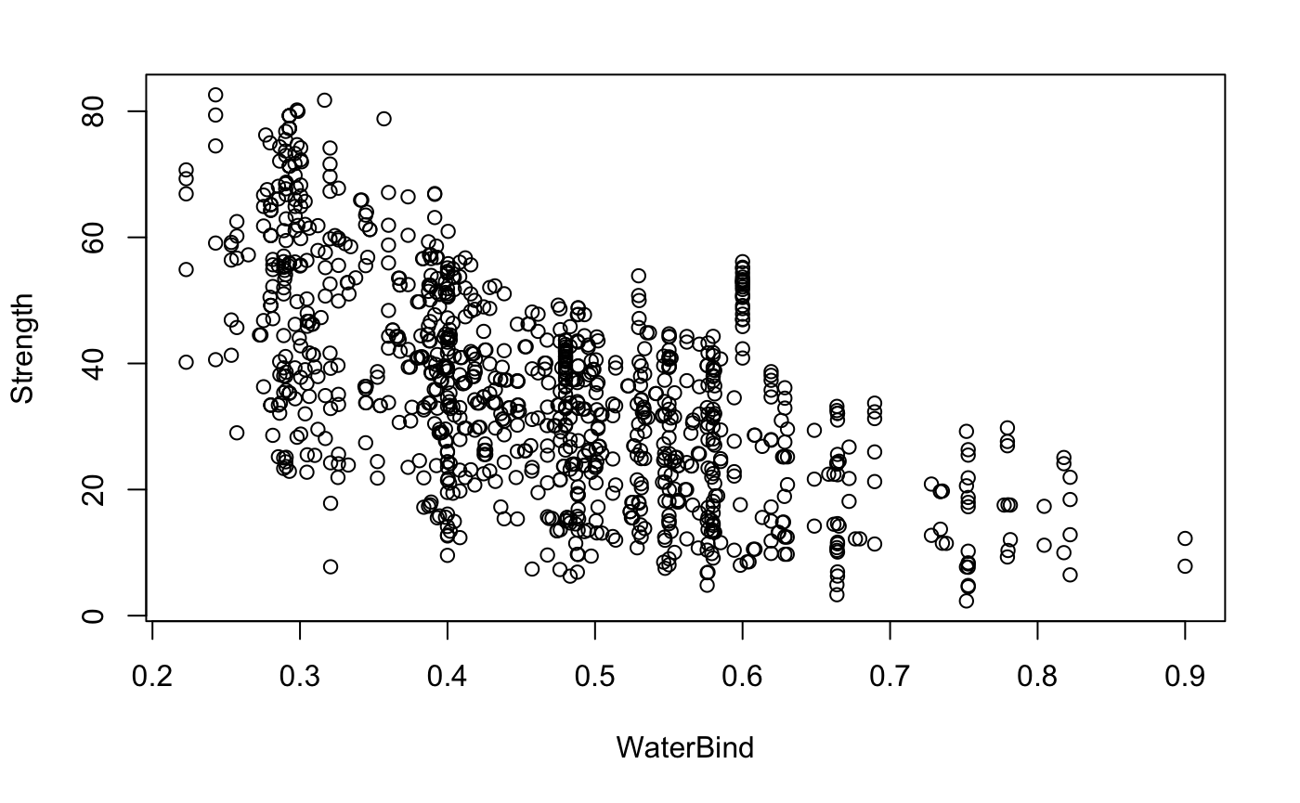
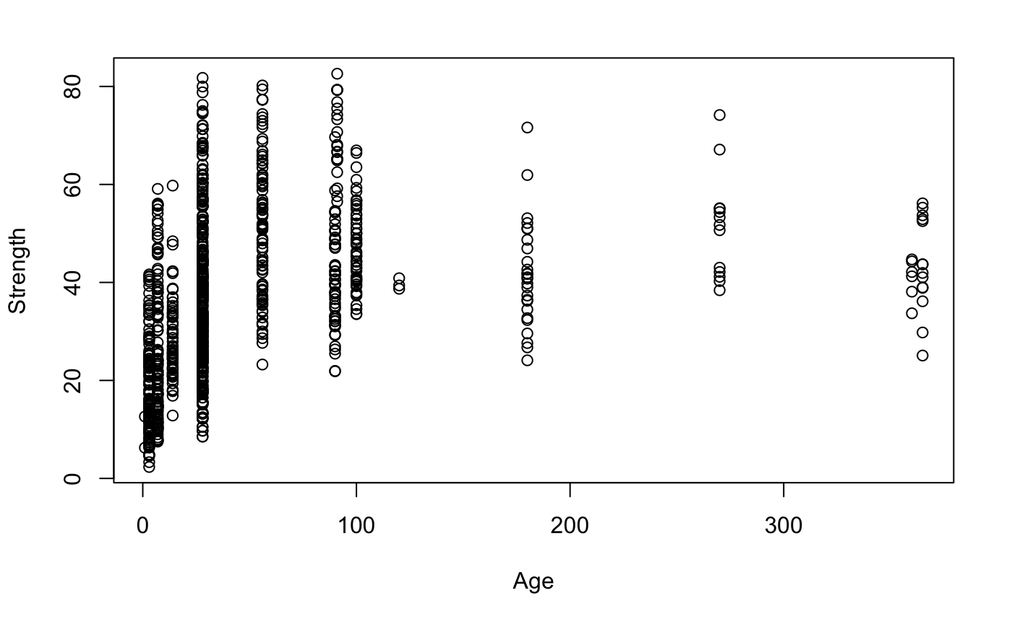
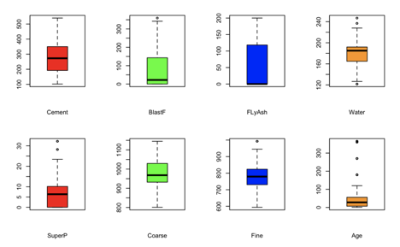
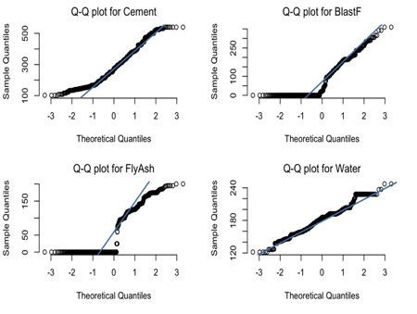
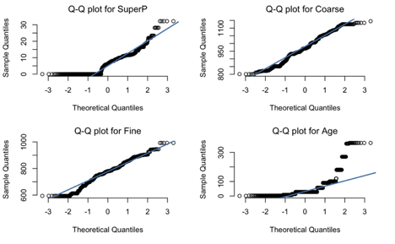
The Dataset - Why study concrete strength?
Concrete is a very important building material and understanding the strength of concrete under compression is vital for the construction industry.
Concrete is a mix of aggregate (fine and coarse rock), water, Portland cement and additives. A chemical reaction occurs, and over time the concrete will harden and can be tested.
Centuries of use have taught us that the specific binder additives, the water-to-binder (w/b) ratios, and the age time all can play a part in determining the ultimate strength.
Data Set: from UCI ML database
1030 observations
Reponses: 1 = concrete strength
Variables: 8 (+1 calculated)
Fine Fly Ash
Coarse Blast Furnace Slag
Water Super Plasticizer
Age Time Cement
Calculated: Water-to-Binder ratio
Conclusion : “...A strength model based on ANN is more accurate than a model based on regression analysis..” R² : Reg = 0.78, ANN = 0.91
Modeling of Strength of High-Performance Concrete Using Artificial Neural Networks.” Cement and Concrete research, 28(12), 1797-1808

Slide 3
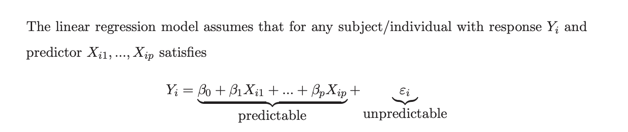
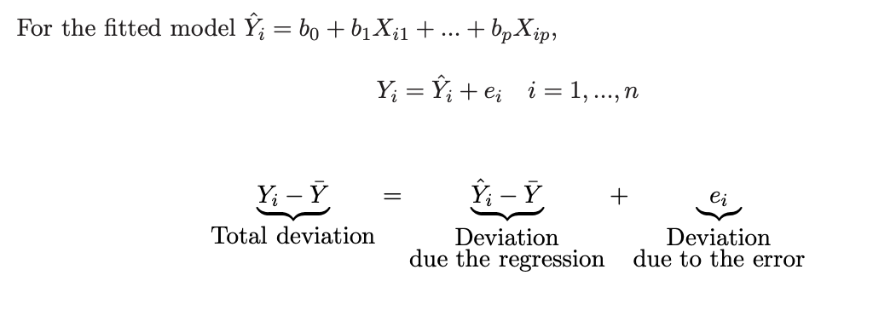
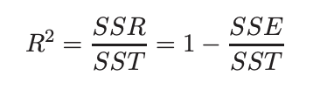
The Theory
Multiple Linear regression model:
β_{k} indicate the change in the mean response EY per unit increase in X_{k} when the other predictors remain constant.
SST = SSR + SSE
Thus, we define the coefficient of multiple determination R² as
It is the proportion of variation in the response that can be explained by the regression model (or that can be explained by the predictors X₁, ..., X_{p} linearly).
0 ≤ R² ≤ 1 , R² and R_{a}² are one of the criterias for model selection.Other criterias are BIC and AIC. Lower the value of AIC and BIC , better is the model.

Slide 4
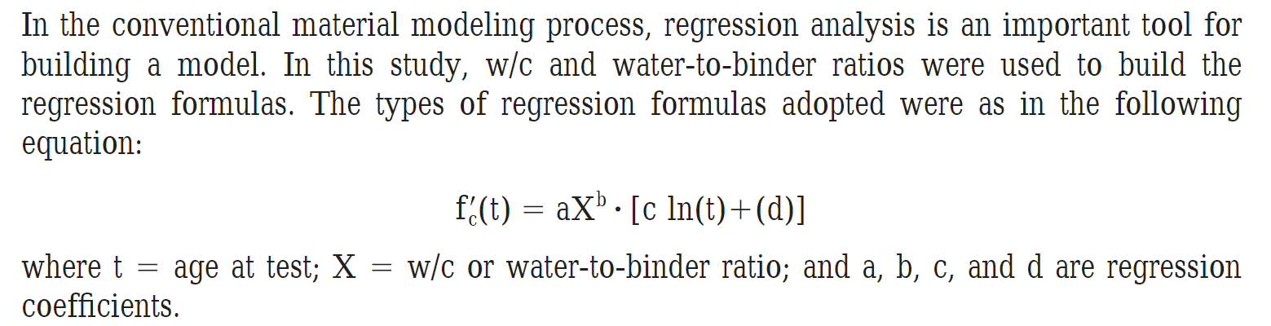
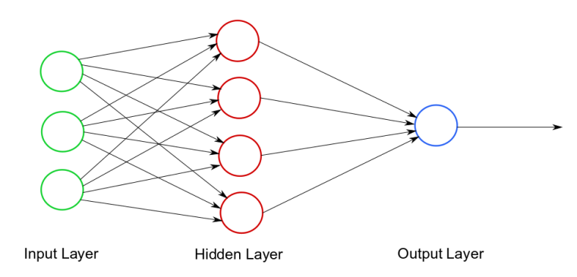
The Approach - Manual and Automated
Problem Statement: Can we build a better Regression model than the original authors, one that approaches the performance of the artificial neural network, a “universal estimator”?
Note: For Regression, the journal article authors used
one transformation (water-binder ratio) and two non-linear
terms, a power-law relationship and a log transformation. For
their neural network they used 8 input nodes, 1 hidden layer
of 8 nodes,and 1 output node.
Math644 Approach - Three step process
Perform “isolation experiments” where we studied different approaches in a trial-and-error fashion to understand sensitivities in the data, test the inclusion of scientific understanding, and understand if interactions were valuable, and determine if we should develop new transformed features which the original articles authors chose not to do. The best of these were assembled bottom-up into a best “hand-model”.
Create a Full model of all permutations of different types of potential transformed variables and all pair-wise interactions then use Akaike criteria to perform top-down feature reduction and ANOVA to produce a reduced “machine-model” from a less-biased starting point.
Study the risk of over-fitting using 10-fold cross-validation and then select the best model with which struck a balance between the best prediction of the real measurement and an economical number of features for efficiency in practice.
x f(x) 1/x 1/x² log(x+1) 1/log(x+1) x₁x₂

Slide 5
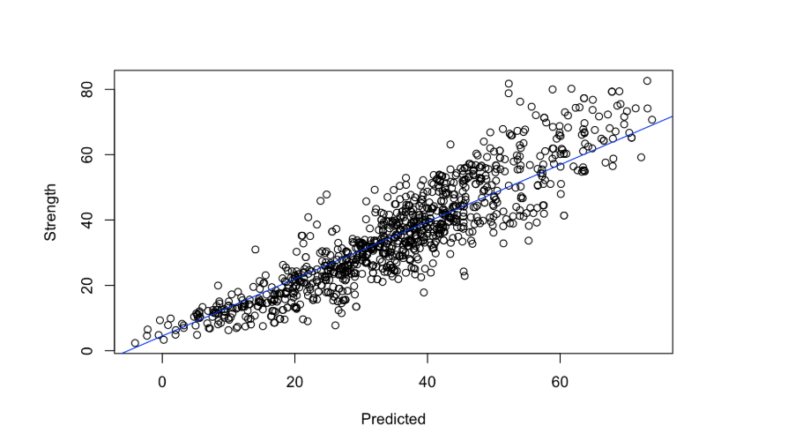
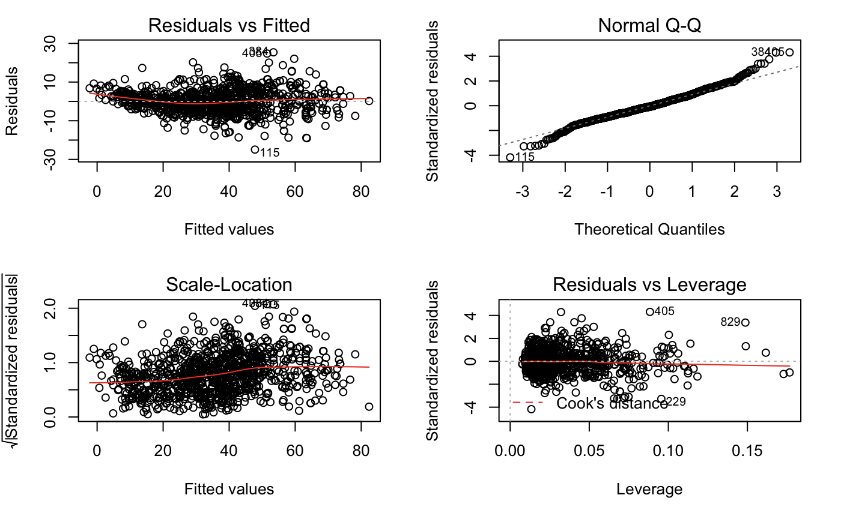
The Results
For our data we had 8 features and one response variable. We started from simple linear regression with 8 features, removed insignificant terms by observing the p values.Also, used water to binder ratio as a feature stated in the research paper we referred.Then, added polynomial terms, log terms and interaction terms by trial and error methods and made a hand model with 28 features with R² value 0.8789. We denoted this model “Reg4”.
We then made an automated Full model with all the possible interaction terms included and had 86 features in total, with R² value 0.9123, which we denoted “RegFull”.
Also, then we removed insignificant terms using the BIC algorithm and ANOVA data which produced the Reduced model “Reg5” with 31 features and R² value 0.8744
LINE Assumptions
Notes:
LINEARITY OF REGRESSION FUNCTION - Verified using the Predicted vs. Actual x-y scatter plot for model Reg5. The relationship shown is linear. The normal Q-Q plot also shows a linear relationship indicating the data is normally distributed. While linear, the Predicted vs Actual plot does show more variation within the model at higher values of strength, the cause is not known. It is possible that the variance is due to the models, but it also may be from the experimental design which produced higher strength concrete not only with different recipes but also longer Age times with tend unidirectionally toward higher strengths.
INDEPENDENT / UNCORRELATED ERROR TERMS - The data points are independent. The data set is the result of large planned experiment with different recipes for each point, producing a tangible, physical sample - a separate slug of cement which hardened over time and was tested for compressive strength.
NORMALITY OF ERROR TERMS - The ‘Residuals vs Fitted’ plot below shows that for both the original Reg model and the optimal Reg5 model, the residuals are scattered randomly.
EQUAL ERROR VARIANCE - The ‘Residuals vs Fitted’ plot below shows that for both the original Reg model and the optimal Reg5 model, the residuals are, at every value of X, following a roughly normal distribution with the same variance above and below the axis across all X’s.
The models meet the LINE criteria, thus, we conclude the models are valid.

Slide 6
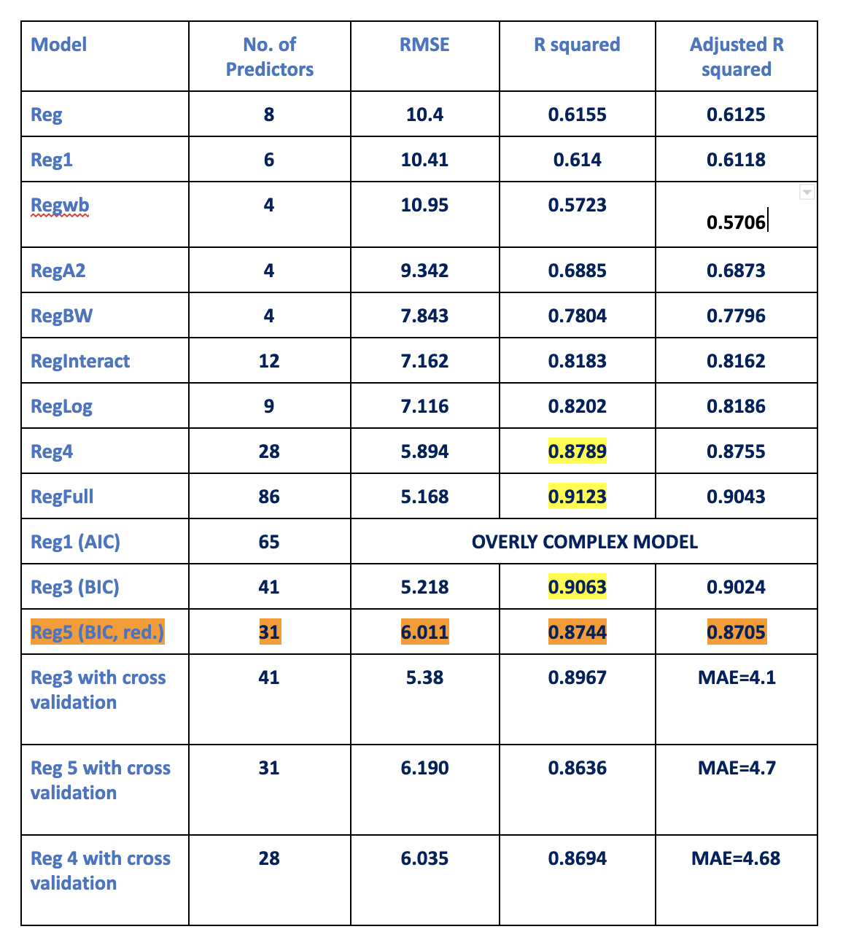
The Results
Model Comparison:

Slide 7
The Results
We use Reg5 model with 31 features as our final best model with multiple linear regression.
Strength = -1.882e+02 + 8.906e+01*WB - 2.647e+01*BW + 1.498e-01*Cement + 3.982e-01*FlyAsh - 1.190e+00*Water -
1.793e-01*BlastF - 1.826e-01*SuperP + 1.290e-01*Coarse - 4.591e-02*Age + 1.836e+02*LogBW + 1.050e+01*LogAge -
2.978e+03*OneOverCement - 3.102e+01*OneOverFlyAsh - 2.216e+01*OneOverBlastF - 9.773e+04*OneOverFine + 2.443e+01
*OneOverBlastF2 + 1.416e-05*SquaredFine + 2.743e+00*LogCement - 7.875e+00*LogFlyAsh + 5.287e+00*LogSuperP +
2.283e+00*WB*Cement + 1.963e+00*WB*FlyAsh + 2.661e+00*WB*BlastF - 7.459e-02*BW*FlyAsh + 2.680e-02*BW*BlastF +
3.356e-02*BW*Age - 1.536e-04*Cement*Fine - 1.842e-04*Cement*Age - 6.613e-04*Water*Fine - 6.105e-04*Water*Coarse +
2.452e-03*BlastF*SuperP
As can be seen from above, many variables have negative effect also.
Analysis of Variance Table
Response: Strength
Df Sum Sq Mean Sq F value Pr(>F)
WB 1 109854 109854 3041.7472 < 2.2e-16 ***
BW 1 7673 7673 212.4566 < 2.2e-16 ***
Cement 1 11216 11216 310.5539 < 2.2e-16 ***
FlyAsh 1 1700 1700 47.0691 1.201e-11 ***
Water 1 247 247 6.8314 0.0090919 **
BlastF 1 796 796 22.0284 3.061e-06 ***
SuperP 1 117 117 3.2525 0.0716178 .
Coarse 1 142 142 3.9362 0.0475313 *
Age 1 45900 45900 1270.9387 < 2.2e-16 ***
LogBW 1 813 813 22.5079 2.398e-06 ***
LogAge 1 58693 58693 1625.1691 < 2.2e-16 ***
OneOverCement 1 1052 1052 29.1169 8.512e-08 ***
OneOverFlyAsh 1 1358 1358 37.6030 1.248e-09 ***
OneOverBlastF 1 135 135 3.7485 0.0531385 .
OneOverFine 1 1743 1743 48.2711 6.689e-12 ***
OneOverBlastF2 1 695 695 19.2504 1.268e-05 ***
SquaredFine 1 236 236 6.5462 0.0106575 *
LogCement 1 64 64 1.7801 0.1824470
LogFlyAsh 1 91 91 2.5127 0.1132497
LogSuperP 1 1634 1634 45.2515 2.914e-11 ***
WB:Cement 1 442 442 12.2392 0.0004886 ***
WB:FlyAsh 1 638 638 17.6728 2.859e-05 ***
WB:BlastF 1 798 798 22.0964 2.957e-06 ***
BW:FlyAsh 1 674 674 18.6492 1.728e-05 ***
BW:BlastF 1 1241 1241 34.3501 6.250e-09 ***
BW:Age 1 192 192 5.3207 0.0212780 *
Cement:Fine 1 603 603 16.7087 4.708e-05 ***
Cement:Age 1 889 889 24.6038 8.273e-07 ***
Water:Fine 1 468 468 12.9510 0.0003355 ***
Water:Coarse 1 466 466 12.9109 0.0003426 ***
BlastF:SuperP 1 559 559 15.4883 8.877e-05 ***
Residuals 998 36043 36
---
Signif. codes: 0 ‘***’ 0.001 ‘**’ 0.01 ‘*’ 0.05 ‘.’ 0.1 ‘ ’ 1

Slide 8
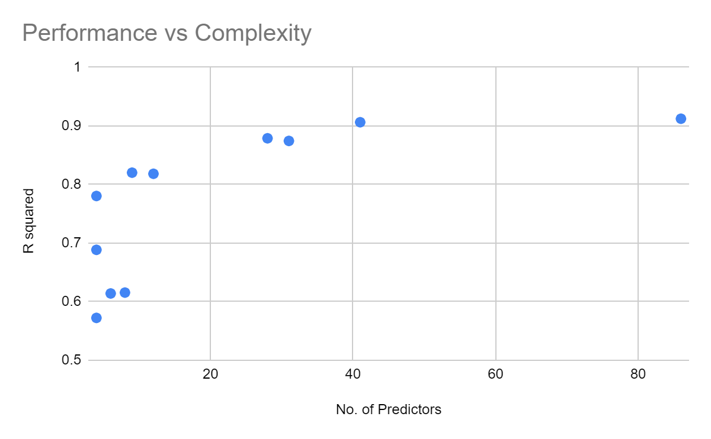
The Final Model
CONCLUSIONS
P-value << 0.05, we reject the null hypothesis; the model is linear and valid.
Our optimal model is “Reg5” with 31 predictors (see above). This model is a trade-off of slightly lower R-square for a substantially lower number of features.
The best hand-built model (Reg4) was close to optimal model, but it was not selected as the optimal model due to potential of excluding terms from trial-and-error approach.
Compared to the journal article, I greatly exceeded the R-squared value of the author’s linear models (0.76-0.79, 4 params.) and equalled the performance of the ANN (0.90-0.92, 72 params.) with fewer parameters.
To match the neural network, it was critical to include both calculated & transformed variables plus interactions.
ANN-JOURNAL
REGR-JOURNAL
MATH644 - BEST MODEL
Reg5 BIC Reduced

