Slide 1

ABES Engineering College, Ghaziabad
Personal Portfolio As
Minor Project
Batch(2021-2023)
AKTU
Under The Distinguish Guidance of:-
Mr. Amit Goel
(Asst. Prof.)
Dept of Computer Application
Submitted by:-
Chhavi Gupta(2100320140047)

Slide 2







INTRODUCTION
◆ Personal Portfolio is a compilation of relevant work samples and documents gathered during your school and college years and presented in structured manner.

Slide 3
OBJECTIVE OF THE PROJECT
It enables students to reflect their real performance
to show their weak and strong domain and to
Observe Students progress during the learning
process, and encourages students to take responsibilities for their own learning

Slide 4

REQUIREMENTS OF PROJECT:-
◆ Windows 10/11/XP0/XP
VS Code
◆ HTML, CSS,JSbs User name and Password

Slide 5
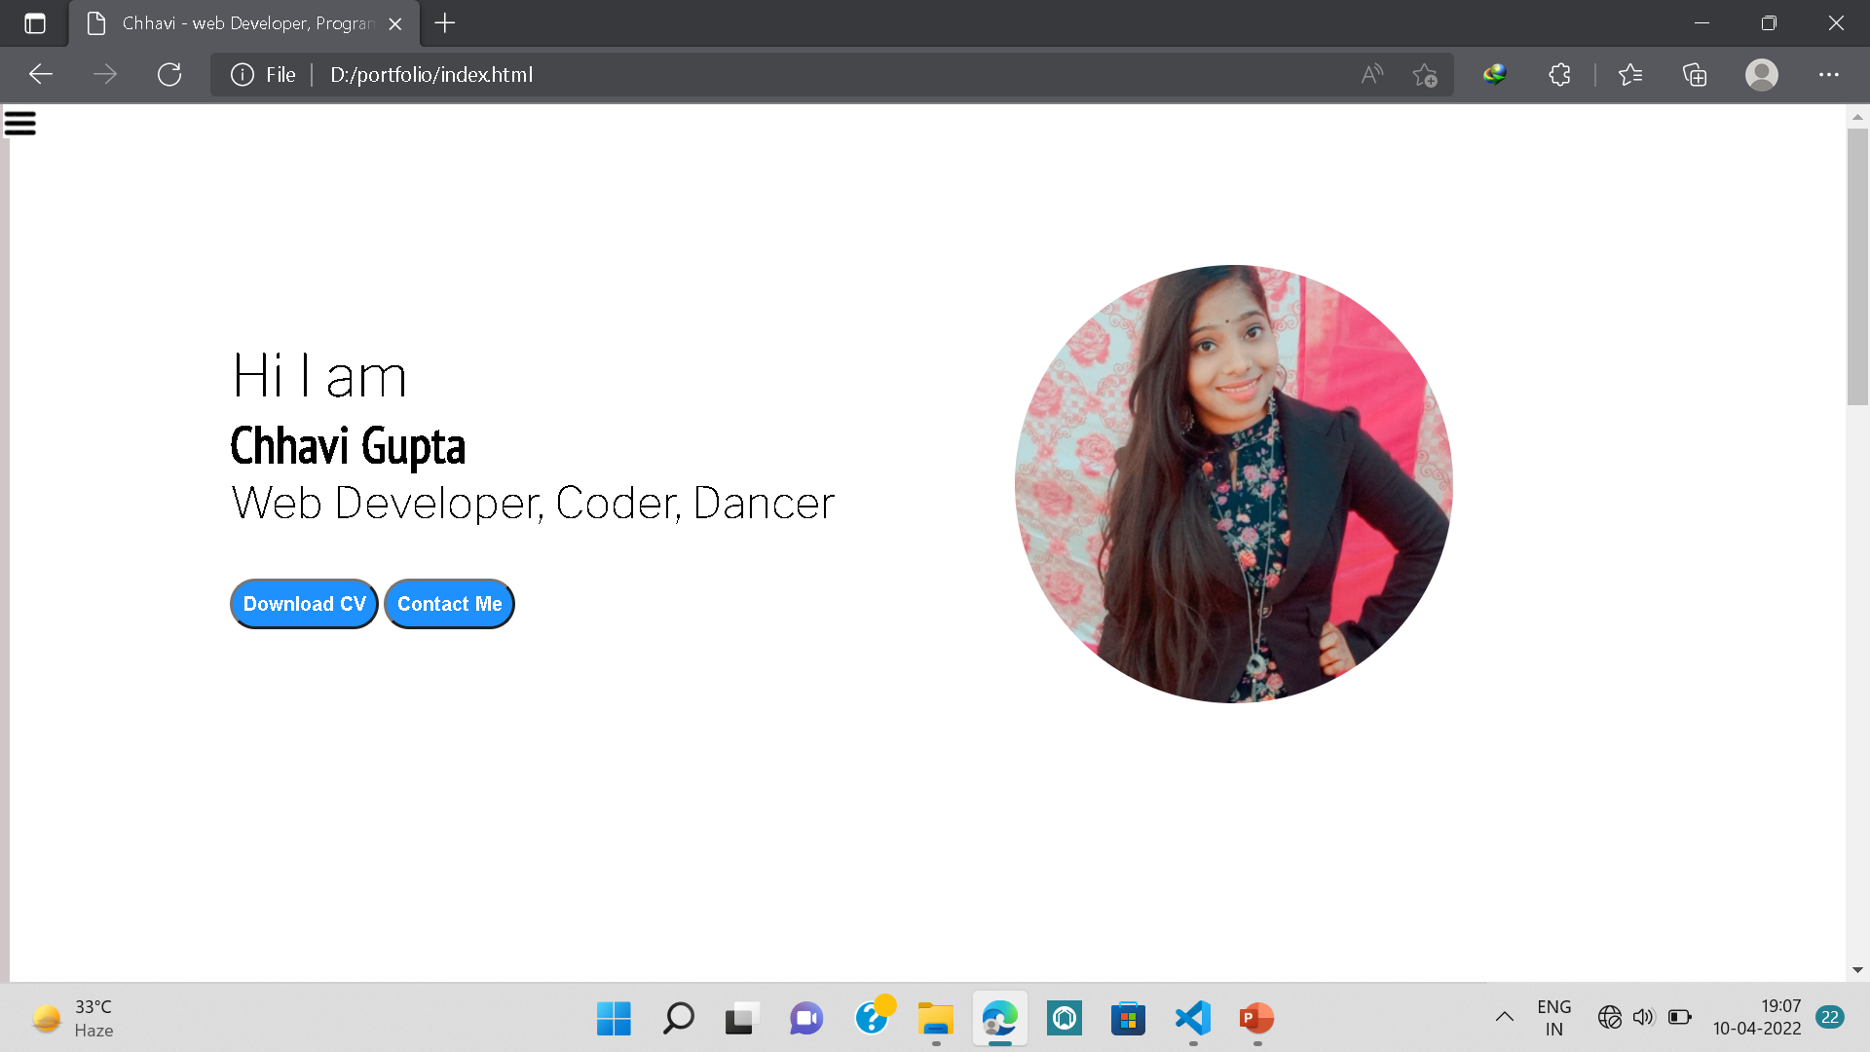
STRUCTURE OF PORTFOLIO

Slide 6
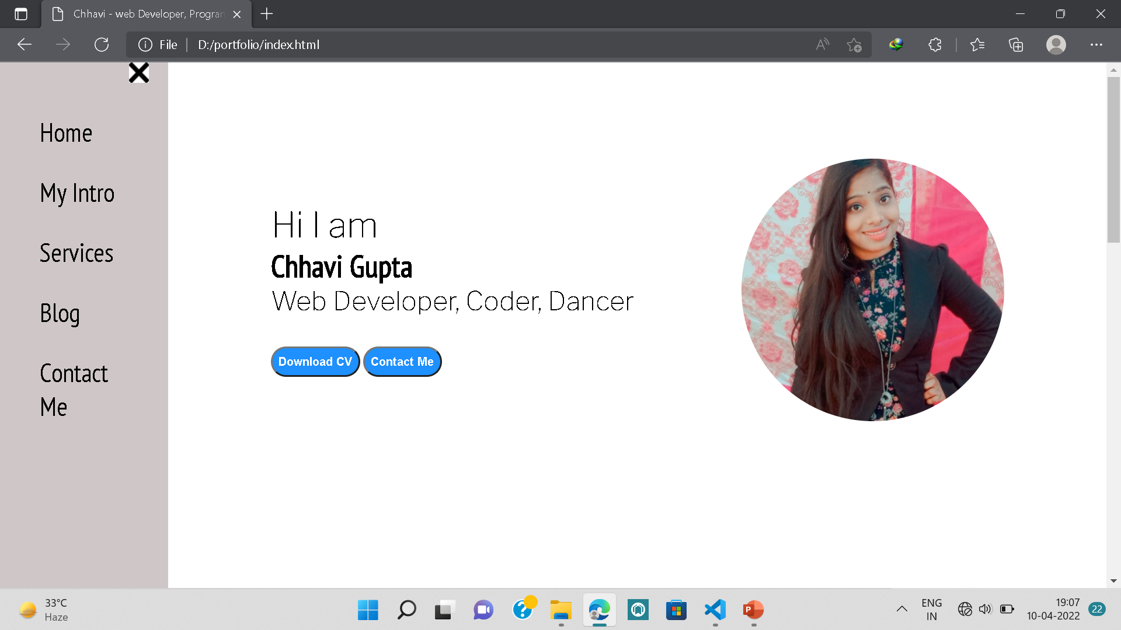
HOME PAGE

Slide 7
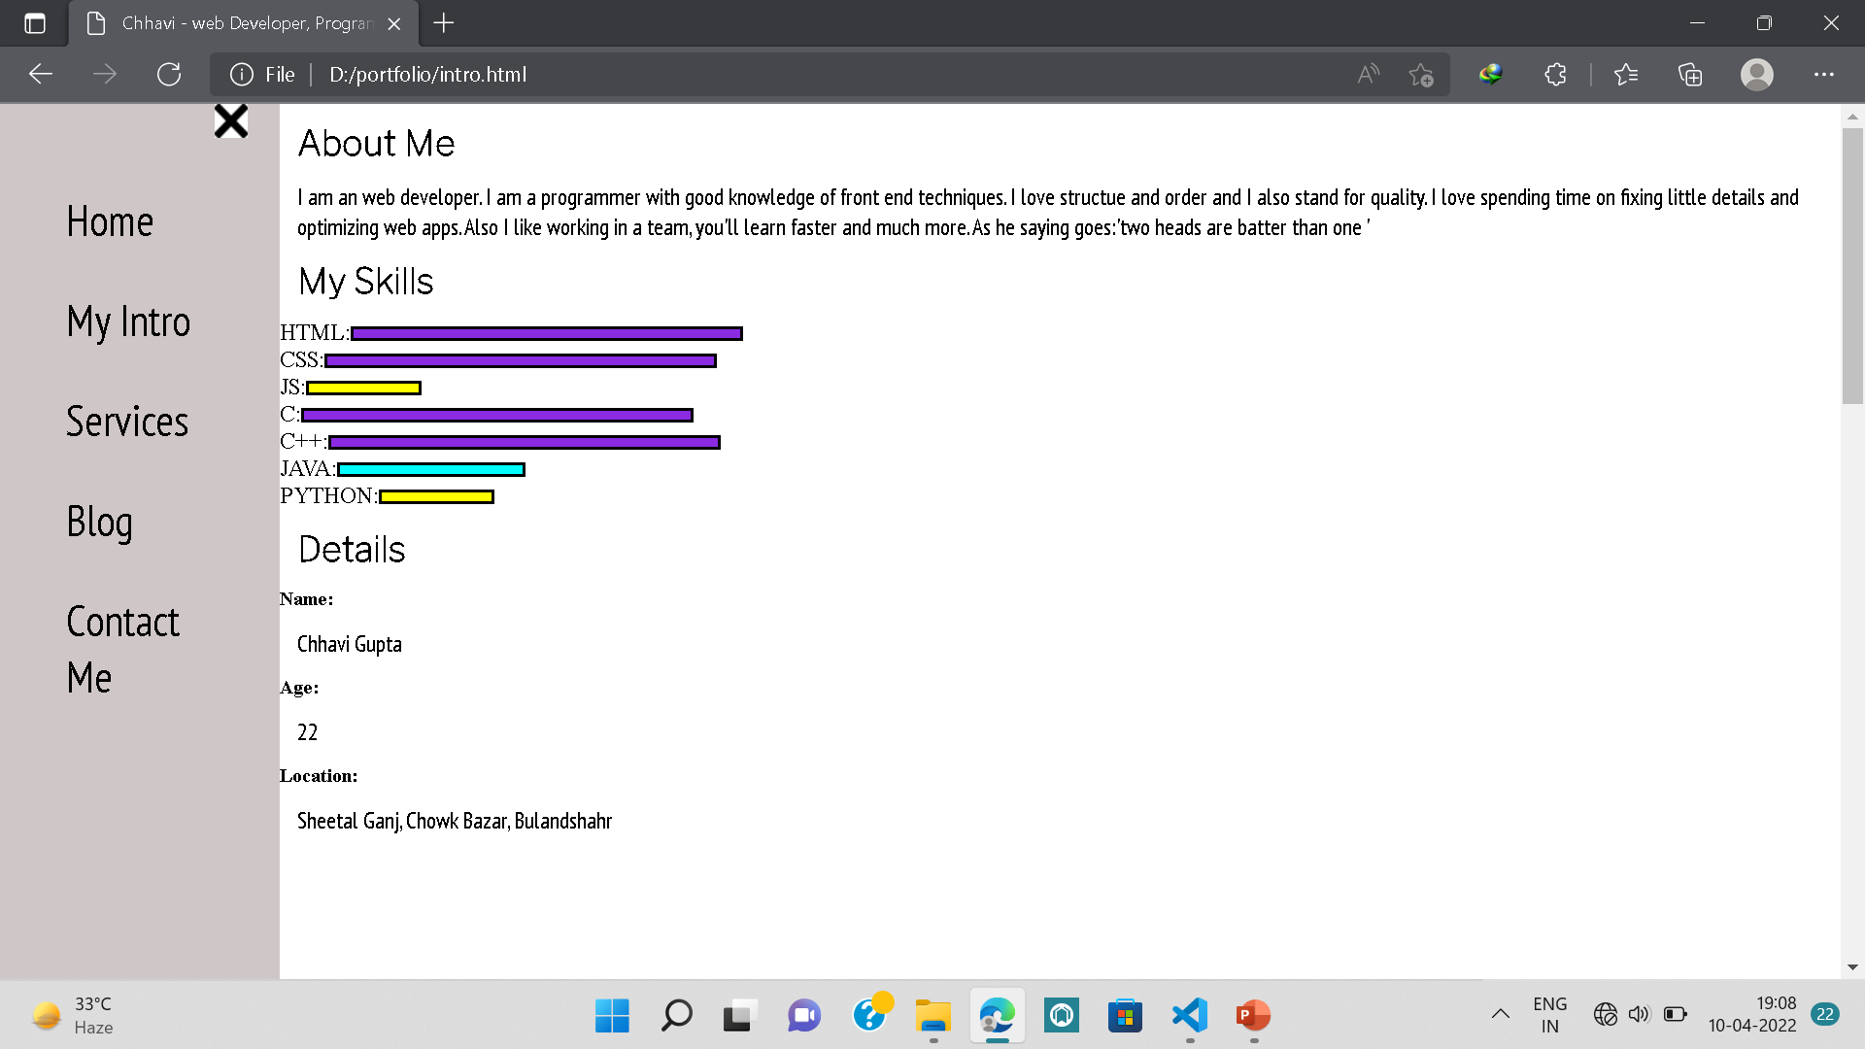
MY INRODUCTION PAGE

Slide 8
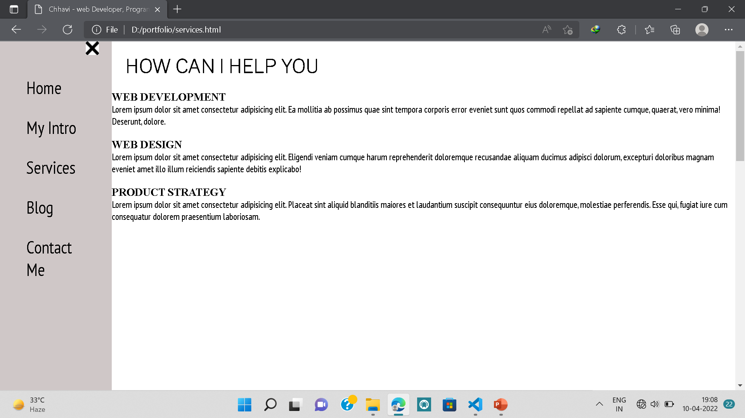
SERVICES PAGE

Slide 9
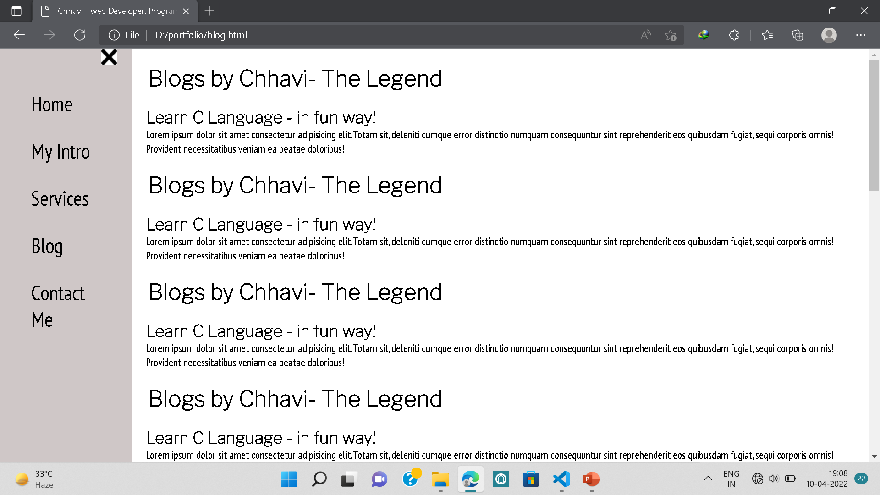
BLOG PAGE

Slide 10
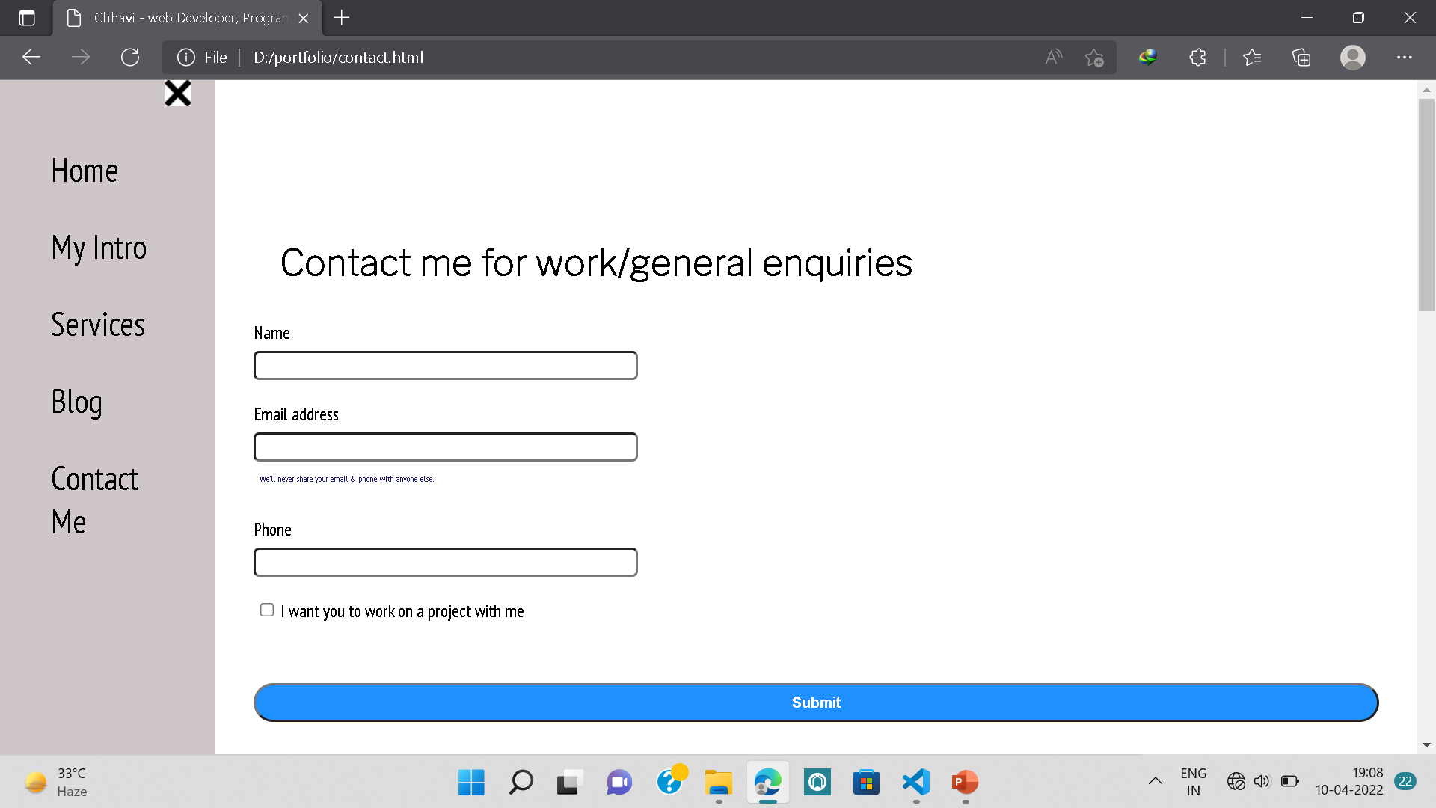
CONTACT ME PAGE

Slide 11






Thank you.

