Slide 1

EXPLORING CLICKSTREAM DATA
A guide through useful business insights for an e-commerce firm

Slide 2



Presentation Plan
  Business Significance
  Problem Scenario
  Data Involved and Brief Overview
  Steps involved in the Analysis
  Hypothesis Testing b/w different types of reviews
  Determining Customer Journey
  Recommendations

Slide 3



Business Significance
Understanding
User Behaviour
Personalisation and Targeting
Conversion Optimisation

Slide 4
Problem Scenario
Defining the objective
To understand how customers behave and what drives their choices online
What key aspects determine consumer behaviour ?
  Influence of different sources of product reviews and which review type performs ensures high returns
  Mapping customer journey in terms of most commonly visited pages, buying trends in lieu of gender, the average number of visits etc.
How to effectively use the inferences gained?
Recommend strategies to optimise the user experience, product performance and overall conversion rates

Slide 5

Data Information
CLICKSTREAM FEED DATA
REVIEWS
AND PRODUCTS
REGISTERED USERS

Slide 6

Brief Overview
5
Website Landing Pages
16123
Unique Users
5
Uniques Selling Products
51.64%
Registered
Buyers

Slide 7


Review Types
Customer Review
Written feedback revolving around
product quality and price points
Video Review
Recorded reactions enabling potential buyers to enjoy the feel of the product & make right decisions
Celebrity Recommendation
Endorsements made by influencers providing
product's credibility and brand's visibility.

Slide 8


Methodology
Data Preprocessing
Statistical Analysis
Visualisation

Slide 9

Handling the data
Data Cleaning
Data Aggregation
Segregated the data points
under the right variables
Grouped the data points based on
each review category and product id
Data Transformation
Data Analysis
Classified each session under the
correct review code and category
Aggregated the count of session ids
and performed hypothesis testing

Slide 10


Sessionwise Distribution of Reviews
75,000
50,000
68,074
25,000
41,974
27,592
0
Customer Review
Video Review
Celebrity Recommendation

Slide 11
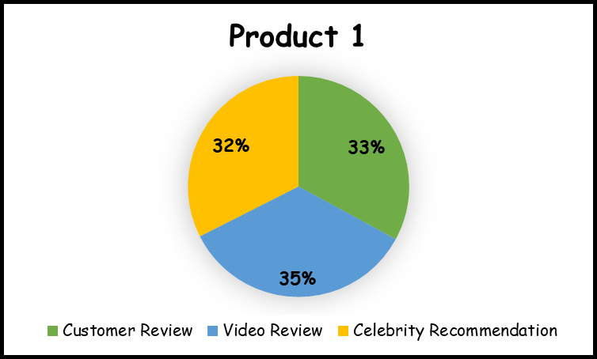


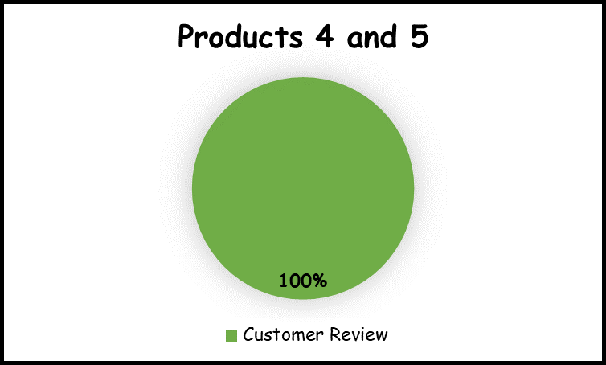
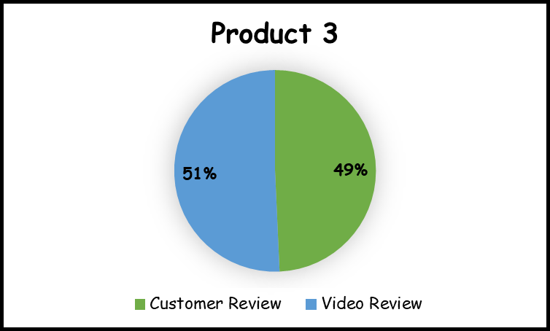

Productwise Distribution of Reviews

Slide 12



Are celebrity reviews more influential than customer reviews ?
Proportions
Customer Reviews = 0.26
Video Reviews = 0.16
Celebrity reviews = 0.11
Hypothesis Test
Z-score for the
difference in
sample proportions
1
-145.03
Corresponding right-tailed
p-value

Slide 13
Since we fail to reject the null hypothesis at 5% level, the following conclusion is drawn:
Celebrity reviews do not prove to be more influential than customer reviews.

Slide 14
How celebrity and customer reviews fare against video reviews ?

Slide 15

Celebrity v/s Video
Customer v/s Video
Z-SCORE FOR THE
DIFFERENCE IN
SAMPLE PROPORTIONS
-58.63
88.71
1
0
RIGHT-TAILED P-VALUE
Celebrity reviews do
not perform better
than video reviews
Customer reviews do
perform better
than video reviews
CONCLUSION

Slide 16

Capturing the "bump"
Total Purchases = β1 customer review + β2 celebrity review*video review
Coefficients
Variables
CUSTOMER
REVIEW
0.1814
CELEBRITY + VIDEO
REVIEWS
0.003761

Slide 17
Measures and policies need to be adopted to improve the performance of influencer ratings and video reviews.
Customer feedback posts should be
promoted to boost sales.

Slide 18

Summarising the solution
Celebrity reviews are least influential in comparison to the other reviews when
considered pairwise.
Customer reviews generate more income for
the business than celebrity endorsements
and video reviews put together.

Slide 19


DETERMINING CUSTOMER JOURNEY
Top 6 most visited pages
Path followed by a set of
random users and their exit pages
Key Indicators
Average number of
pages visited by buyers vs. non-buyers
Average number of
pages visited by males vs. females

Slide 20





A walk through the steps..........
Sort the data by user id and timestamp
Group the data by url and count the
number of distinct occurrences
Filter out a random set of 5 users
Apply the aggregate function
on the time series object

Slide 21






Top Most Website Landing Pages
http://www.RL.com/(homepage)
http://www.RL.com/product/4005
http://www.RL.com/product/4003
http://www.RL.com/product/4002
http://www.RL.com/product/4001
http://www.RL.com/product/4004

Slide 22

Sequence of Pages Visited by Random Users
review/3002
homepage
product/4002
User ID
26B45553-8BE2-4AB0-ABE5-ACDB78B76410
exit
review/3002
product/4004
video/3002

Slide 23


AVERAGE NUMBER OF PAGES VISITED
8.516
9
1.652
2
Buyers
Non-Buyers

Slide 24
AVERAGE NUMBER OF PAGES VISITED
10.727
11
10.378
10
Males
Females

Slide 25
CONCLUSION AND RECOMMENDATIONS
  INVESTIGATE USER EXPERIENCE
  ASSESS THE IMPACT OF REVIEWS ON REVENUE
  VISUALIZE CUSTOMER JOURNEYS FOR ENHANCED PERFORMANCE
  EMPLOY A/B TESTING TECHNIQUE TO IDENTIFY HIGH POINTS
  DEVISE A FINANCIAL PLAN TO ALLOCATE RESOURCES EFFECTIVELY
  IMPROVISE THE FEEDBACK PLATFORM AND KEEP REGULAR CHECKS
  ADOPT MARKETING CAMPAIGNS TO INCREASE CUSTOMER RETENTION RATE

Slide 26
THANK YOU!!

