Slide 1
✓
FraudShield
₹19,000 CRORE LOST IN INDIA · 2025
Catch the digital-arrest scam
before the money moves.
A multimodal AI that reads the scammer's script and the caller's voice together — and warns the victim, in their own language, in time to hang up.
7/7
0
AUC 1.0
ET AI Hackathon 2026 · Problem 6
scam calls caught
false positives
voice deepfake

Slide 2
AT A GLANCE
Everything in one slide
01
THE PROBLEM
02
WHAT WE BUILT
Fake CBI/police officers trap victims — often elderly — on a video call, accuse them of a crime, isolate them, and drain their savings. ₹19,000+ cr lost in 2025.
A consumer app that analyses the call live: an LLM reads the scam script, a wav2vec2 model checks if the voice is AI-generated, and a fusion layer decides — then warns and files.
03
WHY IT'S DIFFERENT
04
PROVEN ON REAL CALLS
It tracks the scam through its stages and fires BEFORE the money is demanded. Voice and text are fused, so a genuine call is never falsely accused.
7/7 real scam recordings flagged · 5/5 genuine calls cleared · 0 false positives. F1 1.00 vs 0.60 for a keyword baseline. Voice detection AUC 1.0.

Slide 3
THE PROBLEM
The signals are in the call. Nothing listens.
HOW THE CALL ACTUALLY GOES
₹19,000 cr+
S1
“This is Inspector Verma, CBI Cyber Crime. Switch on your video.”
lost to digital-arrest fraud in 2025
S2
“A parcel on your Aadhaar was seized — drugs and fake passports.”
30,000+
complaints filed · the reported tip of it
S2
“A non-bailable warrant is being issued in your name.”
Elderly
S3
“You are under digital arrest. Tell no one in your family.”
the most-targeted victims, often alone
S4
“Transfer your balance to this RBI account to prove it is clean.”
Dec 2025: Supreme Court directs RBI to deploy AI/ML · MHA acts on impersonation
Every one of these lines is a detectable signal. FraudShield reads them as they happen.

Slide 4
THE INSIGHT
A scam has stages — so we can get ahead of it
Detection isn't binary. FraudShield tracks the psychological arc of the call, which is what buys the victim time.
0
›
1
›
2
›
3
›
4
›
5
Setup
Pretext
Fear
Isolation
Extraction
Prolong
FraudShield fires HERE — before any money is demanded
money demanded
12 red flags detected across the arc
Impersonation
Accusation
Arrest threat
Isolation
Video custody
Remote access
OTP request
Fund transfer

Slide 5
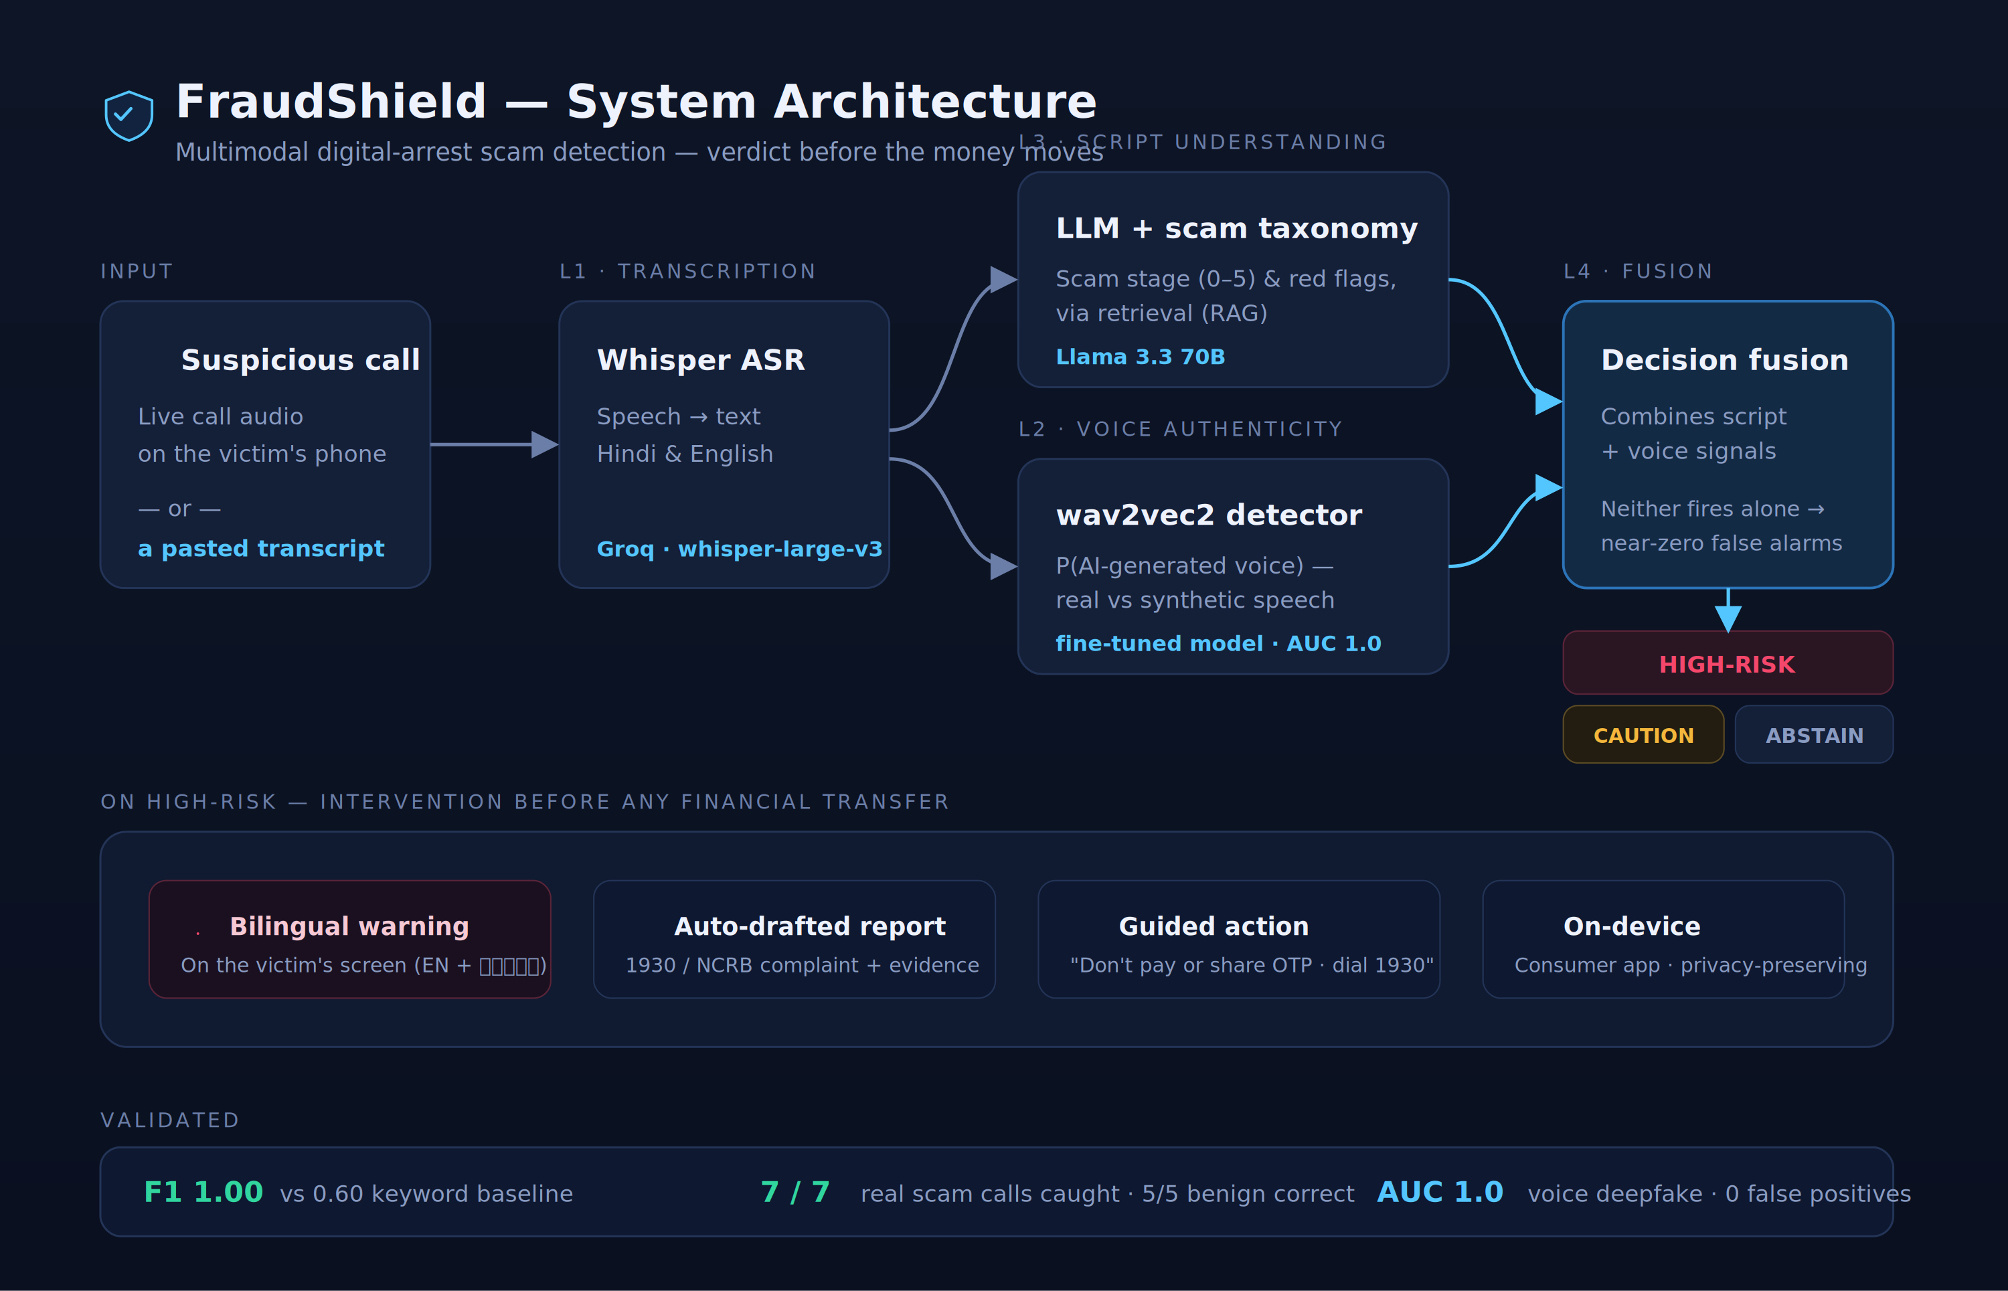
HOW IT WORKS
Four layers, one verdict

Slide 6
WORKING PROTOTYPE
A live app — not a mockup
FraudShield runs as a consumer phone app on a real backend. Type any scam message into the live Scan tab and the model returns a verdict in about a second.
FraudShield
LIVE SCAN
"This is Inspector Verma from CBI. Transfer your balance to this RBI account to verify or a warrant will be issued."
Live scan — paste a call or message → real LLM verdict
Simulated call — risk climbs through the scam stages live
HIGH-RISK
Intervention — bilingual warning + 1930 complaint drafted
Stage 4 / 5 — Extraction
RF01
RF03
RF08
On-device — runs on the victim's phone — privacy first
"Authority impersonation, arrest threat, and fund-transfer demand — indicating a scam attempt."
Hang up
Report 1930

Slide 7
RESULTS & VALIDATION
Tested on real calls — scam and genuine
7/7
5/5
0
1.00
real scam calls flagged
genuine calls cleared
false positives
F1 on adversarial cases
6 HIGH-RISK · 1 CAUTION
none falsely accused
the trust metric
baseline scored 0.60
FRAUDSHIELD VS A KEYWORD BASELINE — ON ADVERSARIAL CASES
F1 score
1.00
FraudShield
0.60
Keyword baseline
False-positive rate (lower is better)
0.00
0.75
Voice layer: AUC 1.00 / EER 0% across 31 clips. The system also correctly declined to fire on a real non-digital-arrest (investment) scam — specificity, not blanket alarming. Evaluation set is focused rather than large; expanding it is the immediate next step.

Slide 8
METHODOLOGY
Why we don't train from scratch
No large labelled corpus of Indian digital-arrest calls exists. Training from scratch would underperform a strong LLM guided by engineered domain knowledge — so we made the deliberate choice:
Retrieval-augmented classification
A pretrained LLM reasons against the digital-arrest taxonomy we engineered — knowledge lives in the taxonomy, not in fragile weights.
A fine-tuned model where it fits
The wav2vec2 voice detector IS a fine-tuned model, deployed and evaluated at AUC 1.0. Training where it's right, prompting where it isn't.
Rigorous evaluation
Baselines, ablations, and real-audio tests on both scam and genuine calls — the discipline that separates a system from a demo.

Slide 9
DEPLOYMENT & PRIVACY
It works without breaking encryption
WhatsApp calls are end-to-end encrypted — you cannot lawfully intercept them from the network, and we don't claim to.
1
Runs on the victim's device
The audio is already decrypted on the phone in order to be heard. An on-device app analyses it locally, with the user's consent.
2
Nothing has to leave the phone
On-device analysis means call content need not be sent to any server — privacy-preserving by design.
3
Multiple entry points
Live call audio, a forwarded suspicious message, or a pasted transcript — family can check on the victim's behalf.
Real-time on-device capture is the deployment roadmap; the prototype proves the detection intelligence today.

Slide 10
SCOPE & ROADMAP
Deep on two pillars — the rest is roadmap
Problem 6 lists five directions. Solo, we chose depth over breadth — building the detection-and-intervention core end to end.
BUILT & VALIDATED
ON THE ROADMAP
✓
Digital Arrest Scam Detection — stage + red-flag classifier, lead-time alerting
→
Counterfeit currency detection — computer-vision note verification
✓
Citizen Fraud Shield — mobile app, instant verdicts, NCRB/1930 reporting
→
Fraud-network graph intelligence — linking mules & scammer infrastructure
✓
Voice / AI-voice detection — wav2vec2 deepfake detector, AUC 1.0
→
Geospatial crime mapping — hotspot & patrol prioritisation
✓
Multi-source fusion — text + voice judged together
→
Telecom integration · 12 languages — provider alerts, full regional coverage

Slide 11
IMPACT
Who it protects — and why now
C
L
P
Citizens
Law enforcement
Policy alignment
Especially elderly and first-time victims — a calm, plain-language warning in their own language, before the savings are gone.
Auto-generated, structured 1930/NCRB complaints turn a chaotic first ten minutes into an evidence-ready report.
Directly answers the Dec-2025 Supreme Court / RBI AI mandate and MHA's push for impersonation detection.
The detection intelligence exists today. FraudShield turns the call itself into the last line of defense.

Slide 12
✓
FraudShield
Catch the scam before the money moves.
A validated, multimodal, on-device defense against digital-arrest fraud — built to protect the people least able to protect themselves.
Working prototype
Architecture diagram
Presentation deck
Demo video
ET AI Hackathon 2026 · Problem 6 — AI for Digital Public Safety

