Slide 1

Major Project Presentation
On
FinSight AI: LLM-Powered SEC Filing Anomaly Detector for Financial Risk Intelligence
Group 12
Name - Riya Chaurasiya Roll No. - 123A9006
Name - Chhaya Gami Roll No. - 123A9007
Name - Stuti Chilweri Roll No. - 123A9008
Name - Sakshi Kale Roll No. - 123A9016

Slide 2
Contents
Introduction
Motivation
Problem Statement
Literature Review: Existing systems/Review of Literature (more focus will be here, bring 5/10 research papers/projects (journals preferred) to support your proposed methodology)
Comparison of the Models (from Literature Review)
Research Gaps: Drawbacks of existing methods/systems in the literature
Proposed Methodology: Proposed system/Proposed system architecture (be clear with input output, tentative proposed methodology diagram)
Hardware / Software Requirements
Hardware Cost Estimation: in case of hardware based projects
References

Slide 3
Introduction
Corporate disclosures are one of the most reliable sources of information for understanding a company's financial health, operational risks, and future outlook. Public companies across different countries publish annual reports through regulatory bodies such as the SEC (USA) and SEBI/NSE/BSE (India). However, manually comparing these lengthy reports across years is time-consuming and often fails to identify subtle but significant changes in risk disclosures.
GlobalRisk AI is an intelligent document analysis platform that leverages Large Language Models (LLMs), Retrieval-Augmented Generation (RAG), semantic embeddings, and Natural Language Processing (NLP) to automatically detect newly introduced risks, removed disclosures, language severity changes, and evolving corporate risk trends across multiple financial markets
Motivation
Annual reports often exceed 300–500 pages, making manual analysis difficult.
Important disclosure changes can indicate emerging financial, legal, cybersecurity, or regulatory risks.
Financial analysts spend considerable time comparing reports across multiple years and companies
There is no unified AI-powered platform capable of analyzing corporate disclosures from both U.S. and Indian financial markets.

Slide 4
Problem Statement
Public companies publish extensive annual reports containing critical information about financial performance and business risks. Analyzing these reports manually is labor-intensive and challenging, especially when comparing multiple years. Current solutions provide limited support for identifying meaningful changes in disclosures, creating the need for an AI-powered system that automatically detects, analyzes, and explains evolving corporate risks.
Proposed Solution
GlobalRisk AI is an AI-powered financial disclosure intelligence platform that automatically analyzes and compares annual corporate reports from multiple financial markets (SEC–USA, NSE/BSE–India) to identify significant changes in risk disclosures.
The system leverages Large Language Models (LLMs), Retrieval-Augmented Generation (RAG), semantic embeddings, and Natural Language Processing (NLP) to detect newly introduced risks, removed disclosures, changes in risk severity, and shifts in corporate tone. By transforming lengthy financial reports into explainable and actionable insights, the platform enables investors, analysts, regulators, and researchers to make faster and more informed decisions.

Slide 5
Literature Review
S.No | Title | Author | Objective | Technology & Working | Findings
1 | FinBERT: Financial Sentiment Analysis with Pre-trained Language Models (2019) | Dogu Araci | Improve sentiment analysis for financial documents. | Fine-tunes BERT on financial text to classify sentiment and understand domain-specific language. | VeAchieved better performance than general BERT on financial NLP tasks but does not compare reports across years.
2 | Sentence-BERT: Sentence Embeddings using Siamese BERT Networks (EMNLP 2019) | Nils Reimers, Iryna Gurevych | Generate semantic sentence embeddings for similarity search. | Uses Siamese BERT architecture to create embeddings and compares text using cosine similarity. | Enables efficient semantic comparison but lacks financial reasoning capabilities.
3 | Retrieval-Augmented Generation for Knowledge-Intensive NLP Tasks (NeurIPS 2020) | Patrick Lewis et al. | Improve LLM responses using external knowledge retrieval. | Combines dense retrieval with a generative language model to produce context-aware answers. | Produces more accurate and explainable outputs but is not specifically designed for financial disclosures.
4 | FinGPT: Open-Source Financial Large Language Models (2023) | CYang Liu et al. | Develop an open-source LLM specialized for financial analysis. | Fine-tunes LLMs on financial news, reports, and market data for domain-specific reasoning. | Demonstrates strong financial language understanding but does not focus on disclosure anomaly detection.

Slide 6
Research Gaps
Existing financial AI systems suffer from several limitations:
Primarily designed for single-country financial reports.
Lack automated year-over-year semantic comparison.
Do not detect emerging or disappearing corporate risks.
Limited explainability of disclosure changes.
Absence of unified support for multiple financial reporting standards.
Hardware & Software Requirements
Large Language Models (GPT / Llama)
Retrieval-Augmented Generation (RAG)
Sentence Transformers
Semantic Embeddings
Natural Language Processing
Vector Database (FAISS)

Slide 7
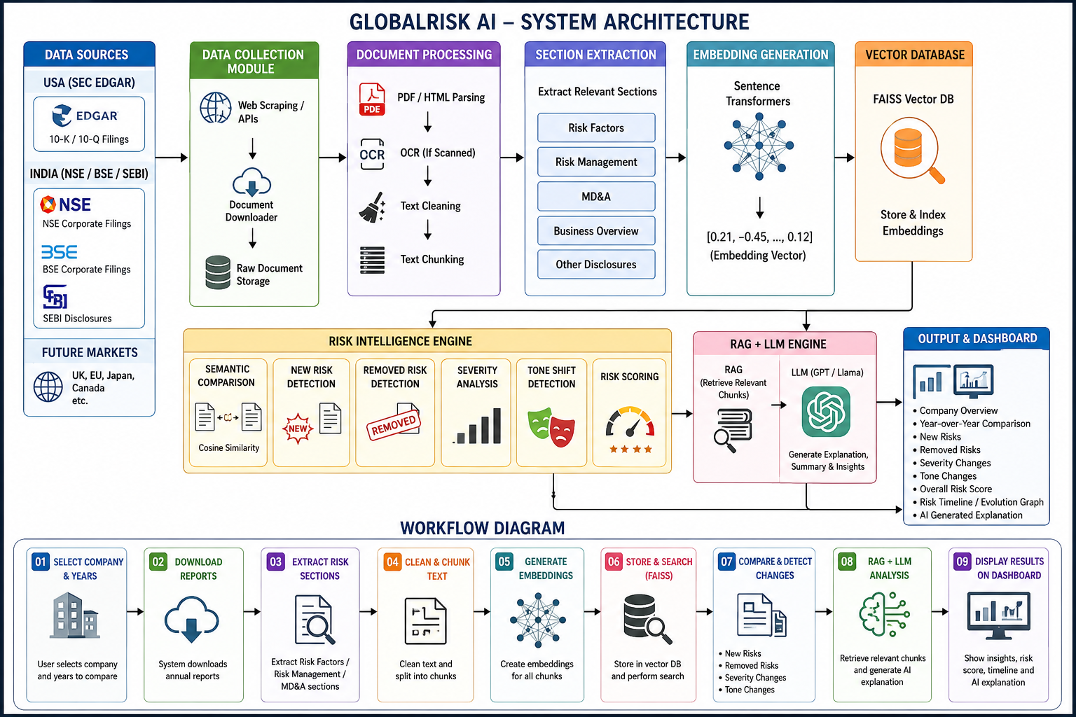

Slide 8
References
J. Wadden, S. Lin, K. Lo, L. L. Wang, M. van Zuylen, and A. Hajishirzi, "Fact or Fiction: Verifying Scientific Claims Using Evidence from the Literature," Proceedings of the 2020 Conference on Empirical Methods in Natural Language Processing (EMNLP), 2020.
J. Thorne, A. Vlachos, C. Christodoulopoulos, and A. Mittal, "FEVER: A Large-Scale Dataset for Fact Extraction and Verification," NAACL-HLT, 2018.
P. Di Tommaso, M. Chatzou, E. W. Floden, P. P. Barja, E. Palumbo, and C. Notredame, "Nextflow Enables Reproducible Computational Workflows," Nature Biotechnology, vol. 35, no. 4, pp. 316–319, 2017.
E. Afgan et al., "The Galaxy Platform for Accessible, Reproducible and Collaborative Biomedical Analyses," Nucleic Acids Research, vol. 46, no. W1, pp. W537–W544, 2018.
W. Ammar et al., "Construction of the Literature Graph in Semantic Scholar," arXiv preprint arXiv:1805.02262, 2018.
Connected Papers, A Visual Tool for Exploring Scientific Literature, 2020.
Consensus AI, AI-Powered Scientific Literature Search and Evidence Discovery Platform, 2023.
Elicit, Ought Inc., AI Research Assistant for Literature Review and Evidence Synthesis, 2023.
LangGraph Documentation, LangChain Inc., Stateful Multi-Agent Application Framework, 2024.
J. Johnson, M. Douze, and H. Jégou, "Billion-Scale Similarity Search with GPUs," IEEE Transactions on Big Data, 2019.

