Slide 1
Python Calculator Application using Tkinter
Project Presentation

Slide 2
Project Objective
Create a GUI Calculator using Python
Perform basic mathematical operations
Learn application development
Understand Tkinter library

Slide 3
Tools & Technologies Used
Core Python Programming
Tkinter Library
Visual Studio Code (IDE)
GitHub for code management

Slide 4
Main Features
Equation display screen
Clickable numeric and operator buttons
Addition, Subtraction, Multiplication, Division
Equal (=) and Clear (C) functions

Slide 5
Code Explanation
press() → Adds numbers/operators to screen
equalpress() → Calculates result using eval()
clear() → Clears the display
Tkinter Buttons & Entry used for GUI

Slide 6
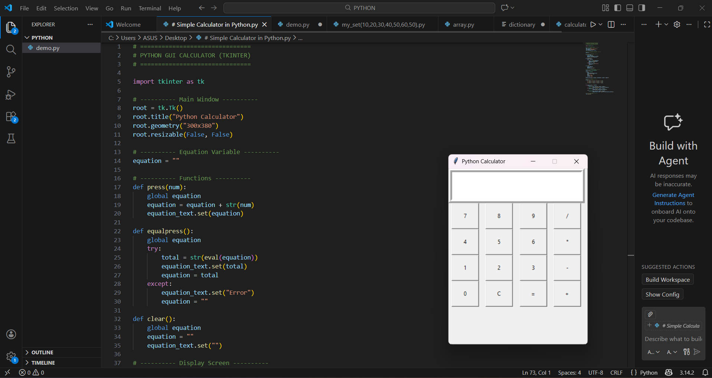
Project Output
The calculator displays numbers and operations.
User clicks buttons to perform calculations.
Result appears instantly on the display screen.

Slide 7
Learning Outcome
Understanding of Core Python
GUI development using Tkinter
Application development skills
Basic GitHub usage

